Slide 1
PHY 745 Group Theory
11-11:50 AM MWF Olin 102
Plan for Lecture 13:
Group properties of atomic orbitals and crystals
Reading: Chapter 5 in DDJ
Correction: Cambell-Baker-Hausdorff equation
Group properties of atomic orbitals
Atomic orbitals in crystal fields

Slide 2
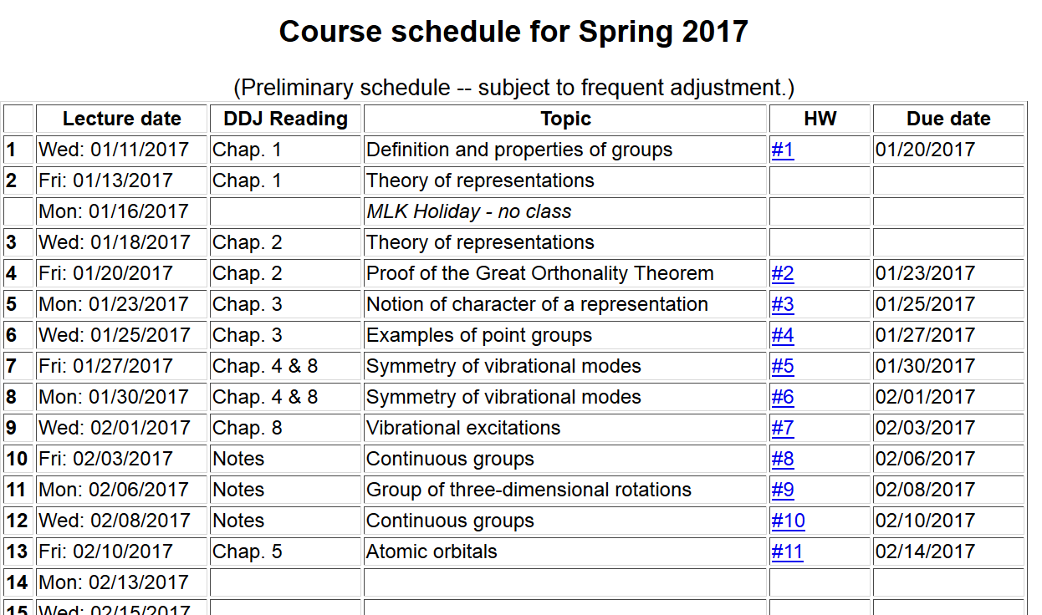

Slide 3
Correction to previous lecture notes

Slide 4
Symmetry properties of electronic states in an atom

Slide 5
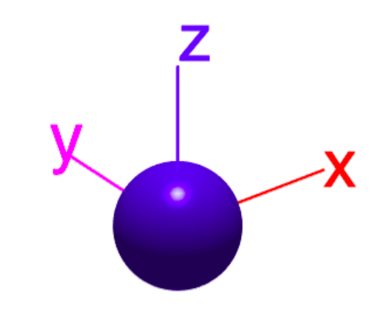
Geometric forms of spherical harmonics (real forms)
l=0
l=1
https://www.mathworks.com/matlabcentral/mlcdownloads/downloads/submissions/43856/versions/9/screenshot.jpg

Slide 6
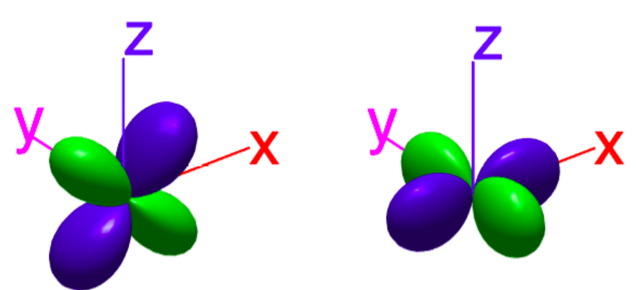
Geometric forms of spherical harmonics (real forms)
l=2
https://www.mathworks.com/matlabcentral/mlcdownloads/downloads/submissions/43856/versions/9/screenshot.jpg

Slide 9
Using character tables to analyze the “crystal field” effects on atomic symmetry

Slide 10
Example for the group O_{h} (48 group members)

Slide 11
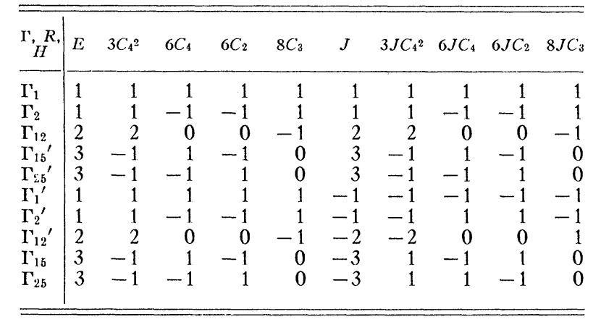
Compatibility of continuous rotation group with the cubic group:
l=0 1 1 1 1 1 1 1 1 1 1
l=1 3 -1 1 -1 0 -3 1 -1 1 0
l=2 5 1 -1 1 -1 5 1 -1 1 -1

Slide 12
Γ₁
l=0 1 1 1 1 1 1 1 1 1 1
l=1 3 -1 1 -1 0 -3 1 -1 1 0
l=2 5 1 -1 1 -1 5 1 -1 1 -1
Γ₁₅
Γ₁₂+Γ_{25’}

Slide 13
Visualization of l=2 orbitals from http://chemwiki.ucdavis.edu/Inorganic_Chemistry/Crystal_Field_Theory/Crystal_Field_Theory
Γ₁₂
Γ_{25’}
Octahedral symmetry

Slide 14
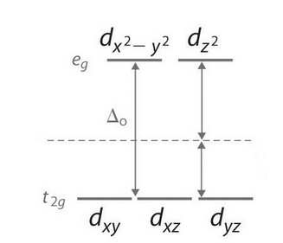
Octahedral symmetry effects on d-orbitals
Γ₁₂ =e_{g}
Γ_{25’}=t_{2g}
Energy diagram

Slide 15
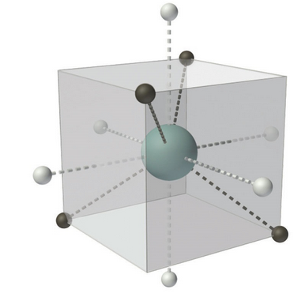
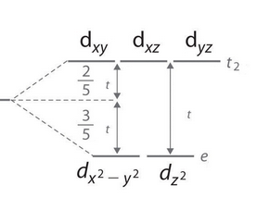
Tetrahedral symmetry effects on d-orbitals
Γ₁₂ =e_{g}
Γ_{25’}=t_{2g}

