Slide 1
PHY 745 Group Theory
11-11:50 AM MWF Olin 102
Plan for Lecture 14:
Properties of direct product groups
    Reading: Chapter 6 in DDJ
      Definition of direct product group
      Representations of direct product groups
      Examples

Slide 2
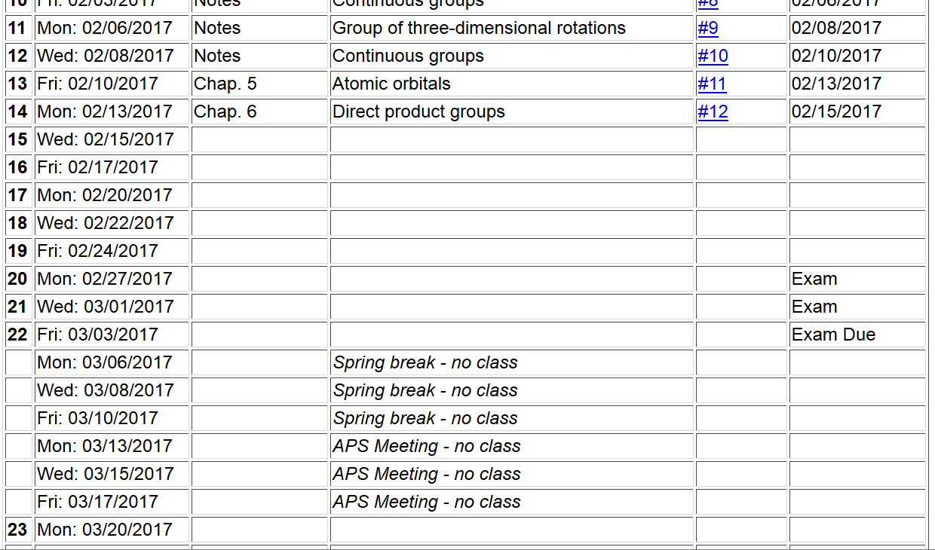

Slide 3
Definition of direct product group

Slide 4
Irreducible representations of direct product groups

Slide 5
Theorem: The direct product of the representations of groups G_{A} and G_{B} forms a representation of their direct product group

Slide 8
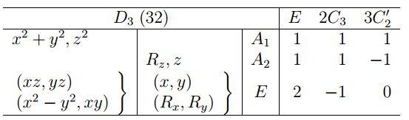
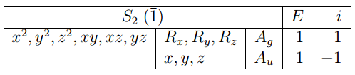
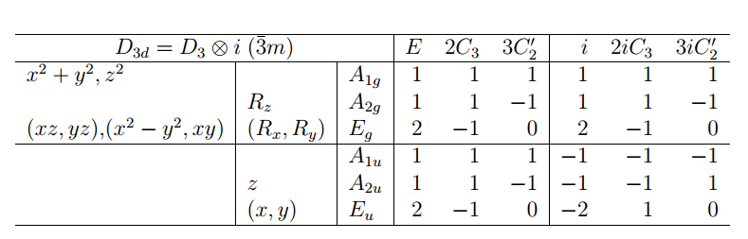
Example
h_{D3}=6
h_{i}=2
h=12

Slide 9
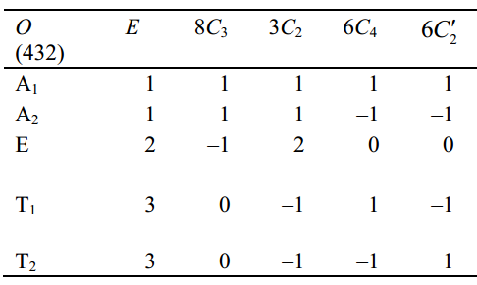
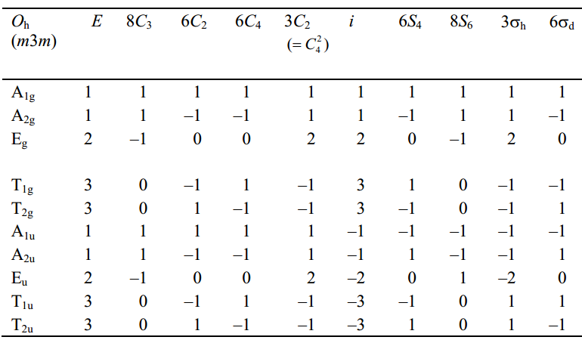
Example

Slide 10
Application of symmetry analysis to point group analysis
  Recall the Fermi Golden Rule for transitions between initial and final states of a quantum mechanical system
density of final states

Slide 11
Prediction of electromagnetic transitions
Example D₃

Slide 12
Example D₃

Slide 13
Example D₃

Slide 14
Example

