Slide 1
PHY 745 Group Theory
11-11:50 AM MWF Olin 102
Plan for Lecture 15:
Symmetry properties of molecular orbitals
Reading: Chapter 7 in DDJ
Linear combinations of atomic orbitals
Molecular bonds
Examples

Slide 2
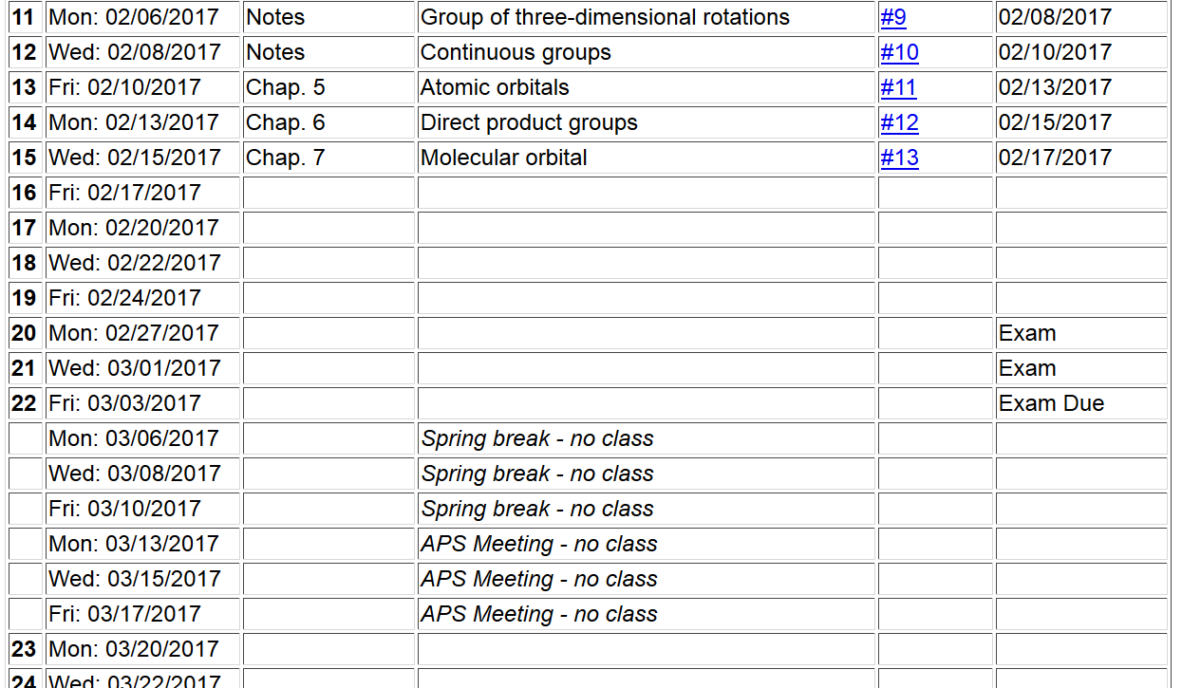

Slide 4
Electronic structure of an atom
For simplicity we will first consider a single electron system; a H-like ion with atomic charge Ze
E₁₀₀=-13. 60569253 Z² eV
a₀ = 0. 52917721092 Å

Slide 5
Example – 1s state of hydrogen-like atom

Slide 6
Electronic structure of H-like molecular ion
(within Born-Oppenheimer approximation)
-e
r_{B}
r_{A}
R_{AB}
Z_{A}e
Z_{B}e

Slide 7
Electronic structure of H-like molecular ion – continued
Ref. Pauling and Wilson, Introduction to Quantum Mechanics (1935) (now published by Dover)

Slide 8
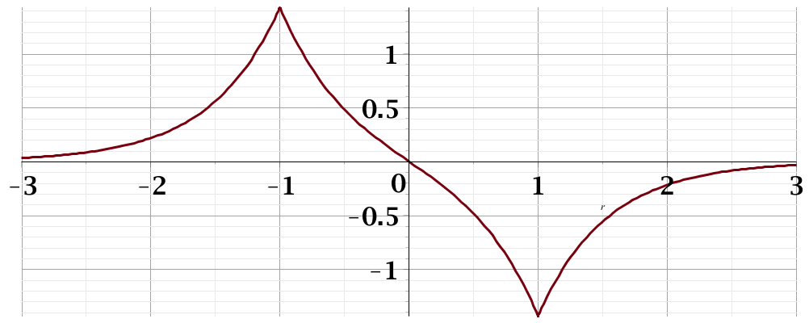
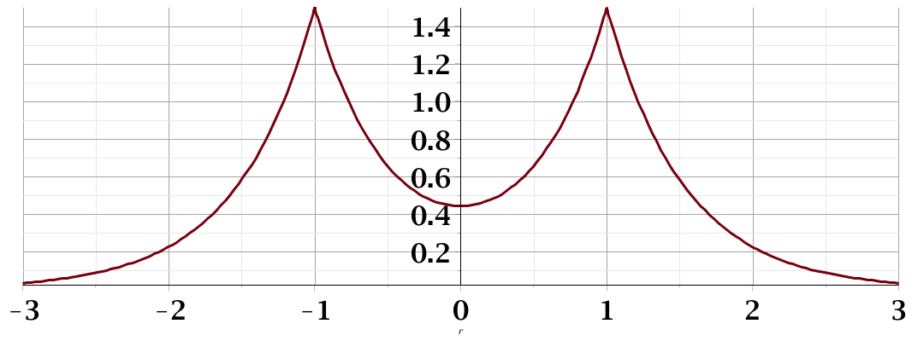
Electronic structure of H-like molecular ion – continued
antibonding
Ψ₋
E₋
H_{AA}
H_{BB}
E₊
bonding
Ψ₊

Slide 9
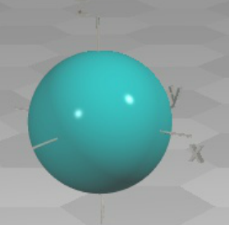
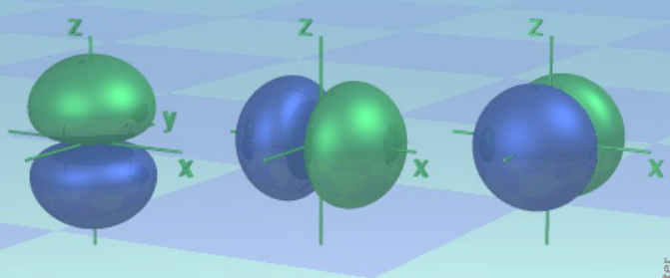
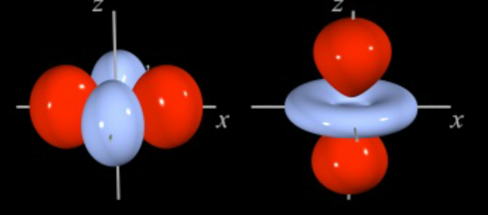
LCAO methods -- continued – angular variation
http://winter.group.shef.ac.uk/orbitron/
l=0
l=1
l=2

Slide 10
LCAO methods -- continued – angular variation
While, for atoms the “z” axis is an arbitrary direction, for diatomic molecules and for describing bonds, it is convenient to take the “z” axis as the bond direction.
Atom
symbol
l=0 m=0 s
l=1 m=0 p
m= ±1 p
l=2 m=0 d
m= ± 1 d
m= ± 2 d
Bond
symbol
l=0 λ=0 σ
l=1 λ=0 σ
λ=1 π
l=2 λ=0 σ
λ=1 π
λ= 2 δ

Slide 11
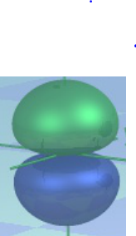
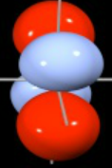
LCAO methods -- continued – bond types
ssσ
ppσ
ppπ
ddπ

Slide 12
Extension of ideas to polyatomic molecules
“atomic site” representation
1
Example: C_{3v}
3
2

Slide 13
Relationship of atomic site representation to irreducible representations for C_{3v}
atomic site character

Slide 14
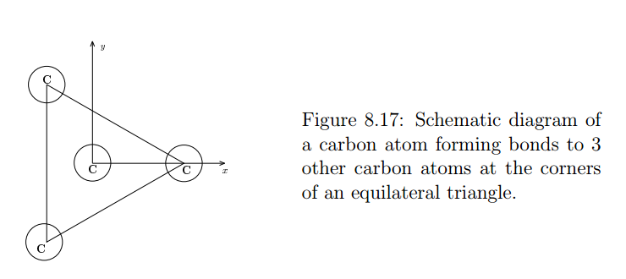
Atomic site symmetry together with internal degrees of freedom such as LCAO
Diagram (and following) from DDJ textbook (earlier version)

Slide 15
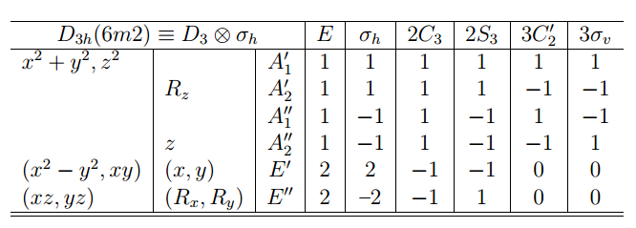
Character table
3 3 0 0 1 1

Slide 16
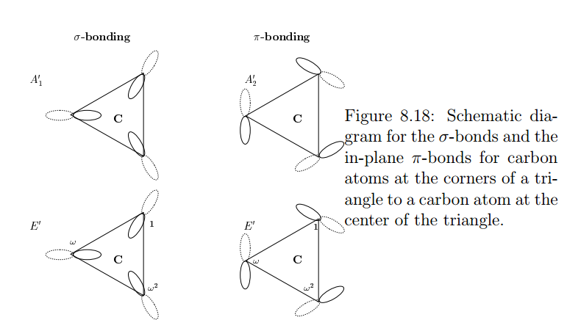
Atomic site symmetry together with internal degrees of freedom such as LCAO
Diagram from DDJ textbook (earlier version)

Slide 17
Analysis of LCAO symmetries for this case

