Slide 1
PHY 745 Group Theory
11-11:50 AM MWF Olin 102
Plan for Lecture 16:
Introduction to space groups
    Reading: Chapter 9 in DDJ
      Definition and scope of space groups
      Terminology
      Examples
This lecture contains some materials from an electronic version of the DDJ text.

Slide 2
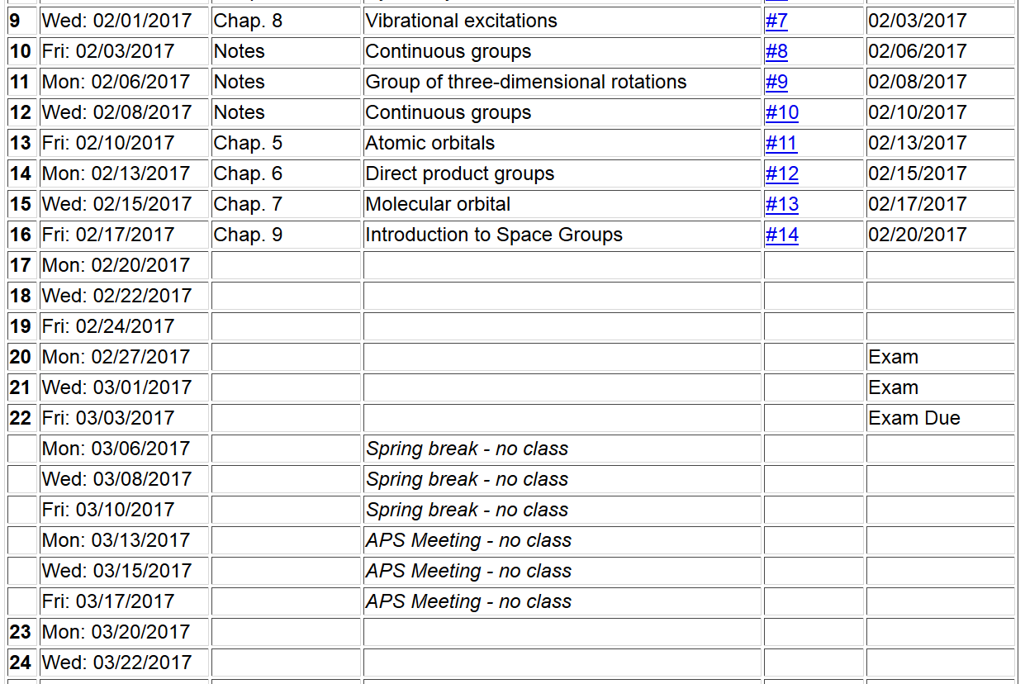

Slide 4
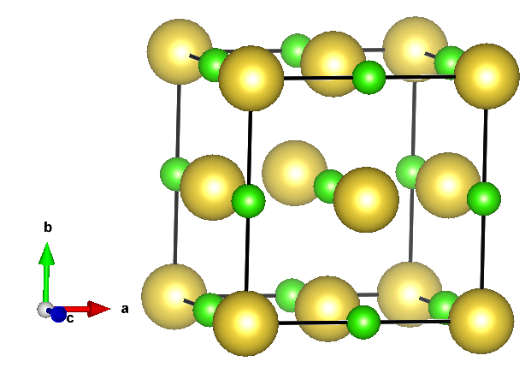
Space groups
NaCl
τ
τ
Translation
Point operation

Slide 6
Lattice translation
Non primitive translation

Slide 7
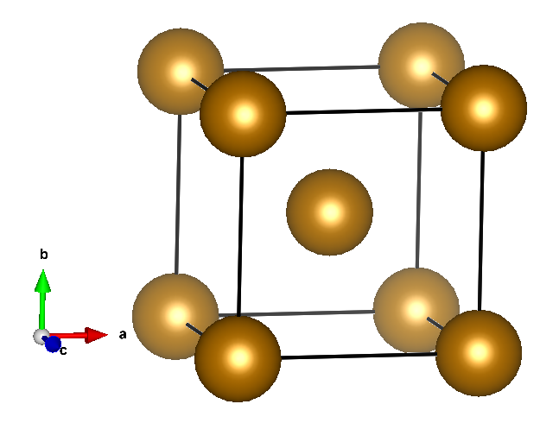
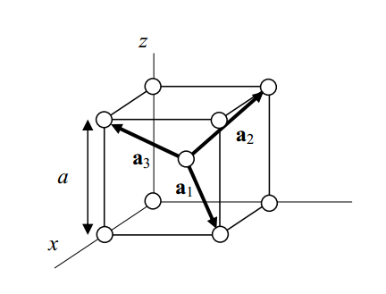
Example of symmorphic lattice Fe (body centered cubic lattice)
τ=T
Primitive translations
Conventional cell

Slide 8
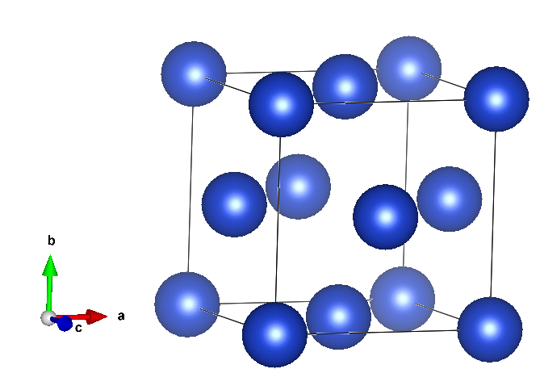
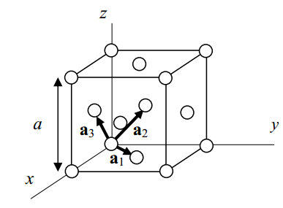
Example of symmorphic lattice Cu (face centered cubic lattice)
τ=T
Primitive translations
Conventional cell

Slide 9
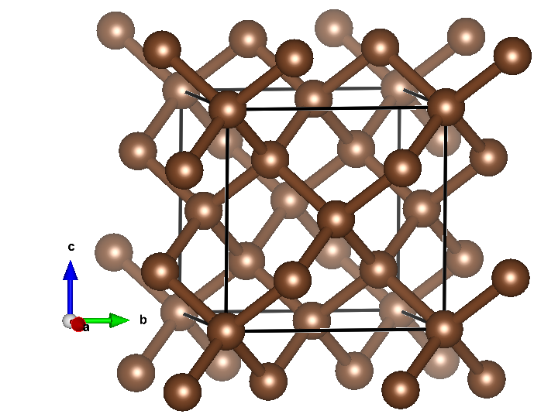
Non-symmorphic space group -- diamond
Primitive translations

Slide 10
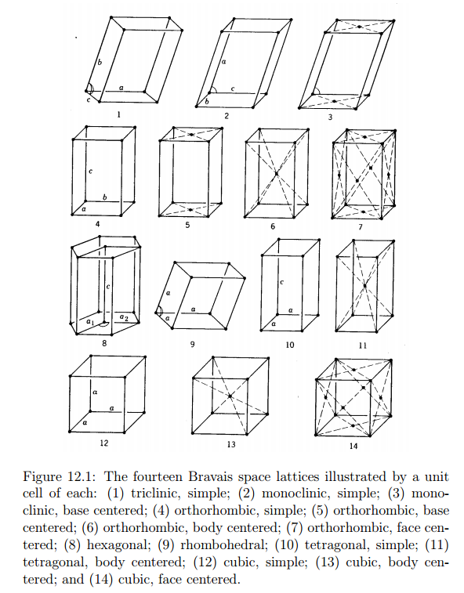

Slide 11
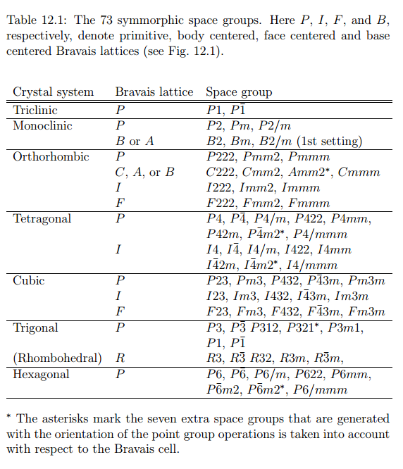

Slide 12
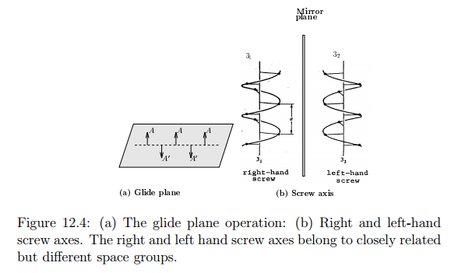
Some non-symmorphic operations and their descriptions

Slide 13
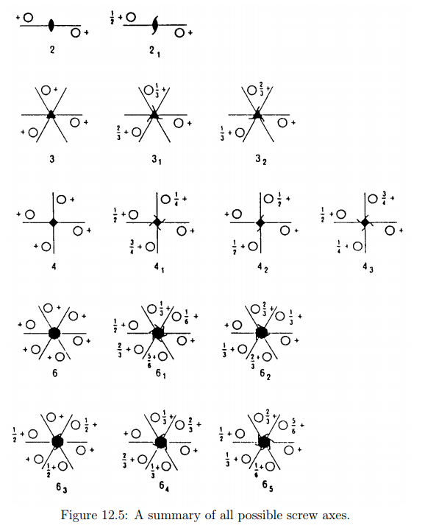

Slide 14
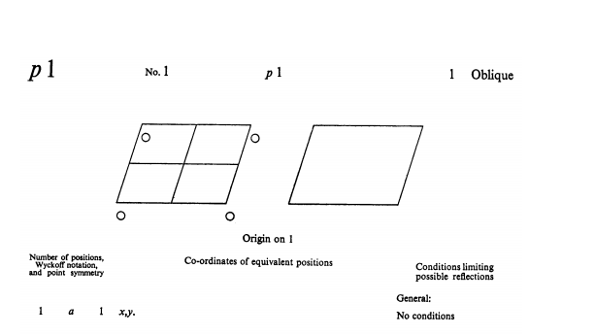
Some examples in 2 dimensions

Slide 15
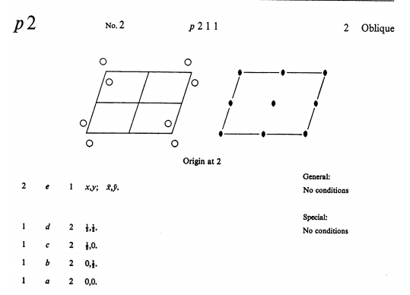
Wyckoff letter
Site symmetry
Multiplicity

Slide 16
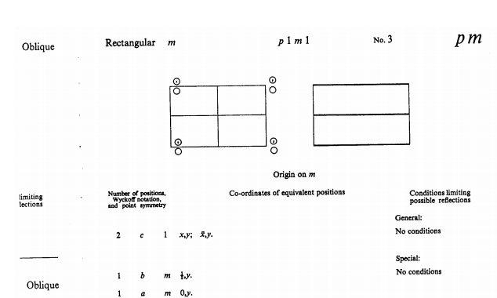

Slide 17
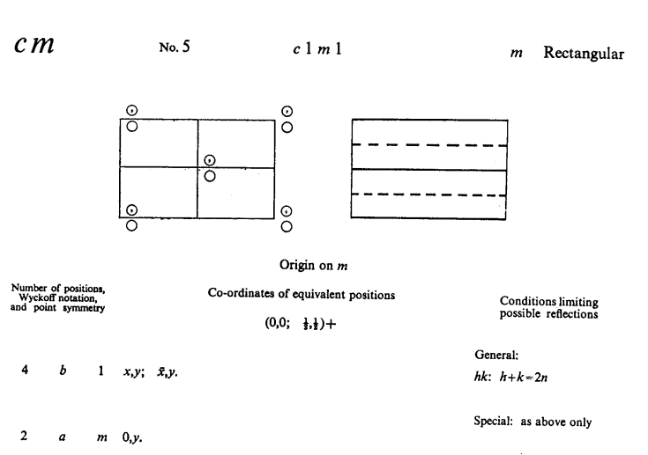
Centered cell

Slide 18
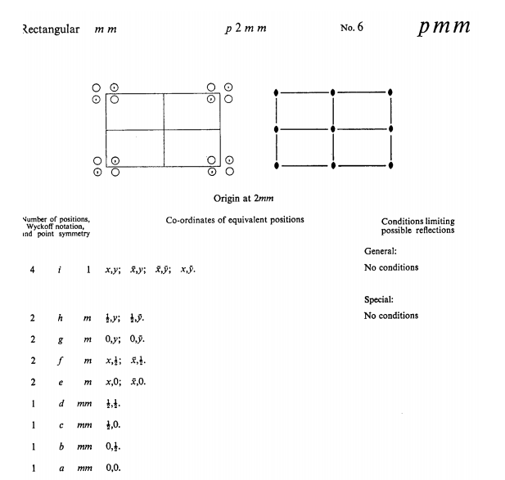
Example with higher symmetry

Slide 19
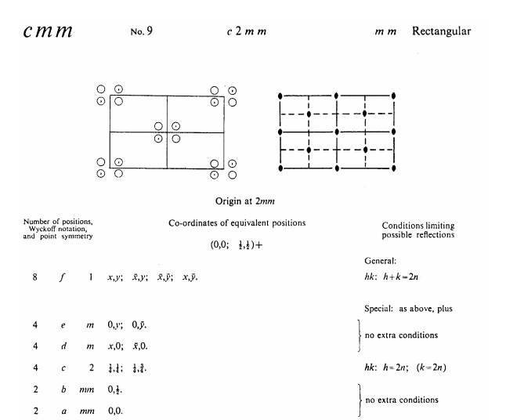

Slide 20
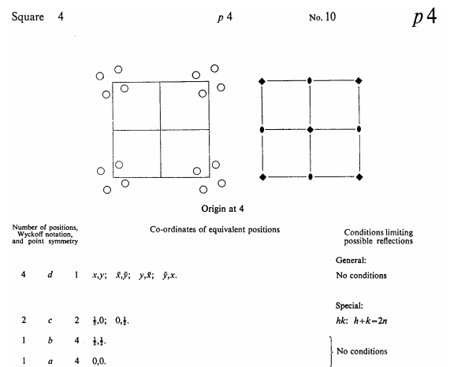
Square lattice

Slide 21
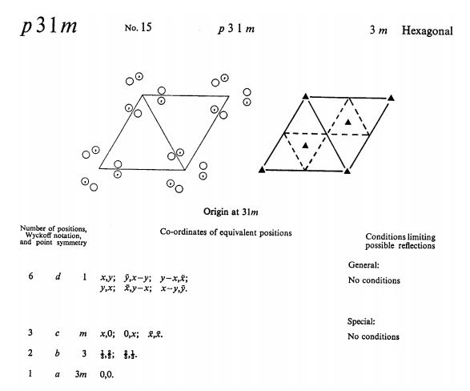
Hexagonal
b
b+a
-a
a
-b-a
-b
-b+a

Slide 22
