Slide 1
PHY 745 Group Theory
11-11:50 AM MWF Olin 102
Plan for Lecture 18:
Group theory for the periodic lattice
Reading: Chapter 10 in DDJ
Symmetry of the wave vector
Compatibility relations
Symmorphic and non-symmorphic space groups
This lecture contains some materials from an electronic version of the DDJ text.

Slide 2
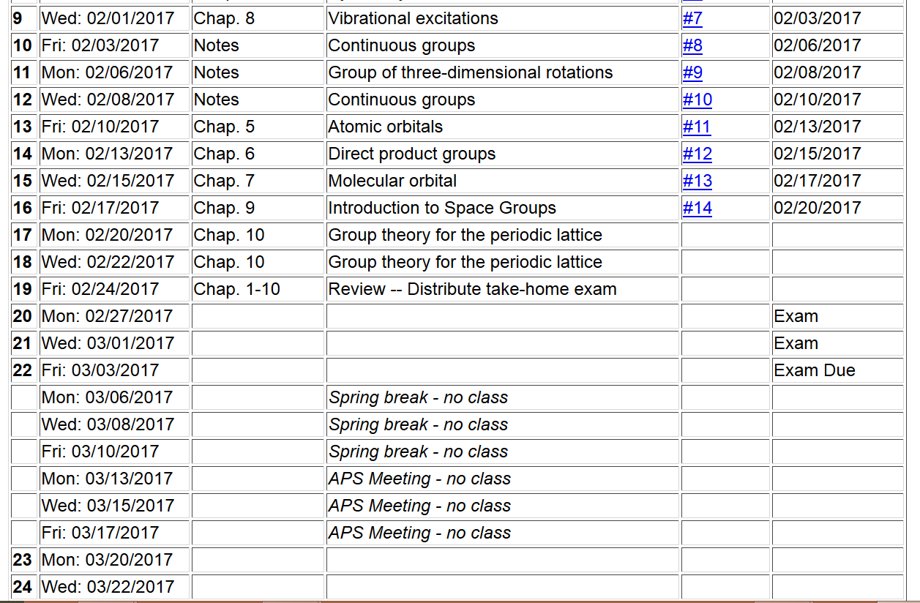

Slide 4
Space group
Non-lattice translation
Lattice translation
Point operation

Slide 7
The symmetry of the wavefunction depends on k
For each k, the spatial point symmetries must be considered.

Slide 8
Effects of group operations on Bloch basis functions (symmorphic case)

Slide 9
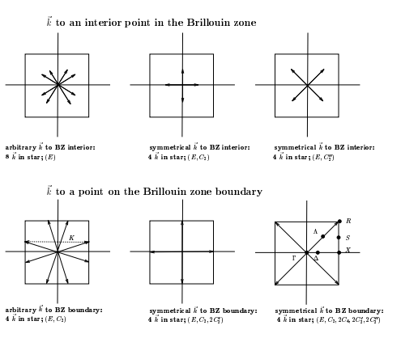
Definition: The group of the wave vector is formed by the set of operations which transform k→k+G, where G is any reciprocal lattice vector.
Example D₄

Slide 10
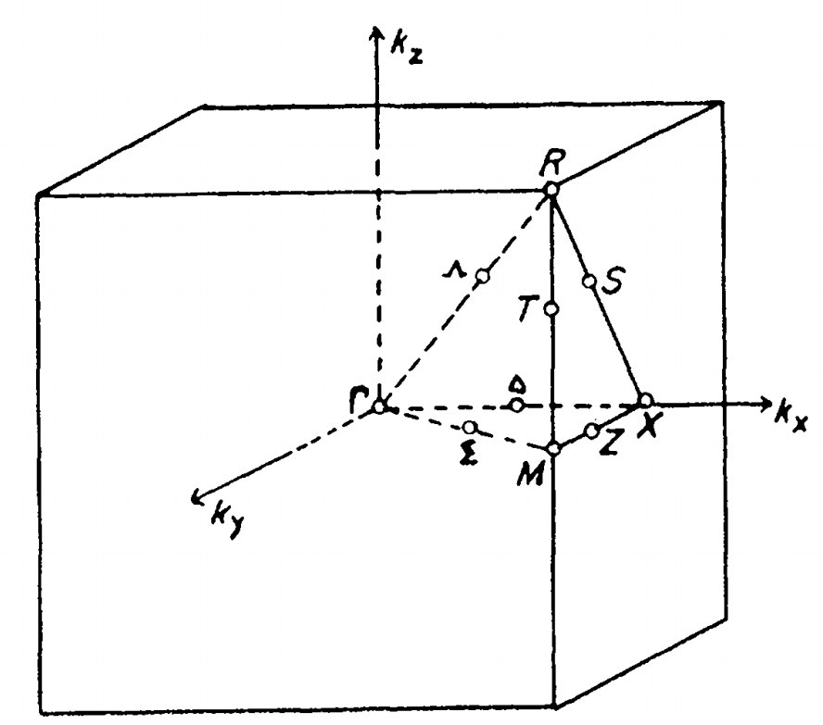
Unit cells of reciprocal space – Brillouin zones
➔simple cubic lattice

Slide 11
Definition: The group of the wave vector is formed by the set of operations which transform k→k+G, where G is any reciprocal lattice vector.
Example – simple cubic lattice

Slide 12
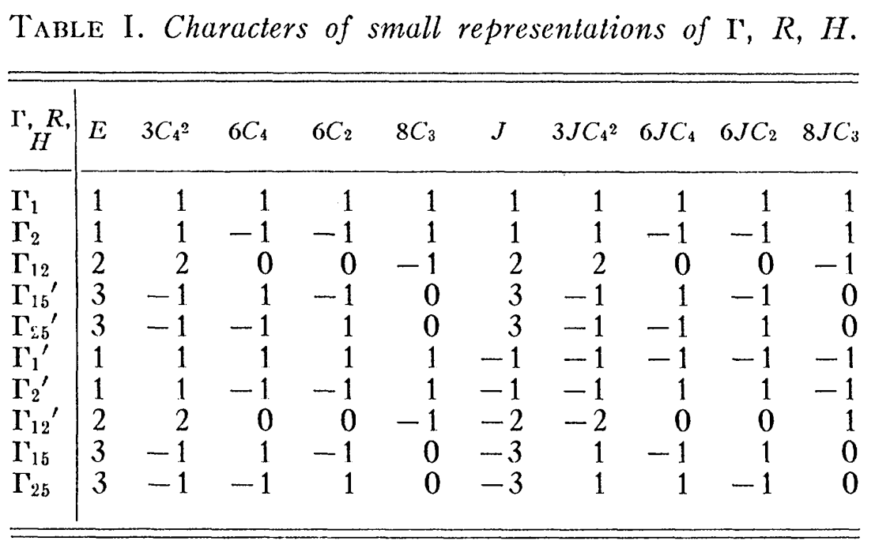
k=0 in a cubic crystal

Slide 13
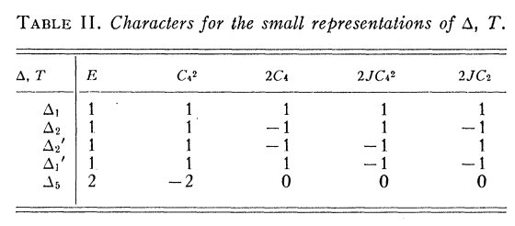
Γ
Δ

Slide 14
→Δ₁
◊Δ₂
◊Δ₁Δ₂
◊Δ₁’ Δ₅

Slide 15
Compatability relations computed by BSW:

Slide 16
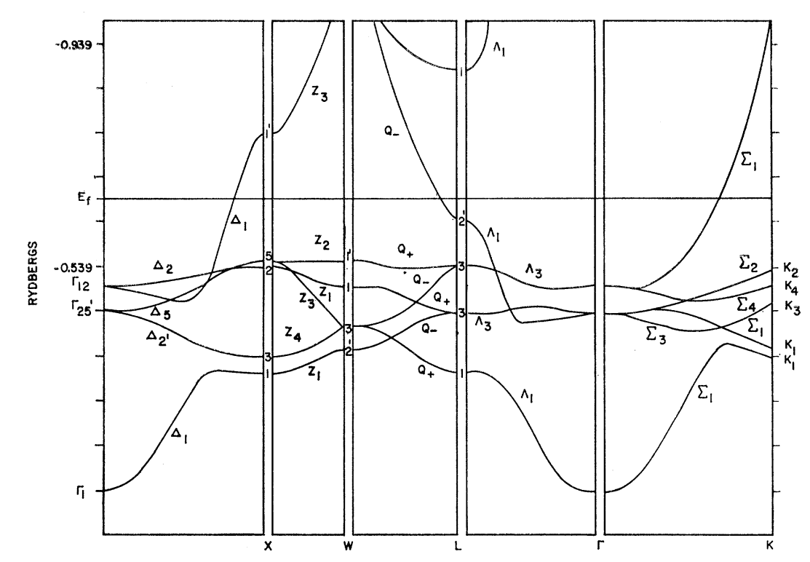
Band structure diagram for fcc Cu (Burdick, PR 129 138-159 (1963))

