Slide 1
PHY 745 Group Theory
11-11:50 AM MWF Olin 102
Plan for Lecture 19:
Review of topics in group theory
Chapters 1-10 in DDJ
General concepts and definitions in group theory
Representations of groups; great orthogonality theorem
Point groups; space groups

Slide 2
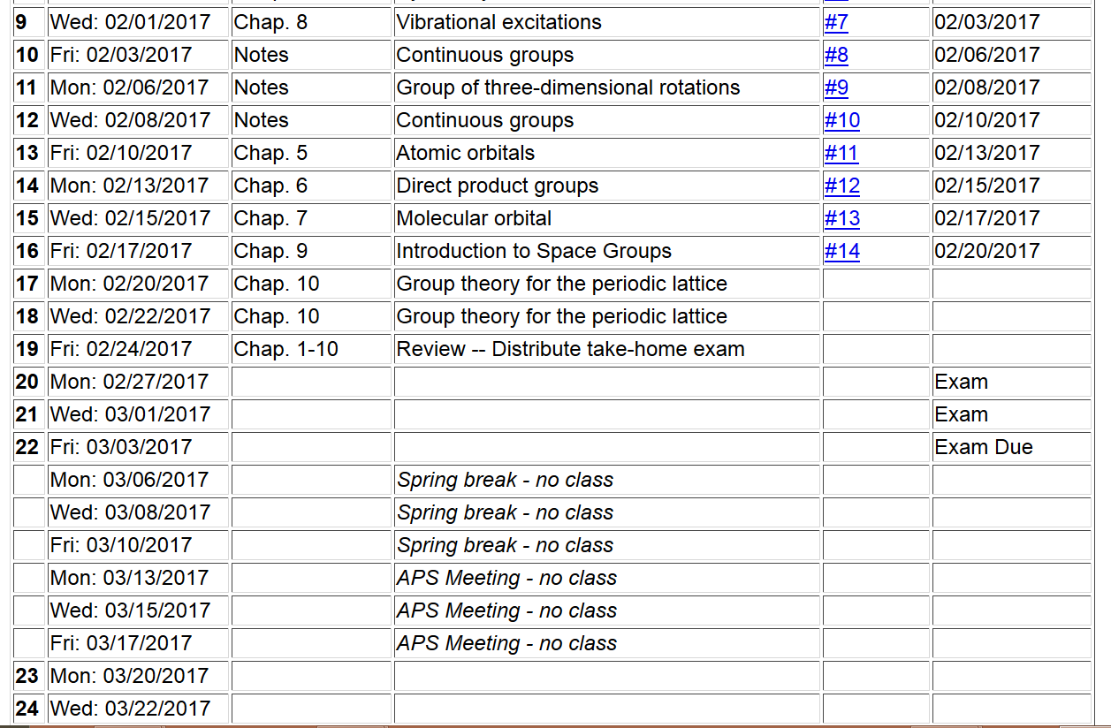

Slide 3
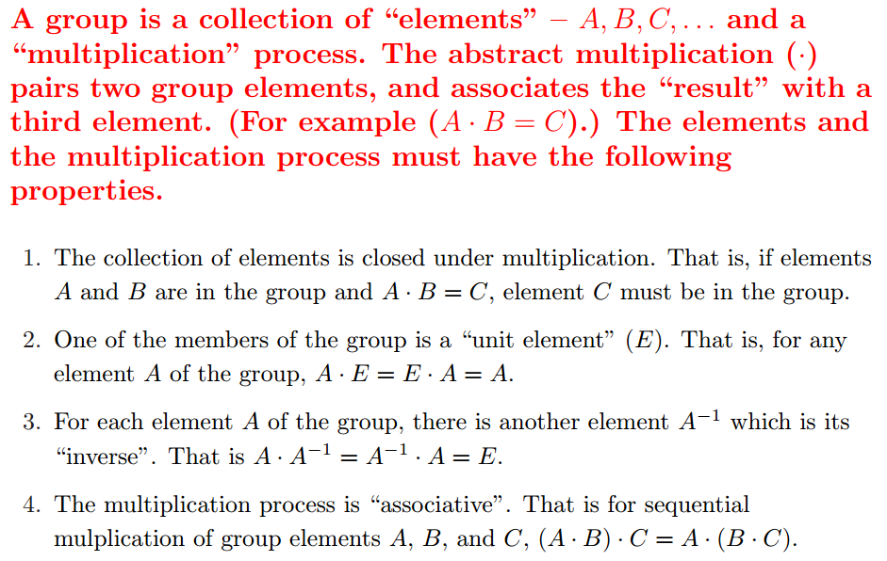
Group theory
An abstract algebraic construction in mathematics
Definition of a group:

Slide 4
Some definitions:
Order of the group ➔ number of elements (members) in the group (positive integer for finite group, ∞ for infinite group)
Subgroup ➔ collection of elements within a group which by themselves form a group
Coset ➔ Given a subgroup g_{i} of a group a right coset can be formed by multiply an element of g with each element of g_{i}
Class ➔members of a group generated by the conjugate construction

Slide 5
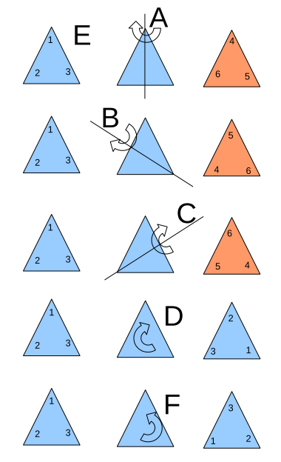
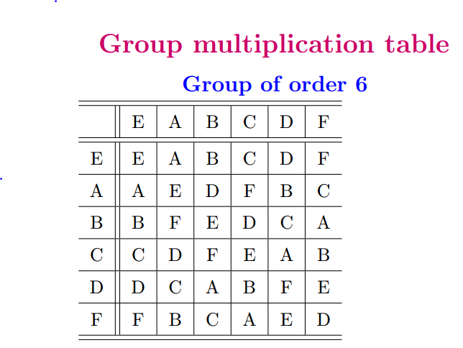
Example of a 6-member group E,A,B,C,D,F,G

Slide 6
For our example:

Slide 7
Representations of a group

Slide 8
Example:

Slide 9
The great orthogonality theorem on unitary irreducible representations

Slide 10
Great orthogonality theorem for characters

Slide 11
Character table for P(3):
 | C₁ | 3C₂ | 2C₃
χ¹ | 1 | 1 | 1
χ² | 1 | -1 | 1
χ³ | 2 | 0 | -1

Slide 12
The characters χ^{i} behave as a vector space with the dimension equal to the number of classes.
➔The number of characters=the number of classes

Slide 13
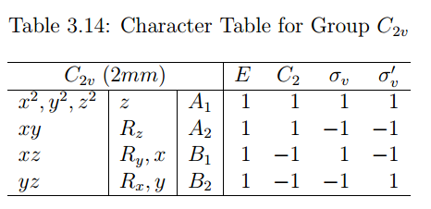
C₂
Example of H₂O
σ_{v}
σ_{v’}
“Standard” notation for representations of C_{2v}

Slide 14
Symmetry analysis
Δy₁
Δy₂
Δy₃
Δx₁
Δy₁
Δz₁
Δx₂
R Δy₂
Δz₂
Δx₃
Δy₃
Δz₃
Δx₁
Δz₁
Δx₂
Δx₃
Δz₂
Δz₃
C₂
σ_{v}
σ_{v’}

Slide 15
Δx₁ 1 0 0 0 0 0 0 0 0 Δx₁
Δy₁ 0 1 0 0 0 0 0 0 0 Δy₁
Δz₁ 0 0 1 0 0 0 0 0 0 Δz₁
Δx₂ 0 0 0 1 0 0 0 0 0 Δx₂
E Δy₂ = 0 0 0 0 1 0 0 0 0 Δy₂
Δz₂ 0 0 0 0 0 1 0 0 0 Δz₂
Δx₃ 0 0 0 0 0 0 1 0 0 Δx₃
Δy₃ 0 0 0 0 0 0 0 1 0 Δy₃
Δz₃ 0 0 0 0 0 0 0 0 1 Δz₃
χ(E)=9

Slide 16
Δx₁ -1 0 0 0 0 0 0 0 0 Δx₁
Δy₁ 0 1 0 0 0 0 0 0 0 Δy₁
Δz₁ 0 0 -1 0 0 0 0 0 0 Δz₁
Δx₂ 0 0 0 0 0 0 -1 0 0 Δx₂
C₂ Δy₂ = 0 0 0 0 0 0 0 1 0 Δy₂
Δz₂ 0 0 0 0 0 0 0 0 -1 Δz₂
Δx₃ 0 0 0 -1 0 0 0 0 0 Δx₃
Δy₃ 0 0 0 0 1 0 0 0 0 Δy₃
Δz₃ 0 0 0 0 0 -1 0 0 0 Δz₃
χ(C₂)=-1
Similarly: χ(σ_{v})=3
χ(σ_{v’})=1

Slide 19
Some properties of continuous group SO(3)

Slide 21
Irreducible representations in terms of angular momentum eigenfunctions

Slide 22
Group of all unitary matrices of dimension 2 – SU(2)

Slide 23
Group of all unitary matrices of dimension 2 – SU(2) --continued

