Slide 1
PHY 745 Group Theory
11-11:50 AM MWF Olin 102
Plan for Lecture 2:
Representation Theory
    Reading: Chapter 2 in DDJ
      Review of group definitions
      Theory of representations

Slide 2
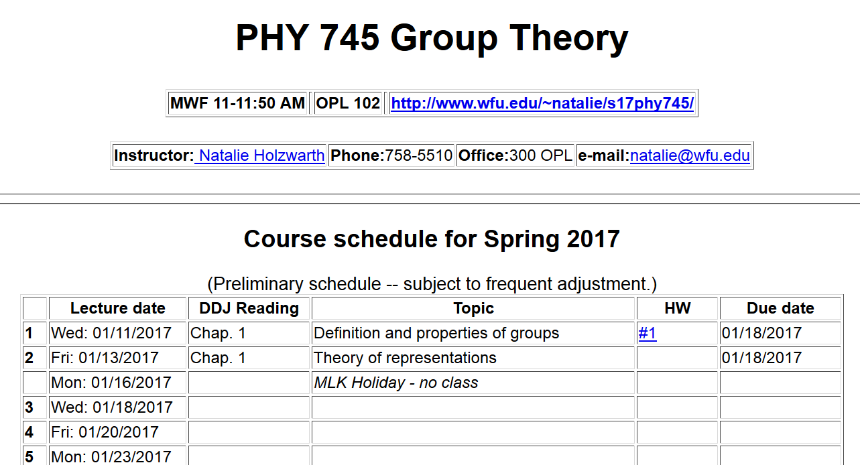

Slide 3
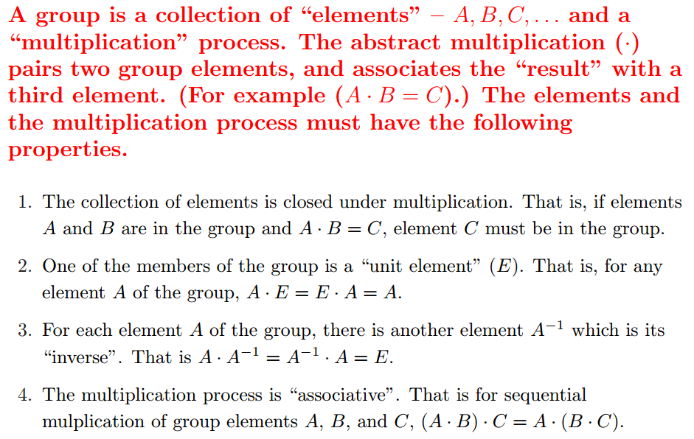
Group theory
  An abstract algebraic construction in mathematics
  Definition of a group:

Slide 4
Some definitions:
Order of the group ➔ number of elements (members) in the group (positive integer for finite group, ∞ for infinite group)
Subgroup ➔ collection of elements within a group which by themselves form a group
    Coset ➔ Given a subgroup g_{i} of a group a right coset can be formed by multiply an element of g with each element of g_{i}
Class ➔members of a group generated by the conjugate construction

Slide 5
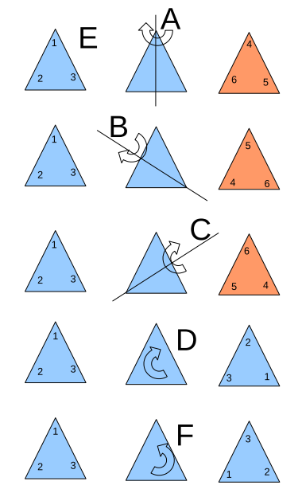
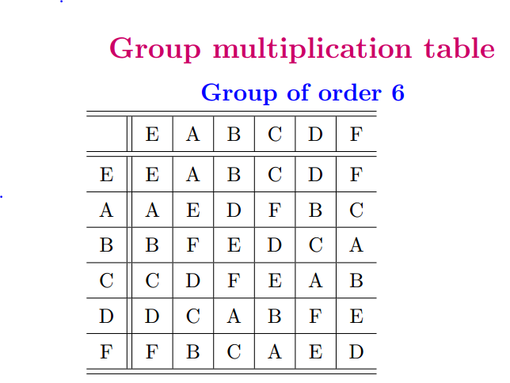
Example of a 6-member group E,A,B,C,D,F,G

Slide 7
Example of cyclic group of order 4:
 | E | A | A² | A³
E | E | A | A² | A³
A | A | A² | A³ | E
A² | A² | A³ | E | A
A³ | A³ | E | A | A²

Slide 8
Example of non-cyclic group of order 4
 | E | A | B | C
E | E | A | B | C
A | A | E | C | B
B | B | C | E | A
C | C | B | A | E

Slide 9
Representations of a group

Slide 10
Example:

Slide 11
Example:

Slide 12
What about 3 or 4 dimensional representations for this group?
For example, the following 3 dimensional representation satisfies the multiplication table:

Slide 13
Reduced form of representation
In this example, the “irreducible” representations for the group are 2 one-dimensional and 1 two-dimensional

Slide 14
Comment about representation matrices
Typically, unitary matrices are chosen for representations
Typically representations are reduced to block diagonal form and the irreducible blocks are considered in the representation theory

Slide 15
similarity transformation
block diagonal form
distinct
irreducible representation

Slide 16
The great orthogonality theorem

Slide 17
Great orthogonality theorem continued

Slide 18
Simplified analysis in terms of the “characters” of the representations
Character orthogonality theorem
Note that all members of a class have the same
character for any given representation i.

Slide 19
What the great (“wonderful”) orthogonality theorem will do for us:
Show that there are a fixed number of distinct irreducible representations and help us find them
Show that the irreducible representations of a group have properties of orthogonal vector spaces.
Result in a simplified orthogonality theorem based on the “characters” of the group
Often the irreducible representations are related to physical quantities such as quantum mechanical wavefunctions or operators.

Slide 20
Example similarity transformation

