Slide 1
PHY 745 Group Theory
11-11:50 AM MWF Olin 102
Plan for Lecture 20:
Space group properties
    Chapter 10 in DDJ
      Non-symmorphic space groups
      Example -- diamond

Slide 2
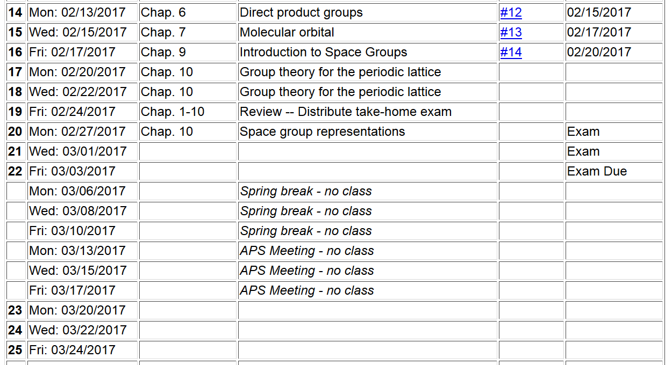

Slide 3
Space group
Non-lattice translation
Lattice translation
Point operation

Slide 4
Effects of group operations on Bloch basis functions (symmorphic case)

Slide 5
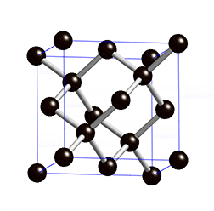
Non-symmorphic space group
Example -- diamond
https://en.wikipedia.org/wiki/Diamond_cubic

Slide 6
Space group symmetry of diamond
➔Maps to O_{h} point symmetry

Slide 7
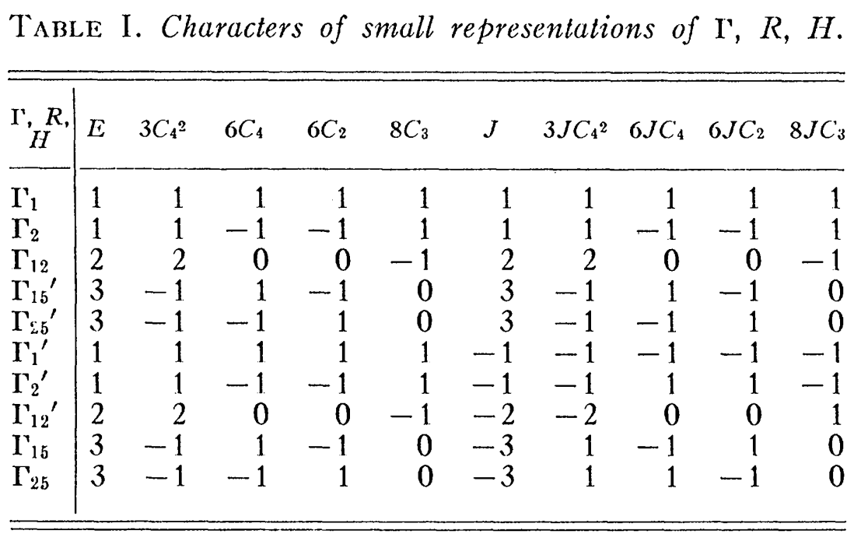
From BSW paper Phys. Rev. 50, 58 (1936)

Slide 8
Effects of group operations on Bloch basis functions (general case)

Slide 9
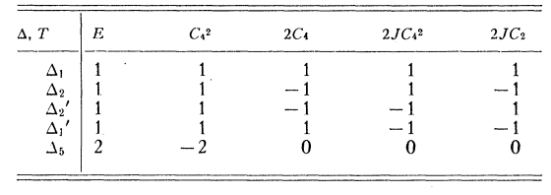
From BSW paper Phys. Rev. 50, 58 (1936)

Slide 10
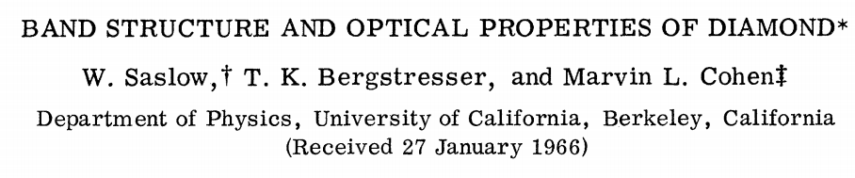
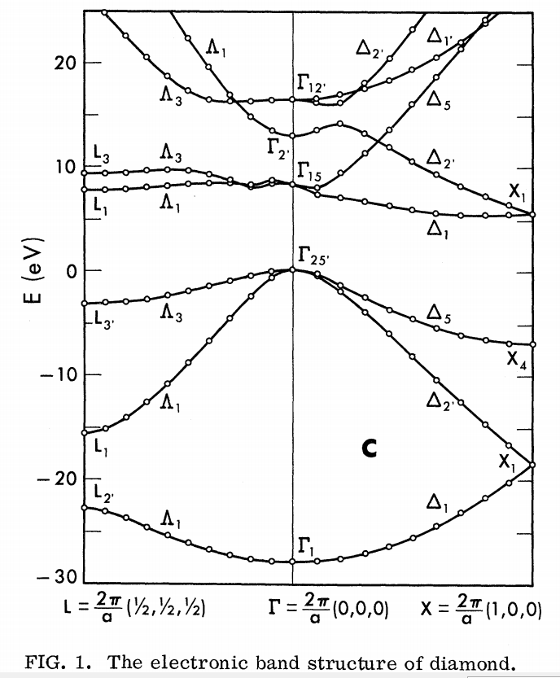
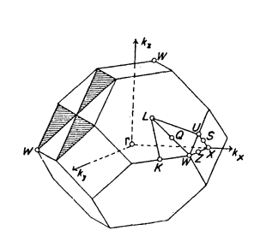
PRL 16, 354 (1966)

