Slide 1
PHY 745 Group Theory
11-11:50 AM MWF Olin 102
Plan for Lecture 21:
Symmetry of lattice vibrations
    Chapter 11 in DDJ
      Review of vibrations in a one-dimensional lattice
      Vibrations in a three-dimensional lattice
      Lattice modes and “molecular” modes
Some materials taken from DDJ and also Solid State Physics text by Grosso and Parravicini (2014)

Slide 2
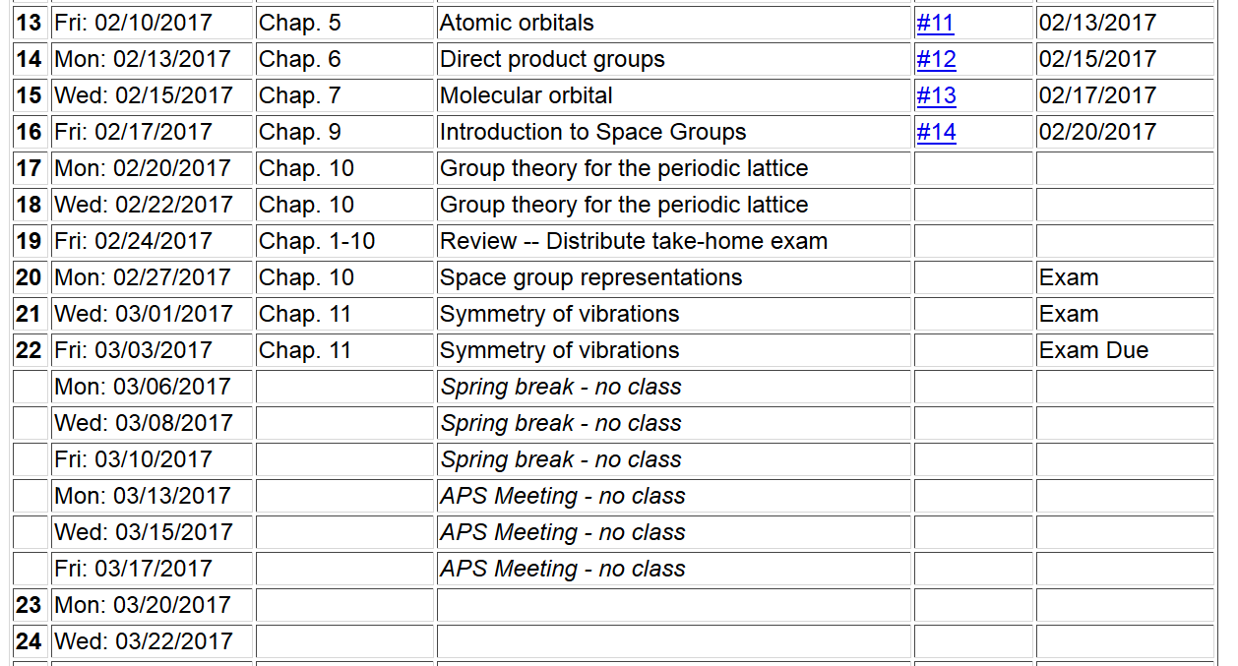

Slide 3
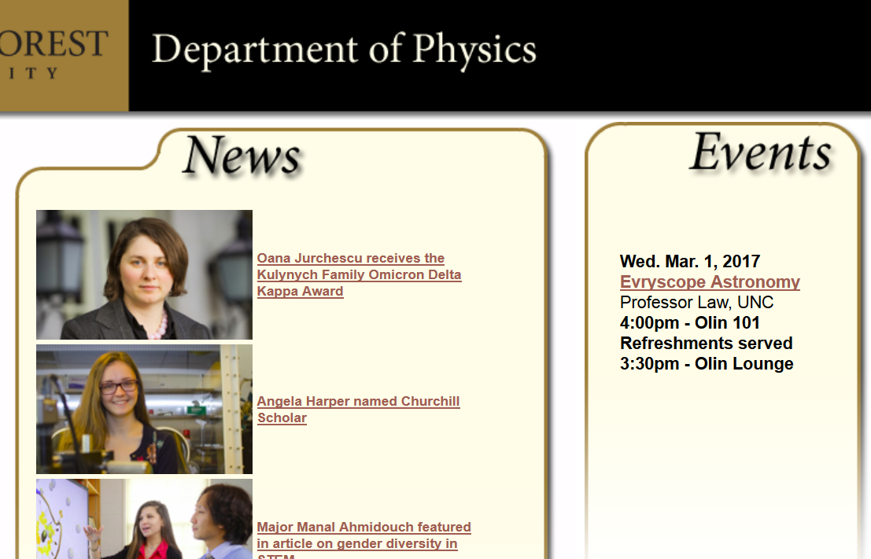

Slide 4
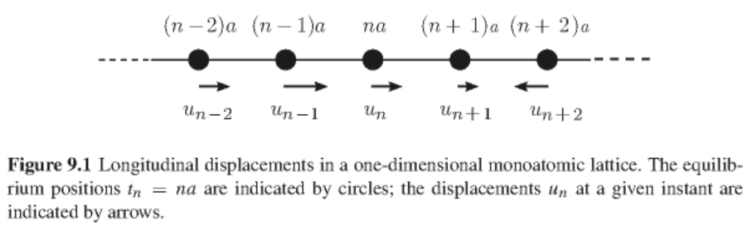
Thanks to the Born-Oppenheimer approximation, the nuclei of a material in equilibrium move in the potential field provided by the ground electronic state of the system

Slide 5
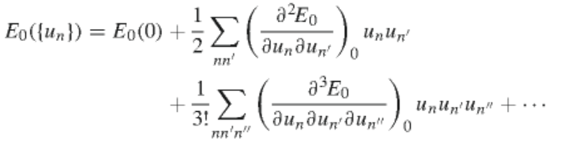
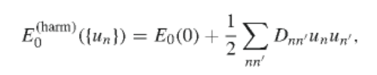
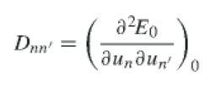



For one-dimensional case:
Relationships:

Slide 6



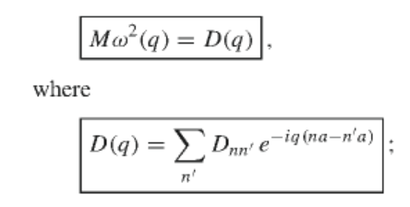
Classical equations of motion:
Solution

Slide 7


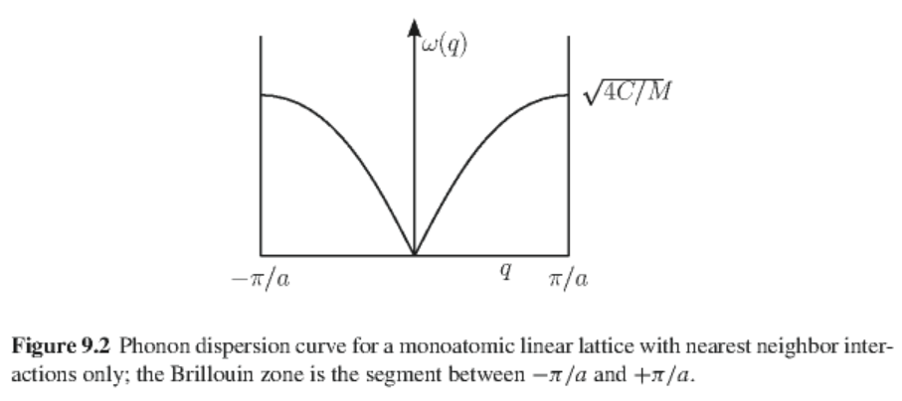
Analytic result for monoatomic chain with only nearest neighbor interactions
➔

Slide 8
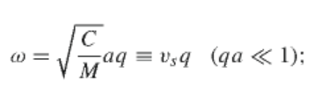
velocity of sound in the material

Slide 9
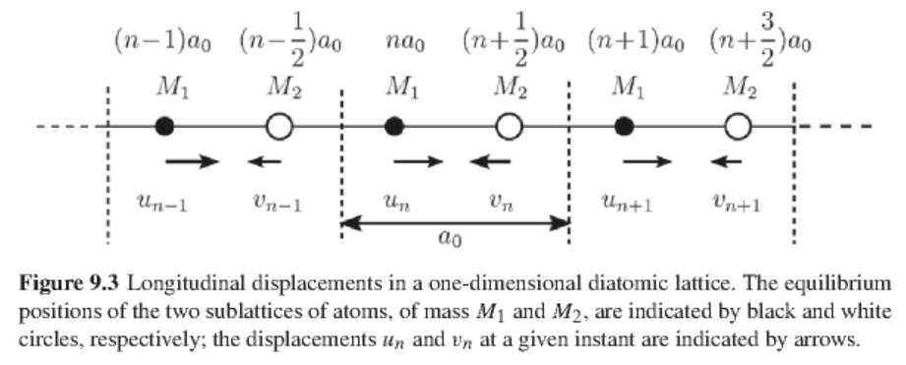
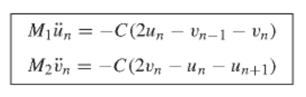
One-dimensional diatomic lattice
Equations of motion for this case:

Slide 10


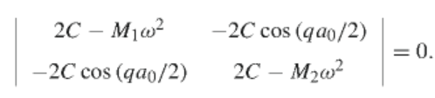
Solution:
convenient constant
Necessary condition for non-trivial solution:

Slide 11
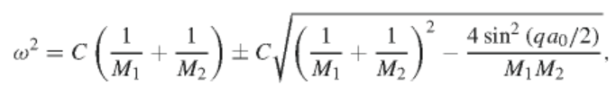
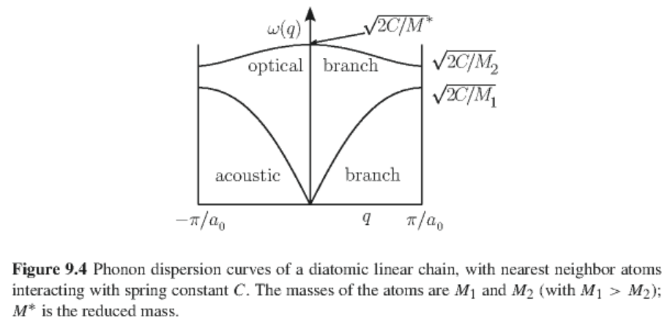
One-dimensional diatomic lattice -- continued
Normal modes

Slide 12
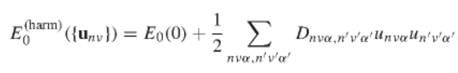
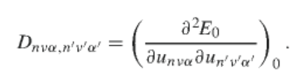



Lattice modes of general three-dimensional crystals
Relationships:

Slide 13
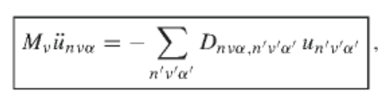



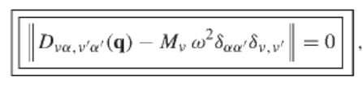
Lattice modes of general three-dimensional crystals -- continued
Equations of motion
Solution

Slide 14


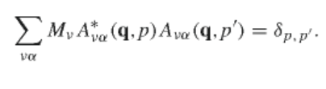
Lattice modes of general three-dimensional crystals -- continued
Some special values
Orthogonality of normal modes

Slide 15
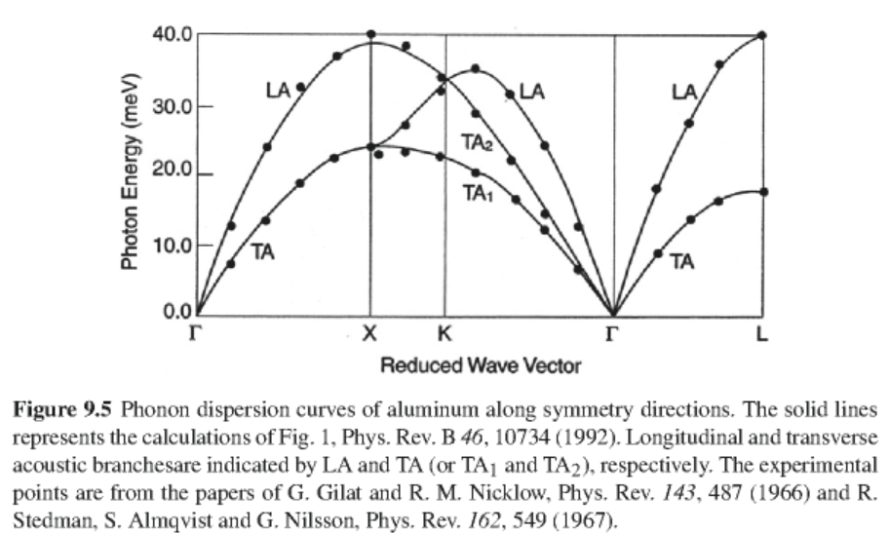
Example for fcc Al lattice
3 branches

Slide 16
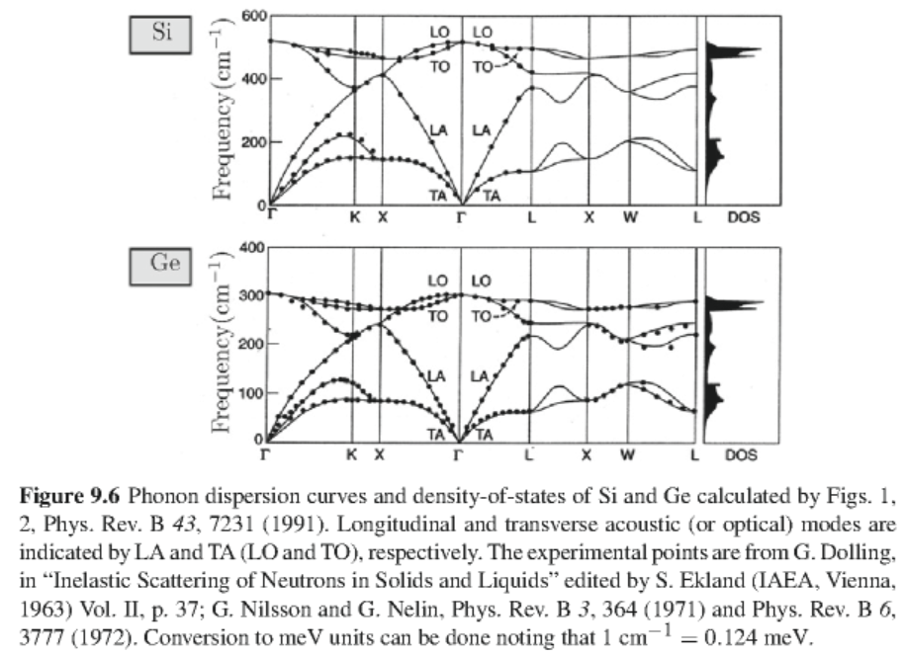
Example for Si and Ge lattices
6 branches
6 branches

Slide 17
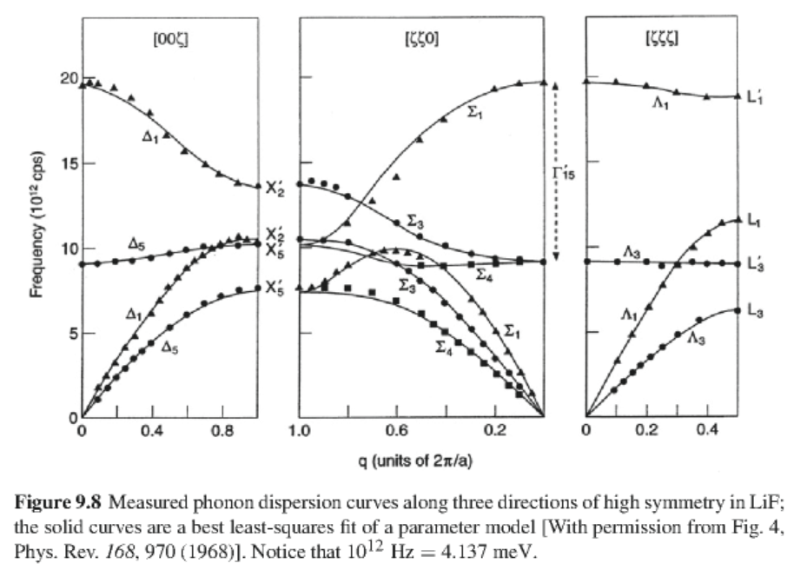
Example for LiF
6 branches

Slide 18
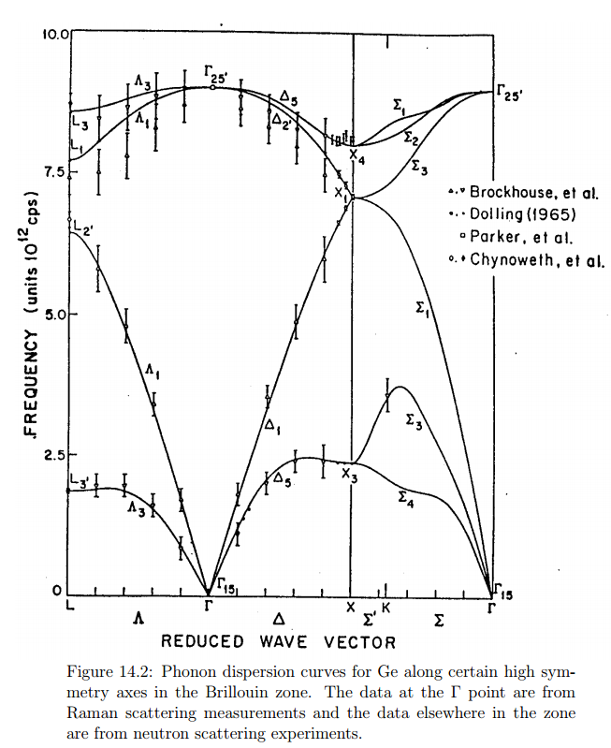
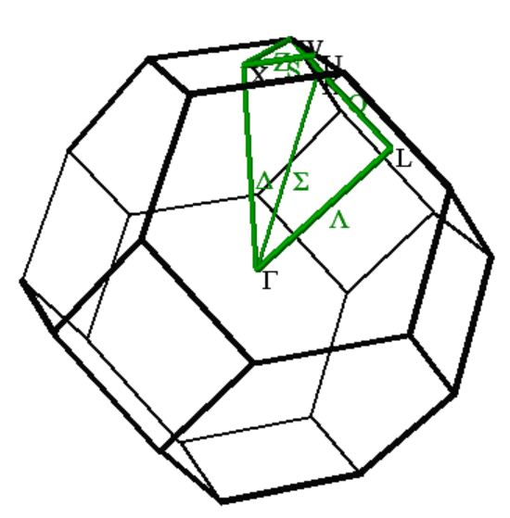
6 branches

Slide 19
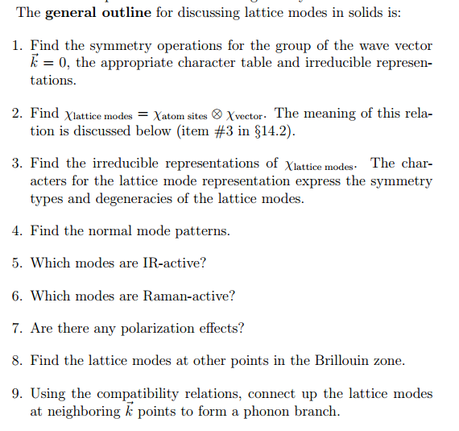

Slide 20
Notation for O_{h} symmetry
BSW | Molecular
Γ₁ | A_{1g}
Γ₂ | A_{2g}
Γ₁₂ | E_{g}
Γ₁₅’ | T_{1g}
Γ₂₅’ | T_{2g}
Γ₁’ | A_{1u}
Γ₂’ | A_{2u}
Γ₁₂’ | E_{u}
Γ₁₅ | T_{1u}
Γ₂₅ | T_{2u}

Slide 21
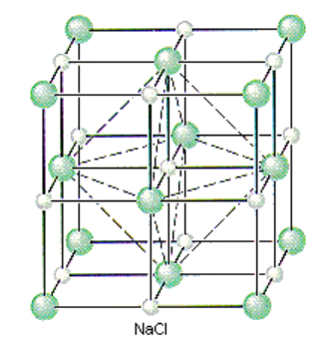
How many phonon branches?
# atoms in unit cell x dimension of lattice
Example -- NaCl
2 atoms per primitive cell
➔ 6 phonon branches

Slide 22
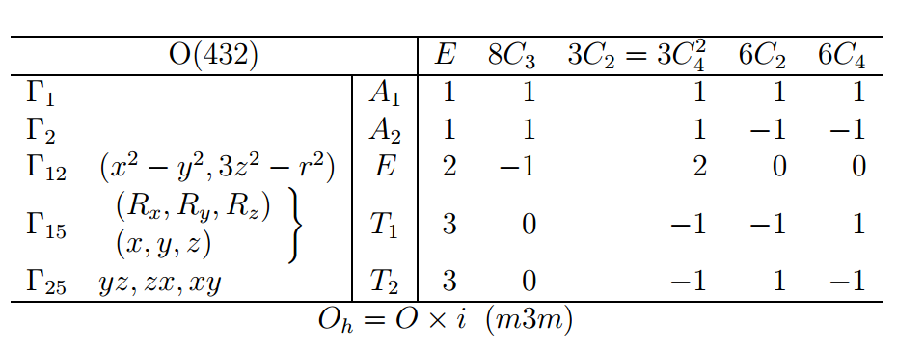
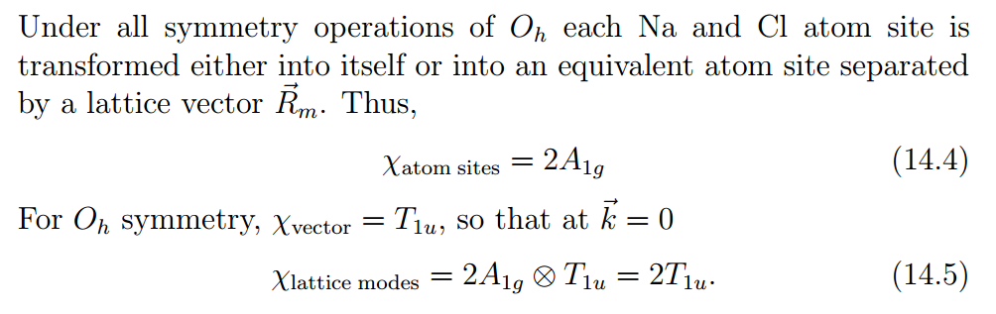
Symmetry associated with k=0 phonons O_{h} symmetry

Slide 23
