Slide 1
PHY 745 Group Theory
11-11:50 AM MWF Olin 102
Plan for Lecture 22:
Symmetry of lattice vibrations
Chapter 11 in DDJ
Lattice vibrations of LiF & elephants
Lattice vibrations of diamond structured materials
Some materials for this lecture were taken from an electronic version of DDJ.

Slide 2
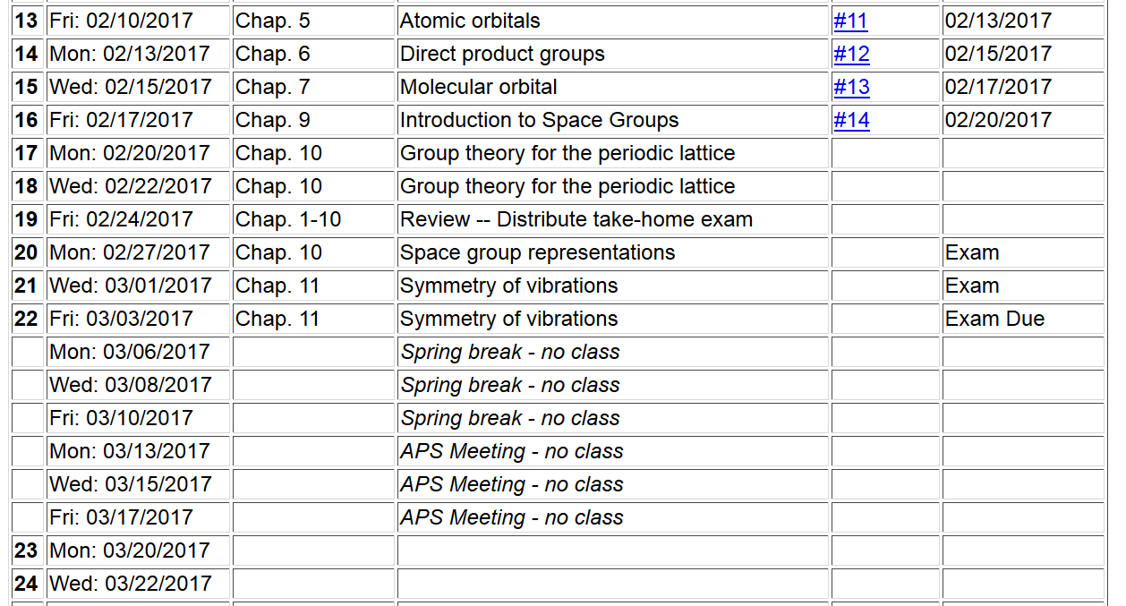

Slide 3
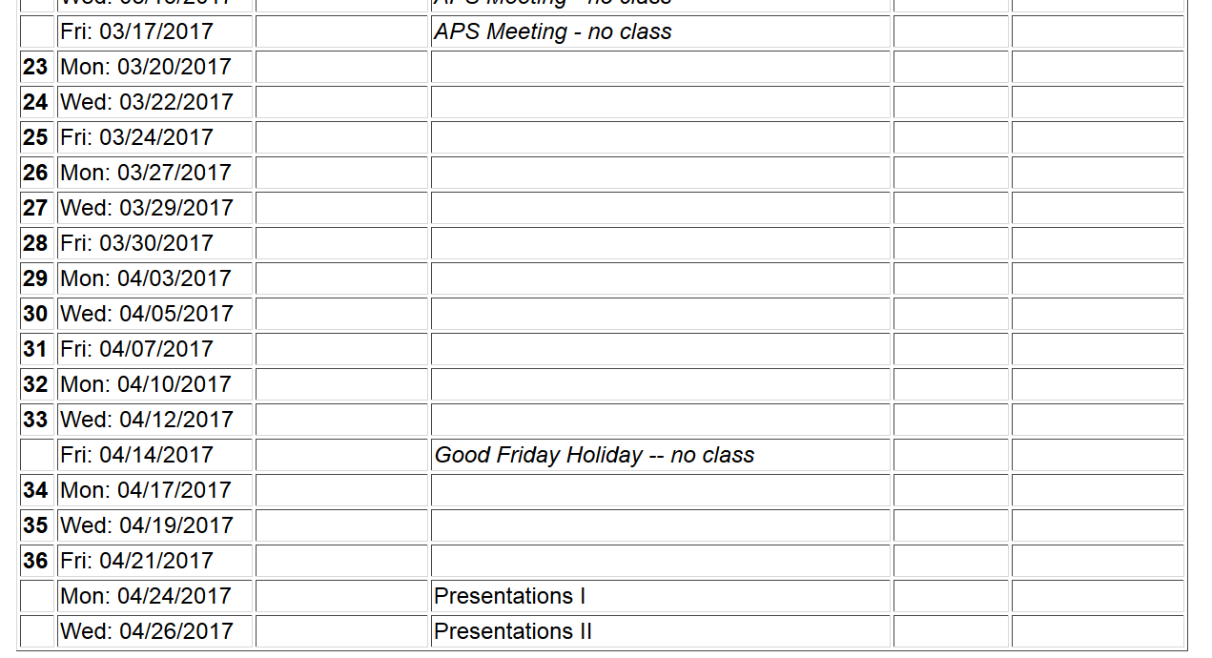
Comments:
Enjoy your spring break
Please use part of the week of March 13 to prepare your presentations for the end of April.

Slide 4
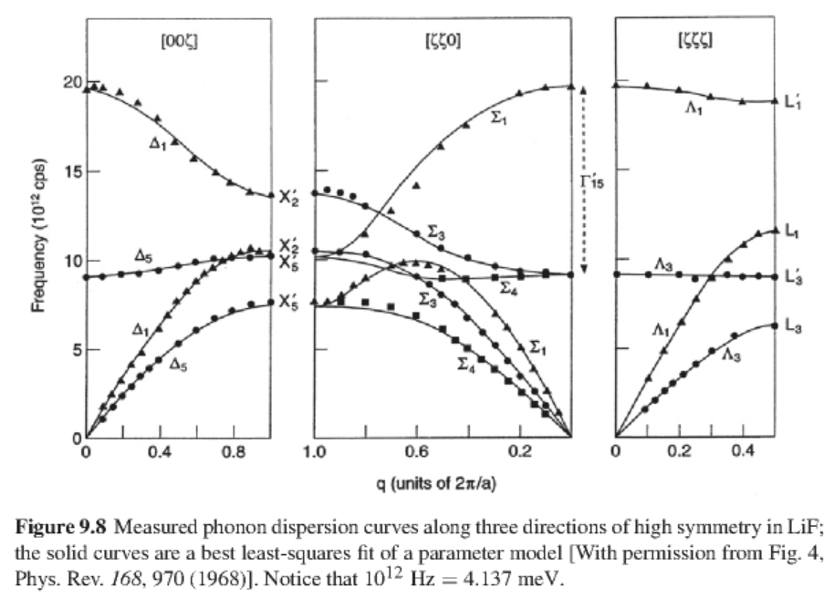
Example for LiF
6 branches

Slide 6
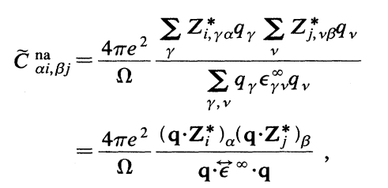
Lattice vibrations in polar crystals couple to electromagnetic fields, adding “non analytic” term to the dynamical matrix:

Slide 7
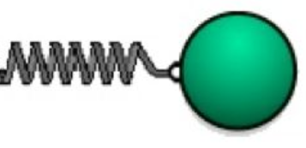
Brief digression concerning LO-TO phonon modes based on Grosso and Parravicini text
q
Resulting polarization density

Slide 8
Coupling to an electric field
Maxwell’s equations
Longitudinal mode

Slide 9
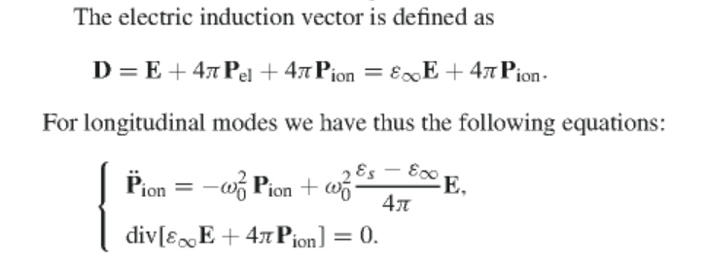
Longitudinal case continued

Slide 10
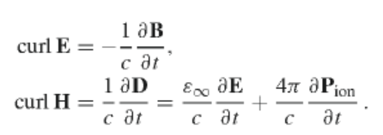
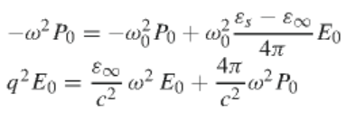
Transverse modes

Slide 11
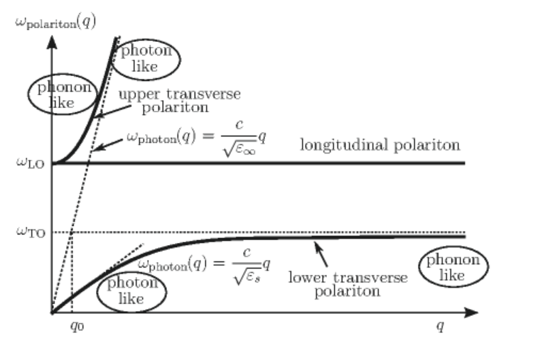
Transverse modes
After several steps we get two modes

Slide 12
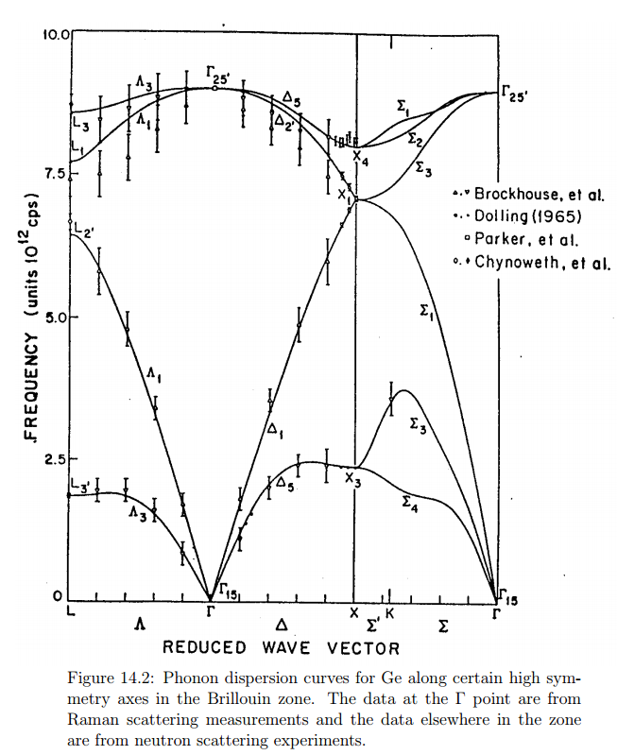
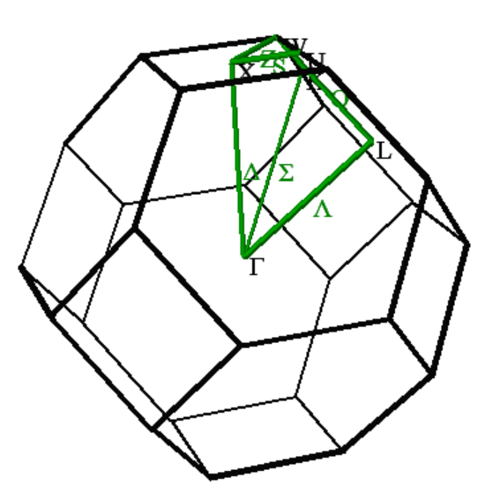
Ge (diamond structure)
6 branches

Slide 13
Notation for O_{h} symmetry
BSW | Molecular
Γ₁ | A_{1g}
Γ₂ | A_{2g}
Γ₁₂ | E_{g}
Γ₁₅’ | T_{1g}
Γ₂₅’ | T_{2g}
Γ₁’ | A_{1u}
Γ₂’ | A_{2u}
Γ₁₂’ | E_{u}
Γ₁₅ | T_{1u}
Γ₂₅ | T_{2u}

Slide 14
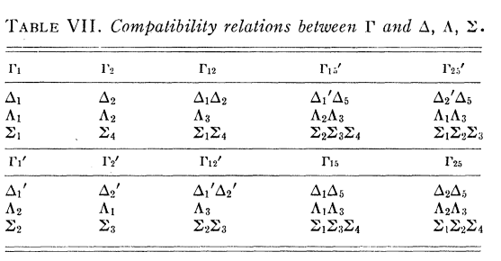
Symmetry of k=0 phonons in diamond structure
Analysis of phonons for k>0 in diamond structure
from Bouckaert, Smoluchowski, and WIgner:

Slide 15
Ge (diamond structure)
6 branches

Slide 16
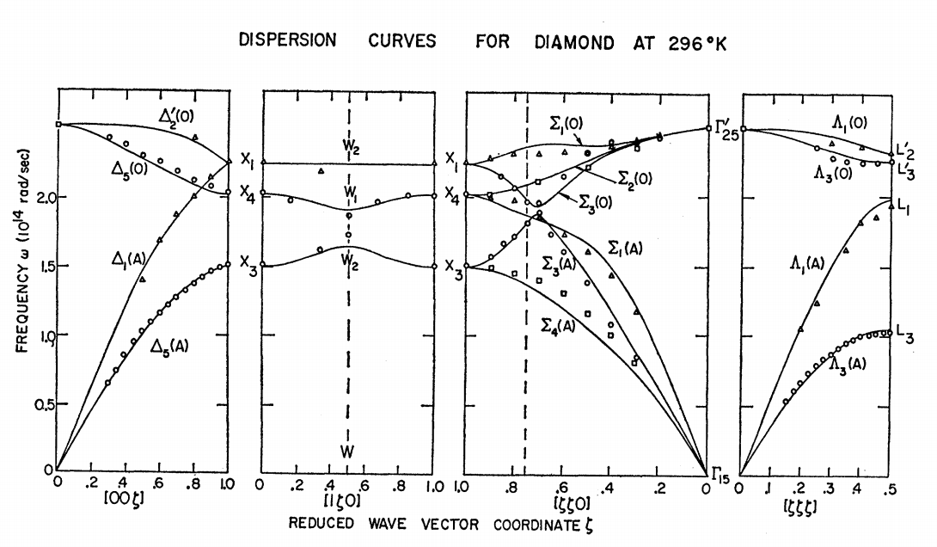
Phys. Rev. 158, 805-808 (1967)

Slide 17
