Slide 1
PHY 745 Group Theory
11-11:50 AM MWF Olin 102
Plan for Lecture 23:
Jahn-Teller Effect
Section 7.7 in DDJ
      Static Jahn-Teller distortion
      Dynamic Jahn-Teller distortion
      Example systems

Slide 2
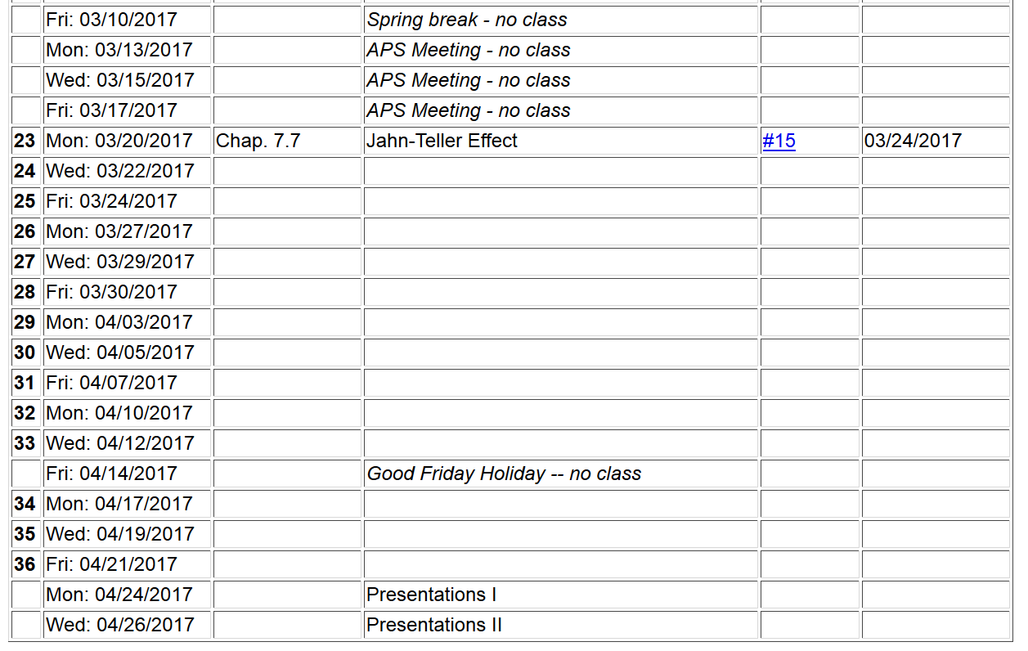

Slide 3
Electronic coordinates
Atomic coordinates
Quantum Theory of materials
Born-Oppenheimer approximation
  Born & Huang, Dynamical Theory of Crystal Lattices, Oxford (1954)

Slide 4
Quantum Theory of materials -- continued
Effective nuclear interaction provided by electrons

Slide 5
Consider electronic Hamiltonian
Electron-electron interaction term prevents exactly separable electron wavefunction

Slide 6
Because of the electron/nuclear mass ratio, Δ_{α} is relatively small. However, the approximation breaks down when the electronic states are degenerate.

Slide 7
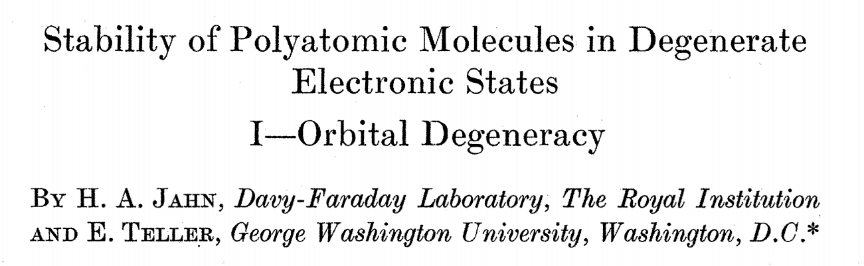
Proceedings of the Royal Society of London. Series A. 161, 220–235 (1937).
Static and dynamic Jahn-Teller distortion

Slide 8
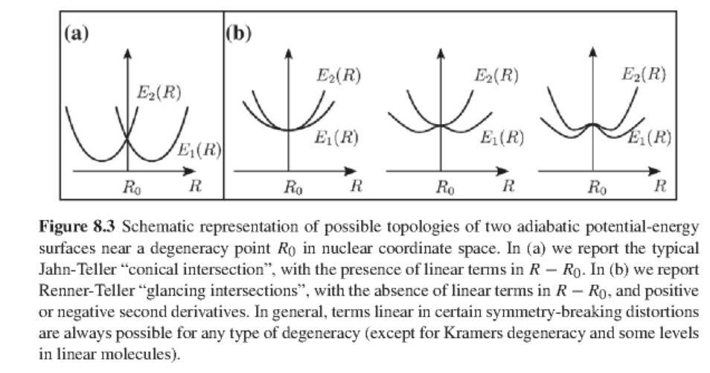
From Grosso and Pastori Parravincini, Solid State Physics textbook:

Slide 9
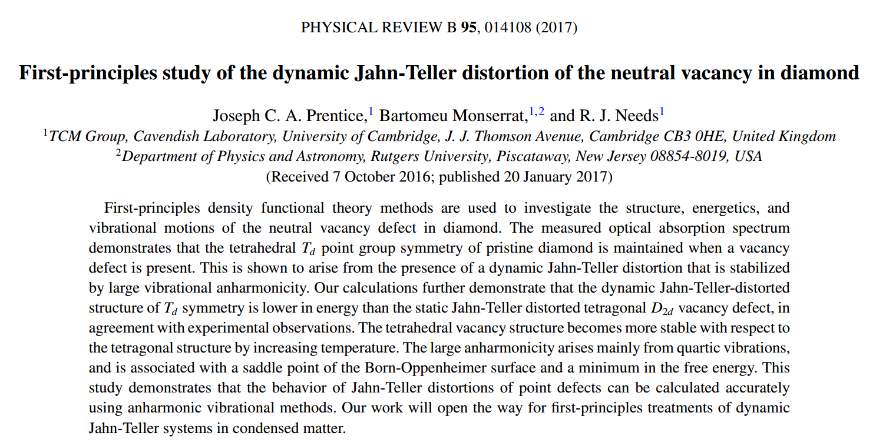

Slide 10
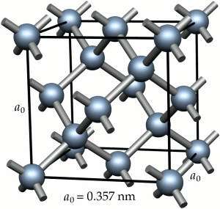
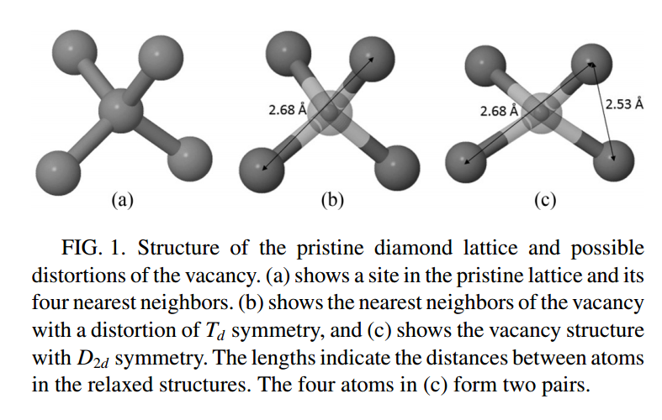

Slide 11
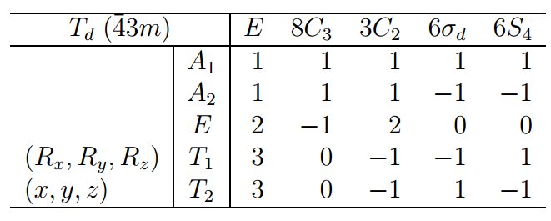
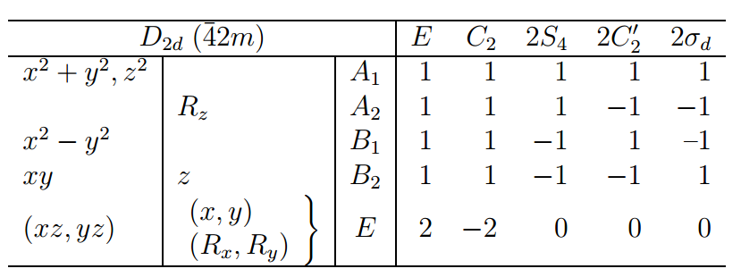
h=24
h=8
➔3 equivalent D_{2d} distortions

Slide 12
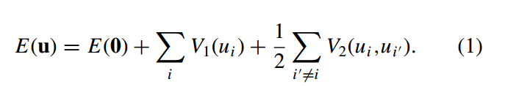
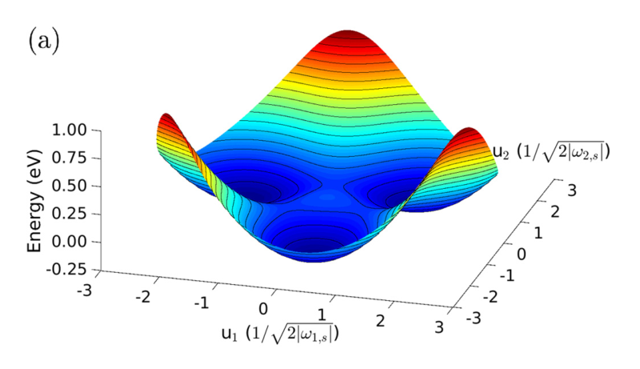
Represent the energy of the vacancy in terms of principal components:
Representation of the potential energy surface in the two dominant coordinates

Slide 13
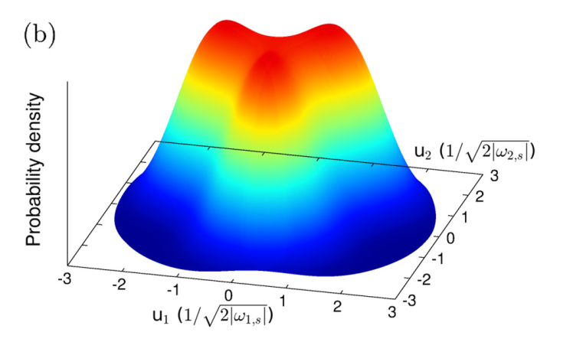
Probability density of “dynamic” Jahn-Teller distortion corresponding to lowest energy configuration of this system.

Slide 14
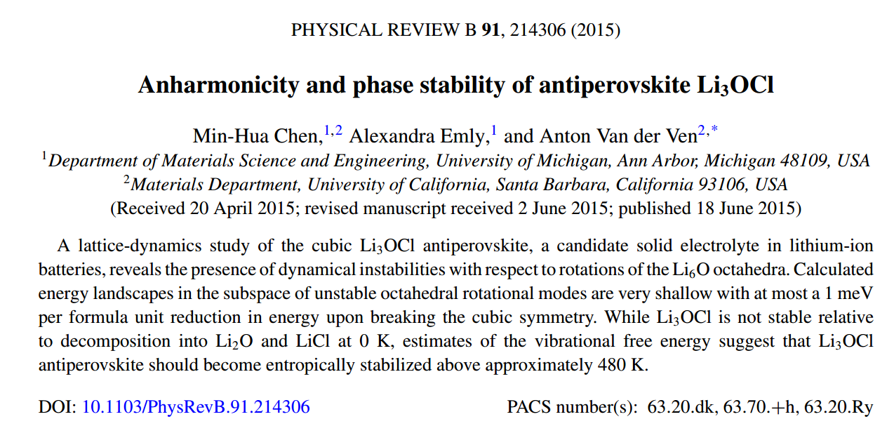

Slide 15
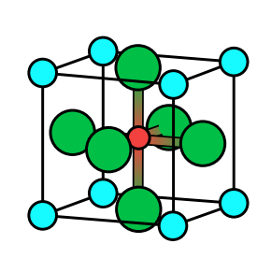
Cl
Li
O

Slide 16
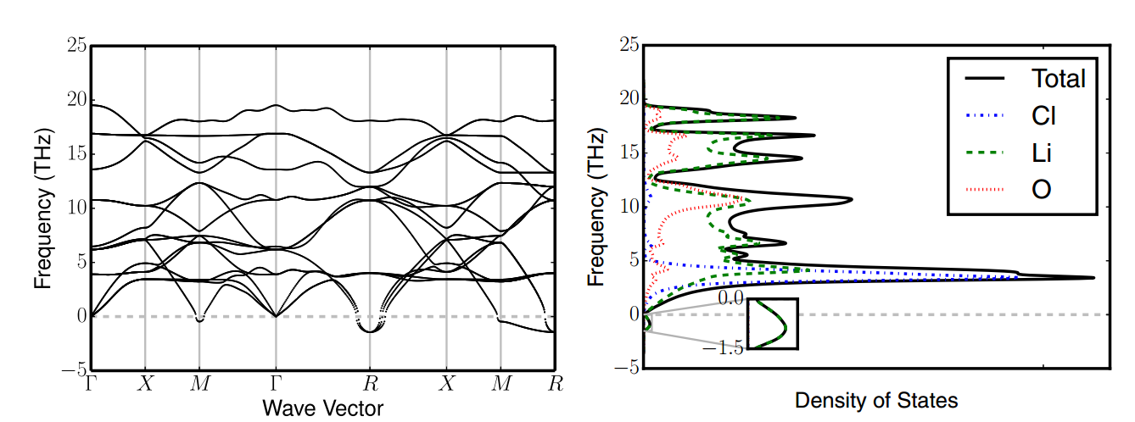
Phonon dispersion
imaginary frequencies

Slide 17
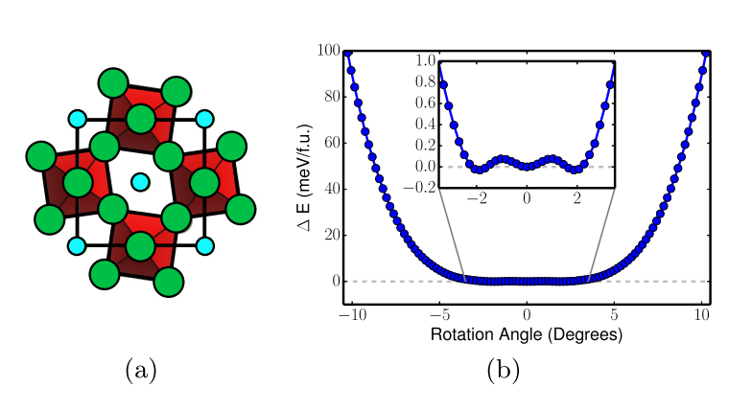
Example of one possible distortion and corresponding energy diagram.

