Slide 1
PHY 745 Group Theory
11-11:50 AM MWF Olin 102
Plan for Lecture 24:
Jahn-Teller Effect
Section 7.7 in DDJ
Example of tetrahedral molecule with doubly or triply degenerate electronic states.
Ref: Grosso and Pastori Parravinci, SSP, Chap. 8, Wang et al. JCP 93, 6318 (1990)

Slide 2
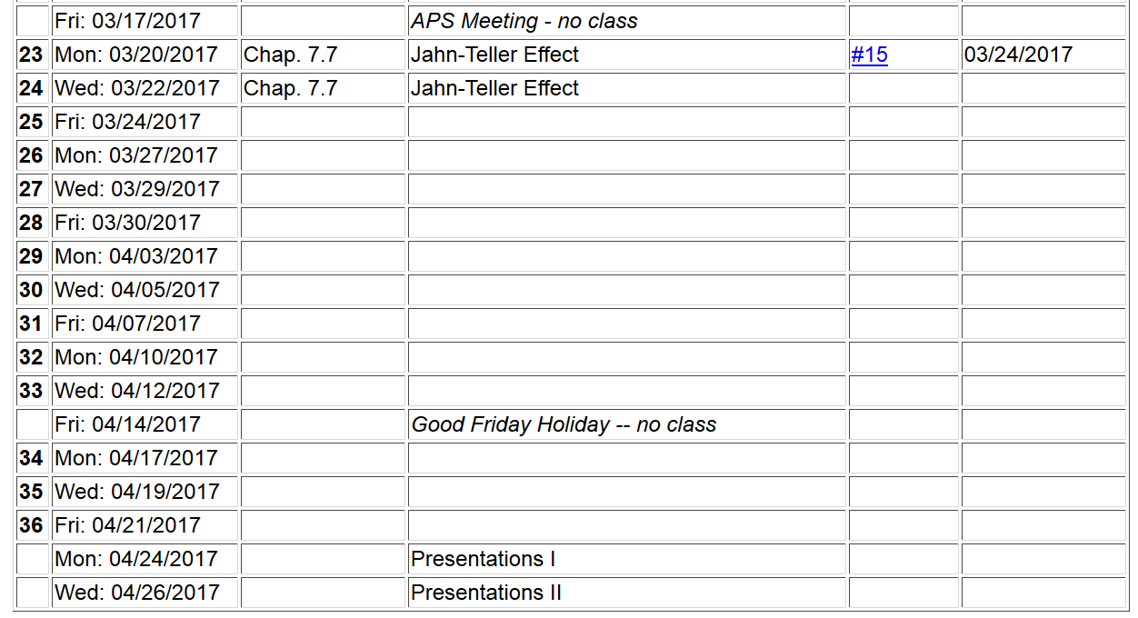

Slide 4
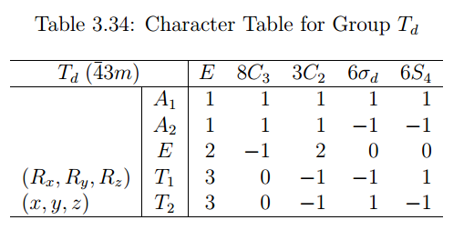
Symmetry analysis of vibrations of tetrahedral system

Slide 5
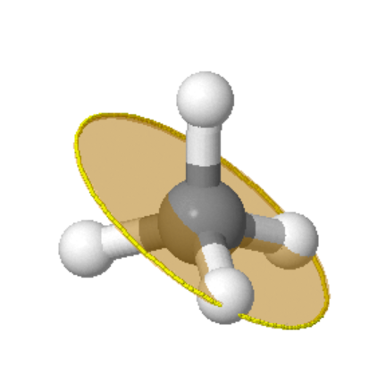
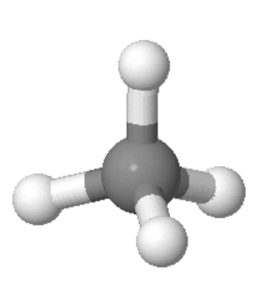
Visualization of symmetry elements
http://symmetry.otterbein.edu/tutorial/methane.html
C₃
C₂ S₄
σ_{d}

Slide 6
Δz₁
Construct 15-component vector V describing the 3-dimensional motion of the 5 atoms in CH₄
Δy₁
Δx₁
Δz₅
Δz₂
Δz₄
Δy₅
Δy₂
Δx₅
Δz₃
Δy₄
Δx₂
Δx₄
Δy₃
Δx₃

Slide 7
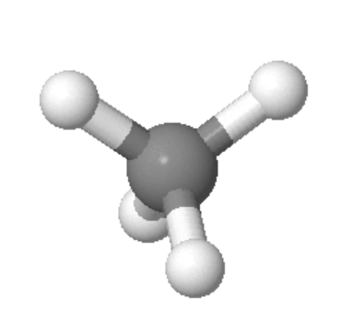
Alternate coordinate system
Δz₁
Δz₂
Δz₁
Δy₁
Δx₁
Δz₅
Δx₁
Δy₁
Δx₂
Δy₂
Δz₅
Δz₄
Δz₃
Δz₂
Δy₅
Δx₅
Δy₅
Δz₄
Δy₂
Δx₅
Δz₃
Δy₄
Δx₃
Δy₃
Δx₂
Δx₄
Δy₃
Δx₄
Δy₄
Δx₃

Slide 8
All motions: ➔A₁+E+T₁+3T₂
Translations: T₂
Rotations: T₁
Vibrations: A₁+E+2T₂

Slide 9
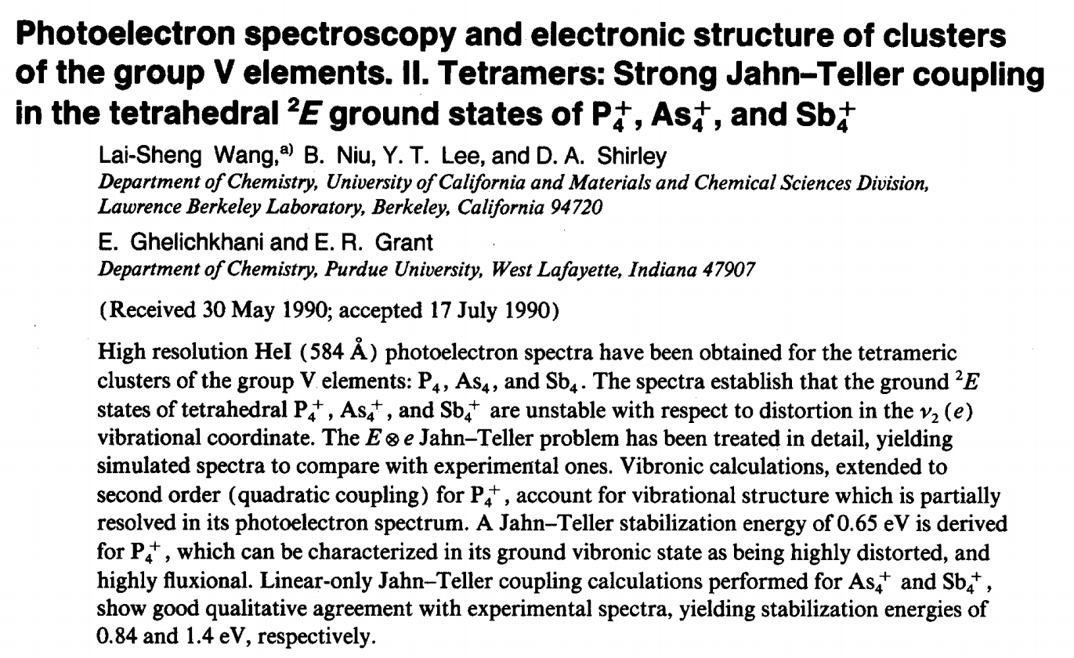

Slide 10
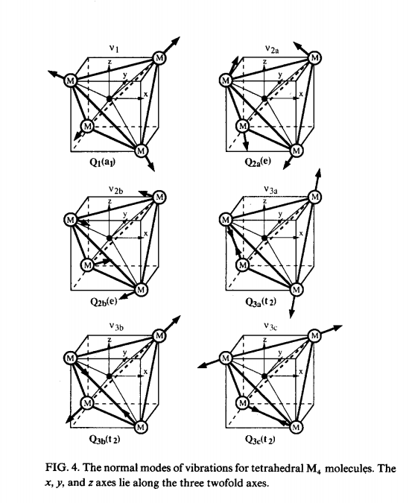

Slide 11
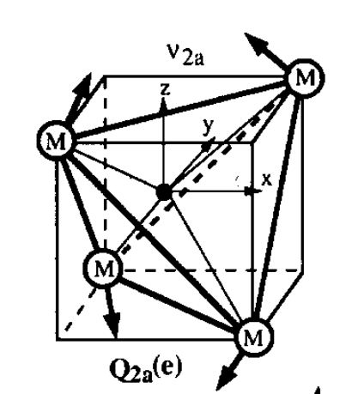
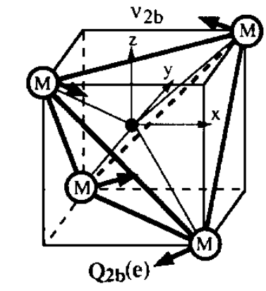

Slide 12
Some equations
nuclei
electrons
Nuclear part:

Slide 13
Some equations -- continued
Transform coordinates to q₁ and q₂ amplitudes of the two
E symmetry normal modes

Slide 14
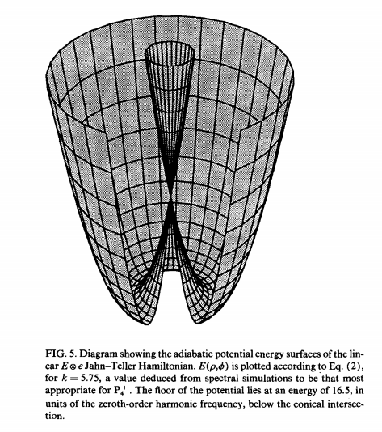

Slide 15
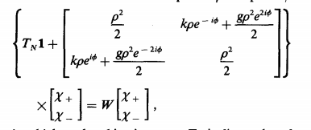
Some equations -- continued
Diagonalize nuclear Hamiltonian
More detailed Hamiltonian from JCP paper:

Slide 16
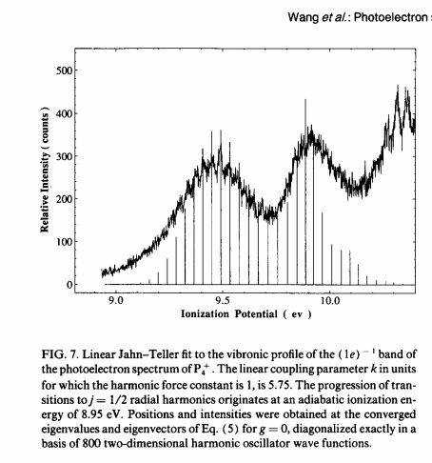
Solved numerically
P₄⁺

Slide 17
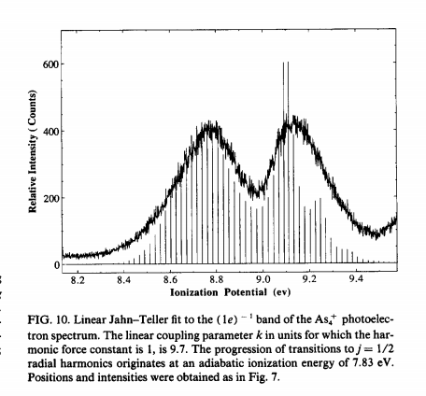
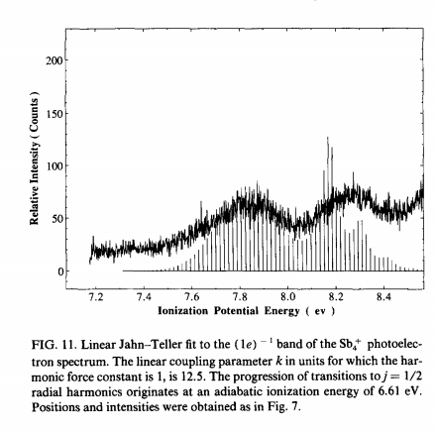
As₄⁺
Sb₄⁺

