Slide 1
PHY 745 Group Theory
11-11:50 AM MWF Olin 102
Plan for Lecture 25:
Group theory and intrinsic spin; specifically, s=1/2
Dirac equation for hydrogen atom
Spin-orbit interaction
Double groups

Slide 2
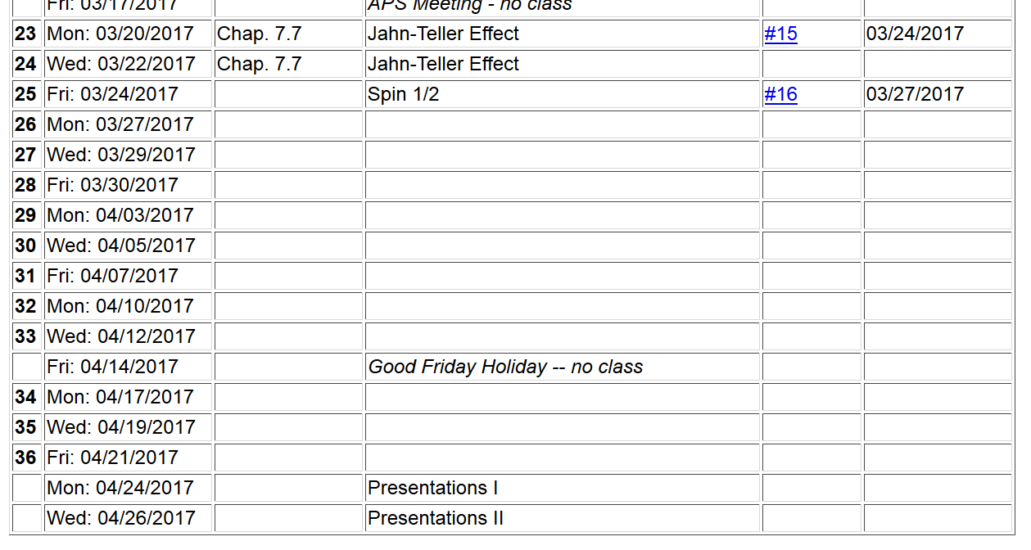

Slide 3
Dirac equation for describing the quantum mechanics of an electron

Slide 4
Four-component Dirac Hamiltonian for an electron in a spherically symmetric scalar potential V(r):
Other useful four-component matrices:

Slide 5
The following commutation relations can be shown:
Useful identity:

Slide 6
Eigenfunctions of Dirac Hamiltonian for spherical potential
Relationships between eigenvalues

