Slide 1
PHY 745 Group Theory
11-11:50 AM MWF Olin 102
Plan for Lecture 27:
Topics involving angular momentum
Chap. 14 in DDJ
  “Addition” of angular momenta
  Rotation of angular momenta
  Double group representations

Slide 2
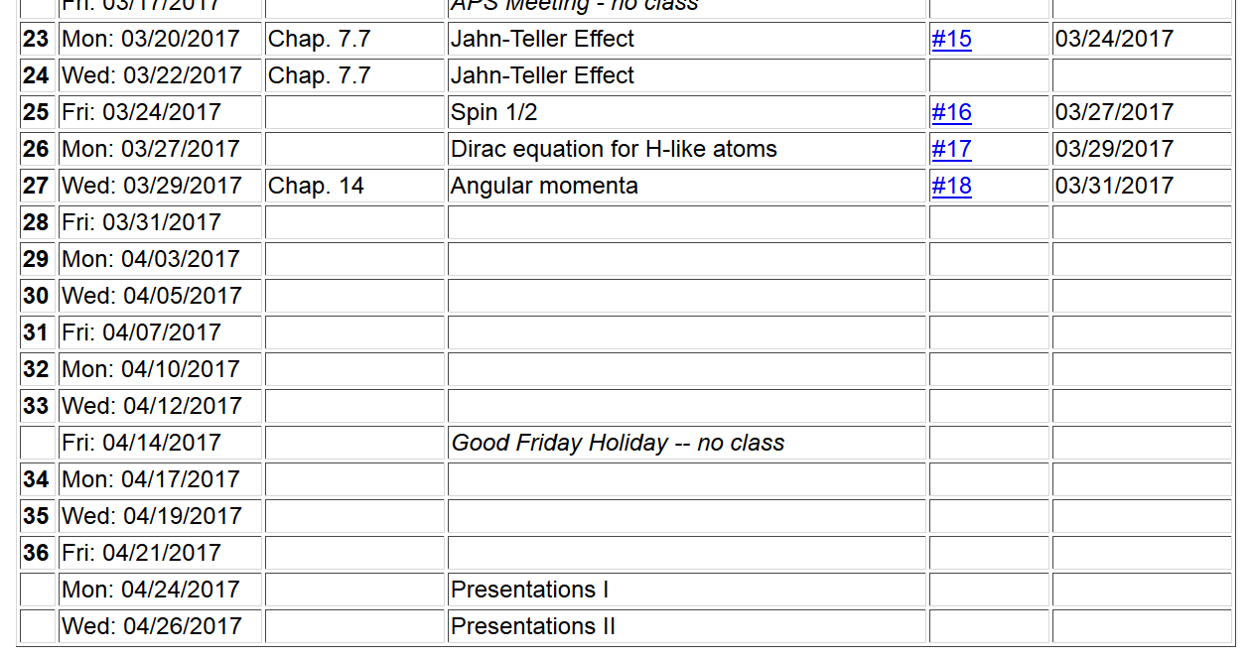

Slide 3
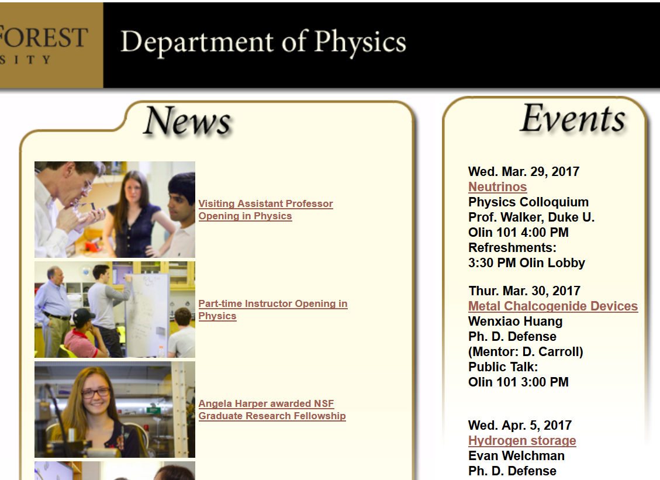

Slide 4


Slide 5
Addition of angular momenta

Slide 6
For more information on the Clebsch-Gordon coefficients: http://dlmf.nist.gov/34

Slide 7
Rotations of angular momentum
Irreducible representations in terms of angular momentum-spin eigenfunctions

Slide 8
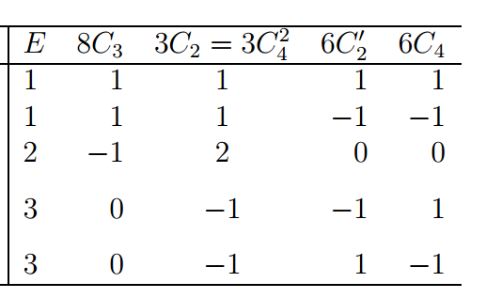
Octahedral symmetry

Slide 10
+3R
+6R
Note that complete group is now of order 48
and there are 8 classes and 8 representations
➔need to find three more representations

Slide 11
+3R
+6R
1 0 0 -2 -1
2 1 0 0 -2 -1
4 -1 0 0 0 -4 1 0

Slide 12
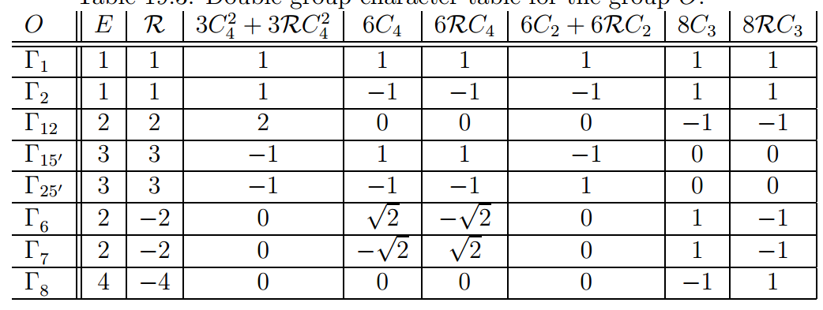
Summary of results
valid double group representations

Slide 13
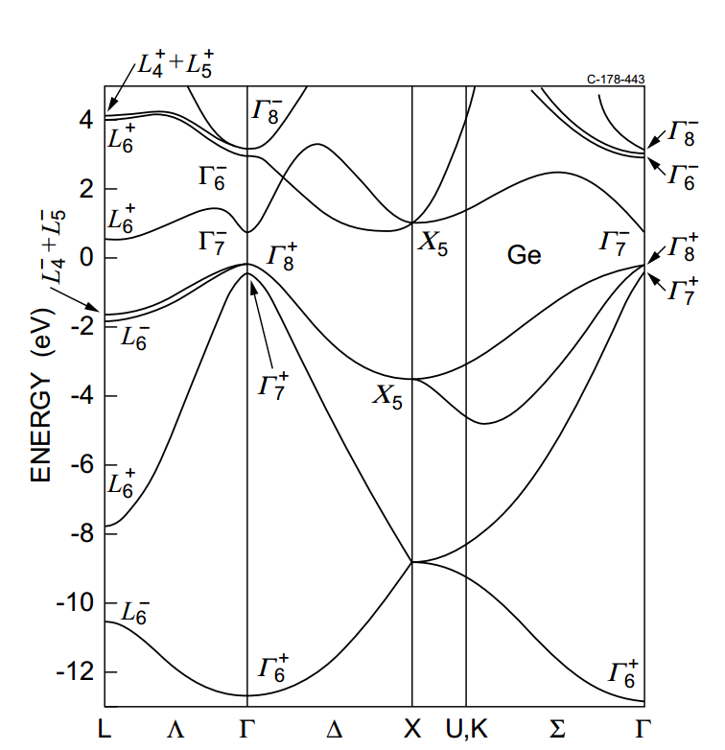
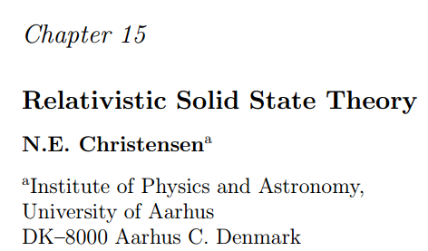
Double group band structure of Ge

Slide 14
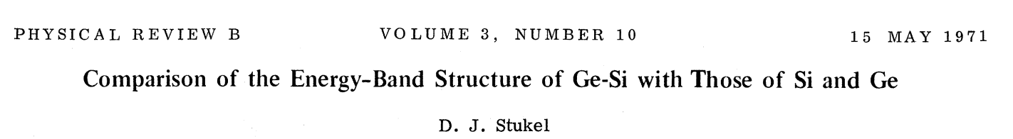
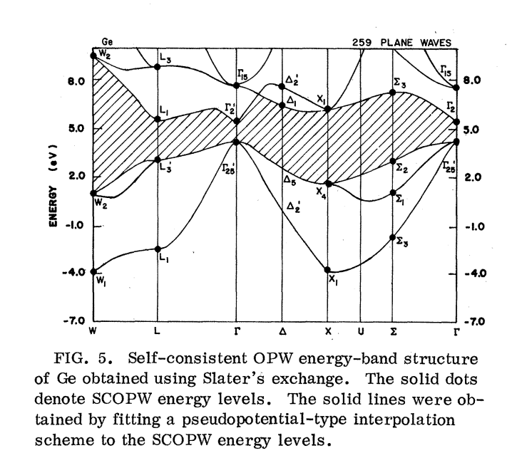

Slide 15
Crystal field splitting of atom in octahedral field

Slide 16
Crystal field splitting of atom in octahedral field

Slide 17
