Slide 1
PHY 745 Group Theory
11-11:50 AM MWF Olin 102
Plan for Lecture 28:
Time reversal symmetry and
Magnetic groups
Chap. 16 in DDJ
  Effects of time reversal symmetry on point groups and space groups
  Effects of magnetic configurations on point groups and space groups
Note: These slides contain materials from an electronic version of the Dresselhaus textbook.

Slide 2


Slide 3

Time reversal symmetry in physics:
-t ⬅➔ t

Slide 4
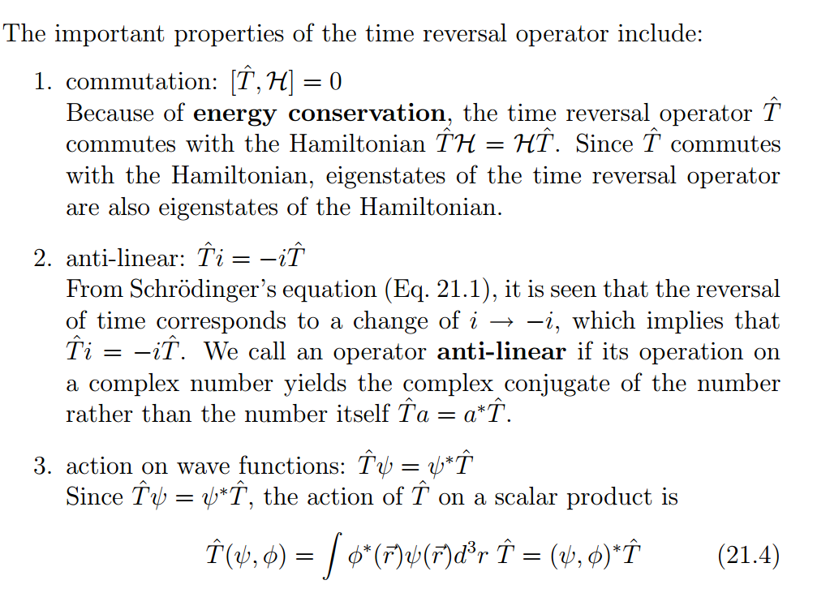
Properties of the time-reversal symmetry

Slide 5
More details
For a wavefunction not involving electron spin
Krammer’s theorem: All energy levels of a system containing an odd number of electrons must be at least doubly degenerate (unless magnetic fields remove the degeneracy.

Slide 6
Effects of time reversal symmetry on point groups
Wigner’s possibilities:
D and D* are equivalent to the same real irreducible representation.
D and D* are inequivalent.
D and D* are equivalent but cannot be made real.

Slide 7
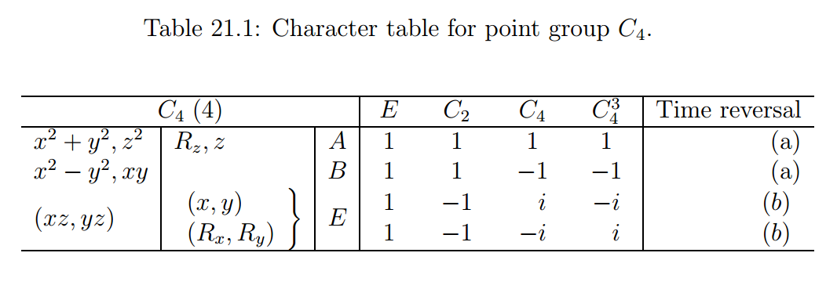
Wigner’s possibilities:
D and D* are equivalent to the same real irreducible representation.
D and D* are inequivalent.
D and D* are equivalent but cannot be made real.
Example:

Slide 8
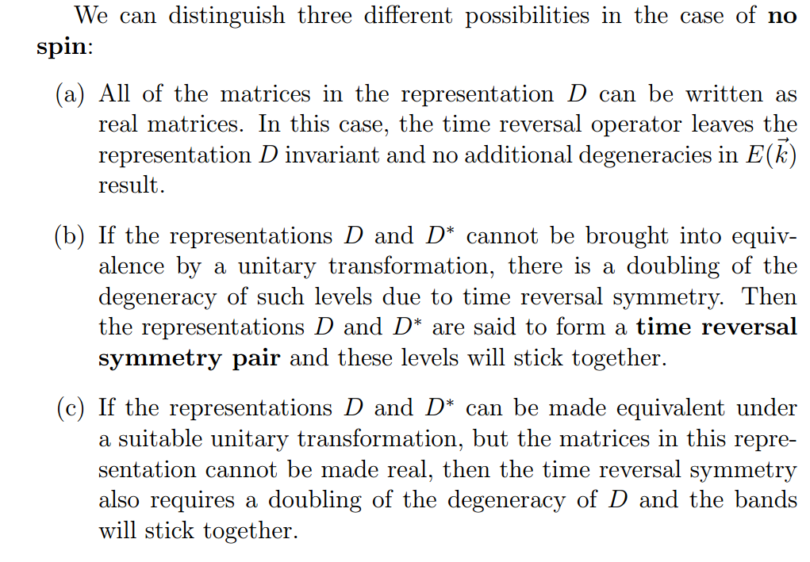
Some details:

Slide 9
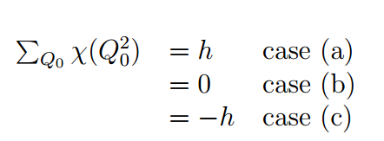
Time reversal symmetry effects on the group of the wavevector
Possibilities according to C. Herring:

Slide 10

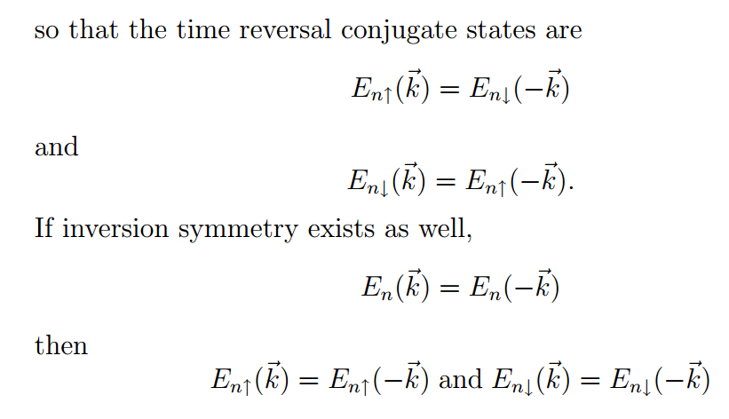
Effects of time reversal symmetry on a Bloch state

Slide 11
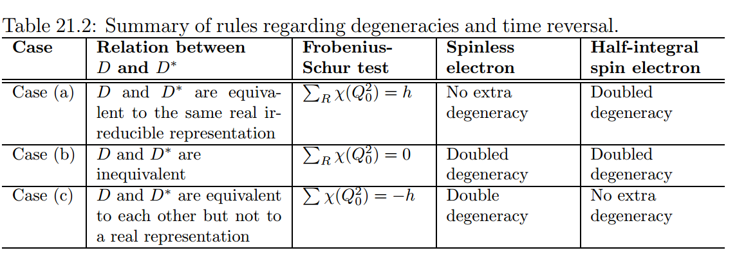

Slide 12
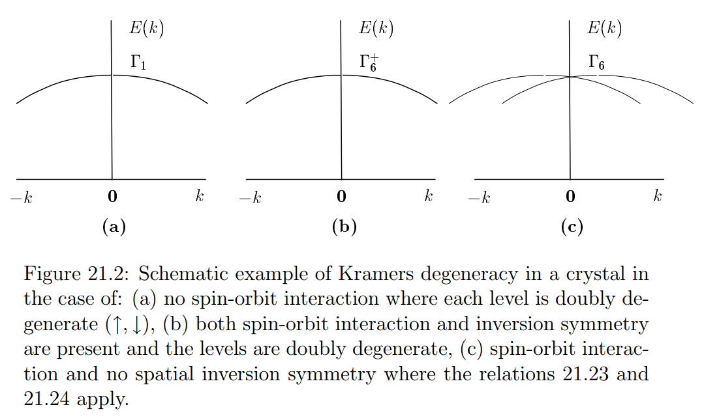
Examples:

Slide 13
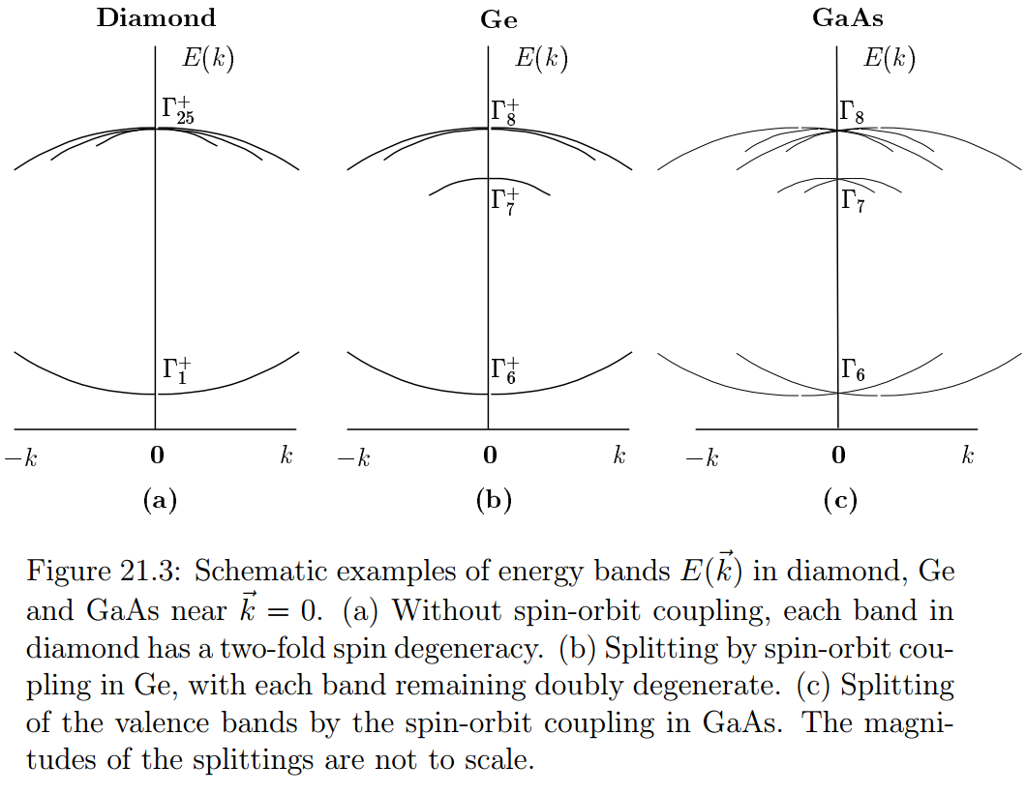
Examples:

Slide 14
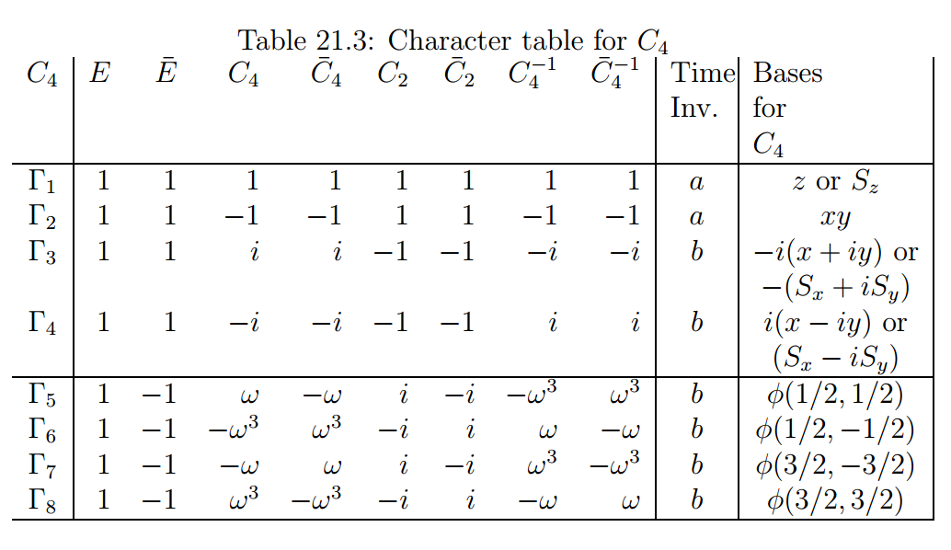

Slide 15
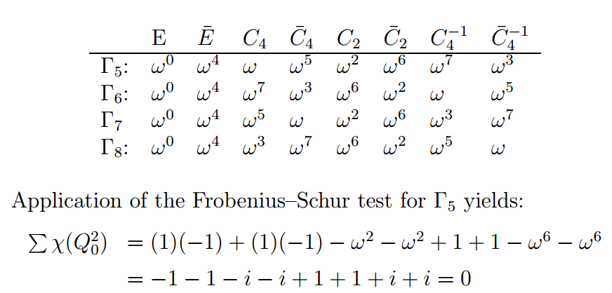
Some details

Slide 16
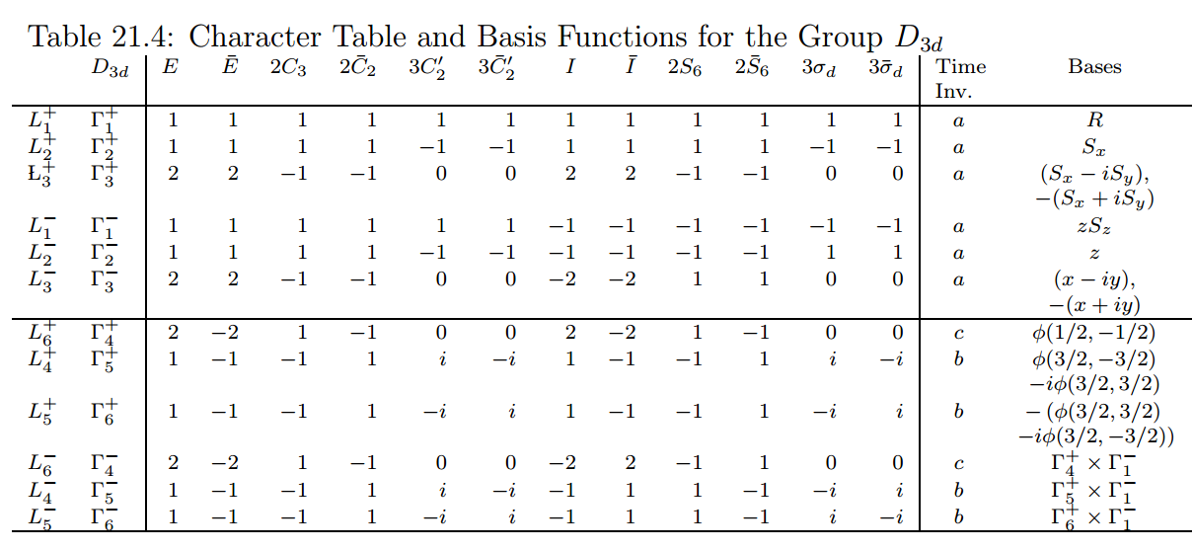

Slide 17
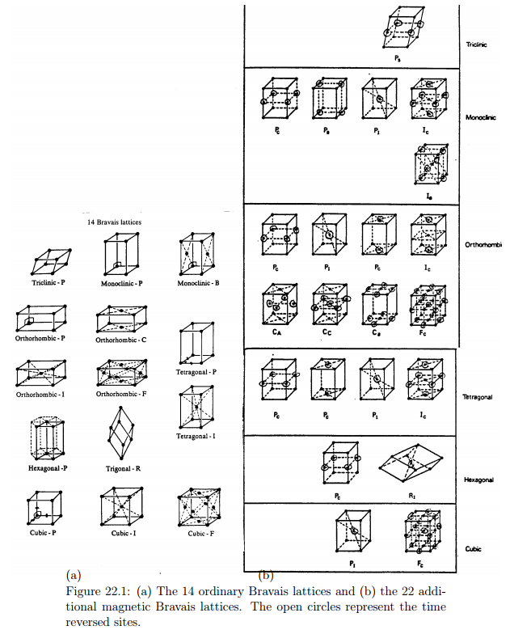
Magnetic space groups

Slide 18
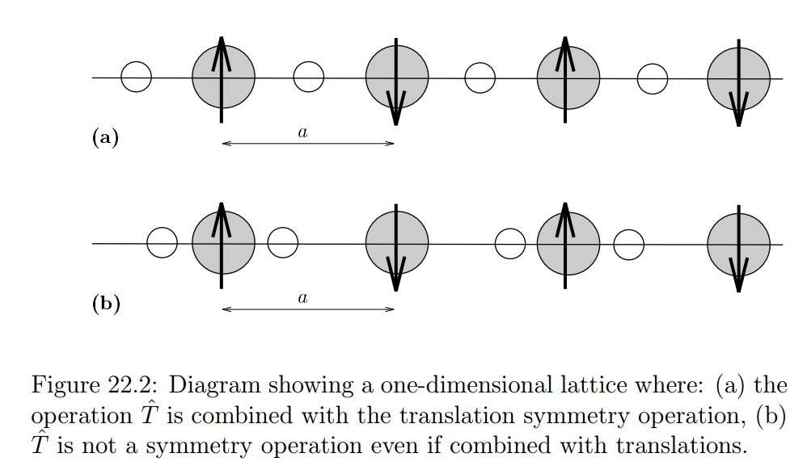
Example

Slide 19
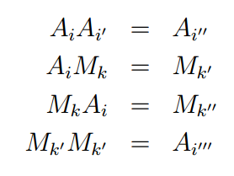

Slide 20
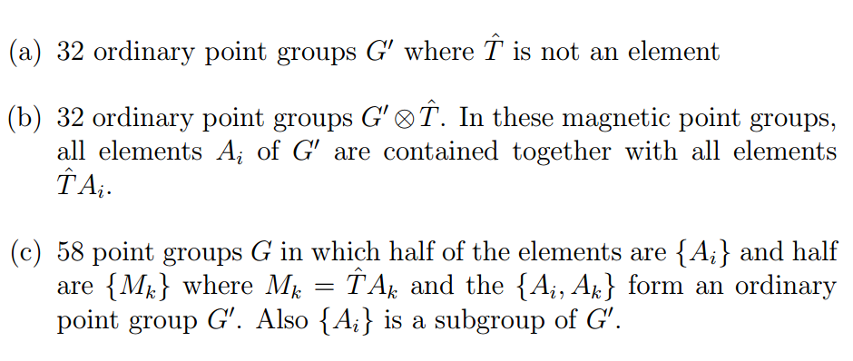
Types of magnetic point groups
total=122

