Slide 1
PHY 745 Group Theory
11-11:50 AM MWF Olin 102
Plan for Lecture 29:
Time reversal symmetry and
Magnetic groups
Chap. 16 in DDJ
Effects of magnetic configurations on point groups and space groups
Examples of magnetic point groups
Note: These slides contain materials from an electronic version of the Dresselhaus textbook.

Slide 2
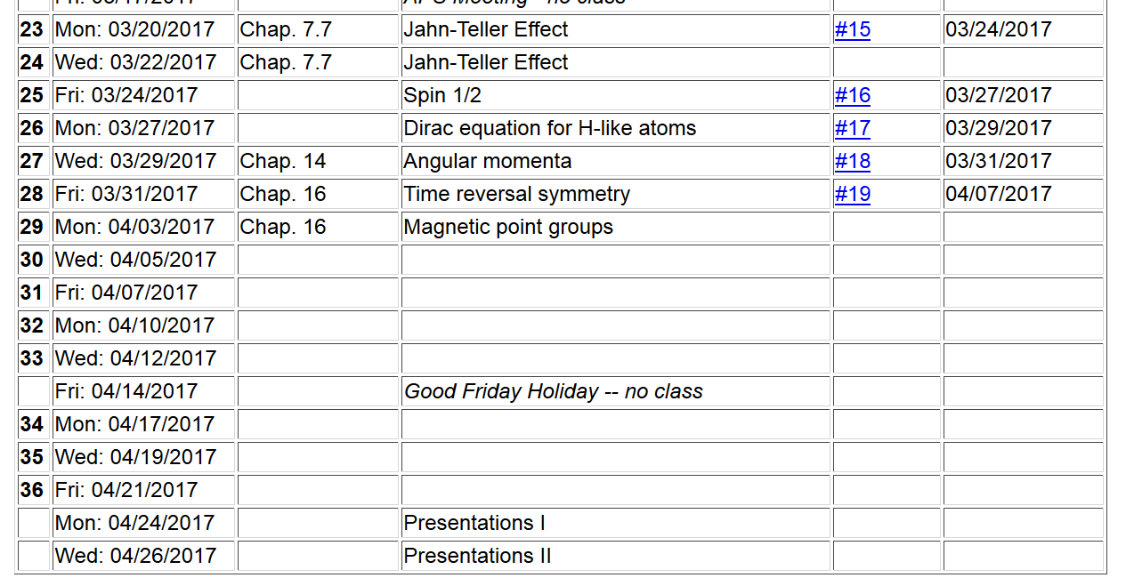
Topic for presentation

Slide 3
Presentation ideas
Digest the content of a literature paper which involves aspects of group theory and present the theory and results.
Find a particular molecule or crystal and analyze its group theoretic aspects
Band structure analysis; find at least 3 special k-points or directions, analyzing their groups and compatibility relationships
Point group analysis, finding selection rules for various transitions between representations
Vibrational mode analysis

Slide 4
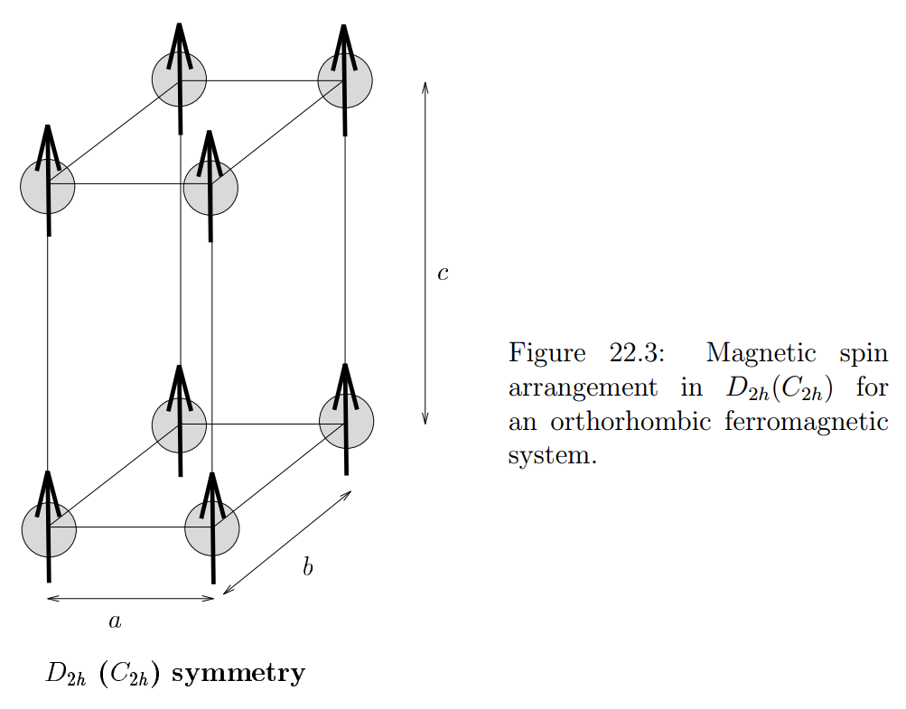
Group theory describing magnetic configurations

Slide 5
When is magnetic ordering important?
What does time reversal symmetry have to do with magnetic configurations?
Time reversal symmetry does not effect charge density
Time reversal symmetry does effect internal spin so that the effects of the T operator on the group operations must be taken into account

Slide 7
Example #1:

Slide 8
Example #2:
(non-magnetic crystal)

Slide 9
Example #2:
(space group)

Slide 11
Example of possibility #3:
C_{2h}(C₂)
C_{2h}(C_{i})
C_{2h}(C_{1h})

Slide 13
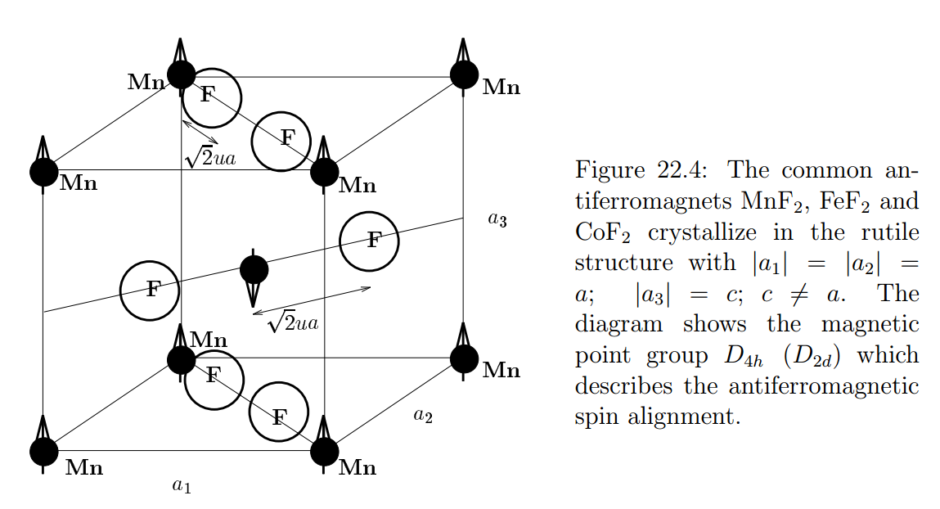
Example of #3

Slide 14
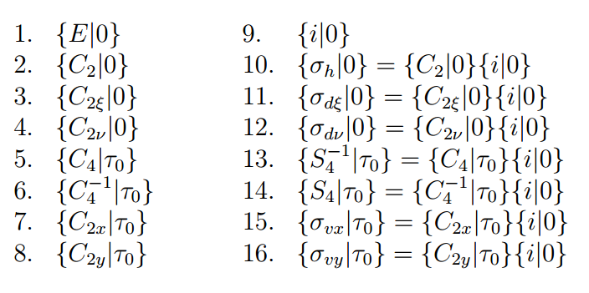
D_{4h}(D_{2h}) -- continued
H
TA_{k}

Slide 15
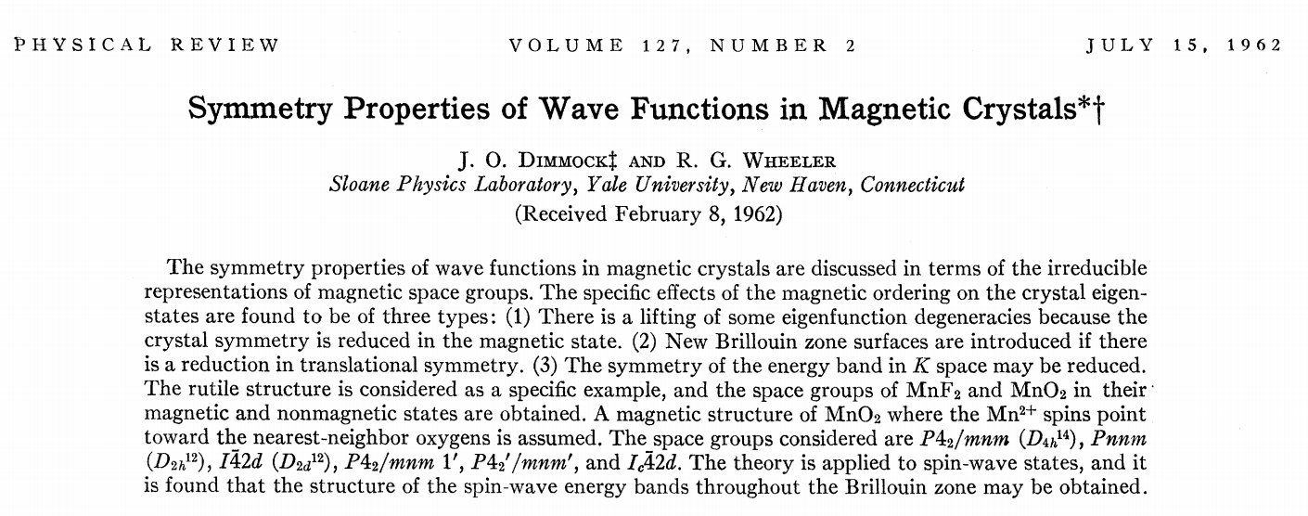
Some character table analysis for magnetic groups

Slide 16
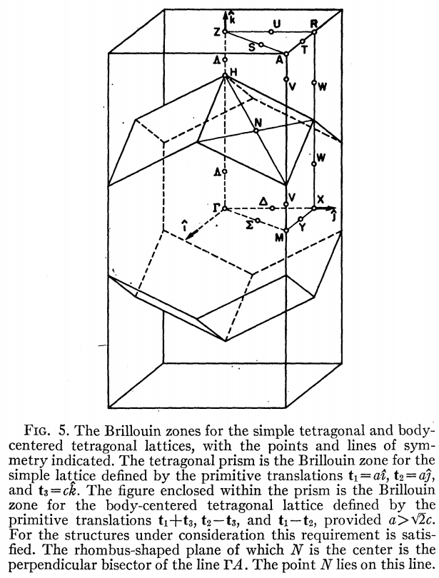

Slide 17
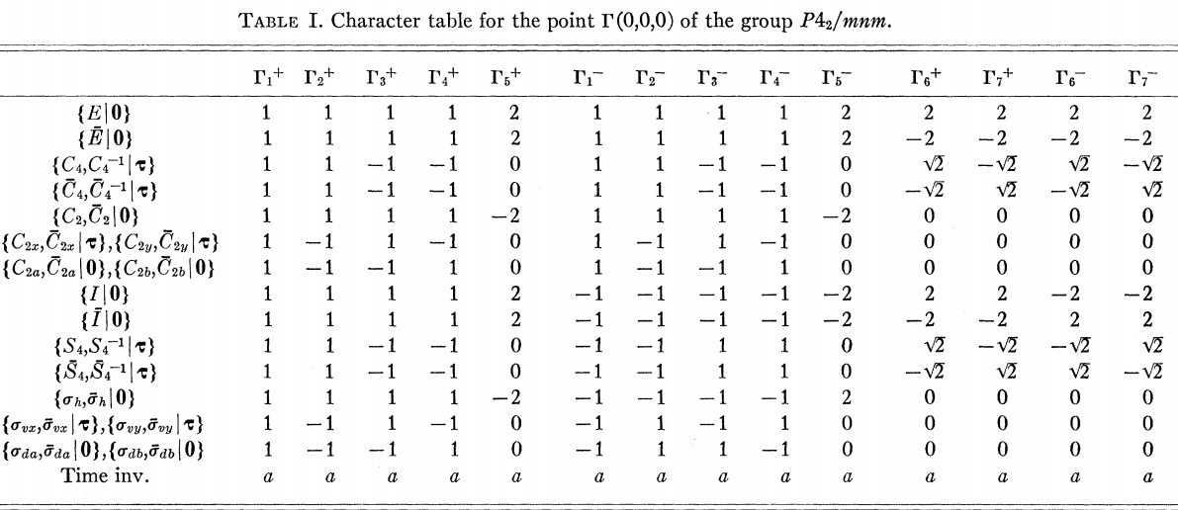

Slide 18
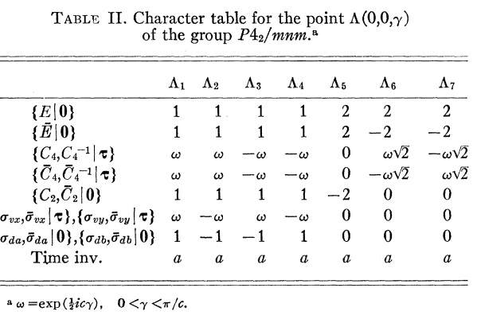
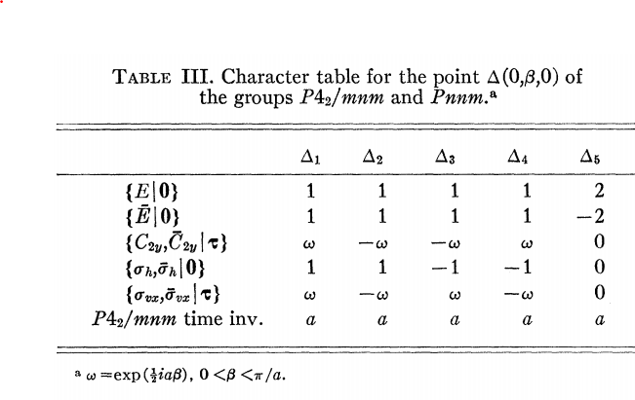

Slide 20
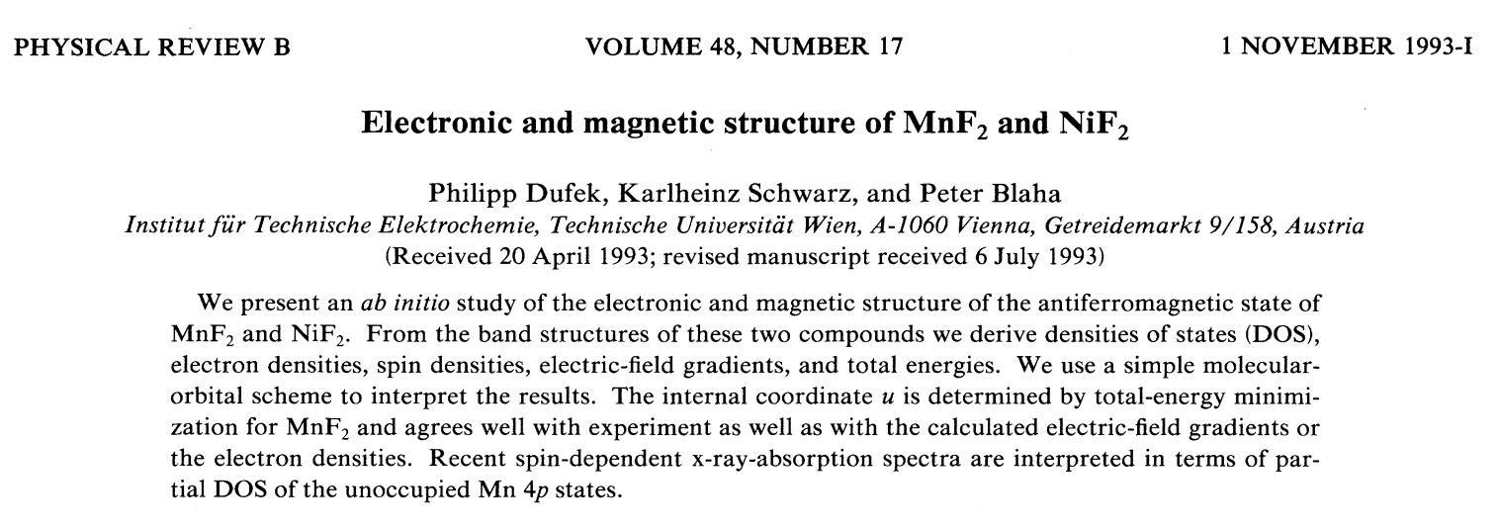
Example: MnF₂ and NiF₂

Slide 21
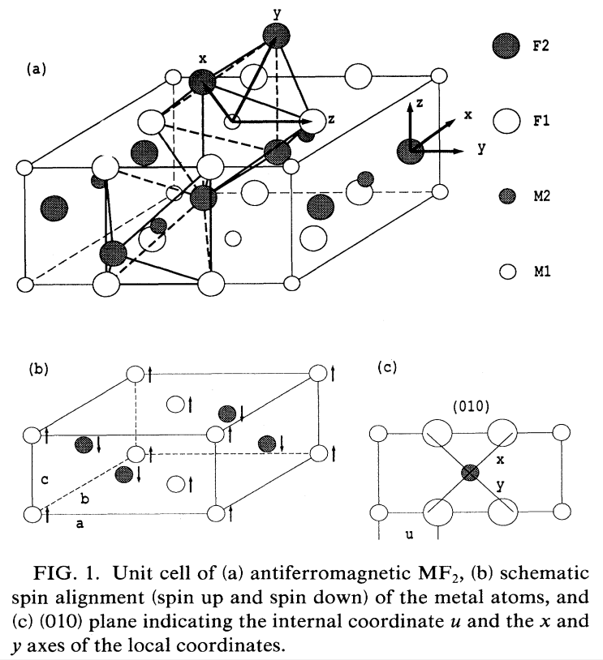

Slide 22
