Slide 1
PHY 745 Group Theory
11-11:50 AM MWF Olin 102
Plan for Lecture 3:
Representation Theory
    Reading: Chapter 2 in DDJ
      Some details of groups and subgroups
      Preparations for proving the “Great Orthgonality Theorem”

Slide 2
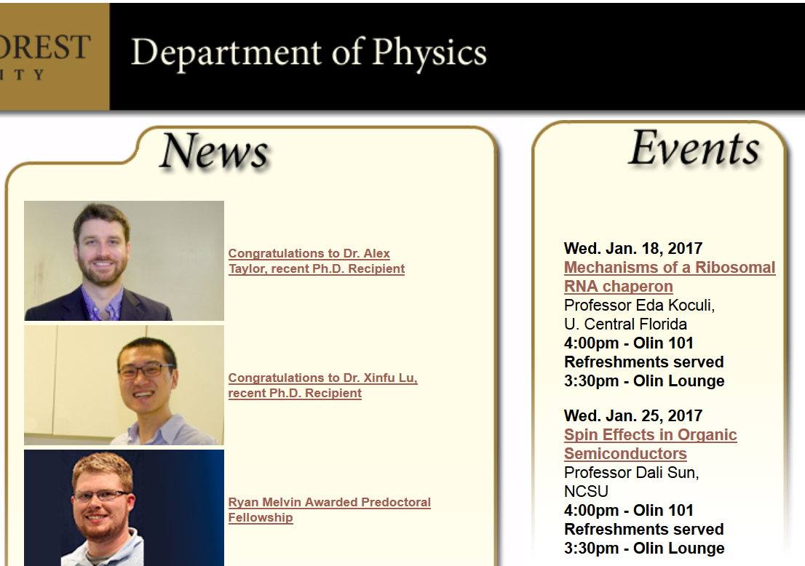

Slide 3
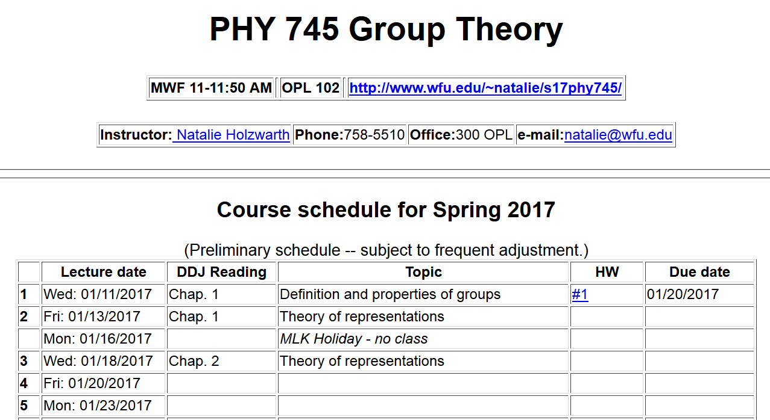

Slide 4
Groups and subgroups
  A subgroup S is composed of elements of a group G which form a group
  A subgroup is called invariant (or normal or self-conjugate) if

Slide 5
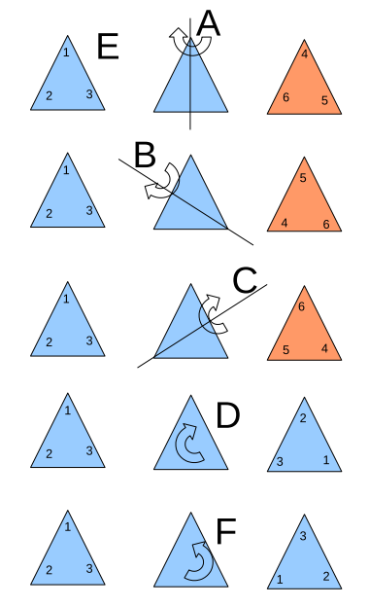
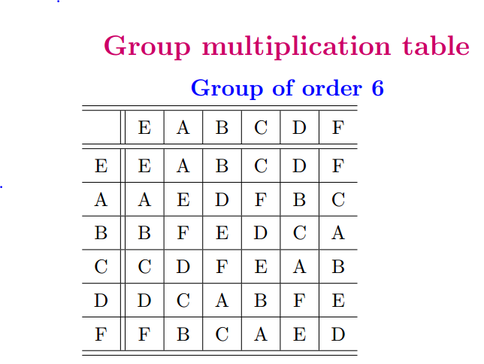
Example of a 6-member group E,A,B,C,D,F,G

Slide 6
Note that this group (called P(3) in your text) can be also described in terms of the permutations:

Slide 7
Invariant subgroup

Slide 8
Groups of groups –
The factor group is constructed with respect to a normal subgroup as the collection of its cosets. The factor group is itself a group. Note that for a normal subgroup, the left and right cosets are the same.
Group properties:

Slide 9
P(3) example:
Factor group
Multiplication table for factor group:

Slide 10
Representations of a group

Slide 11
Example:

Slide 12
The great orthogonality theorem on unitary irreducible representations

Slide 13
Example:

Slide 14
Special types of matrices -- unitary

Slide 15
Special types of matrices -- Hermitian
Here the diagonal elements are real.

Slide 16
Digression: Note that unitary matrices themselves can also be put into diagonal form with a unitary similarity transformation. Last week we had the example:
In this case the diagonal elements have modulus unity.

Slide 17
Proof of the great orthogonality theorem
  Prove that all representations can be unitary matrices
  Prove Schur’s lemma part 1 – any matrix which commutes with all matrices of an irreducible representation must be a constant matrix
  Prove Schur’s lemma part 2
  Put all parts together

Slide 18
Proof of the great orthogonality theorem
  Prove that all representations can be unitary matrices
  Prove Schur’s lemma part 1 – any matrix which commutes with all matrices of an irreducible representation must be a constant matrix
  Prove Schur’s lemma part 2
  Put all parts together

Slide 19
  Prove that all representations can be unitary matrices

Slide 20
Summation over all elements of group

Slide 21
Note that all elements of the diagonal matrix d are real and positive.

Slide 23
  Proved that all representations can be unitary matrices
Consider our example:

