Slide 1
PHY 745 Group Theory
11-11:50 AM MWF Olin 102
Plan for Lecture 30:
Topological analysis of band structures and their relationships to group theory
Hasan and Kane, RMP 82, 3045-3067 (2010)
  What is the notion of topological order
  Examples

Slide 2
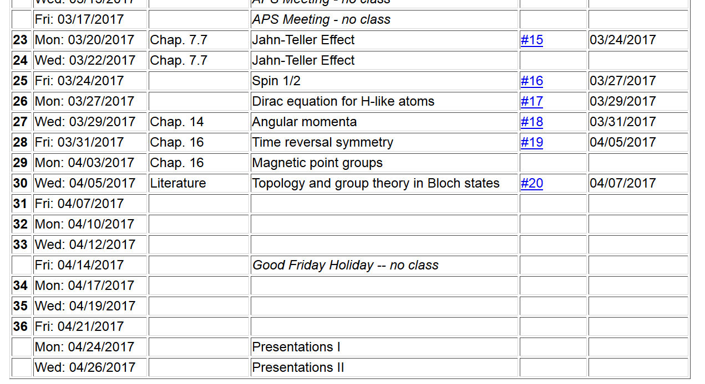
Topic for presentation

Slide 3
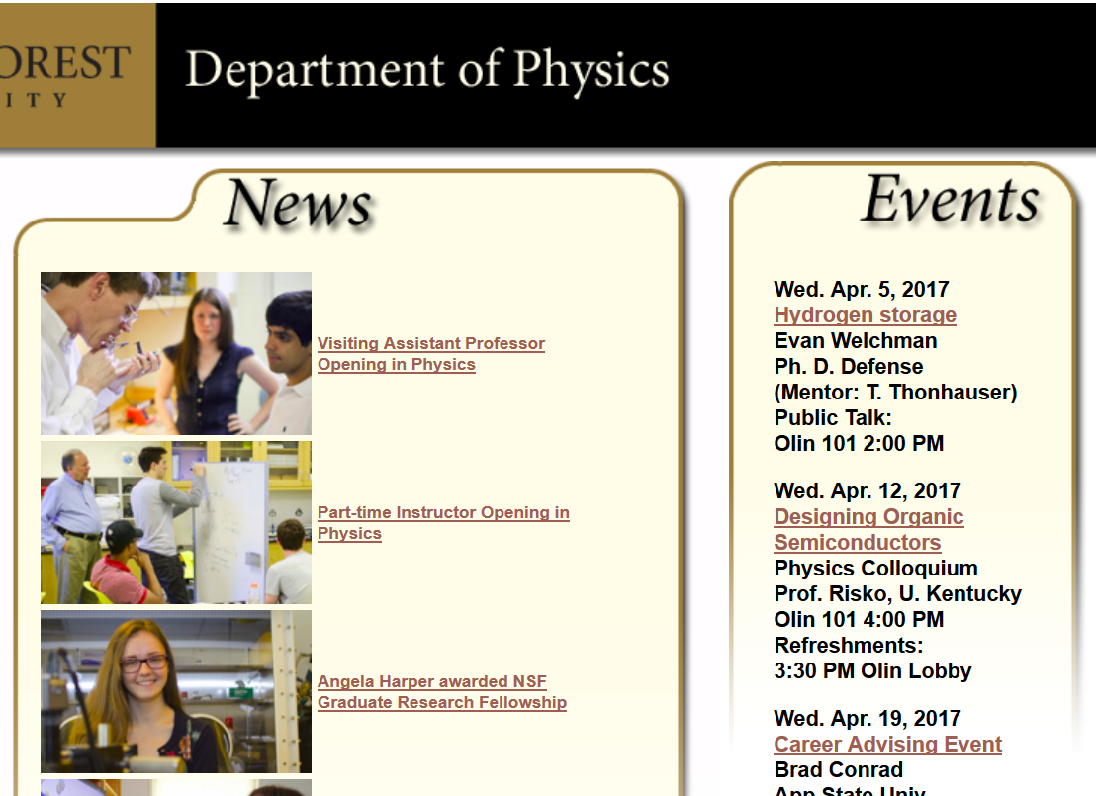

Slide 4

pgs. 3045-3067

Slide 5
Topology is a mathematical term concerned with the properties of space that are preserved under continuous deformations.

Slide 6
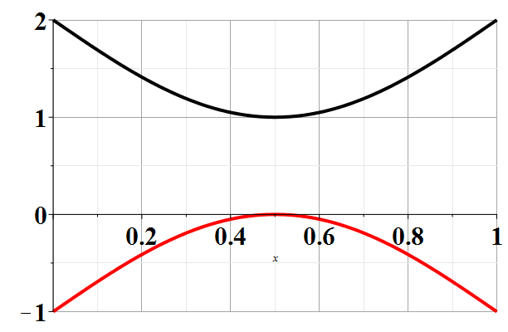
Typical band structure of an insulator
E_{F}

Slide 7
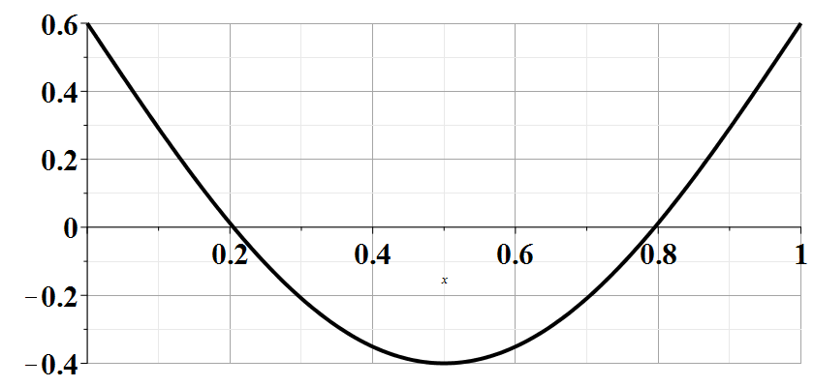
Typical band structure of a metal

Slide 8
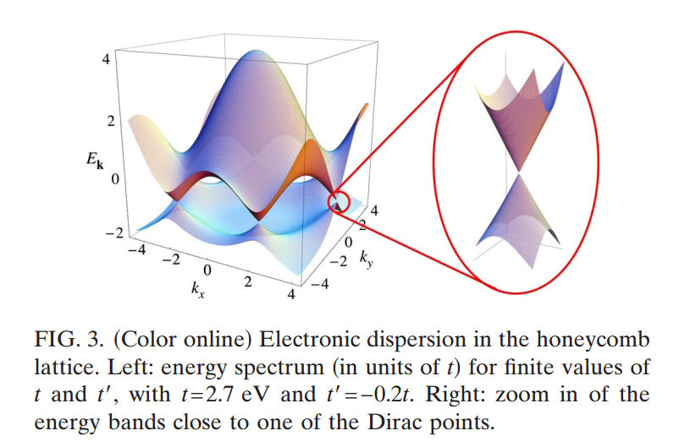
Much more exciting band structure -- graphene --
From: Castro Neto et al. Rev. Mod. Phys. 81 109-162 (2009)

Slide 9
Digression – what happens when electrons confined to two dimensions are placed in a magnetic field?

Slide 10
Spectrum
B=0
B>0
E
n=3
n=2
n=1
n=0

Slide 11
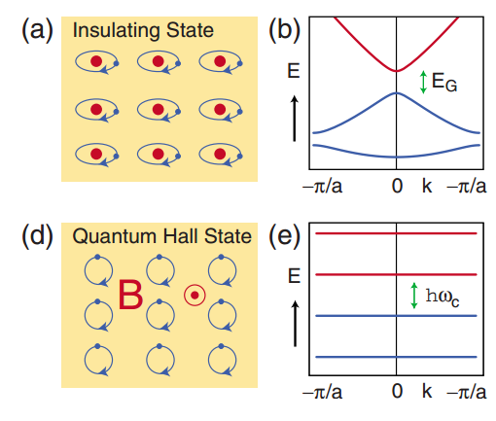
Topological similarity of insulator and 2-dimensional Landau-level (quantum Hall) system

Slide 12
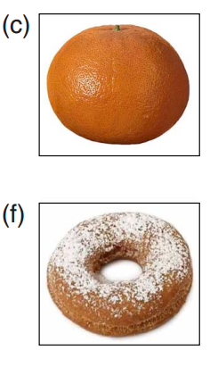
Weird sense of humor
These two donuts illustrate two different topologies

Slide 13

From Nature 464, 194-198 (2010)

Slide 14
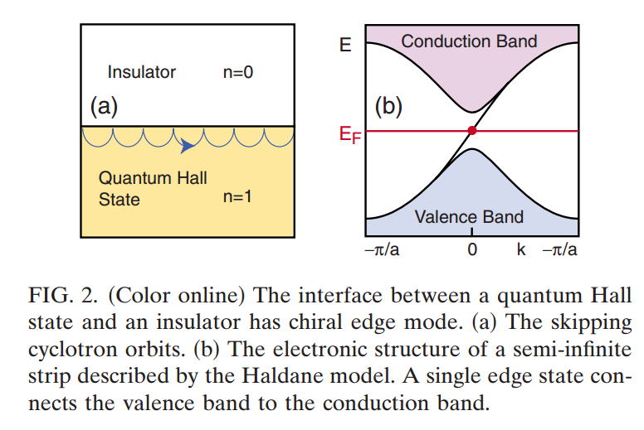
Examples of these surface states

Slide 15
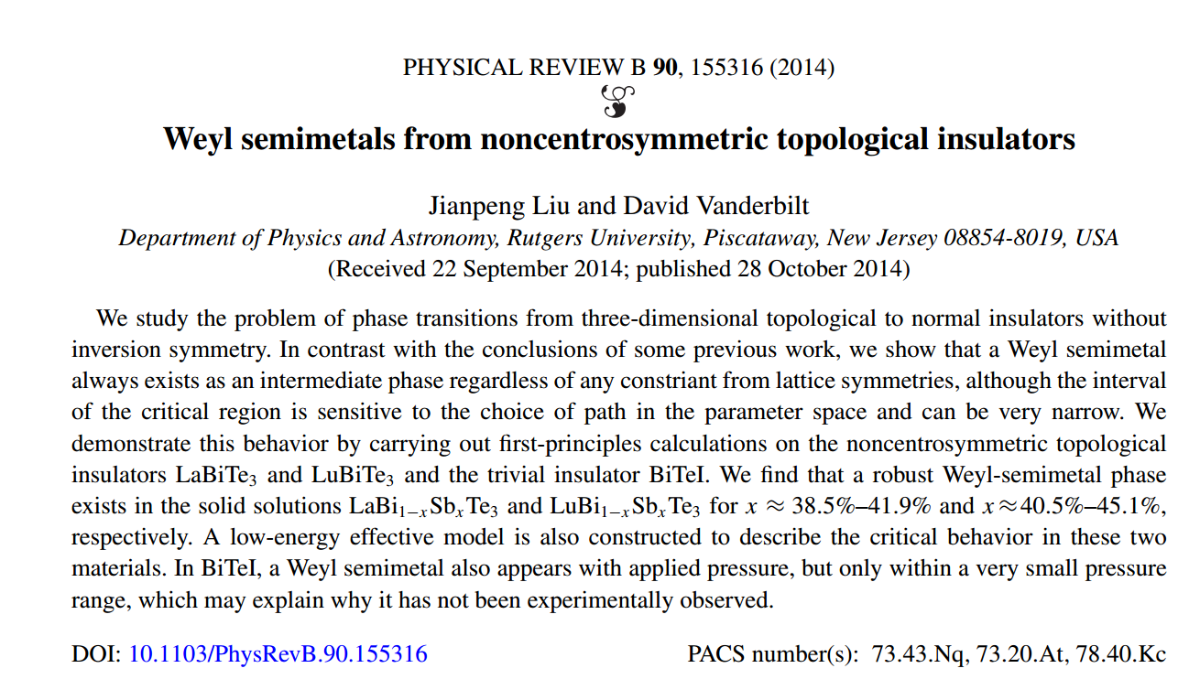
Productive strategy for studying these effects
Model Hamiltonian
⬅➔
First principles calculations

Slide 16
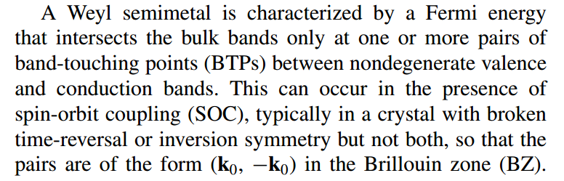

Slide 17

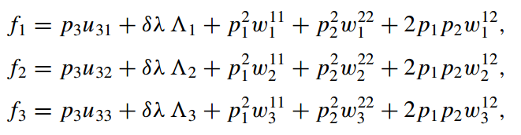
Model Hamiltonian
Many assumptions → quadratic model in region of interest

Slide 18
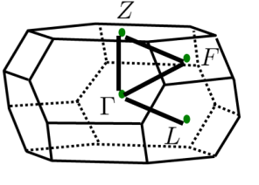
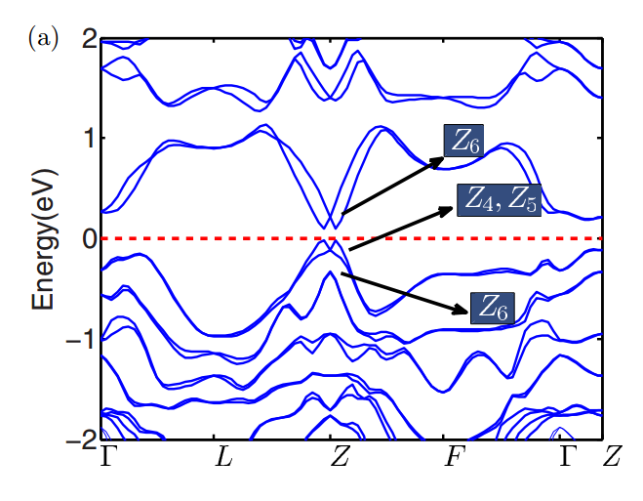
Band structure of LaBiTe₃

Slide 19
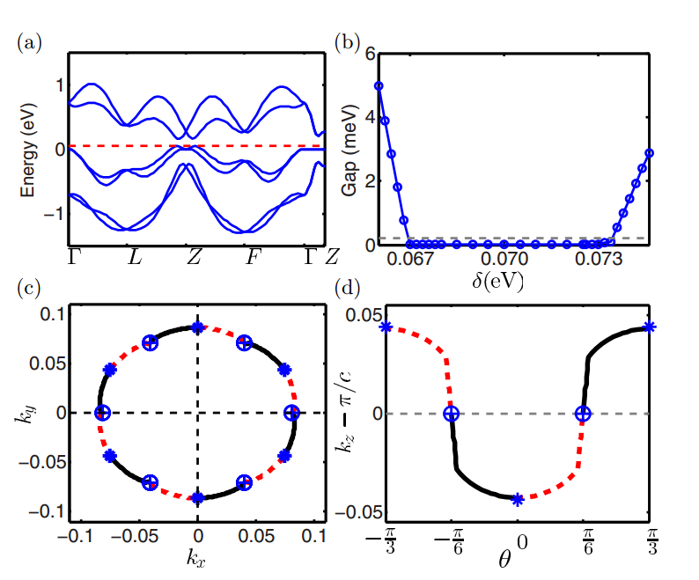
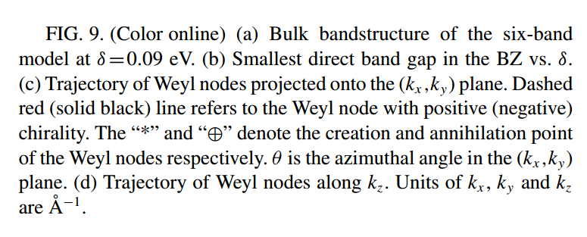

Slide 20

Additional review articles --
pgs. 1057-1110

