Slide 1
PHY 745 Group Theory
11-11:50 AM MWF Olin 102
Plan for Lecture 31:
Introduction to linear Lie groups
  Definitions
  Properties
  Examples
  Ref. J. F. Cornwell, Group Theory in Physics, Vol I and II, Academic Press (1984)

Slide 2
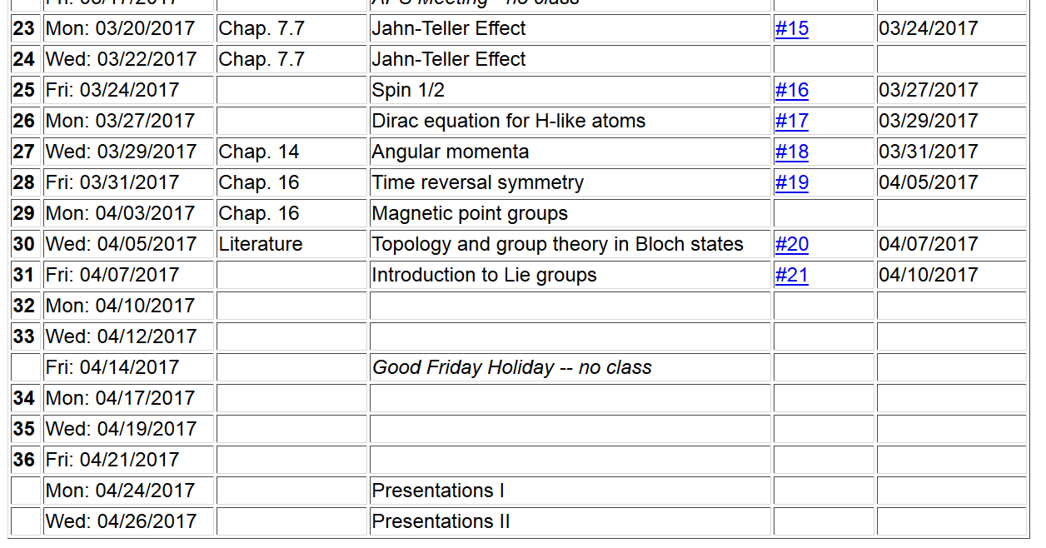

Slide 3
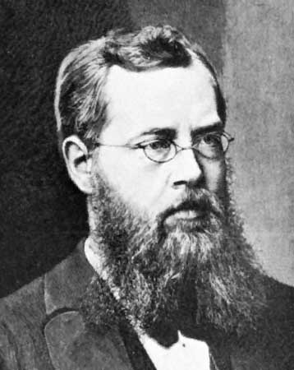
Sophus Lie
1842-1899
Norweigian mathematician
https://www.britannica.com/biography/Sophus-Lie

Slide 4
Definition of a linear Lie group
  A linear Lie group is a group
    Each element of the group T forms a member of the group T’’ when “multiplied” by another member of the group T”=T·T’
    One of the elements of the group is the identity E
    For each element of the group T, there is a group member a group member T⁻¹ such that T·T⁻¹=E.
    Associative property: T·(T’·T’’)= (T·T’)·T’’
  Elements of group form a “topological space”
  Elements also constitute an “analytic manifold”
  ➔Non countable number elements lying in a region “near” its identity

Slide 5
Definition: Linear Lie group of dimension n
  A group G is a linear Lie group of dimension n if it satisfied the following four conditions:
  G must have at least one faithful finite-dimensional represention Γ which defines the notion of distance.

Slide 6
Definition: Linear Lie group of dimension n -- continued
  Consider the distance between group elements T with respect to the identity E -- d(T,E). It is possible to define a sphere M_{δ} that constains all elements T’

Slide 7
Definition: Linear Lie group of dimension n -- continued
  There must exist
There is a requirement that the corresponding representation is analytic

Slide 11
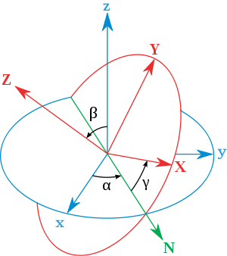
General transformation between rotated coordinates – Euler angles
inertial
body
x
y
y
x
http://en.wikipedia.org/wiki/Euler_angles

Slide 12
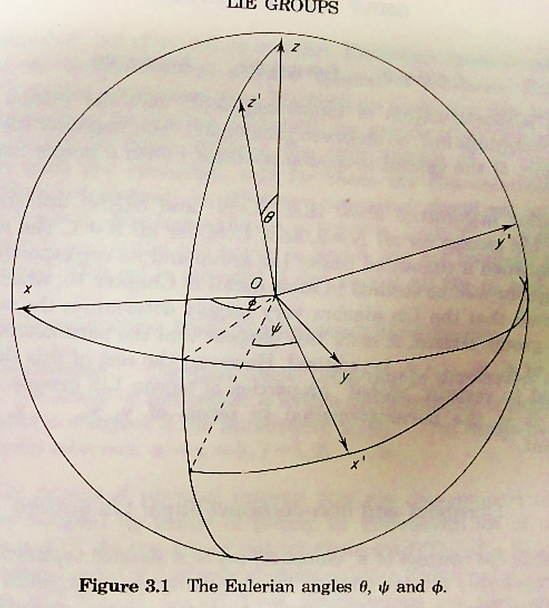

Slide 13
Homomorphic mapping of SU(2) onto SO(3)

Slide 14
Recall:

