Slide 1
PHY 745 Group Theory
11-11:50 AM MWF Olin 102
Plan for Lecture 32:
Introduction to linear Lie groups
  Notion of linear Lie group
  Notion of corresponding Lie algebra
  Examples
  Ref. J. F. Cornwell, Group Theory in Physics, Vol I and II, Academic Press (1984)

Slide 2
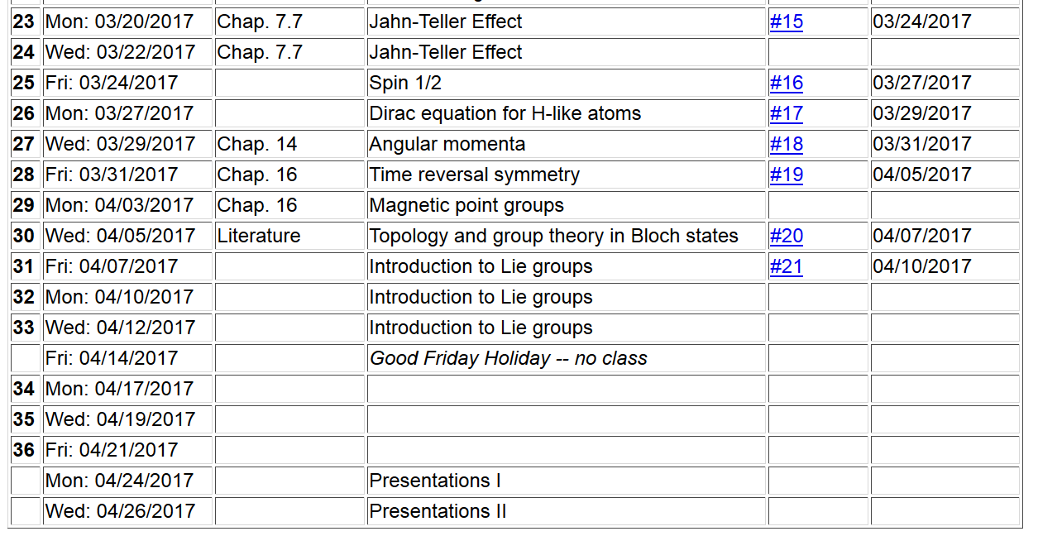

Slide 3
Definition of a linear Lie group
  A linear Lie group is a group
    Each element of the group T forms a member of the group T’’ when “multiplied” by another member of the group T”=T·T’
    One of the elements of the group is the identity E
    For each element of the group T, there is a group member a group member T⁻¹ such that T·T⁻¹=E.
    Associative property: T·(T’·T’’)= (T·T’)·T’’
  Elements of group form a “topological space”
  Elements also constitute an “analytic manifold”
  ➔Non countable number elements lying in a region “near” its identity

Slide 4
Definition: Linear Lie group of dimension n
  A group G is a linear Lie group of dimension n if it satisfied the following four conditions:
  G must have at least one faithful finite-dimensional representation Γ which defines the notion of distance.

Slide 5
Definition: Linear Lie group of dimension n -- continued
  Consider the distance between group elements T with respect to the identity E -- d(T,E). It is possible to define a sphere M_{δ} that contains all elements T’

Slide 6
Definition: Linear Lie group of dimension n -- continued
  There must exist
There is a requirement that the corresponding representation is analytic

Slide 9
Some more details
There is a requirement that the corresponding representation is analytic

Slide 11
It can be shown that the matrices a_{p} form the basis for an n-dimensional vector space.

Slide 12
Correspondence between a linear Lie group and its corresponding Lie algebra
Some theorems

Slide 13
Note that the last result is attributed to Campbell-Baker-Hausdorff formula.

Slide 16
Fundamental theorem –
For every linear Lie group there exisits a corresponding real Lie algebra of the same dimension. For example if the linear Lie group has dimension n and has mxm matrices a_{1,} a₂,….a_{n} then these matrices form a basis for the real Lie algebra.

