Slide 1
PHY 745 Group Theory
11-11:50 AM MWF Olin 102
Plan for Lecture 33:
Introduction to linear Lie groups -- continued
  Linear Lie group and real Lie algebra
  Fundamental theorem
  Examples
  Ref. J. F. Cornwell, Group Theory in Physics, Vol I and II, Academic Press (1984)

Slide 2
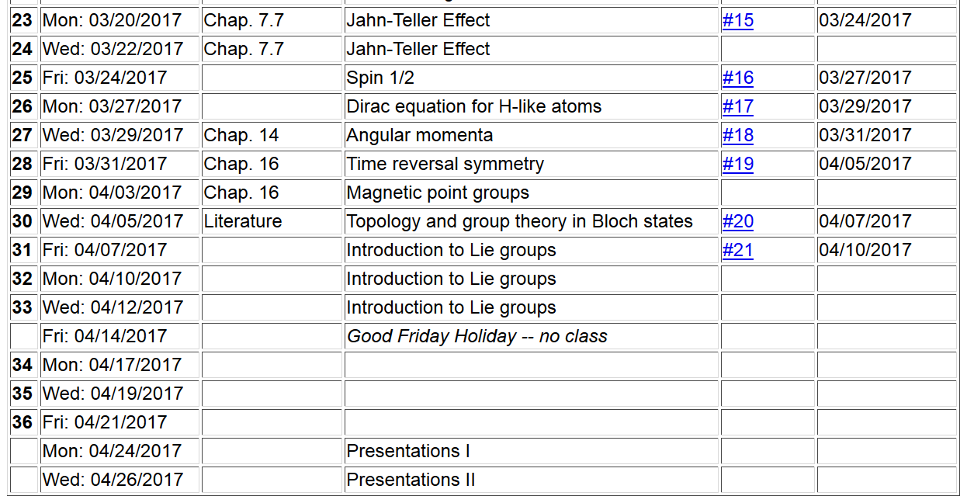

Slide 3
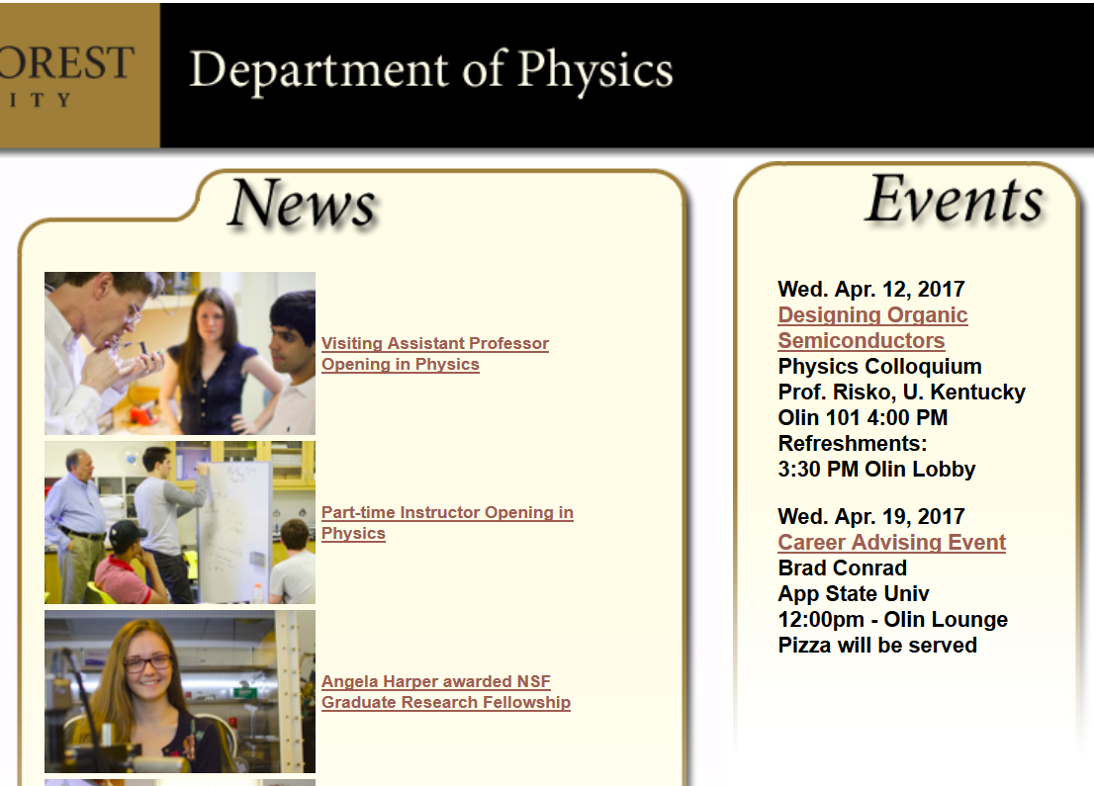

Slide 4
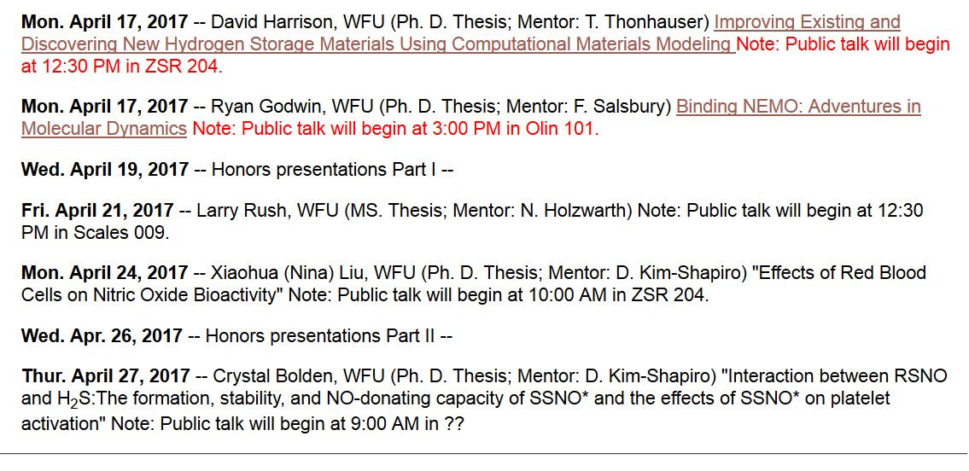

Slide 5
Definition of a linear Lie group
  A linear Lie group is a group
    Each element of the group T forms a member of the group T’’ when “multiplied” by another member of the group T”=T·T’
    One of the elements of the group is the identity E
    For each element of the group T, there is a group member a group member T⁻¹ such that T·T⁻¹=E.
    Associative property: T·(T’·T’’)= (T·T’)·T’’
  Elements of group form a “topological space”
  Elements also constitute an “analytic manifold”
  ➔Non countable number elements lying in a region “near” its identity

Slide 6
Definition: Linear Lie group of dimension n
  A group G is a linear Lie group of dimension n if it satisfied the following four conditions:
  G must have at least one faithful finite-dimensional representation Γ which defines the notion of distance.

Slide 7
Definition: Linear Lie group of dimension n -- continued
  Consider the distance between group elements T with respect to the identity E -- d(T,E). It is possible to define a sphere M_{δ} that contains all elements T’

Slide 8
Definition: Linear Lie group of dimension n -- continued
  There must exist
There is a requirement that the corresponding representation is analytic

Slide 9
Some more details
There is a requirement that the corresponding representation is analytic

Slide 12
Fundamental theorem –
For every linear Lie group there exisits a corresponding real Lie algebra of the same dimension. For example if the linear Lie group has dimension n and has mxm matrices a_{1,} a₂,….a_{n} then these matrices form a basis for the real Lie algebra.

Slide 13
One-parameter subgroup of a linear Lie group

Slide 15
Correspondence between each linear Lie group G and a real Lie algebra L Simplify the consideration to G consisting of mxm matrices T=A and Γ(T)=A.

Slide 18
Converse to fundamental theorem: Every real Lie algebra is isomorphic to the real Lie algebra of some linear Lie group.

Slide 19
Example: SO(3)

