Slide 1
PHY 745 Group Theory
11-11:50 AM MWF Olin 102
Plan for Lecture 34:
Introduction to linear Lie groups
Definitions and properties
Comparison with finite groups
Usefulness for physics and mathematics
Ref. J. F. Cornwell, Group Theory in Physics, Vol I and II, Academic Press (1984)
Robert Gilmore, Lie Groups, Physics, and Geometry, Cambridge U. Press (2008)

Slide 2
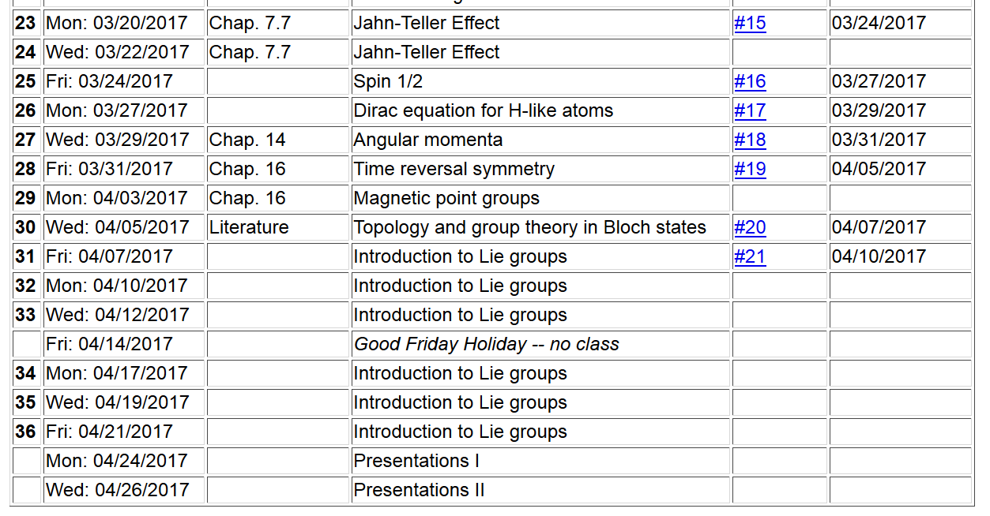

Slide 4
Some comments from Gilmore text:
Marius Sophus Lie (1842-1899) had the vision to use group theory to solve, analyze, simplify differential equations by exploring relationships between symmetry and group theory and related algebraic and geometric structures. His worked followed that of Evariste Galois (1811-1832).

Slide 5
Definition of a linear Lie group
A linear Lie group is a group
Each element of the group T forms a member of the group T’’ when “multiplied” by another member of the group T”=T·T’
One of the elements of the group is the identity E
For each element of the group T, there is a group member a group member T⁻¹ such that T·T⁻¹=E.
Associative property: T·(T’·T’’)= (T·T’)·T’’
Elements of group form a “topological space”
Elements also constitute an “analytic manifold”
➔Non countable number elements lying in a region “near” its identity

Slide 6
Definition: Linear Lie group of dimension n
A group G is a linear Lie group of dimension n if it satisfied the following four conditions:
G must have at least one faithful finite-dimensional representation Γ which defines the notion of distance.

Slide 7
Definition: Linear Lie group of dimension n -- continued
Consider the distance between group elements T with respect to the identity E -- d(T,E). It is possible to define a sphere M_{δ} that contains all elements T’

Slide 8
Definition: Linear Lie group of dimension n -- continued
There must exist
There is a requirement that the corresponding representation is analytic

Slide 9
Some more details
There is a requirement that the corresponding representation is analytic

Slide 11
Generalizations for the notion of distance – choice of “metric”. Here we have chosen the Hilbert-Schmidt metric:

Slide 12
Relationships of finite groups to continuous group – notions of “connectedness”

Slide 14
➔ subgroup

Slide 15
A linear Lie group is said to be “connected” if it possesses only one connected component.

Slide 17
With the notion of a compact linear Lie groups, we can relate their properties, such as the great orthogonality theorem, to those of finite groups.

Slide 19
Other examples –

