Slide 1
PHY 745 Group Theory
11-11:50 AM MWF Olin 102
Plan for Lecture 35:
Introduction to linear Lie groups
Examples – SO(3) and SU(2)
  General properties
  Class structures
  Representations
  Direct products; Clebsch-Gordan coefficients
  Examples
  Ref. J. F. Cornwell, Group Theory in Physics, Vol I and II, Academic Press (1984)

Slide 2
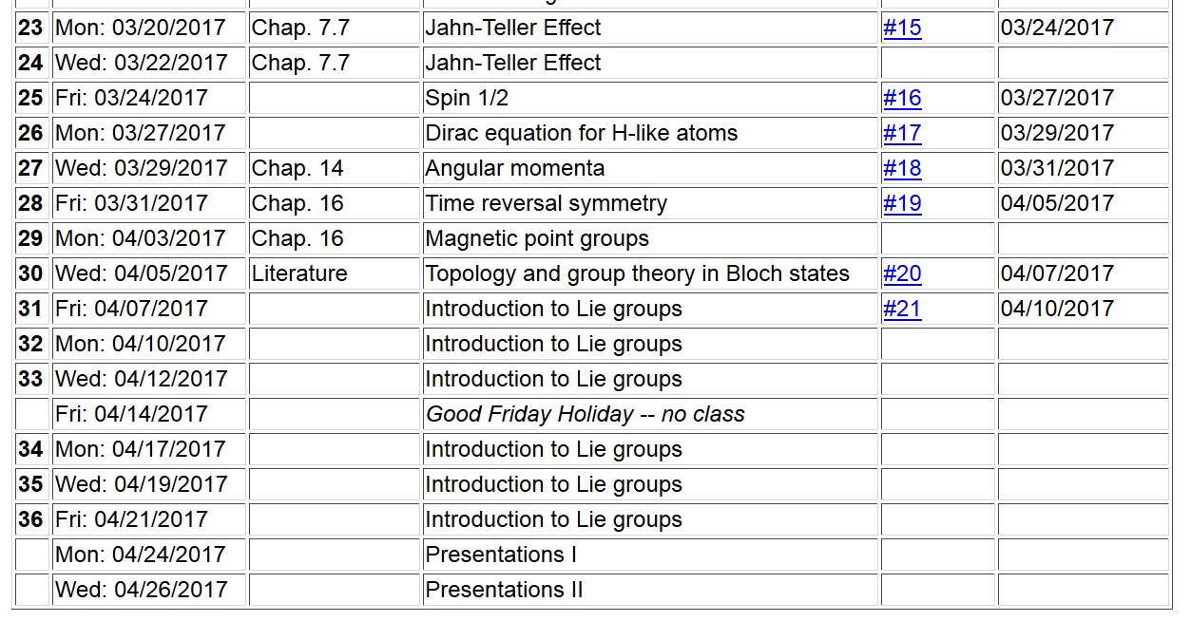

Slide 3
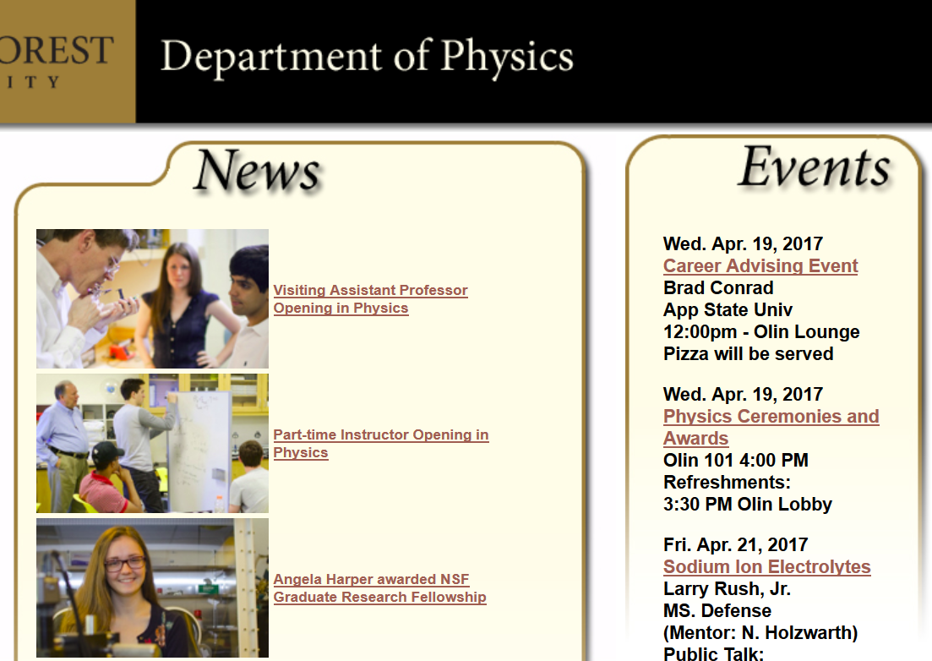

Slide 4
SO(3) – all continuous linear transformations in 3-dimensional space which preserve the length of coordinate vectors --
SU(2) – all 2x2 unitary matrices
z
ω
y
x

Slide 5
z
V
V’
ω
y
x

Slide 6
z
V
V’
ω
y
x

Slide 7
Class structure of these groups

Slide 8
“Generators” of the groups

Slide 9
Irreducible representations of SO(3) and SU(2)
-- focusing on SU(2)
In order to determine irreducible representations of SU(2), determine eigenstates associated with generators.

Slide 10
Eigenfunctions associated with generator functions of SU(2)

Slide 11
Eigenfunctions associated with generator functions of SU(2)

Slide 12
Eigenfunctions associated with generator functions of SU(2)

Slide 14
Eigenfunctions associated with generator functions of SO(3)

Slide 16
Consistent with representation derived from SU(2) analysis:

