Slide 1
PHY 745 Group Theory
11-11:50 AM MWF Olin 102
Plan for Lecture 36:
Summary of what we learned about linear Lie groups, especially SO(3) and SU(2), their direct products and Clebsch-Gordan coefficients
Review of topics in Group Theory
Course evaluation
Ref. J. F. Cornwell, Group Theory in Physics, Vol I and II, Academic Press (1984)

Slide 2
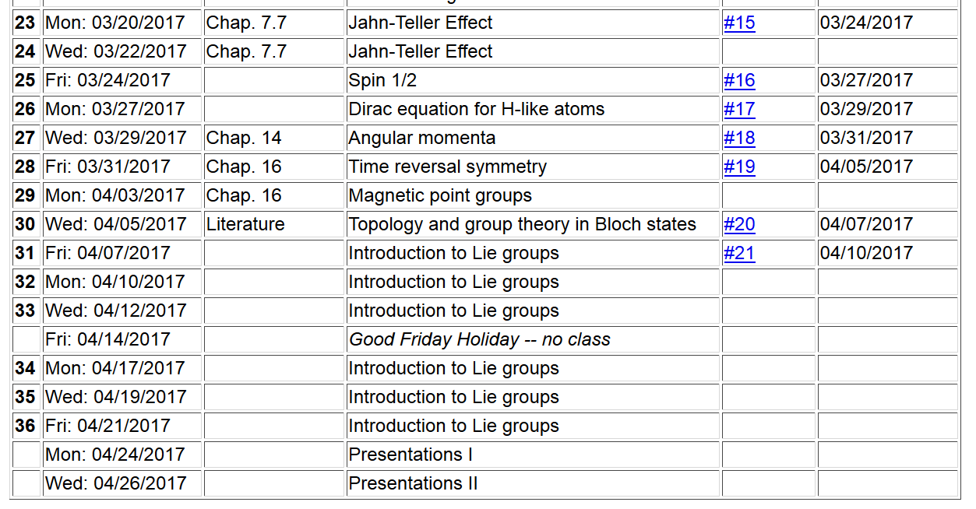
Jason and Ahmad
Taylor

Slide 4
SO(3) – all continuous linear transformations in 3-dimensional space which preserve the length of coordinate vectors --
SU(2) – all 2x2 unitary matrices
z
ω
y
x

Slide 5
z
V
V’
ω
y
x

Slide 6
z
V
V’
ω
y
x

Slide 7
Class structure of these groups

Slide 8
“Generators” of the groups

Slide 9
Irreducible representations of SO(3) and SU(2)
-- focusing on SU(2)
In order to determine irreducible representations of SU(2), determine eigenstates associated with generators.

Slide 10
Eigenfunctions associated with generator functions of SU(2)

Slide 11
Eigenfunctions associated with generator functions of SU(2)

Slide 12
Eigenfunctions associated with generator functions of SU(2)

Slide 13
Comment of analogous equations for SO(3) --
Eigenfunctions associated with generator functions of SO(3)

Slide 15
However, in this case A₃ is not diagonal; using a similarity transformation:

Slide 16
Direct product of irreducible representations

Slide 17
For example: j₁=1/2 and j₂=1/2
Review --

Slide 18
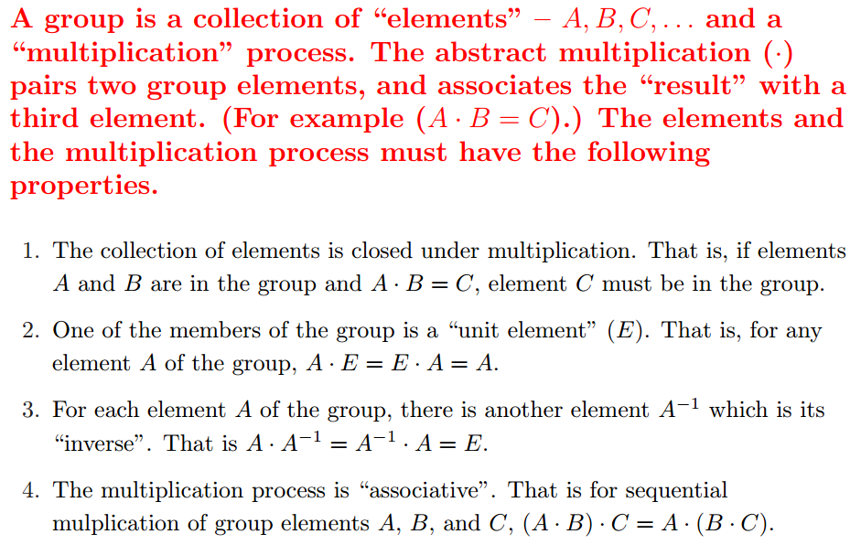
Group theory
An abstract algebraic construction in mathematics
Definition of a group:

Slide 19
Definition:
Definition:
A class is composed of members of a group which are generated by the conjugate construction:

Slide 20
The great orthogonality theorem

Slide 22
Some further conclusions:
The characters χ^{i} behave as a vector space with the dimension equal to the number of classes.
➔The number of characters=the number of classes

Slide 23
Example of character table for D₃
“Standard” notation for representations of D₃

Slide 24
Extension of group notions to continuous groups
Introduced notion of mapping group members to finite number of continuous parameters
Introduced notion of “metric”
Introduced notion of connected subgroups
“Algebraic” properties of group generators

