Slide 1
PHY 745 Group Theory
11-11:50 AM MWF Olin 102
Plan for Lecture 4:
The “great” orthogonality theorem
    Reading: Chapter 2 in DDJ
      Schur’s lemmas
      Prove the “Great Orthgonality Theorem”

Slide 2
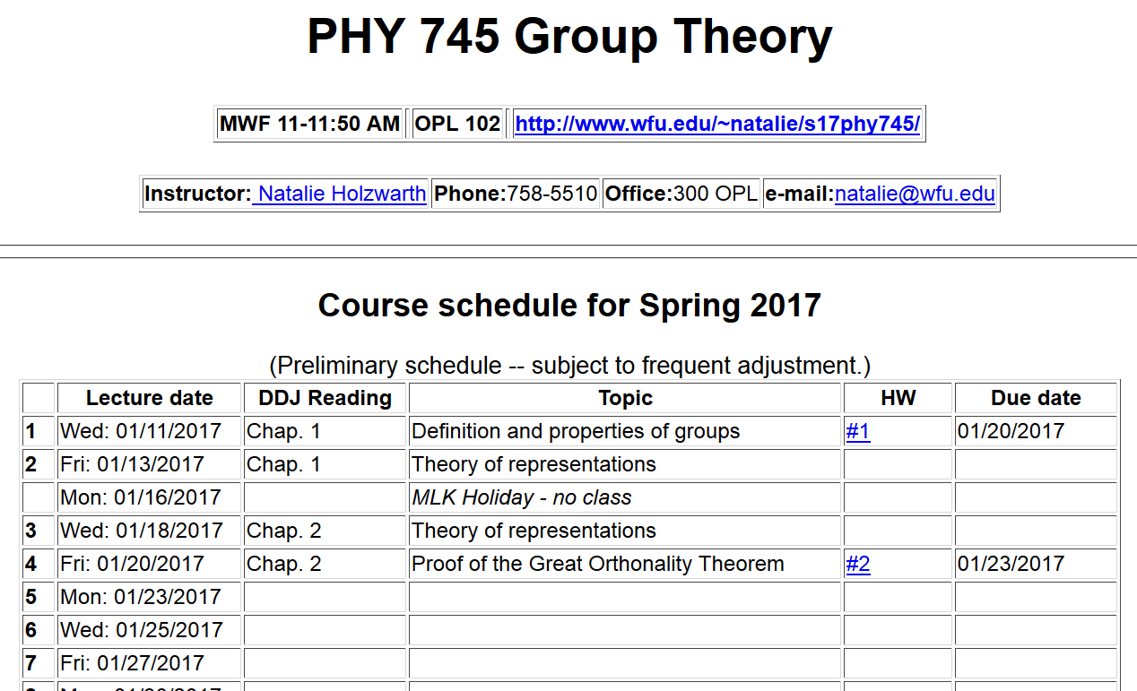

Slide 3
The great orthogonality theorem on unitary irreducible representations

Slide 4
Proof of the great orthogonality theorem
  Prove that all representations can be unitary matrices
  Prove Schur’s lemma part 1 – any matrix which commutes with all matrices of an irreducible representation must be a constant matrix
  Prove Schur’s lemma part 2
  Put all parts together

Slide 5
Proof of the great orthogonality theorem
  Prove that all representations can be unitary matrices
  Prove Schur’s lemma part 1 – any matrix which commutes with all matrices of an irreducible representation must be a constant matrix
  Prove Schur’s lemma part 2
  Put all parts together
Schur’s lemma part 1:
A matrix M which commutes with all of the matrices of an irreducible representation must be a constant matrix: M=sI where s is a scalar constant and I is the identity matrix.

Slide 6
Schur’s lemmas part 1:
A matrix M which commutes with all of the matrices of an irreducible representation must be a constant matrix: M=sI where s is a scalar constant and I is the identity matrix.

Slide 7
Example irreducible representation:
In these terms, the premise is:

Slide 8
Hermitian matrices can be diagonalized by a unitary transformation U

Slide 9
Proof of the great orthogonality theorem
  Prove that all representations can be unitary matrices
  Prove Schur’s lemma part 1 – any matrix which commutes with all matrices of an irreducible representation must be a constant matrix
  Prove Schur’s lemma part 2
  Put all parts together

Slide 11
Schur’s lemma part 2 -- continued

Slide 12
Schur’s lemma part 2 -- continued

Slide 13
Proof of the great orthogonality theorem
  Prove that all representations can be unitary matrices
  Prove Schur’s lemma part 1 – any matrix which commutes with all matrices of an irreducible representation must be a constant matrix
  Prove Schur’s lemma part 2
  Put all parts together

Slide 15
Proof continued:

Slide 16

Proof continued:
$$∗$$

