Slide 1
PHY 745 Group Theory
11-11:50 AM MWF Olin 102
Plan for Lecture 5:
Representations, characters, and
the “great” orthogonality theorem
    Reading: Chapter 3 in DDJ
      Finish proof of “Great Orthogonality Theorem”
      Character of a representation
      Great orthogonality theorem for characters

Slide 2
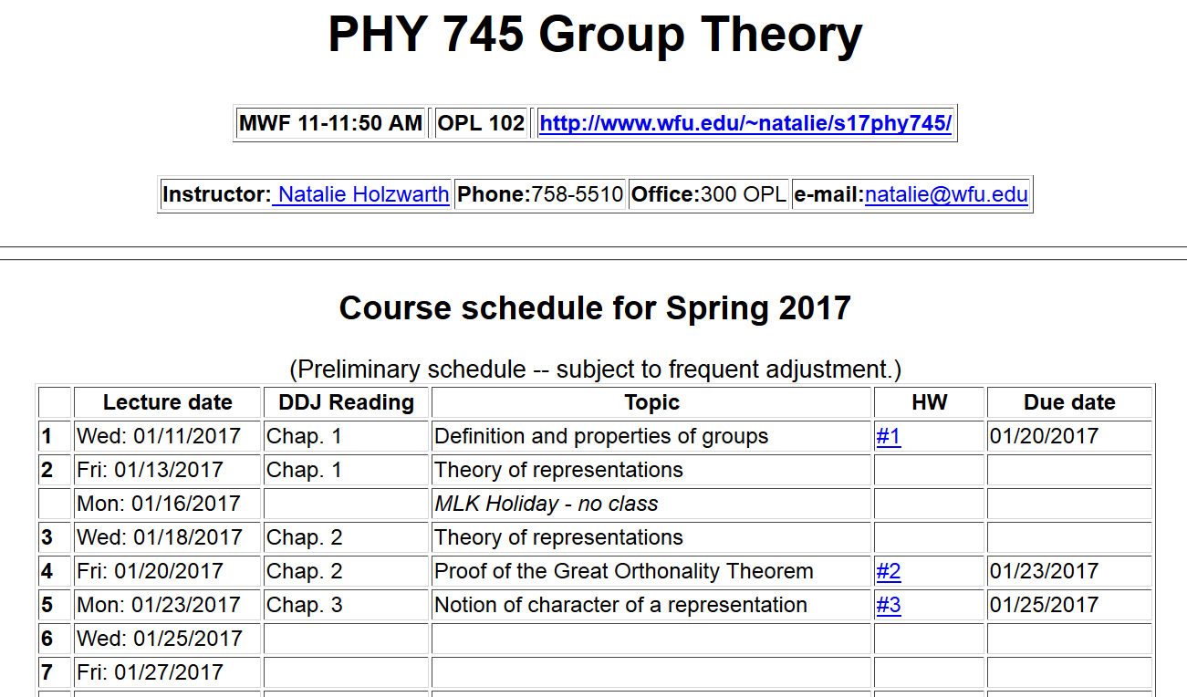

Slide 3
The great orthogonality theorem on unitary irreducible representations

Slide 4
Proof of the great orthogonality theorem
  Prove that all representations can be unitary matrices
  Prove Schur’s lemma part 1 – any matrix which commutes with all matrices of an irreducible representation must be a constant matrix
  Prove Schur’s lemma part 2
  Put all parts together

Slide 5
Proof of the great orthogonality theorem
  Prove that all representations can be unitary matrices
  Prove Schur’s lemma part 1 – any matrix which commutes with all matrices of an irreducible representation must be a constant matrix
  Prove Schur’s lemma part 2
  Put all parts together

Slide 8
Proof continued:

Slide 10
Characters

Slide 11
Great orthogonality theorem for characters

Slide 12
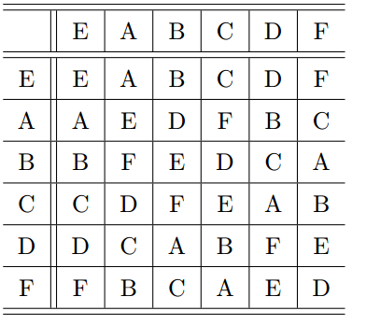
Example – P(3):

Slide 13
Character table for P(3):
 | C₁ | 3C₂ | 2C₃
χ¹ | 1 | 1 | 1
χ² | 1 | -1 | 1
χ³ | 2 | 0 | -1

Slide 14
Check orthogonality:
 | C₁ | 3C₂ | 2C₃
χ¹ | 1 | 1 | 1
χ² | 1 | -1 | 1
χ³ | 2 | 0 | -1

Slide 15
Some further conclusions:
The characters χ^{i} behave as a vector space with the dimension equal to the number of classes.
➔The number of characters=the number of classes

Slide 16
The regular representation is composed of h x h matrices constructed as follows, shown with the P(3)
example:
1 0 0 0 0 0
0 1 0 0 0 0
0 0 1 0 0 0
0 0 0 1 0 0
0 0 0 0 1 0
0 0 0 0 0 1
0 1 0 0 0 0
1 0 0 0 0 0
0 0 0 0 0 1
0 0 0 0 1 0
0 0 0 1 0 0
0 0 1 0 0 0
Γ^{reg} (E)=
Γ^{reg} (A)=
E A B C D F
E⁻¹ E A B C D F
A⁻¹ A E D F B C
B⁻¹ B F E D C A
C⁻¹ C D F E A B
D⁻¹ F B C A E D
F⁻¹ D C A B F E
➔
0 0 1 0 0 0
0 0 0 0 1 0
1 0 0 0 0 0
0 0 0 0 0 1
0 1 0 0 0 0
0 0 0 1 0 0
0 0 0 1 0 0
0 0 0 0 0 1
0 0 0 0 1 0
1 0 0 0 0 0
0 0 1 0 0 0
0 1 0 0 0 0
Γ^{reg} (B)=
Γ^{reg} (C)=
Γ^{reg} (D)=
0 0 0 0 1 0
0 0 1 0 0 0
0 0 0 1 0 0
0 1 0 0 0 0
0 0 0 0 0 1
1 0 0 0 0 0
Γ^{reg} (F)=
0 0 0 0 0 1
0 0 0 1 0 0
0 1 0 0 0 0
0 0 1 0 0 0
1 0 0 0 0 0
0 0 0 0 1 0

Slide 17
Regular representation continued –
Note that the regular representation matrices satisfy the multiplication table of the group and have the same class structure as the group.

Slide 18
Example for P(3):
 | C₁ | 3C₂ | 2C₃
χ¹ | 1 | 1 | 1
χ² | 1 | -1 | 1
χ³ | 2 | 0 | -1

