Slide 1
PHY 745 Group Theory
11-11:50 AM MWF Olin 102
Plan for Lecture 6:
Examples of point groups and their characters
    Reading: Chapter 3 in DDJ
      Schoenflies notation
      Hermann-Mauguin notation
      Relationships between symmetries
Note: In this lecture, some materials are taken from an electronic version of the Dresselhaus, Dresselhaus, Jorio text

Slide 2
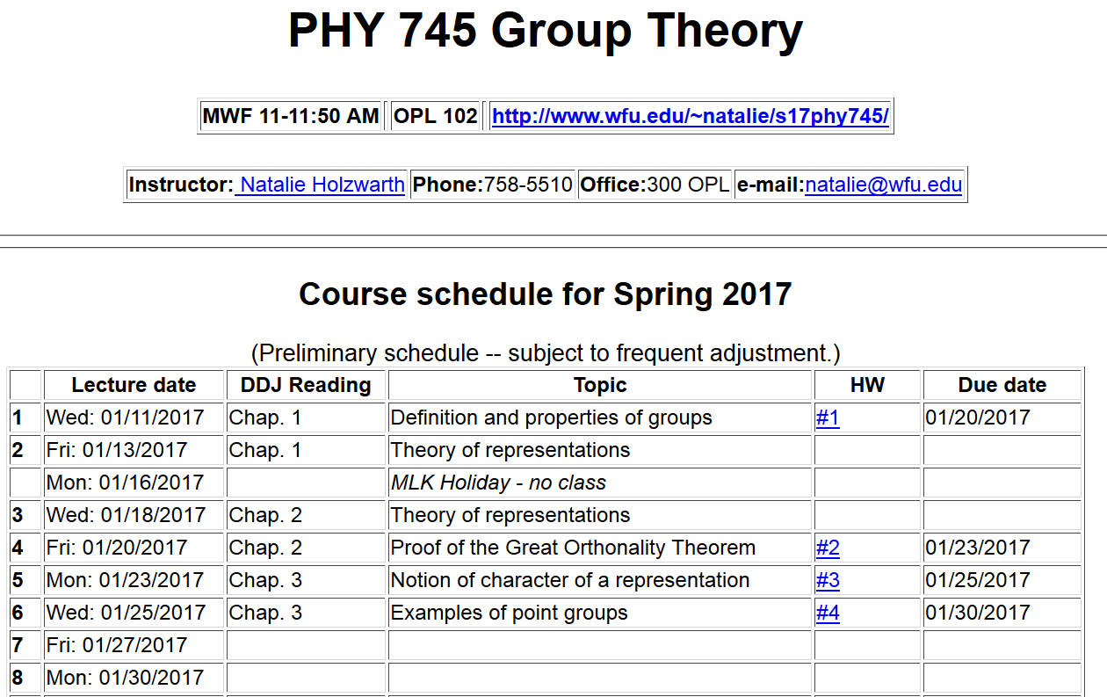

Slide 3
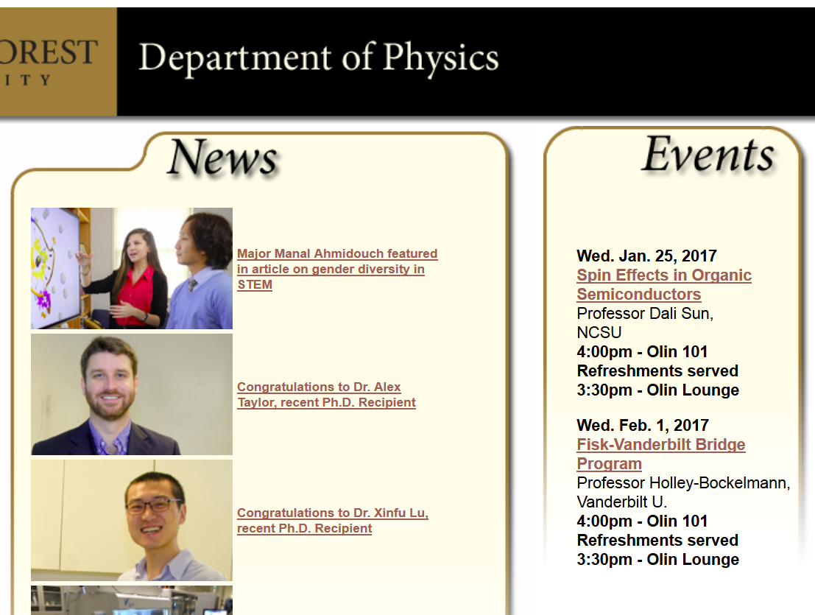

Slide 4
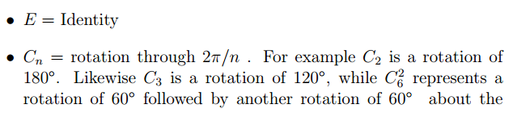
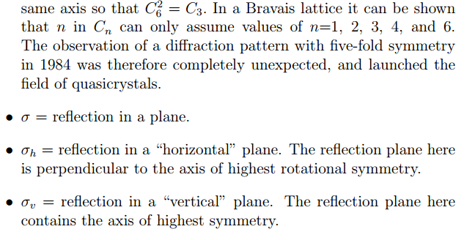
Point group symmetry elements in the Schoenflies notation

Slide 5
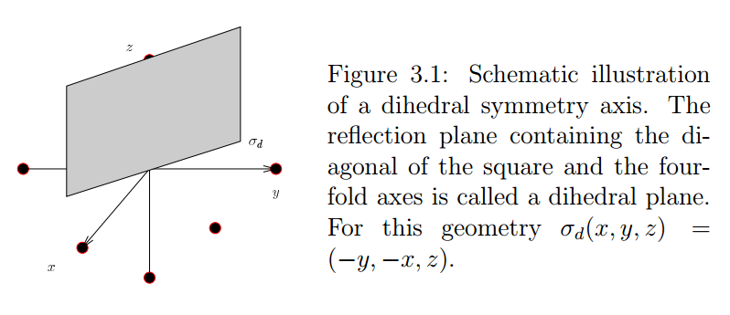
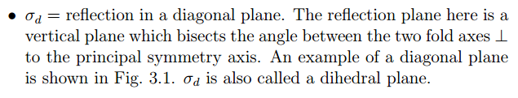

Slide 6
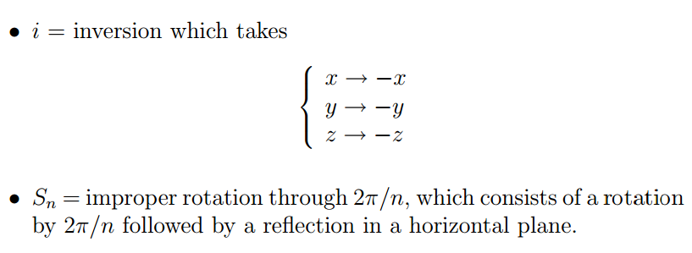

There are 32 distinct point groups generated by combinations of these operations

Slide 7
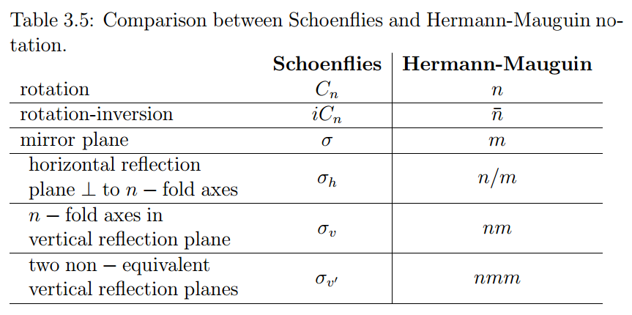
Point group symmetry elements in the Hermann-Mauguin notation

Slide 8
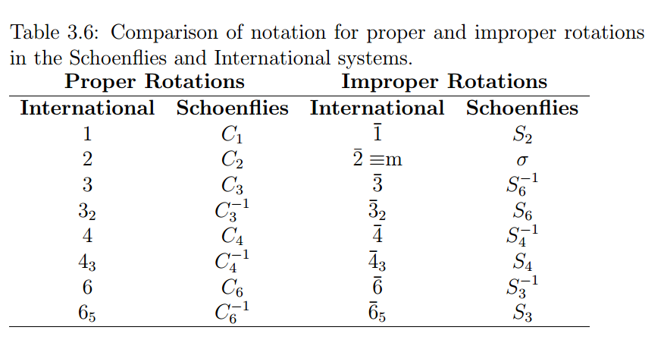

Slide 9
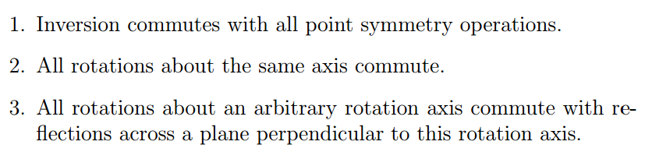
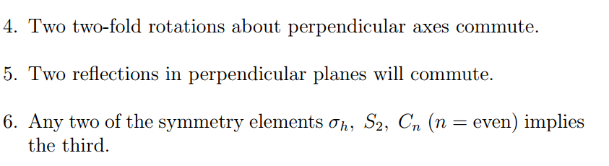
Some relationships between point symmetry elements

Slide 10
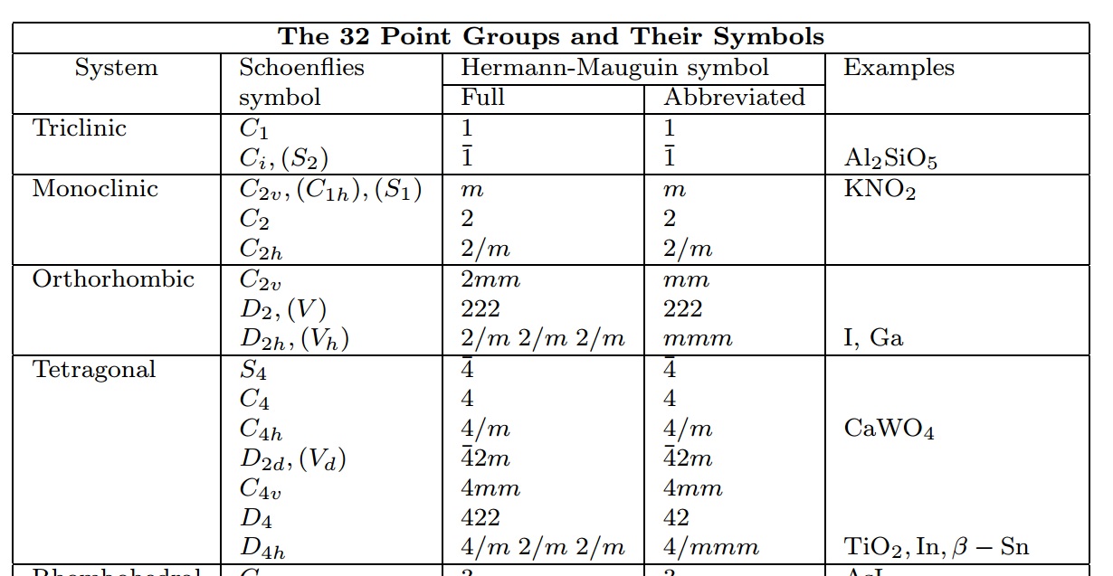

Slide 11
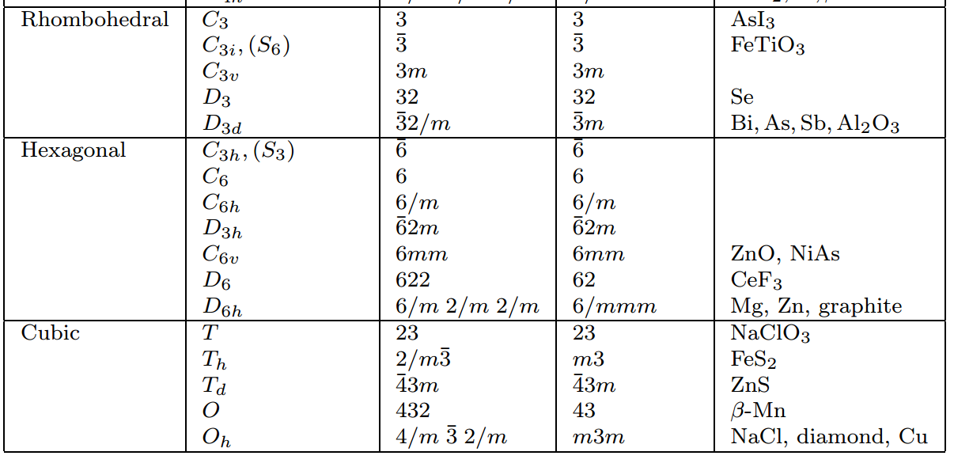

Slide 12
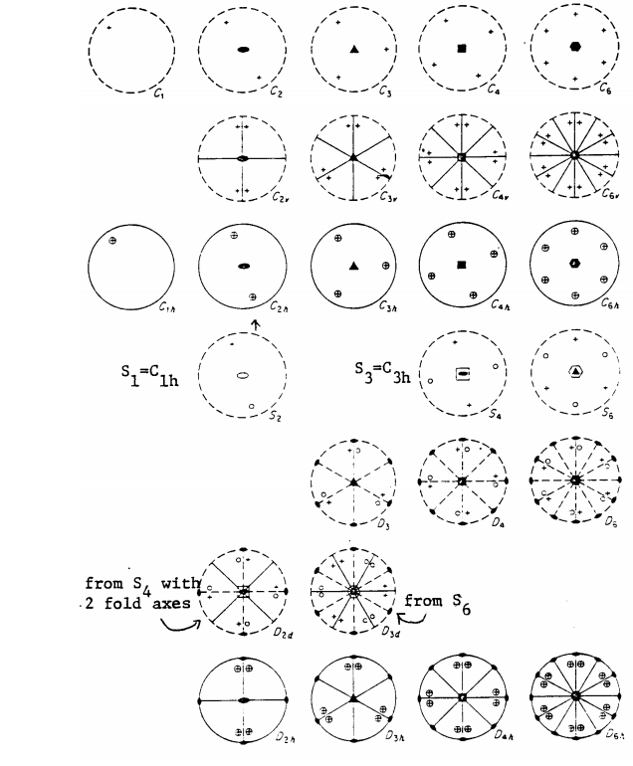
Stereographic projections of simple point groups

Slide 13
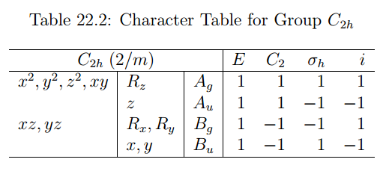
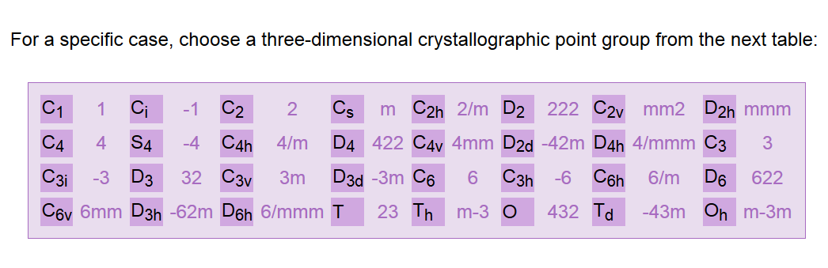
Some details
More details from the Bilbao crystallographic server:
http://www.cryst.ehu.es/#pointop

Slide 14
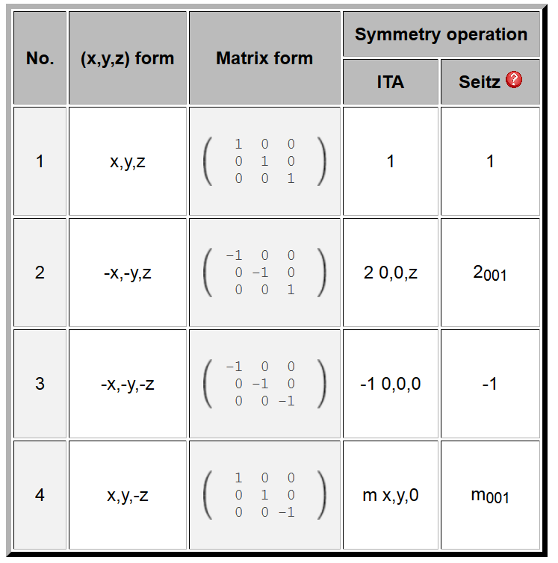
C_{2h} symmetry operations (for unique axis z)

Slide 15
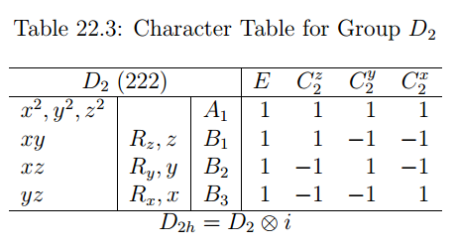
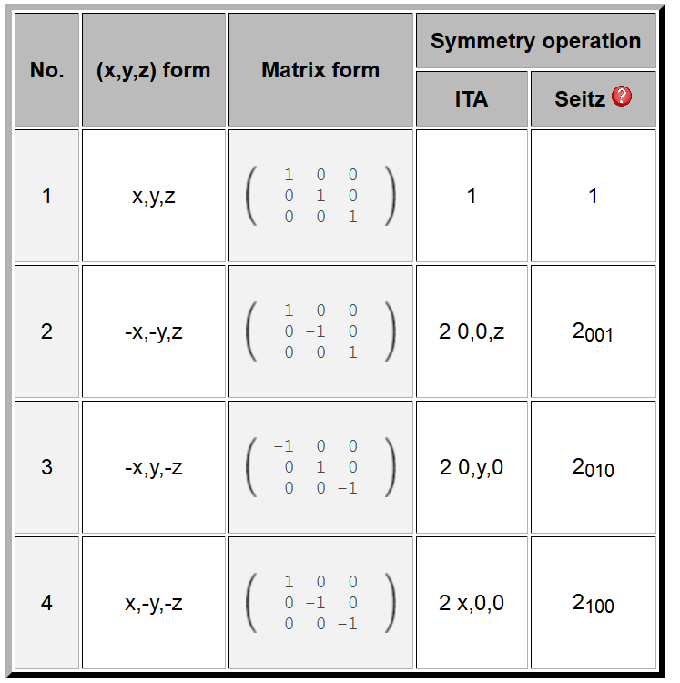
Another example

Slide 16
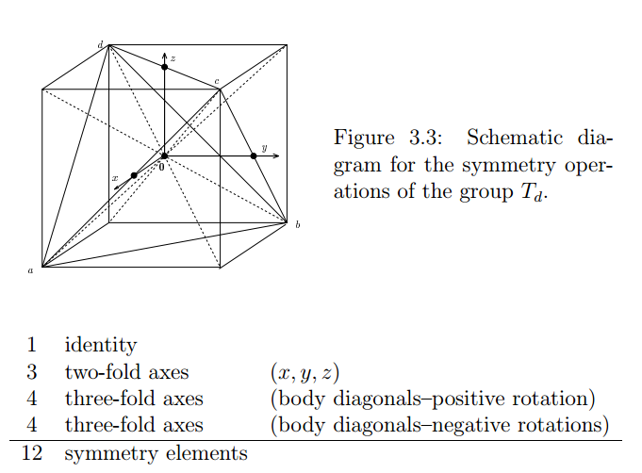
Tetrahedral group:
For simple tetrahedron:

Slide 17
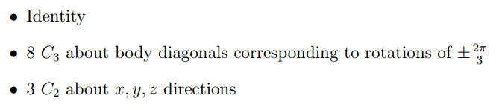

Tetrahedral group:
For complex tetrahedron:
______________________
24 symmetry elements

Slide 18
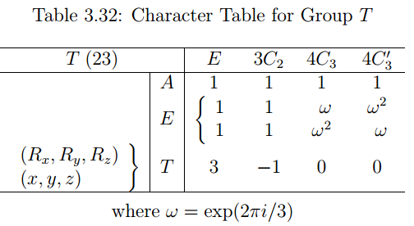
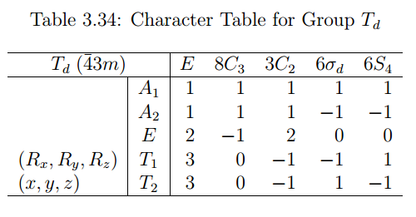

Slide 19
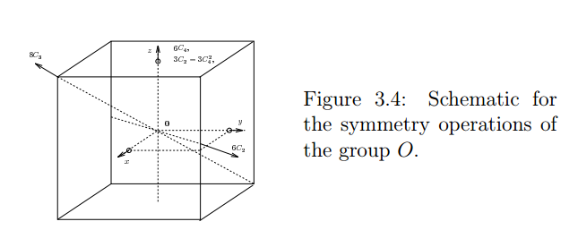
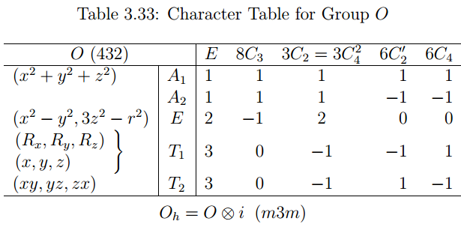
Octahedral group

