Slide 1
PHY 745 Group Theory
11-11:50 AM MWF Olin 102
Plan for Lecture 7:
Examples of point groups and their characters
Reading: Chapter 4 & 8 in DDJ
Symmetry basis functions
Examples of point groups – molecules and their vibrational modes
Note: In this lecture, some materials are taken from an electronic version of the Dresselhaus, Dresselhaus, Jorio text

Slide 3
Point symmetry groups in physics
Notion of symmetry related basis functions
Properties:
Orthogonality:

Slide 4
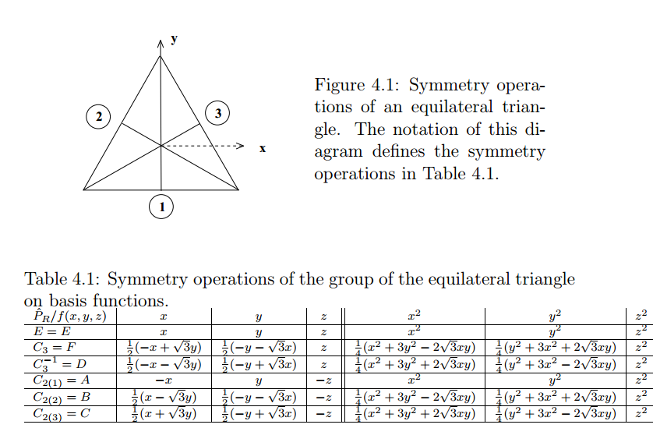
Examples of basis functions based on Cartesian coordinates for the example of the triangular group:

Slide 5
Summary of basis functions associated with
character table for D₃
“Standard” notation for representations of D₃

Slide 6
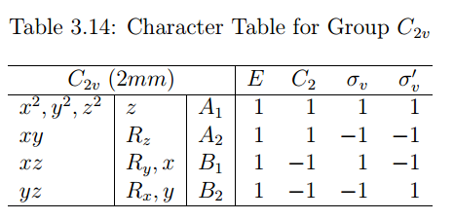
C₂
Example of H₂O
σ_{v}
σ_{v’}
“Standard” notation for representations of C_{2v}

Slide 7
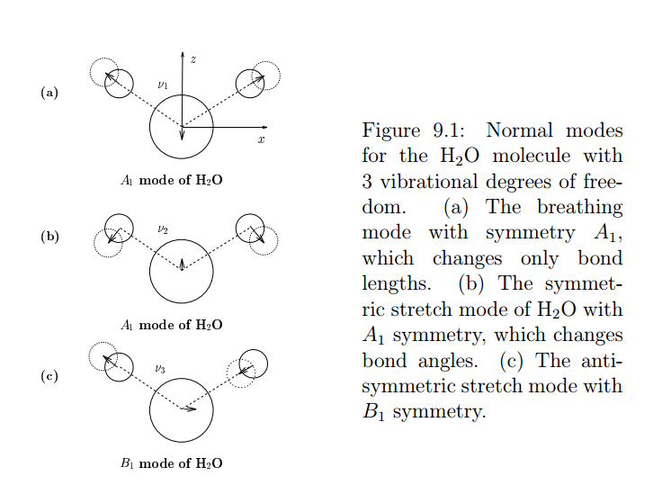
Lattice vibrations of H₂O:
3 modes:
3x3 degrees of freedom
3 translations
3 rotations
Symmetric stretch:
ν=3685 cm⁻¹
Sissors bend:
ν=1885 cm⁻¹
Asymmetric stretch:
ν=3506 cm⁻¹

Slide 8
Symmetry analysis
Δy₁
Δy₂
Δy₃
Δx₁
Δy₁
Δz₁
Δx₂
R Δy₂
Δz₂
Δx₃
Δy₃
Δz₃
Δx₁
Δz₁
Δx₂
Δx₃
Δz₂
Δz₃
C₂
σ_{v}
σ_{v’}

Slide 9
Δx₁ 1 0 0 0 0 0 0 0 0 Δx₁
Δy₁ 0 1 0 0 0 0 0 0 0 Δy₁
Δz₁ 0 0 1 0 0 0 0 0 0 Δz₁
Δx₂ 0 0 0 1 0 0 0 0 0 Δx₂
E Δy₂ = 0 0 0 0 1 0 0 0 0 Δy₂
Δz₂ 0 0 0 0 0 1 0 0 0 Δz₂
Δx₃ 0 0 0 0 0 0 1 0 0 Δx₃
Δy₃ 0 0 0 0 0 0 0 1 0 Δy₃
Δz₃ 0 0 0 0 0 0 0 0 1 Δz₃
χ(E)=9

Slide 10
Δx₁ -1 0 0 0 0 0 0 0 0 Δx₁
Δy₁ 0 1 0 0 0 0 0 0 0 Δy₁
Δz₁ 0 0 -1 0 0 0 0 0 0 Δz₁
Δx₂ 0 0 0 0 0 0 -1 0 0 Δx₂
C₂ Δy₂ = 0 0 0 0 0 0 0 1 0 Δy₂
Δz₂ 0 0 0 0 0 0 0 0 -1 Δz₂
Δx₃ 0 0 0 -1 0 0 0 0 0 Δx₃
Δy₃ 0 0 0 0 1 0 0 0 0 Δy₃
Δz₃ 0 0 0 0 0 -1 0 0 0 Δz₃
χ(C₂)=-1
Similarly: χ(σ_{v})=3
χ(σ_{v’})=1

Slide 13
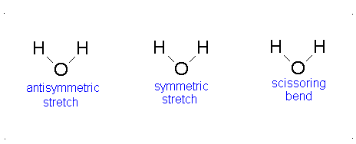
From:
http://chem.libretexts.org/Core/Physical_and_Theoretical_Chemistry/Spectroscopy/Vibrational_Spectroscopy/Vibrational_Modes
B₁
A₁
A₁

