Slide 1
PHY 745 Group Theory
11-11:50 AM MWF Olin 102
Plan for Lecture 8:
Examples of point groups and their characters – more details
Reading: Chapter 4 & 8 in DDJ
More details on basis functions
More details on symmetries of molecular vibrations
Note: In this lecture, some materials are taken from an electronic version of the Dresselhaus, Dresselhaus, Jorio text

Slide 2
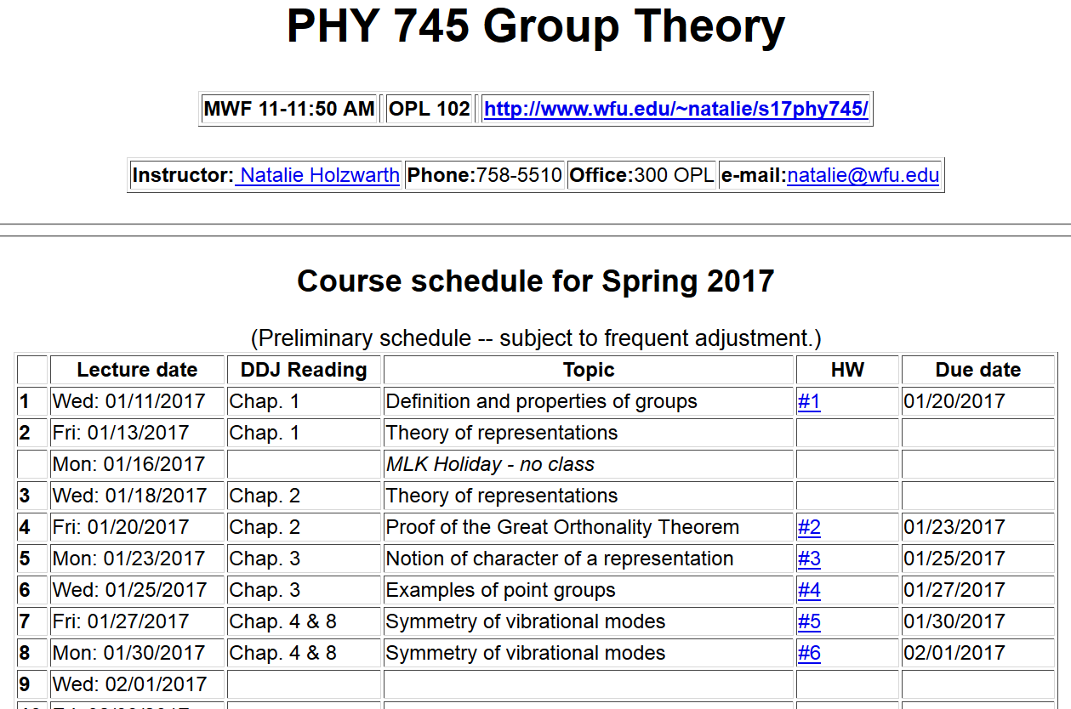

Slide 3
Point symmetry groups in physics
Notion of symmetry related basis functions*
Properties:
Orthogonality:
*(Using notation in DDJ textbook)

Slide 4
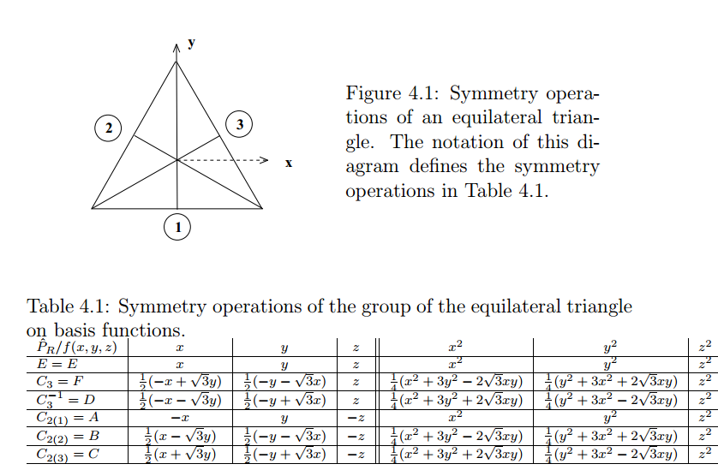
Examples of basis functions based on Cartesian coordinates for the example of the triangular group: P(3)=D₃

Slide 5
Summary of basis functions associated with
character table for D₃
“Standard” notation for representations of D₃

Slide 6
Example basis functions:
z
y
x
Comment on orthogonality:
Assume integral implied by braket takes place over unit sphere and appropriate normalization constants will be applied.

Slide 7
z
y
x
Note that basis functions related to irreducible representations follow:

Slide 8
z
y
x

Slide 10
Extension to quadratic basis functions

Slide 11
Summary of basis functions associated with
character table for D₃
“Standard” notation for representations of D₃
In this case, R_{x}, R_{y}, R_{z} behave as axial vectors along x, y, z.

Slide 12
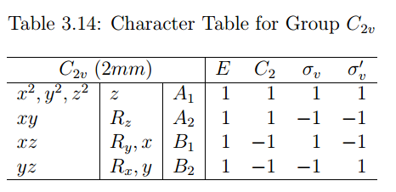
C₂
Example of H₂O
σ_{v}
σ_{v’}
“Standard” notation for representations of C_{2v}

Slide 13
Basis functions for this case --
z
C₂
x
y
σ_{v}
σ_{v’}

Slide 14
Basis functions for C_{2v} – continued --

Slide 15
Vibrational modes
From:
http://chem.libretexts.org/Core/Physical_and_Theoretical_Chemistry/Spectroscopy/Vibrational_Spectroscopy/Vibrational_Modes
B₁
A₁
A₁

Slide 16
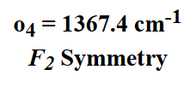
Another example – CH₄ (tetrahedral symmetry)
http://www2.ess.ucla.edu/~schauble/MoleculeHTML/CH4_html/CH4_page.html
(2 modes)
T₂
T₂
(3 modes)
(3 modes)

Slide 17
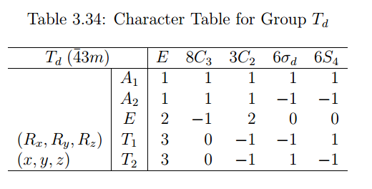
Symmetry analysis of vibrations of CH₄

Slide 18
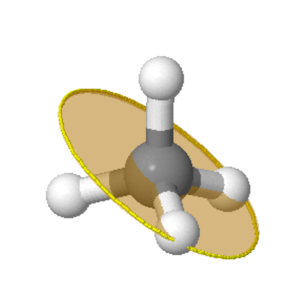
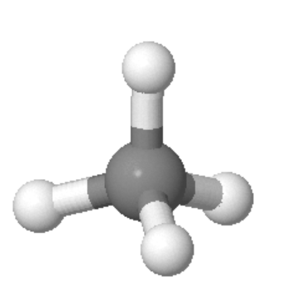
Visualization of symmetry elements
http://symmetry.otterbein.edu/tutorial/methane.html
C₃
C₂ S₄
σ_{d}

Slide 19
Δz₁
Construct 15-component vector V describing the 3-dimensional motion of the 5 atoms in CH₄
Δy₁
Δx₁
Δz₅
Δz₂
Δz₄
Δy₅
Δy₂
Δx₅
Δz₃
Δy₄
Δx₂
Δx₄
Δy₃
Δx₃

Slide 20
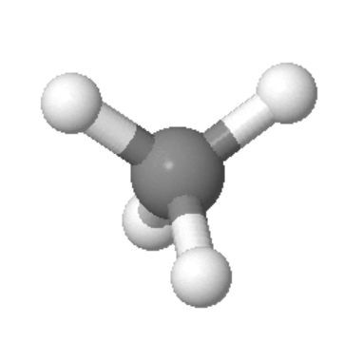
Alternate coordinate system
Δz₁
Δz₂
Δz₁
Δy₁
Δx₁
Δz₅
Δx₁
Δy₁
Δx₂
Δy₂
Δz₅
Δz₄
Δz₃
Δz₂
Δy₅
Δx₅
Δy₅
Δz₄
Δy₂
Δx₅
Δz₃
Δy₄
Δx₃
Δy₃
Δx₂
Δx₄
Δy₃
Δx₄
Δy₄
Δx₃

Slide 21
All motions: ➔A₁+E+T₁+3T₂
Translations: T₂
Rotations: T₁
Vibrations: A₁+E+2T₂

Slide 22
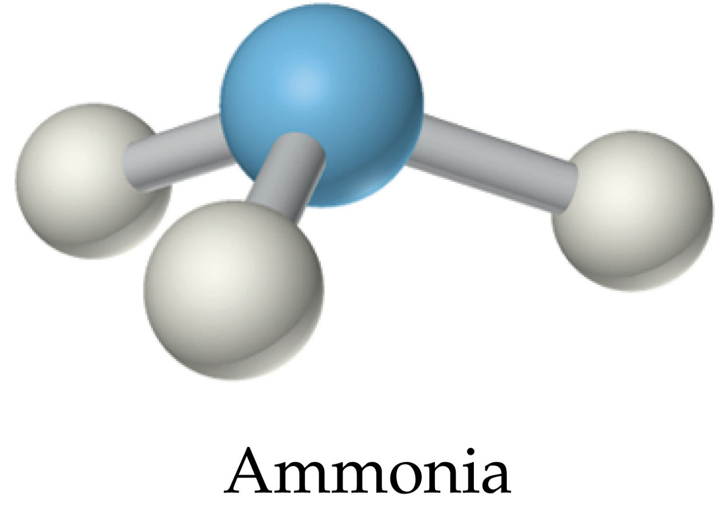
Symmetry of NH₃
C_{3v}
http://wps.prenhall.com/wps/media/objects/602/616516/Media_Assets/Chapter19/Text_Images/FG19_07-12UN.JPG

Slide 23
