Slide 1
PHY 745 Group Theory
11-11:50 AM MWF Olin 102
Plan for Lecture 9:
Evaluating transition matrix elements using character tables
    Reading: Chapter 8 in DDJ
      Analysis of vibrational infrared spectra
      Analysis of vibrational Raman spectra
Note: In this lecture, some materials are taken from an electronic version of the Dresselhaus, Dresselhaus, Jorio text

Slide 2
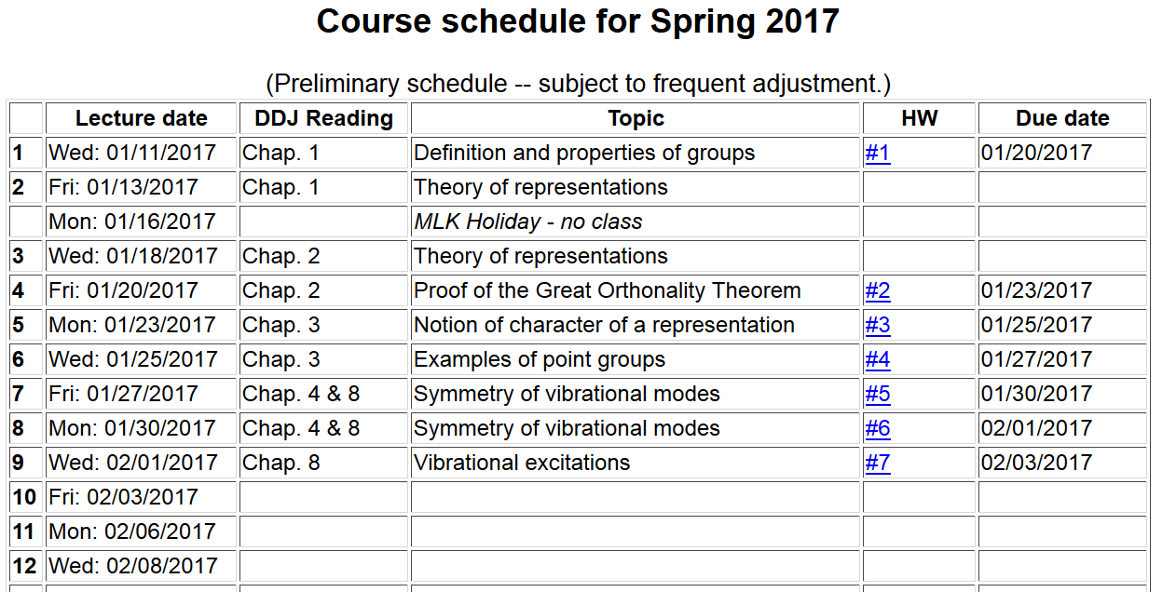

Slide 3
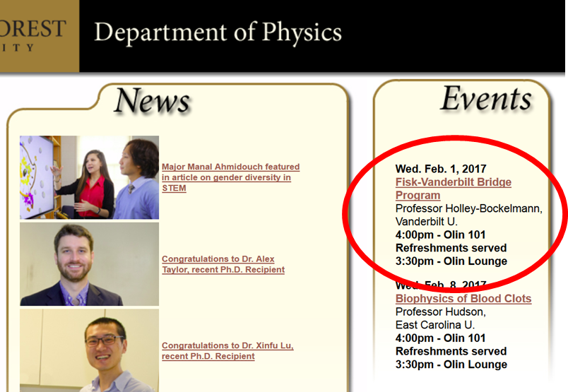

Slide 4
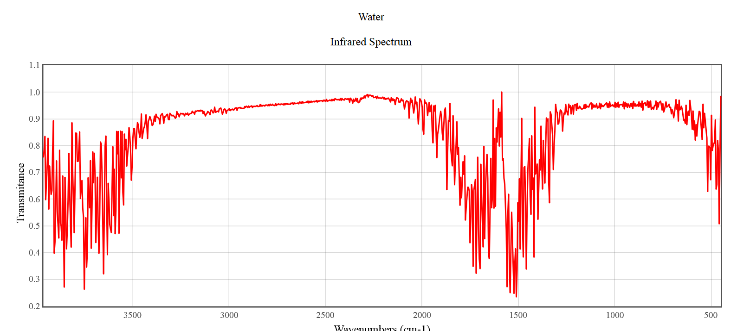
Symmetry analysis of the coupling of electromagnetic waves to molecular vibrations
Infrared spectrum of gaseous H₂O from NIST
B₁
A₁
A₁

Slide 5
Fermi Golden Rule for absorption of electromagnetic radiation
density of final states
Note that radiation couples to molecules with net dipole moment

Slide 6
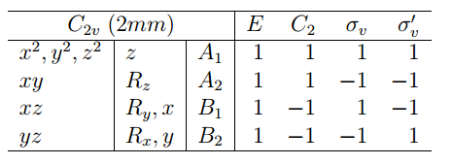
Example of H₂O

Slide 7
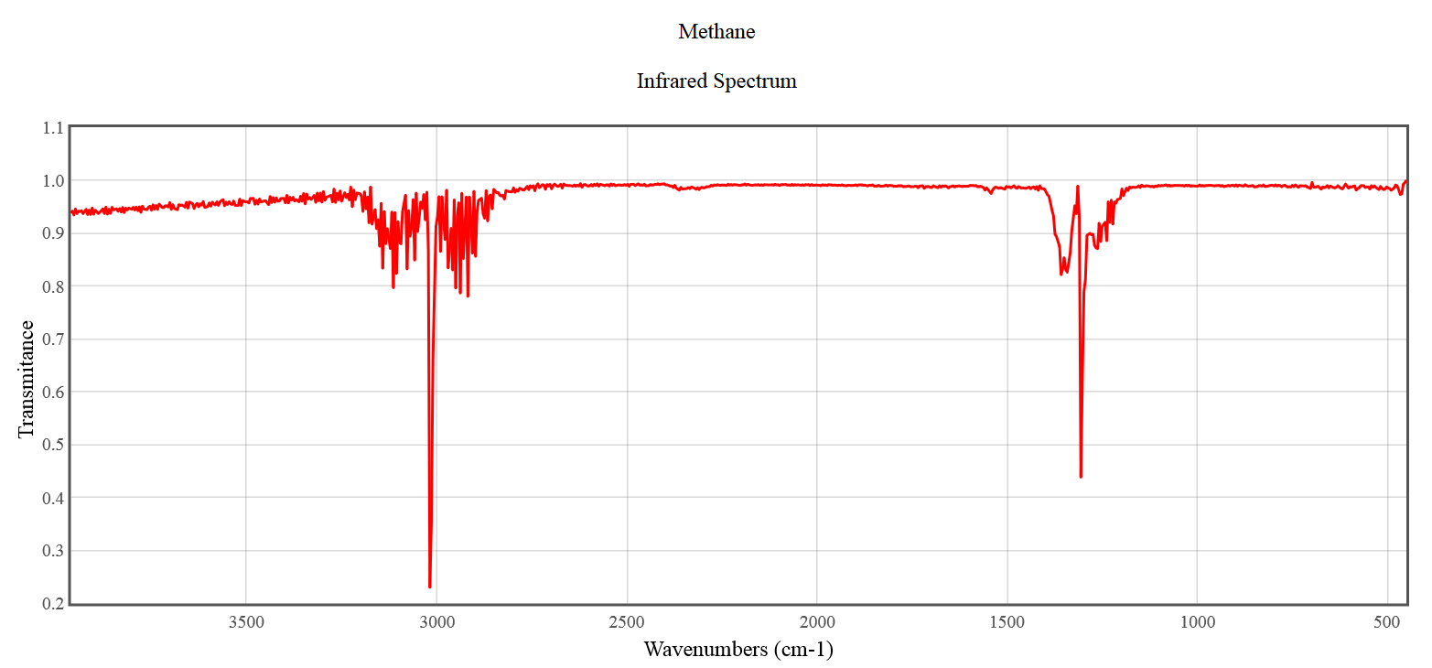
Infrared spectrum of gaseous CH₄ from NIST

Slide 8
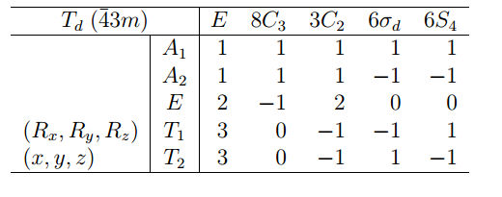
Example of CH₄

Slide 9
Vibrational modes excited by Raman scattering
polarizability due to vibration at frequency ω_{v}
static polarizability
anti-Stokes interaction
Rayleigh interaction
Stokes interaction

Slide 11
Example for H₂O

Slide 12
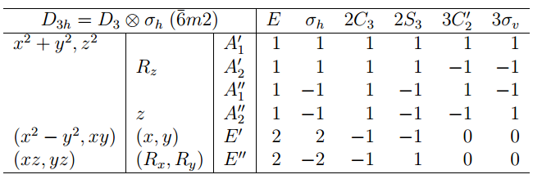
Other examples
➔Raman
➔IR
➔IR+Raman
➔Raman

