Slide 1
PHY 712 Electrodynamics
9-9:50 AM MWF Olin 105
Plan for Lecture 1:
Reading: Appendix 1 and Chapters I&1
Course structure and expectations
Units – SI vs Gaussian
Electrostatics – Poisson equation

Slide 2
Postponed

Slide 3
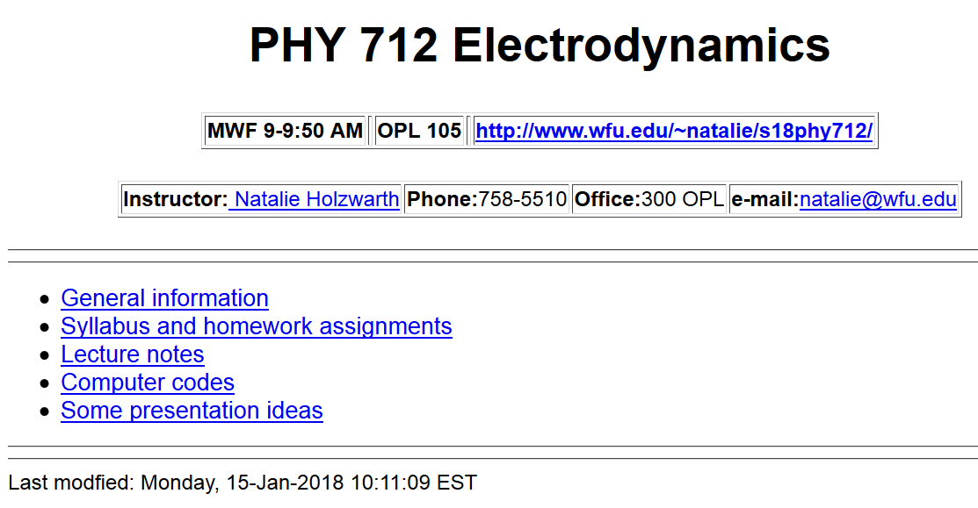
http://users.wfu.edu/natalie/s18phy712/

Slide 4
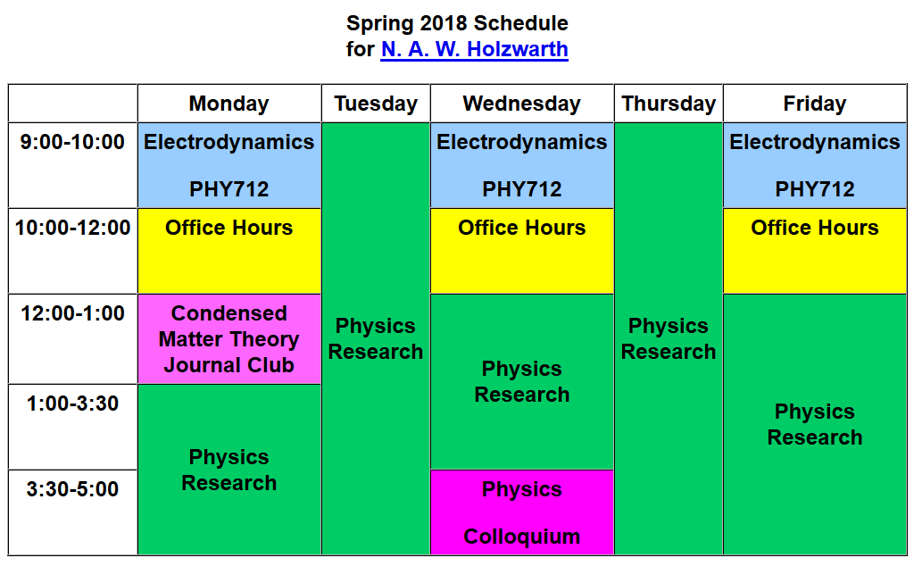

Slide 5
Textbook
Optional supplement

Slide 6
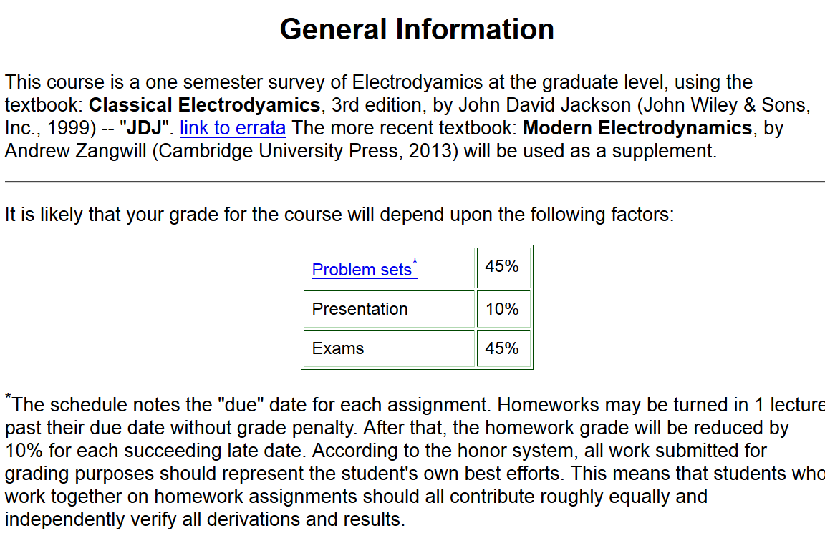

Slide 7
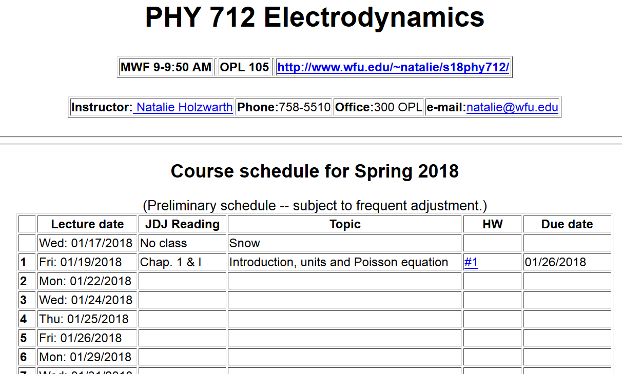

Slide 8
Comment about HW #1: (Jackson problem 1.5)
The time-averaged potential of a neutral hydrogen atom is given by:
where q denotes the magnitude of the elementary charge of an electron or proton and where a₀ denotes the Bohr radius. Find the distribution of charge (both continuous and discrete) that will give this potential and interpret your results physically.

Slide 9
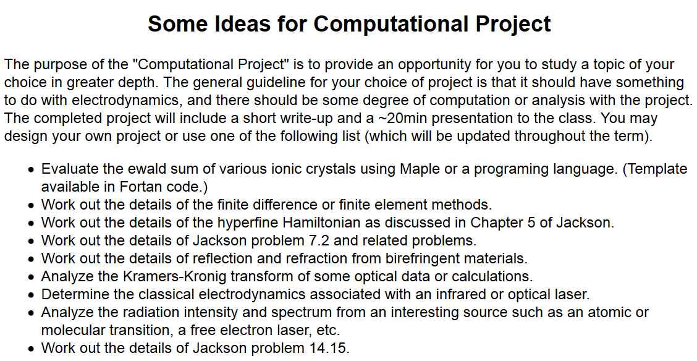

Slide 10
Material discussed in Appendix of textbook --

Slide 14
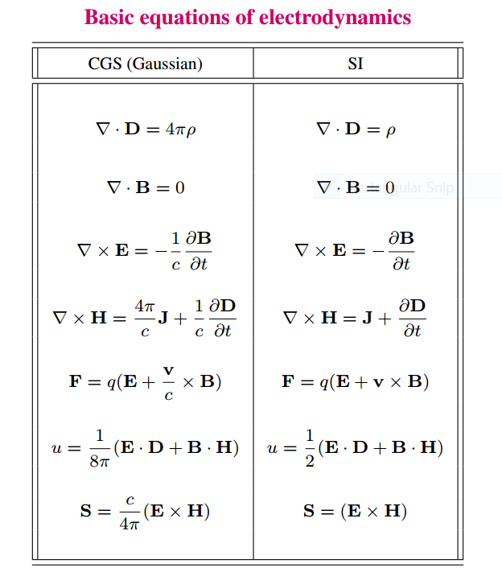

Slide 15
Units choice for this course:
SI units for Jackson in Chapters 1-10
Gaussian units for Jackson in Chapters 11-16
Electrostatics
q₂
q₁
q₃
q₄

Slide 16
Electrostatics
Discrete versus continuous charge distributions

Slide 17
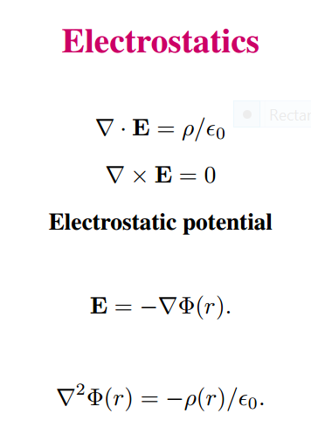
Differential equations --

Slide 18
Relationship between integral and differential forms of electrostatics --

Slide 19
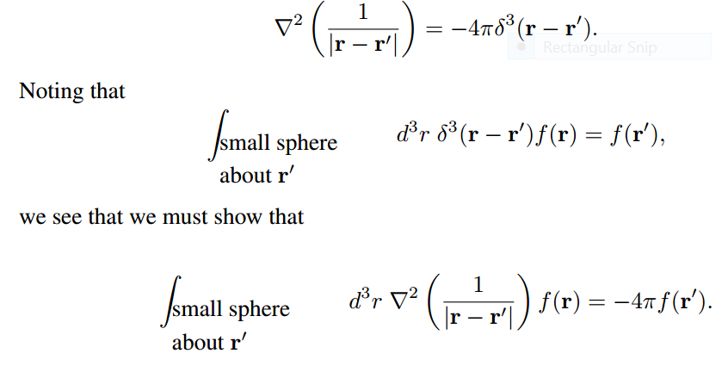
Relationship between integral and differential forms of electrostatics --
Need to show:

Slide 20
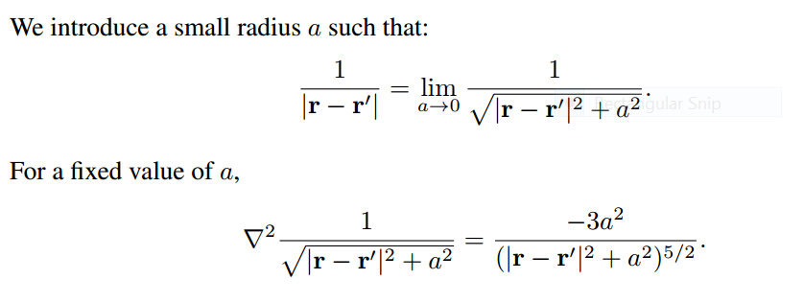

Slide 22
➔
➔

Slide 23
Example in HW1

