Slide 1
PHY 712 Electrodynamics
9-9:50 AM MWF Olin 105
Plan for Lecture 25:
Start reading Chap. 11
Equations in cgs (Gaussian) units
Special theory of relativity
Lorentz transformation relations

Slide 2
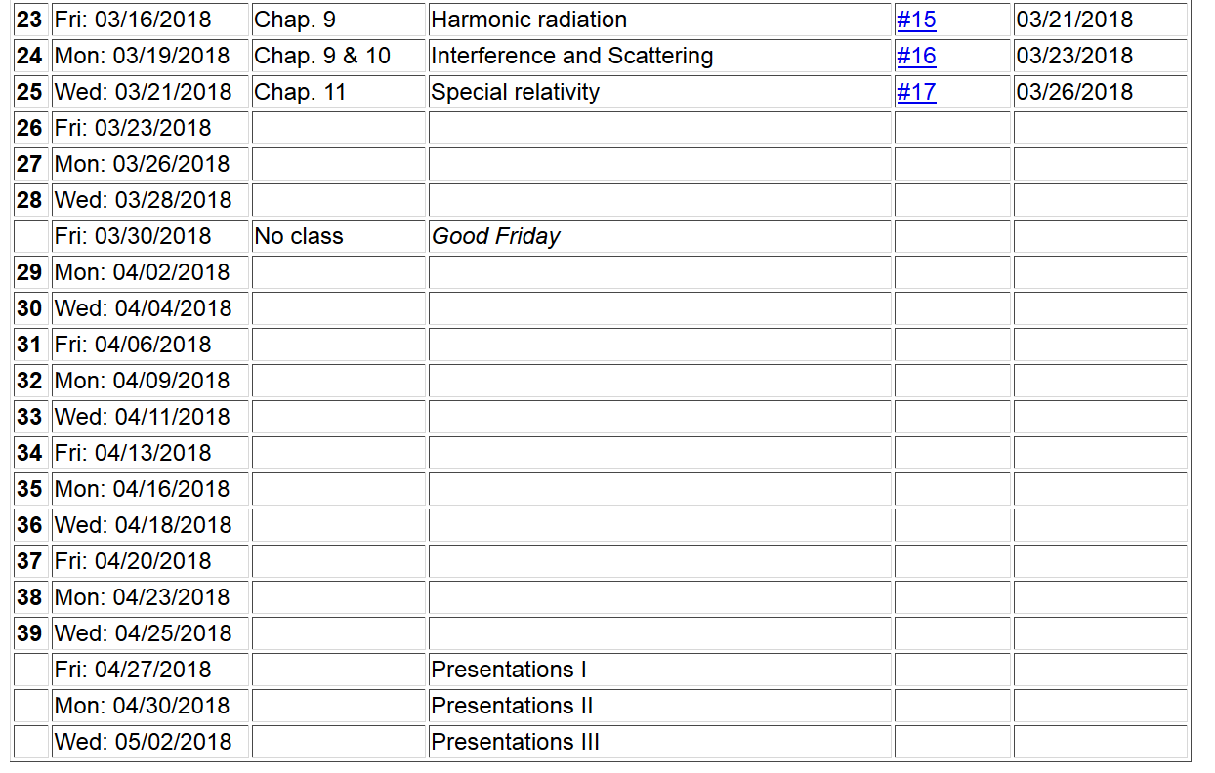

Slide 3
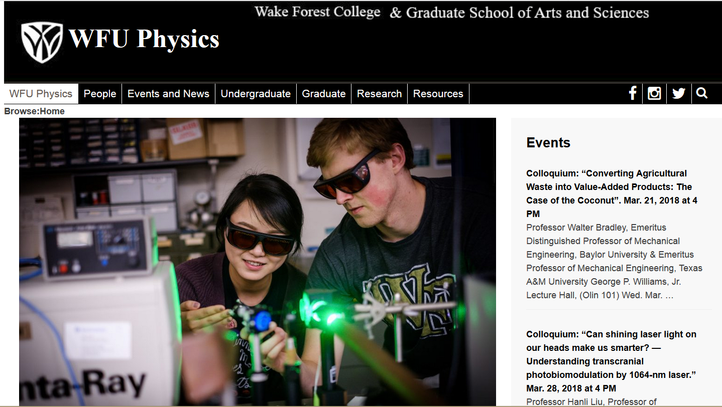

Slide 5
Notions of special relativity
The basic laws of physics are the same in all frames of reference (at rest or moving at constant velocity).
The speed of light in vacuum c is the same in all frames of reference.
y
y’
v
x
x’
y’
y
x’
x

Slide 6
Lorentz transformations
y
y’
v
x
x’
y’
y
x’
x

Slide 7
Lorentz transformations -- continued

Slide 8
Examples of other 4-vectors
applicable to the Lorentz transformation:

Slide 9
The Doppler Effect

Slide 10
The Doppler Effect -- continued
y’
y
k’
v
k
x’
x

Slide 11
Electromagnetic Doppler Effect (θ=0)
Sound Doppler Effect (θ=0)

Slide 12
Lorentz transformation of the velocity
For an infinitesimal increment:

Slide 13
Lorentz transformation of the velocity -- continued

Slide 14
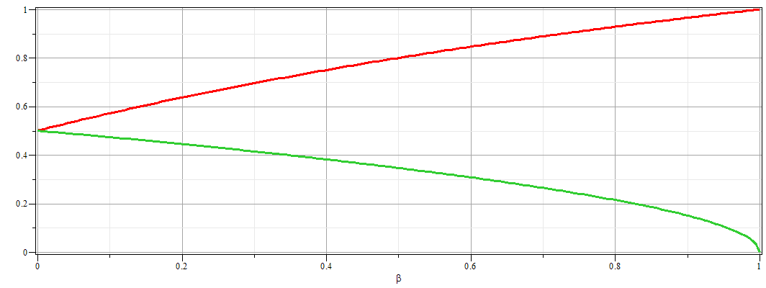
Example of velocity variation with β:
u_{x}/c
u_{y}/c

Slide 16
Velocity transformations continued:
Velocity 4-vector:

Slide 17
Some details:

Slide 18
Significance of 4-velocity vector:
Introduce the “rest” mass m of particle characterized by velocity u:
Properties of energy-moment 4-vector:

Slide 19
Properties of Energy-momentum 4-vector -- continued

Slide 20
Summary of relativistic energy relationships

Slide 21
Special theory of relativity and Maxwell’s equations

Slide 22
More 4-vectors:

Slide 23
Lorentz transformations

