Slide 1
PHY 712 Electrodynamics
9-9:50 AM MWF Olin 105
Plan for Lecture 28:
Continue reading Chap. 14 –
Radiation by moving charges
Motion in a line
Motion in a circle
Spectral analysis of radiation

Slide 2
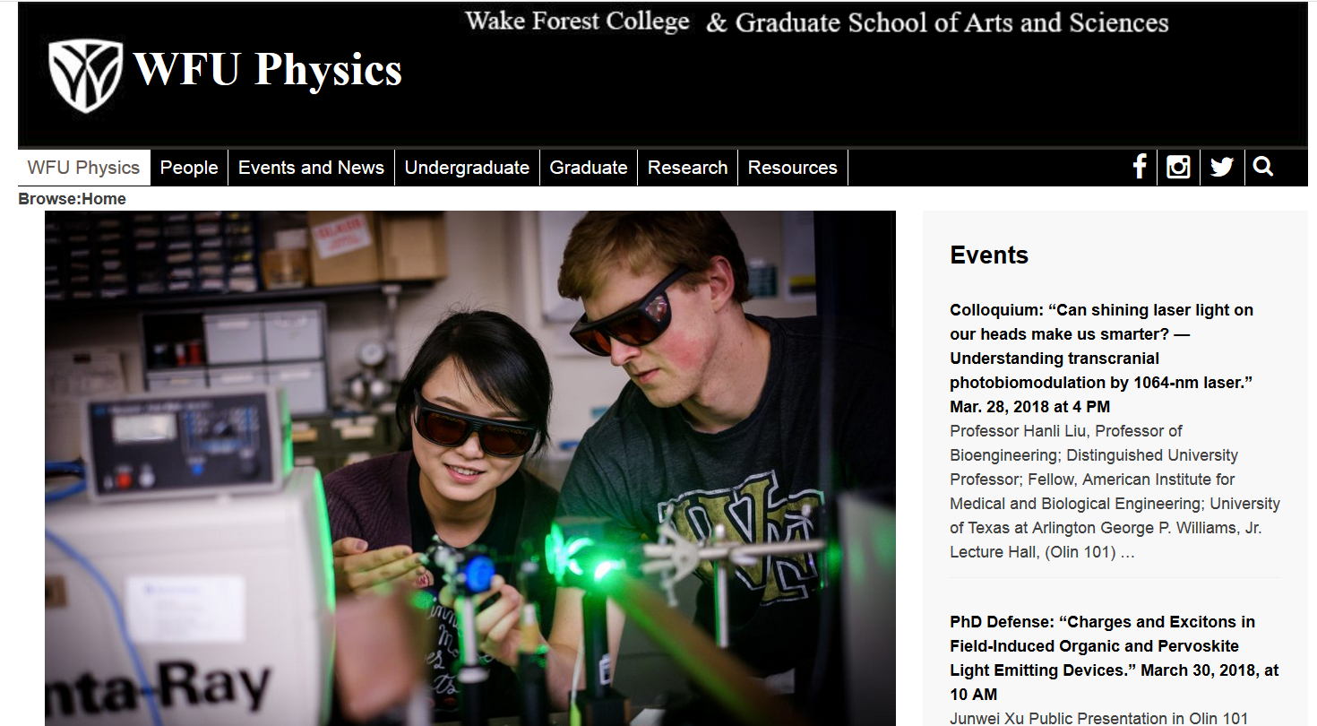

Slide 3
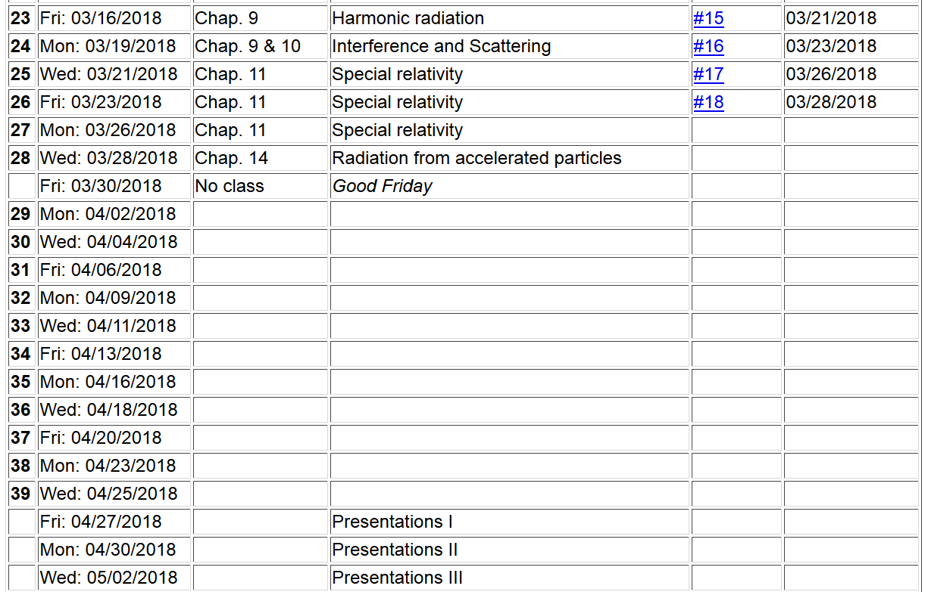

Slide 4
Radiation from a moving charged particle
z
r-R_{q}(t)
q
r
R_{q}(t)
y
x

Slide 5
Liénard-Wiechert fields (cgs Gaussian units):

Slide 6
Electric field far from source:

Slide 7
Poynting vector:

Slide 8
Power radiated

Slide 9
Radiation from a moving charged particle
z
.
v
r-R_{q}(t_{r})=R
q
Θ
r
R_{q}(t)
y
x

Slide 10
Radiation power in non-relativistic case -- continued

Slide 11
Radiation distribution in the relativistic case
This expression gives us the energy per unit field time t. We are often interested in the power per unit retarded time t_{r}=t-R/c:

Slide 12
Radiation distribution in the relativistic case -- continued
For linear acceleration:

Slide 13
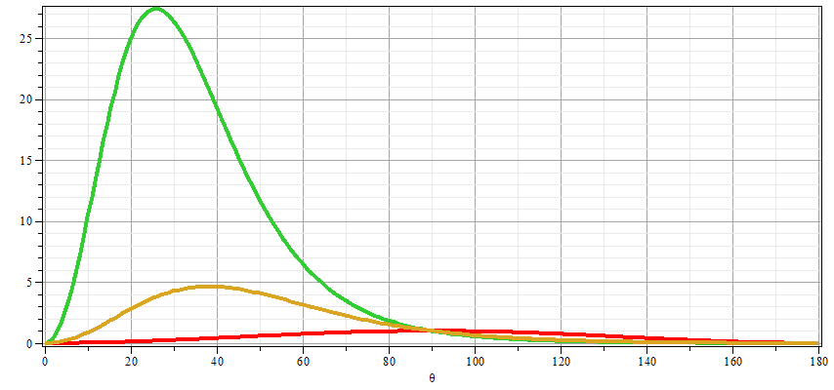
Power from linearly accelerating particle
β=0.7
β=0.5
β=0

Slide 14
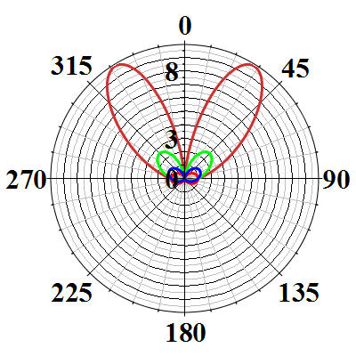
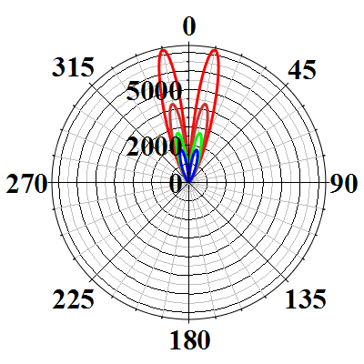
Polar plots:
β=0.93
β=0.6
β=0.90
β=0

Slide 15
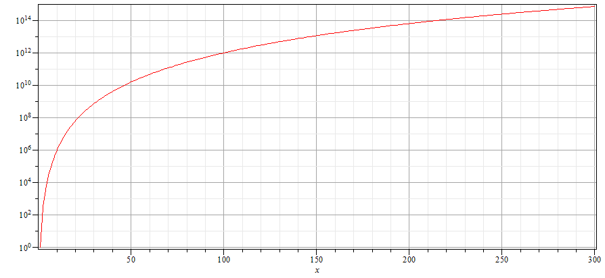
Power from linearly accelerating particle

Slide 16
Power distribution for linear acceleration -- continued
z
r
.
β
θ
y
β
x

Slide 17
Power distribution for circular acceleration
z
r
.
θ
β
y
β
x

Slide 18
Power distribution for circular acceleration
z
r
.
θ
β
y
β
φ
x

Slide 19
Spectral composition of electromagnetic radiation
Previously we determined the power distribution from
a charged particle:

Slide 20
Spectral composition of electromagnetic radiation -- continued
Parseval’s theorem
Marc-Antoine Parseval des Chênes 1755-1836
http://www-history.mcs.st-andrews.ac.uk/Biographies/Parseval.html

Slide 21
Spectral composition of electromagnetic radiation -- continued

Slide 22
Spectral composition of electromagnetic radiation -- continued

Slide 23
Spectral composition of electromagnetic radiation -- continued

Slide 24
Spectral composition of electromagnetic radiation -- continued

Slide 25
Spectral composition of electromagnetic radiation -- continued

Slide 26
Example – radiation from a collinear acceleration burst

Slide 27
Example:
r
θ
Δv

Slide 28
Spectral composition of electromagnetic radiation -- continued

