Slide 1
PHY 712 Electrodynamics
9-9:50 AM MWF Olin 105
Plan for Lecture 3:
Reading: Chapter 1 in JDJ
Review of electrostatics with one-dimensional examples
Poisson and Laplace Equations
Green’s Theorem and their use in electrostatics

Slide 2
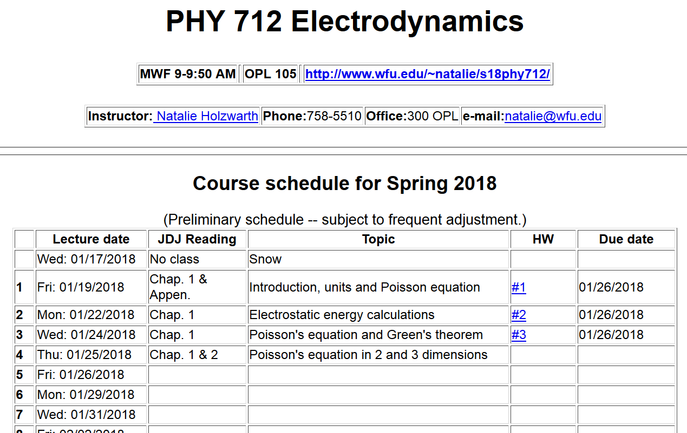

Slide 3
Announcements:
Make-up class scheduled for tommorrow – 1/25/2018 at 11 AM in Olin 105.
No physics colloquium this week --

Slide 4
Poisson and Laplace Equations
We are concerned with finding solutions to the Poisson equation:
and the Laplace equation:
The Laplace equation is the “homogeneous” version of the Poisson equation. The Green's theorem allows us to determine the electrostatic potential from volume and surface integrals:

Slide 5
Poisson equation -- continued

Slide 6
General comments on Green’s theorem
This general form can be used in 1, 2, or 3 dimensions. In general, the Green's function must be constructed to satisfy the appropriate (Dirichlet or Neumann) boundary conditions. Alternatively or in addition, boundary conditions can be adjusted using the fact that for any solution to the Poisson equation, other solutions may be generated by use of solutions of the Laplace equation

Slide 7
“Derivation” of Green’s Theorem

Slide 8
“Derivation” of Green’s Theorem

Slide 9
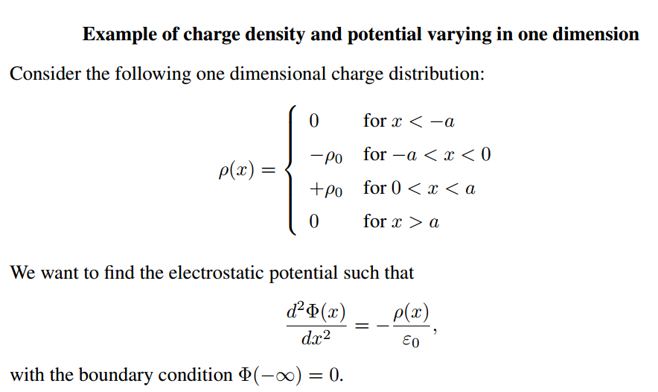

Slide 11
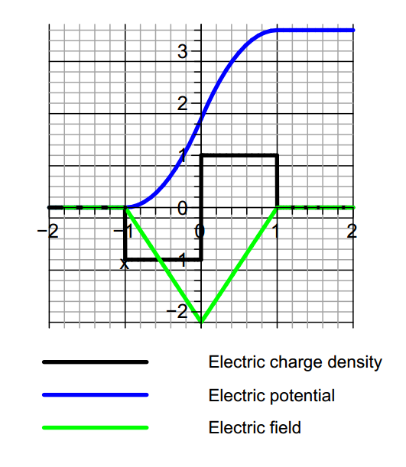

Slide 12
Comment about the example and solution
This particular example is one that is used to model semiconductor junctions where the charge density is controlled by introducing charged impurities near
the junction.
The solution of the Poisson equation for this case can be determined by piecewise solution within each of the four regions. Alternatively, from Green's theorem in one-dimension, one can use the Green's function

Slide 13
Notes on the one-dimensional Green’s function

Slide 14
Construction of a Green’s function in one dimension

Slide 15
Summary

Slide 16
One dimensional Green’s function in practice
This expression gives the same result as previously obtained for the example ρ(x) and more generally is appropriate for any neutral charge distribution.

Slide 18
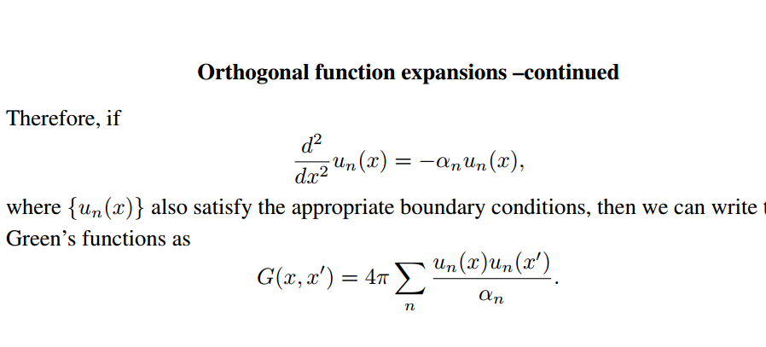

Slide 19
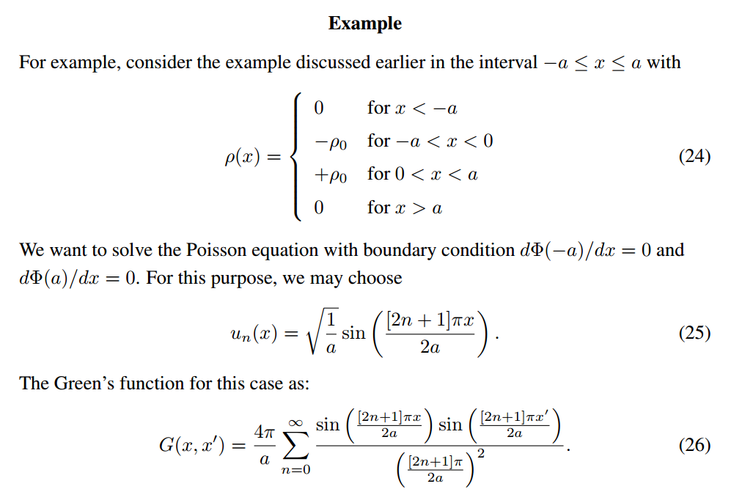

Slide 20
