Slide 1
PHY 712 Electrodynamics
9-9:50 AM MWF Olin 105
Plan for Lecture 30:
Finish reading Chap. 14 –
Radiation from charged particles
Review of synchrotron radiation
Free electron laser
Thompson and Compton scattering

Slide 2
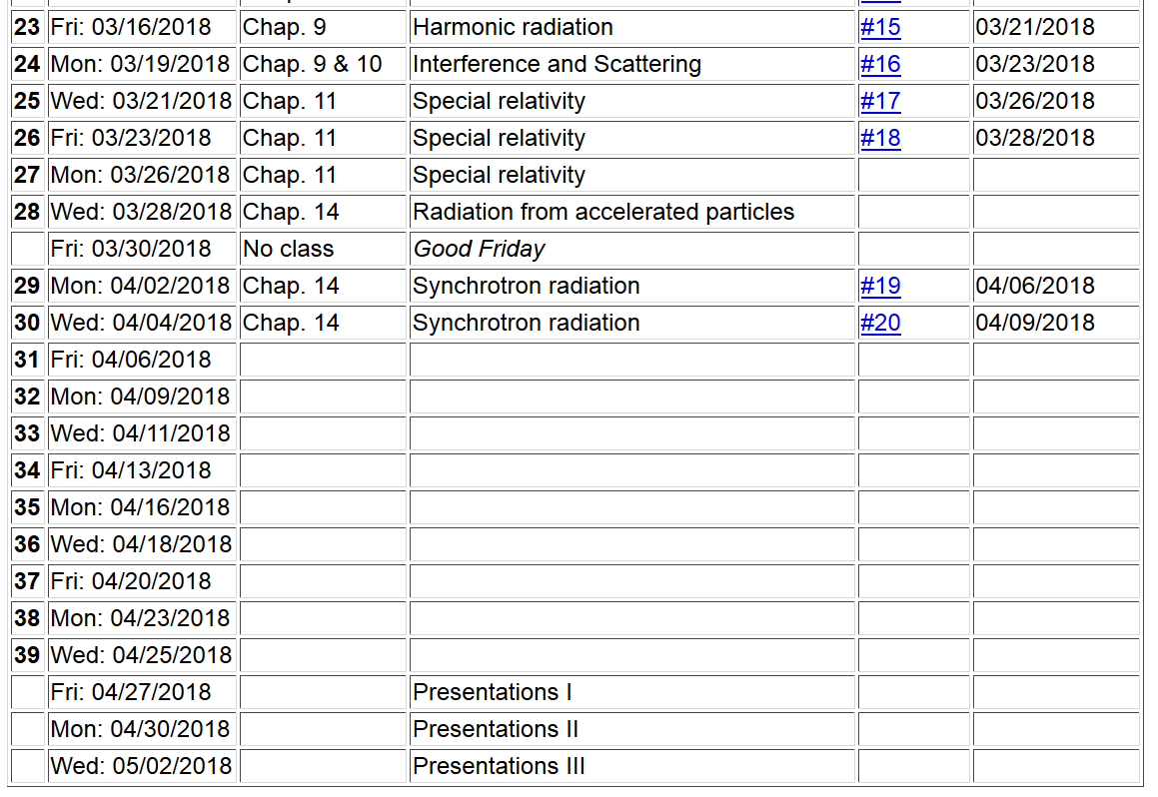

Slide 5
Radiation from a moving charged particle
z
r-R_{q}(t)
q
r
R_{q}(t)
y
x

Slide 6
Liénard-Wiechert fields (cgs Gaussian units):

Slide 7
Electric and magnetic fields far from source:

Slide 8
Poynting vector:

Slide 9
Spectral composition of electromagnetic radiation

Slide 10
Spectral composition of electromagnetic radiation -- continued

Slide 11
z
Example for circular motion:
r
.
θ
β
y
β
Top view:
x
ρ
y
x

Slide 12
z
r
.
θ
β
y
β
x

Slide 13
Synchrotron radiation geometry –
using modified Bessel functions
Exponential factor

Slide 14
Spectral form of synchrotron radiation in this case:

Slide 15
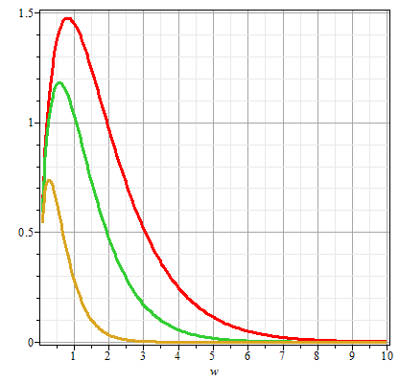
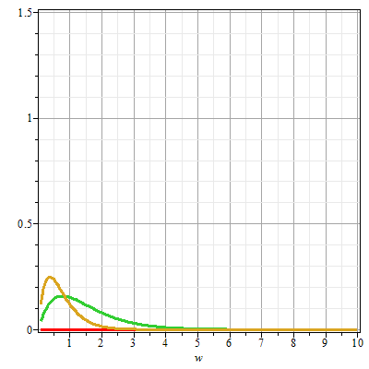
Plots of the intensity function for synchrotron radiation
γθ=0
γθ=0.5
γθ=1
γθ=1
γθ=0.5
ω/ω_{c}
ω/ω_{c}

Slide 16
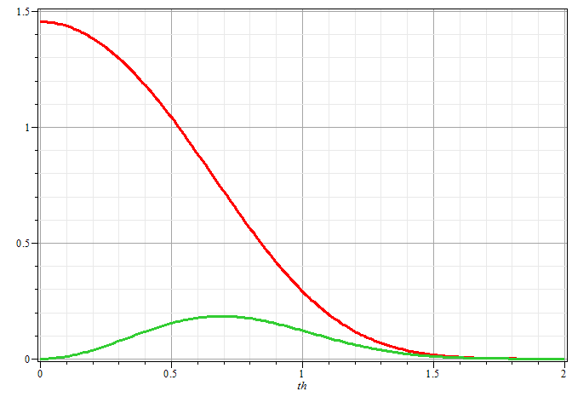
Plots of the intensity function for synchrotron radiation
ω/ω_{c}=1
γθ

Slide 17
Synchrotron facilities worldwide
https://lightsources.org/

Slide 18
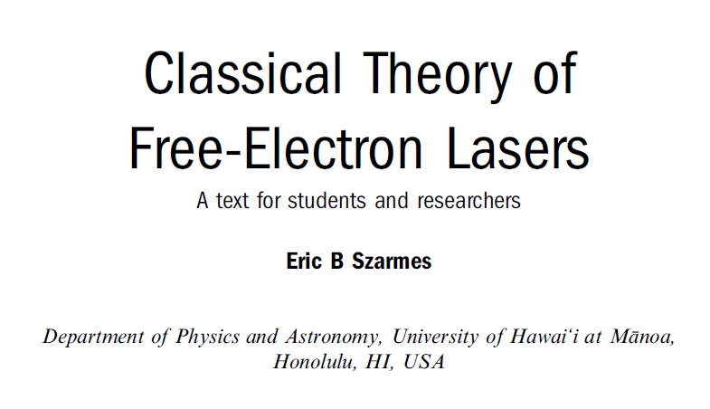
Free electron laser
Reference:

Slide 19
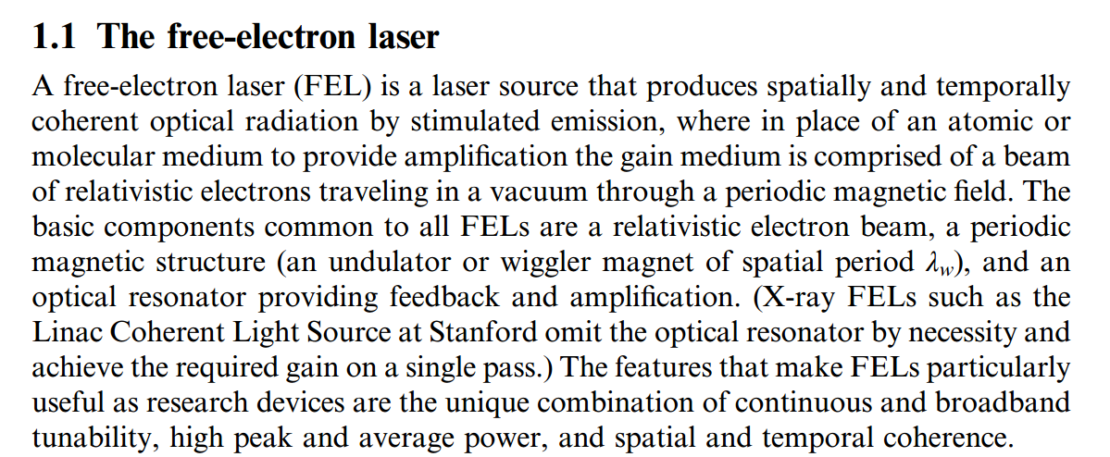

Slide 20
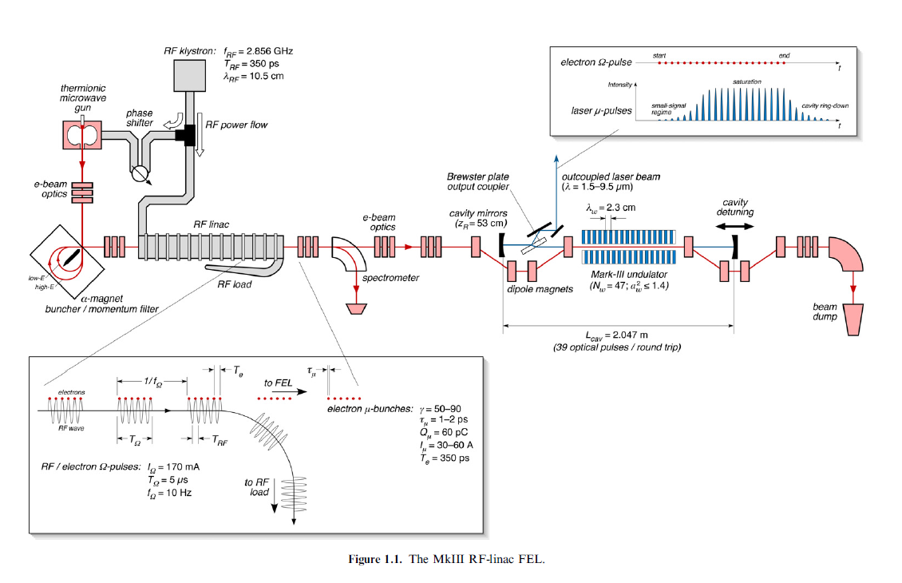

Slide 21
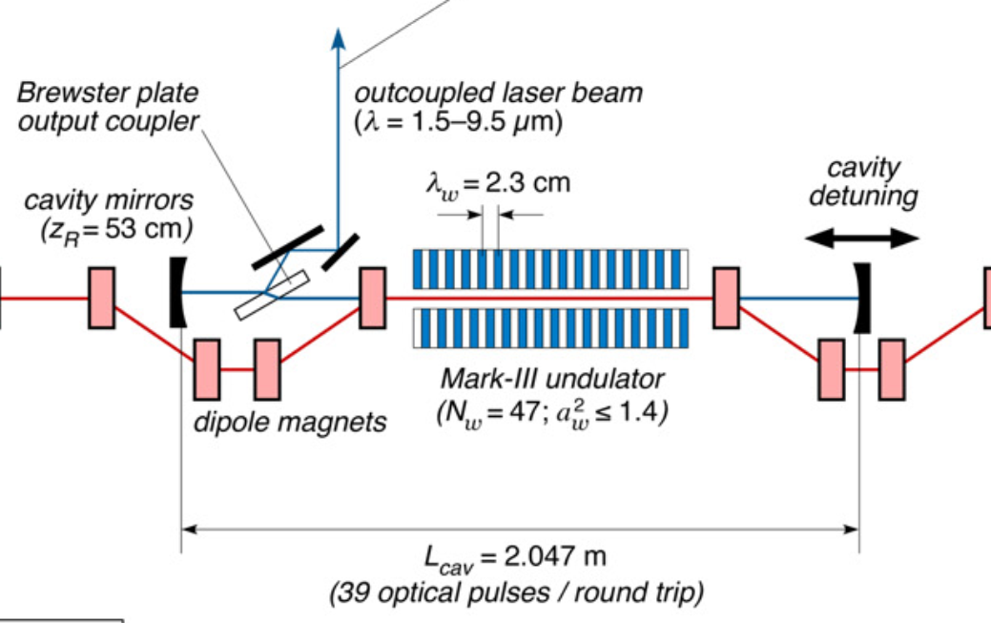

Slide 22
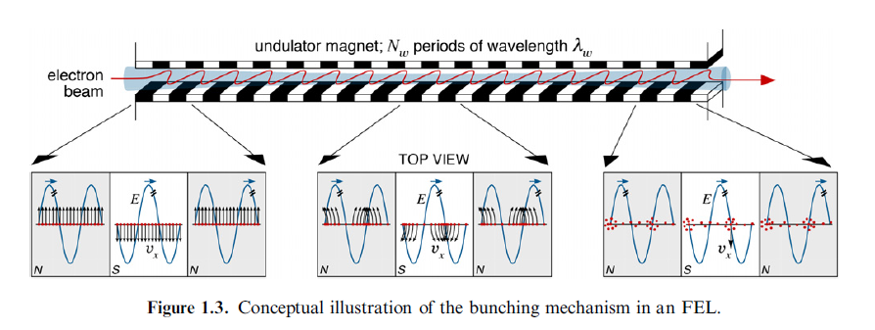
Electron emission in periodic magnet

Slide 23
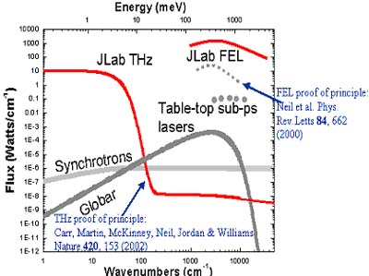
Spectral output for FEL at Jefferson Lab (in Virginia)

Slide 24
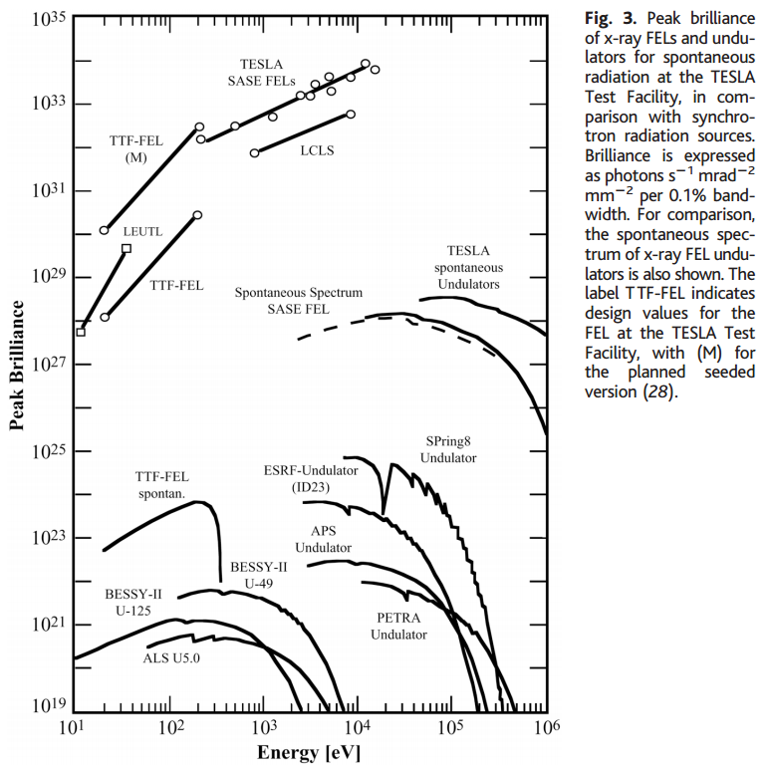

Slide 25
Some details of scattering of electromagnetic waves incident on a particle of charge q and mass m_{q}
r
k₀
θ
ε₂
ε₀
φ
ε₁

Slide 26
Thompson scattering – non relativistic approximation

Slide 27
Thompson scattering – non relativistic approximation -- continued
r
k₀
θ
ε₂
ε₀
φ
ε₁

Slide 28
Thompson scattering – non relativistic approximation -- continued
Scattered light may be polarized parallel to incident field or polarized with an angle θ so that the time and polarization averaged cross section is given by:
This formula is appropriate in the X-ray scattering of electrons or soft γ-ray scattering of protons

Slide 29
Thompson scattering – relativistic and quantum modifications
p_{q}
incident photon
α
p
θ
p’
scattered
photon
04/08/2013
29

Slide 30
Thompson scattering – relativistic and quantum modifications
p_{q}
incident photon
α
p
θ
p’
scattered
photon

