Slide 1
PHY 712 Electrodynamics
9-9:50 AM MWF Olin 105
Plan for Lecture 33:
Review – radiating systems
Coments/corrections on Cherenkov radiation
Solution of Maxwell’s equations with sources
Liénard-Wiechert potentials
Time periodic sources

Slide 2
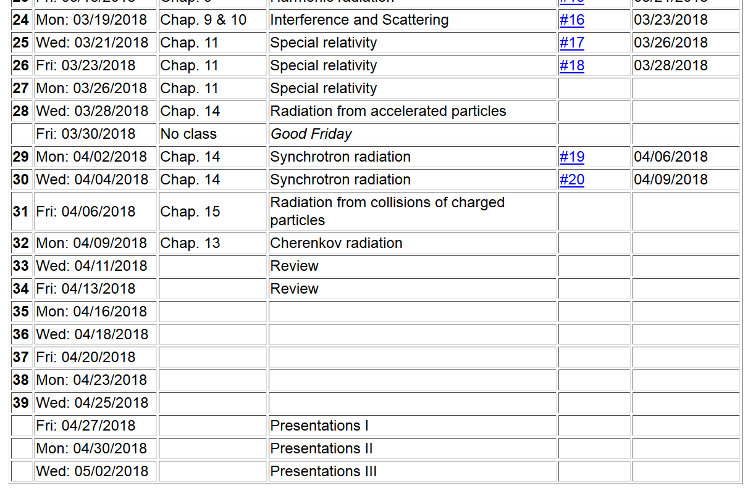

Slide 3
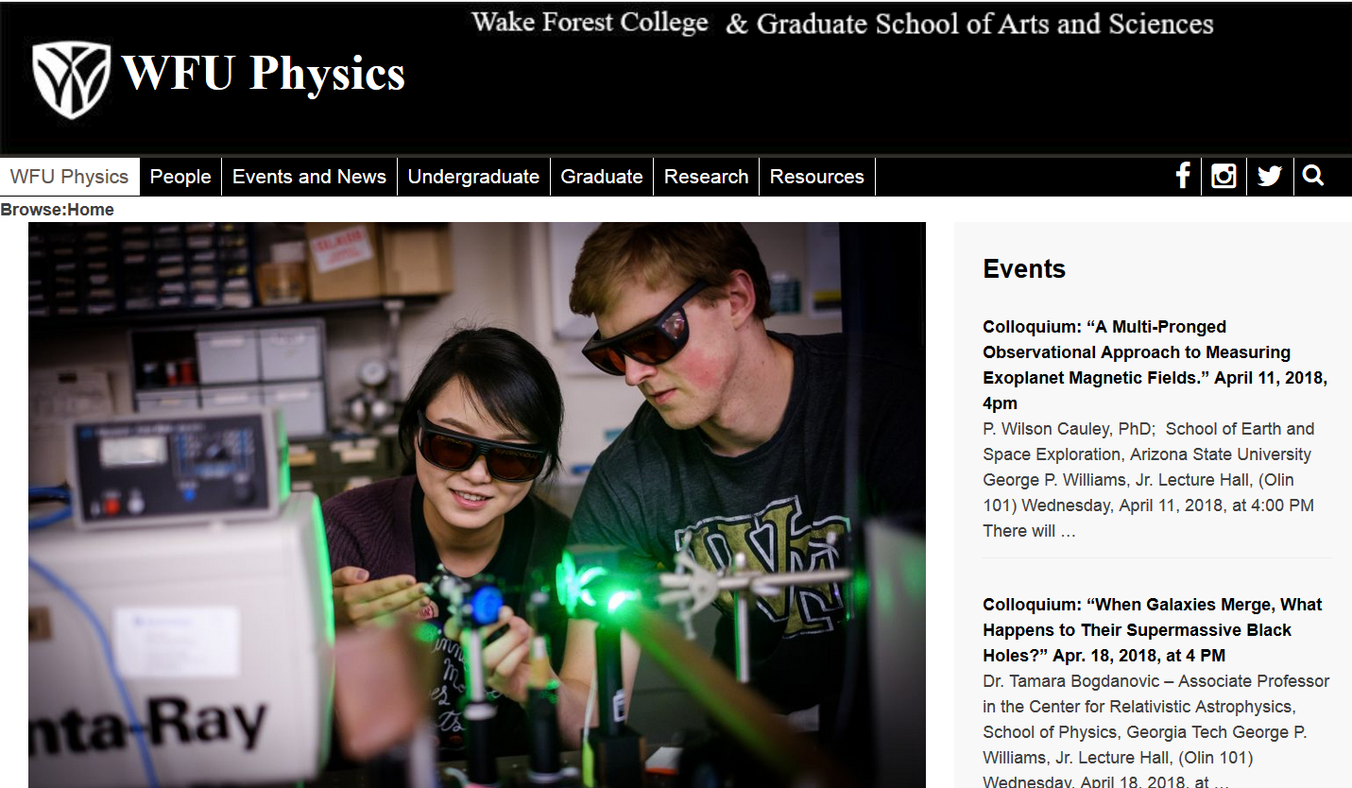

Slide 4
R_{q}(t)
q

Slide 5
Liénard-Wiechert potential solutions:

Slide 6
r
R(t)
R(t_{r})
vt_{r}
vt

Slide 7
r
R(t)
R(t_{r})
θ(t)
vt_{r}
vt

Slide 8
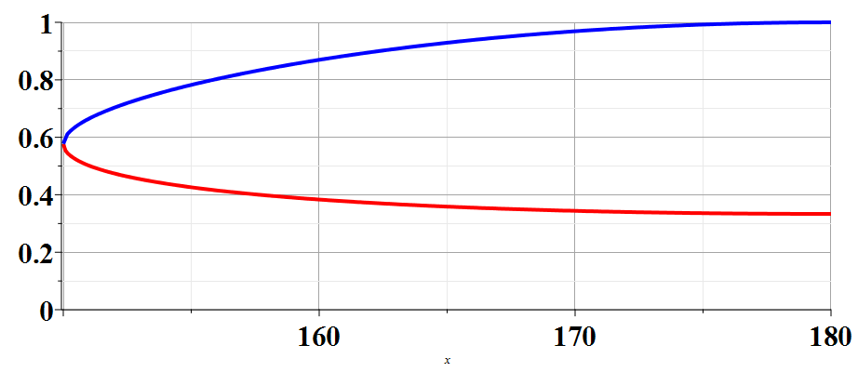
R(t_{r})/R(t)
β=2
θ

Slide 9
Liénard-Wiechert potentials for two
different retarded times:
r
R(t)
R(t_{r})
θ(t)
vt_{r}
vt
➔Diagram is not correct!

Slide 10
Physical fields for β_{n} > 1 -- two retarded solutions contribute
r
R(t)
R(t_{r})
θ(t)
vt_{r}
vt

Slide 11
Physical fields for β > 1

Slide 12
Intermediate steps:
r
R(t)
R(t+Δt)
θ(t)
θ(t+Δt)
vt
vΔt

Slide 13
Cherenkov radiation observed near the angle θ_{c} -- continued
E
S

Slide 14
General review --
Maxwell’s equations

Slide 15
General review --
Maxwell’s equations

Slide 16
Keep SI units for the moment --
Formulation of Maxwell’s equations in terms of vector and scalar potentials

Slide 17
Formulation of Maxwell’s equations in terms of vector and scalar potentials -- continued

Slide 18
Formulation of Maxwell’s equations in terms of vector and scalar potentials -- continued

Slide 19
Solution of Maxwell’s equations in the Lorentz gauge

Slide 20
Solution of Maxwell’s equations in the Lorentz gauge -- continued

Slide 21
Solution of Maxwell’s equations in the Lorentz gauge -- continued

Slide 22
➔Liénard-Wiechert potentials

Slide 23
Liénard-Wiechert potentials
*
*

