Slide 1
PHY 712 Electrodynamics
9-9:50 AM MWF Olin 105
Plan for Lecture 34:
Review – radiating systems
Solution of Maxwell’s equations with sources
Time periodic sources
Examples

Slide 2
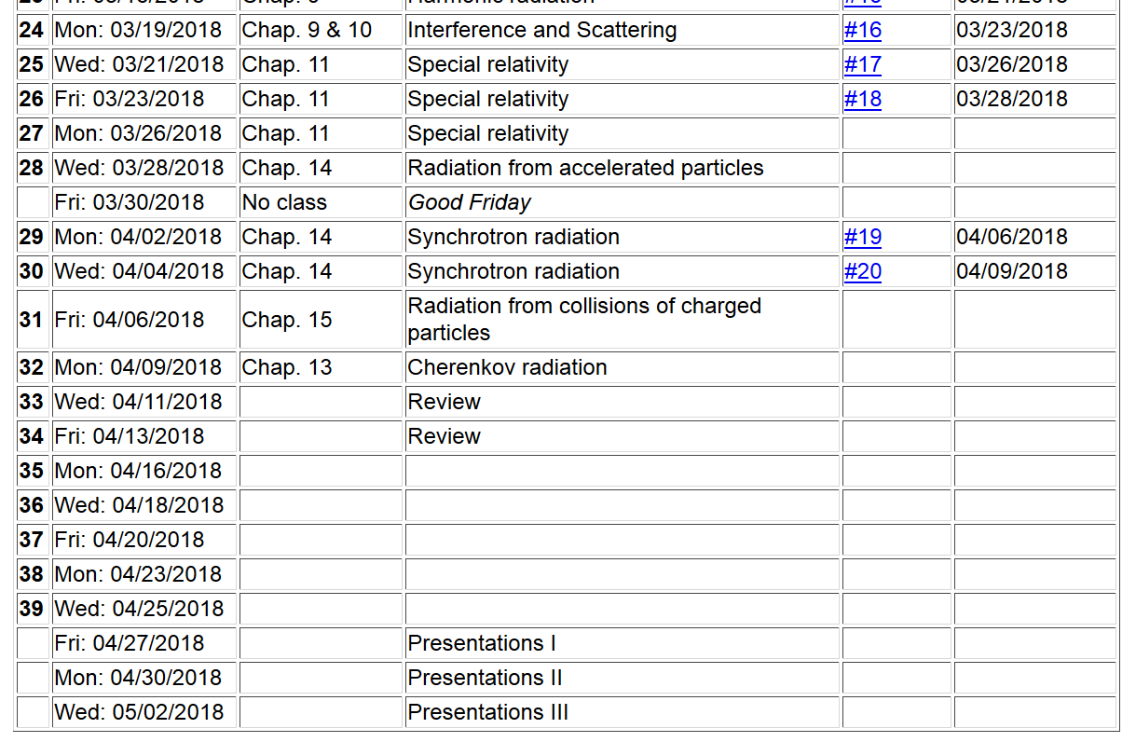

Slide 3
General review --
Maxwell’s equations

Slide 4
Formulation of Maxwell’s equations in terms of vector and scalar potentials

Slide 5
Formulation of Maxwell’s equations in terms of vector and scalar potentials -- continued

Slide 6
Formulation of Maxwell’s equations in terms of vector and scalar potentials -- continued

Slide 7
Solution of Maxwell’s equations in the Lorentz gauge -- continued

Slide 8
Solution of Maxwell’s equations in the Lorentz gauge -- continued

Slide 9
➔Liénard-Wiechert potentials

Slide 10
Summary --

Slide 11
Solution of Maxwell’s equations in the Lorentz gauge -- continued

Slide 12
Electromagnetic waves from time harmonic sources

Slide 13
Electromagnetic waves from time harmonic sources – continued:

Slide 14
Radiation from time harmonic sources --

Slide 16
Electromagnetic waves from time harmonic sources – continued:

Slide 17
Electromagnetic waves from time harmonic sources – continued:

Slide 18
Forms of spherical Bessel and Hankel functions:
j₀(x)
j₁(x)
y₀(x)
y₁(x)

Slide 19
Electromagnetic waves from time harmonic sources – continued:

Slide 20
Electromagnetic waves from time harmonic sources – continued -- some details:

Slide 21
Electromagnetic waves from time harmonic sources – continued:
Example of radiation source

Slide 22
Example of radiation source

Slide 23
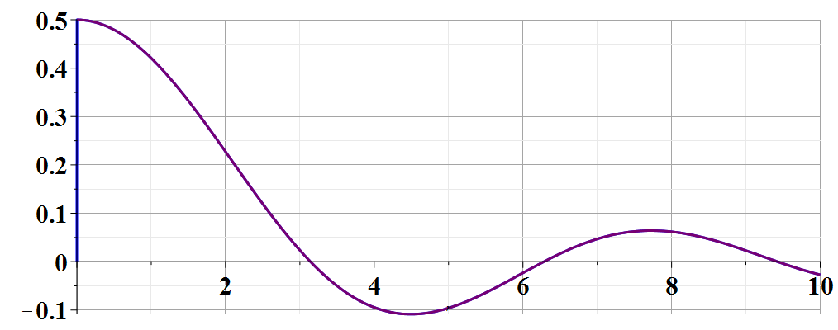
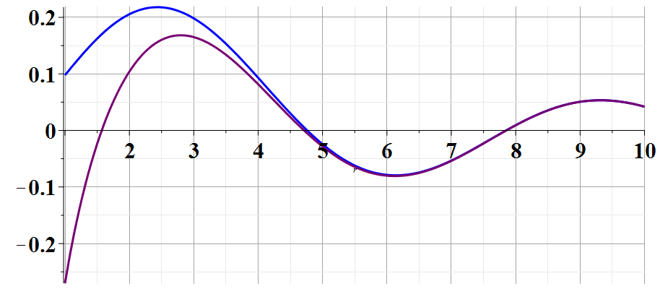
Example of radiation source

Slide 24
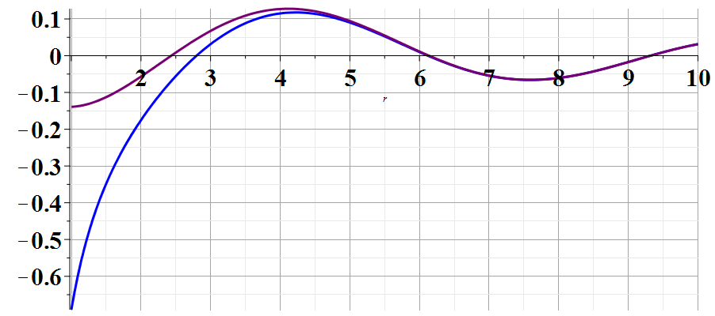
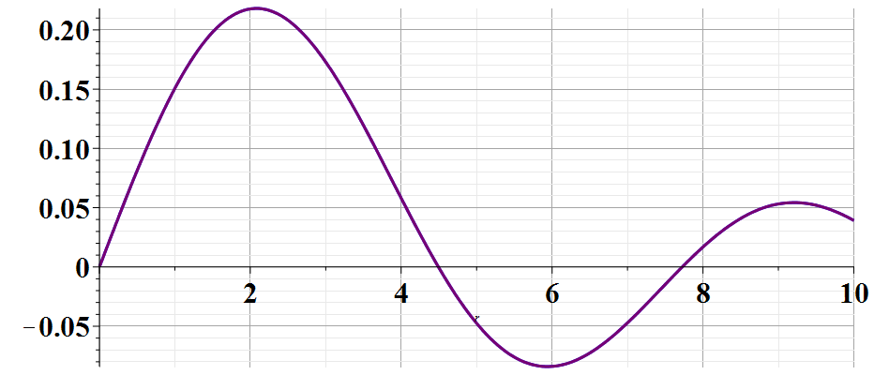
Example of radiation source

Slide 25
Example of dipole radiation source -- continued
Relationship to pure dipole approximation (exact when kR➔0)

