Slide 1
PHY 712 Electrodynamics
9-9:50 AM MWF Olin 105
Plan for Lecture 37:
Special Topics in Electrodynamics:
Tunneling between superconductors
Optical properties of materials
Birefringence
Non-linear effects

Slide 2
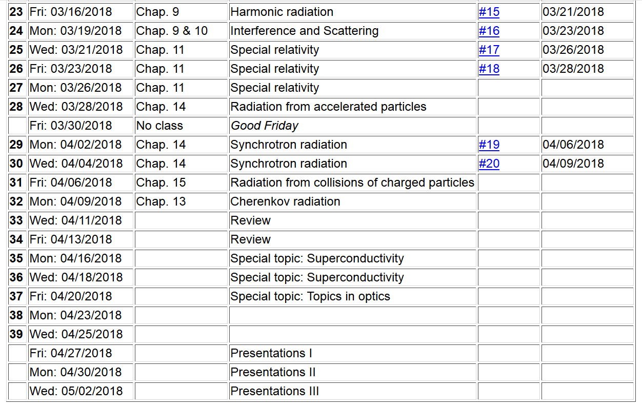

Slide 3
Mechanism for vortex detection --
Josephson junction -- tunneling current between two superconductors (Ref. Teplitz, Electromagnetism (1982))
d
x
B_{z}

Slide 4
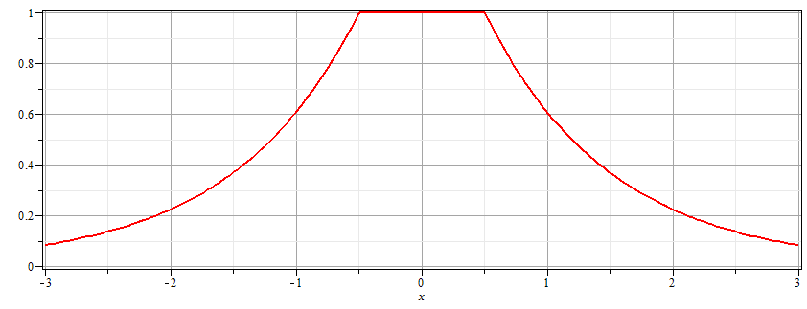
Josephson junction -- continued
Supercon left
Junction
Supercon right
B_{z}
d

Slide 5
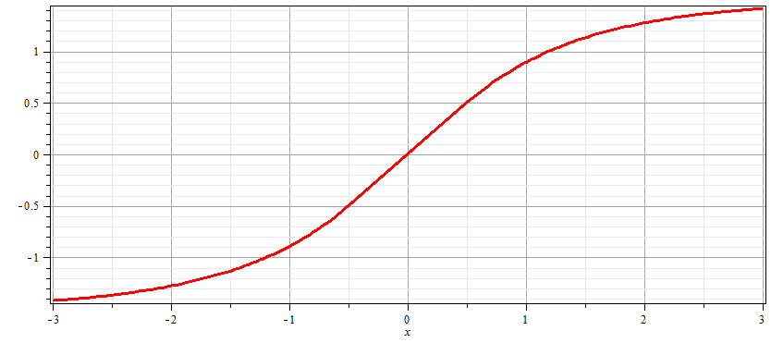
Josephson junction -- continued
Supercon left
Junction
Supercon right
A_{y}
d

Slide 6
Josephson junction -- continued
d
L
R
x
Coupling parameter

Slide 7
Josephson junction -- continued

Slide 8
Josephson junction -- continued
J_{L}
J_{R}
J_{T}
L
R
x

Slide 9
Josephson junction -- continued
J_{L}
J_{R}
J_{T}
L
R
x

Slide 10
Josephson junction -- continued
J_{L}
J_{R}
J_{T}
L
R
x

Slide 11
Josephson junction -- continued
Supercon left
Junction
Supercon right
A_{y}
d

Slide 12
Josephson junction -- continued
J_{L}
J_{R}
J_{T}
L
R
x
B_{z}

Slide 13
Josephson junction -- continued
J_{L}
J_{R}
J_{T}
L
R
w
w
x

Slide 14
Josephson junction -- continued
J_{L}
J_{R}
J_{T}
L
R
w
w
x

Slide 15
Josephson junction -- continued
d
J_{L}
J_{R}
J_{T}
L
R
w
w
x
B_{z}

Slide 16
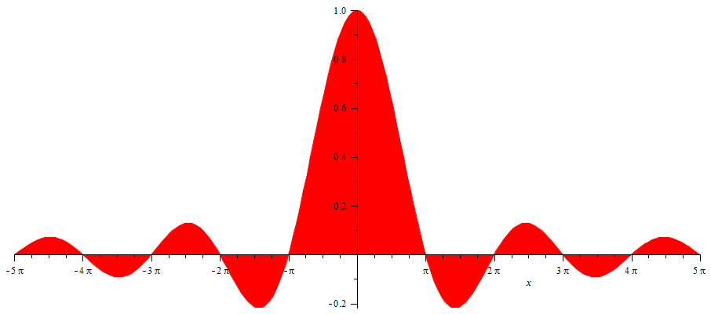
Josephson junction -- continued
SQUID =superconducting quantum interference device
I_{T}
Φ/Φ₀
Note: This very sensitive “SQUID” technology has been used in scanning probe techniques. See for example, J. R. Kirtley, Rep. Prog. Physics 73, 126501 (2010).

Slide 17
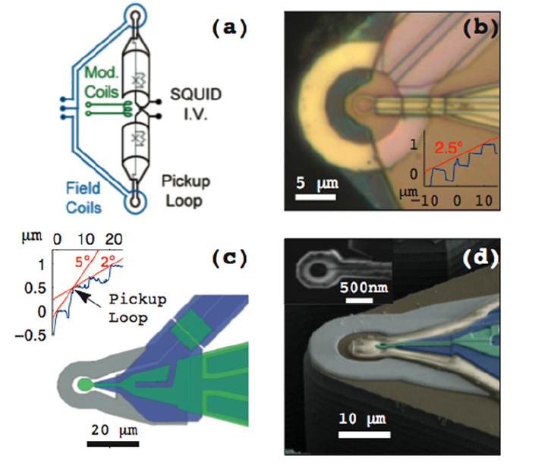
Scanning SQIUD microscopy
Ref. J. R. Kirtley, Rep. Prog. Phys. 73 126501 (2010)

Slide 18
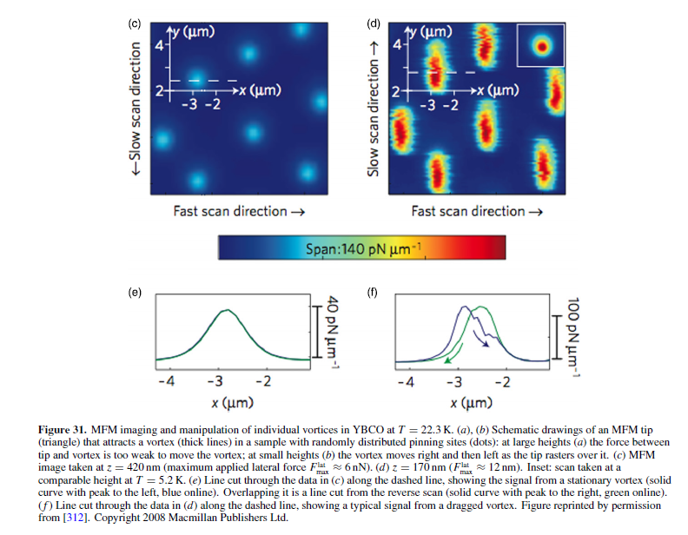

Slide 19
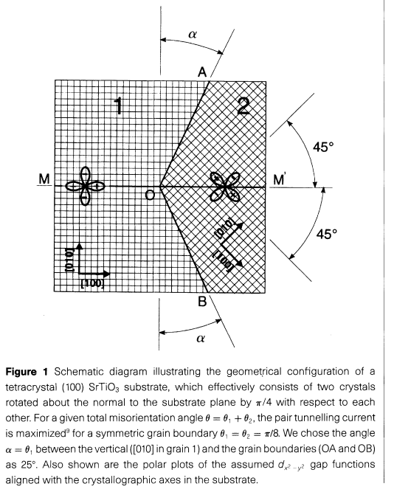
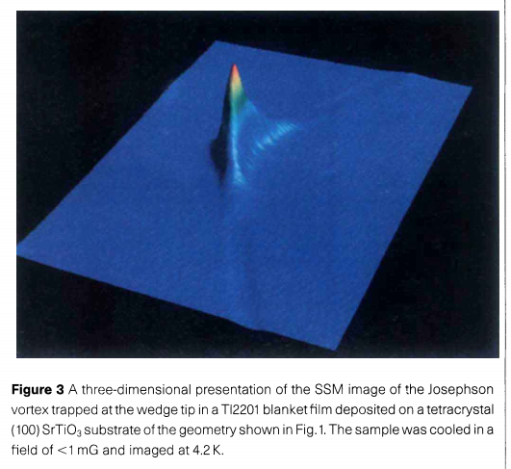
pg. 481

Slide 20
Change of topics – review of reflection/refraction of electromagnetic plane waves.
Maxwell’s equations

Slide 21
Analysis of Maxwell’s equations without sources -- continued:
E₀
B₀
k

Slide 22
Reflection and refraction of plane electromagnetic waves at a plane interface between dielectrics (assumed to be lossless)
isotropic materials
μ’ ε’
k’
θ
μ ε
k_{R}
k_{i}
i
R

Slide 23
Reflection and refraction -- continued
μ’ ε’
θ
k’
μ ε
k_{i}
k_{R}
i
R

Slide 24
Reflection and refraction -- continued
μ’ ε’
θ
k’
μ ε
k_{i}
k_{R}
i
R

Slide 25
Reflection and refraction -- continued
μ’ ε’
θ
k’
μ ε
k_{i}
k_{R}
i
R

Slide 26
Reflection and refraction -- continued
μ’ ε’
θ
k’
μ ε
k_{i}
k_{R}
i
R

Slide 27
Reflection and refraction -- continued
s-polarization – E field “polarized” perpendicular to plane of incidence
μ’ ε’
θ
k’
μ ε
k_{i}
k_{R}
i
R

Slide 28
Reflection and refraction -- continued
p-polarization – E field “polarized” parallel to plane of incidence
μ’ ε’
θ
k’
μ ε
k_{i}
k_{R}
i
R

Slide 29
Reflection and refraction -- continued
μ’ ε’
θ
k’
μ ε
k_{i}
k_{R}
i
R

Slide 30
For s-polarization
For p-polarization

Slide 31
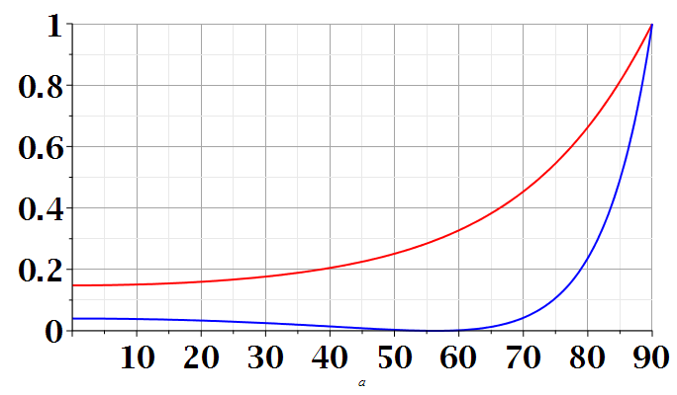
s-polarization
p-polarization
i
i

Slide 32
Extension of analysis to anisotropic media --

Slide 33
Consider the problem of determining the reflectance from an anisotropic medium with isotropic permeability μ₀ and anisotropic permittivity ε₀ κ where:
By assumption, the wave vector in the medium is
confined to the x-y plane and will be denoted by
The electric field inside the medium is given by:

Slide 34
Digression --
Expecting this matrix to be symmetric/Hermitian, it can be diagonalized by a similarity transformation

Slide 35
Inside the anisotropic medium, Maxwell’s equations for time harmonic fields are:

Slide 36
Inside the anisotropic medium, Maxwell’s equations for time harmonic fields – continued --

Slide 37
The fields for the incident and reflected waves are the same as for the isotropic case.
Note that, consistent with Snell’s law:
Continuity conditions at the y=0 plane must be applied for the following fields:
There will be two different solutions, depending of the polarization of the incident field.

Slide 38
Solution for s-polarization

Slide 39
Solution for p-polarization

