Slide 1
PHY 712 Electrodynamics
9-9:50 AM MWF Olin 105
Plan for Lecture 38:
Special Topics in Electrodynamics:
Optical properties of materials
Image reconstruction – computerized tomography
Ref. Born & Wolf, Principles of Optics, 7th edition (1999)

Slide 2
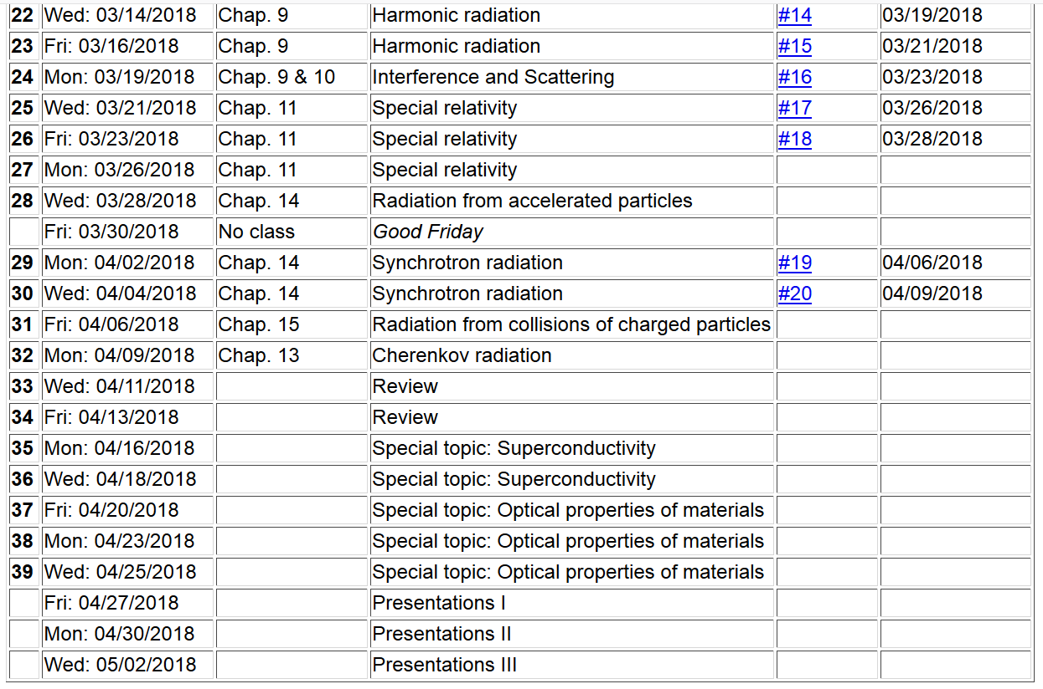

Slide 3
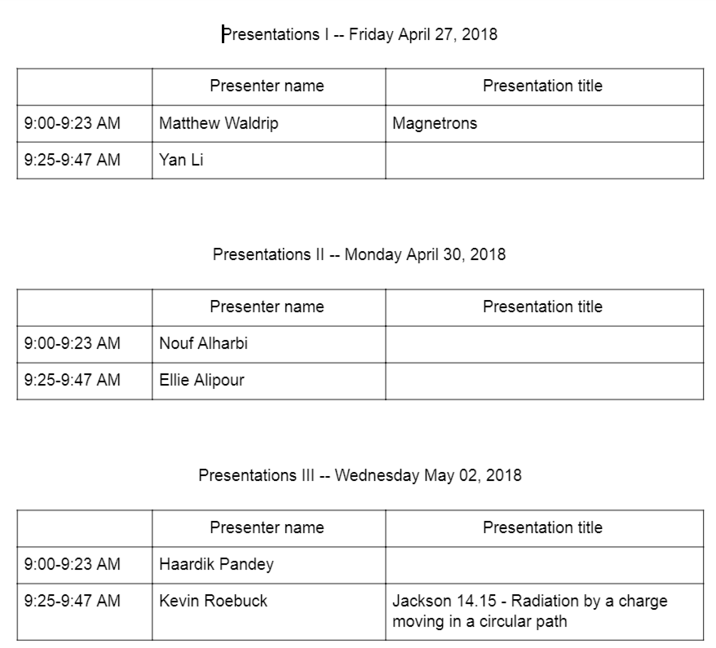

Slide 4
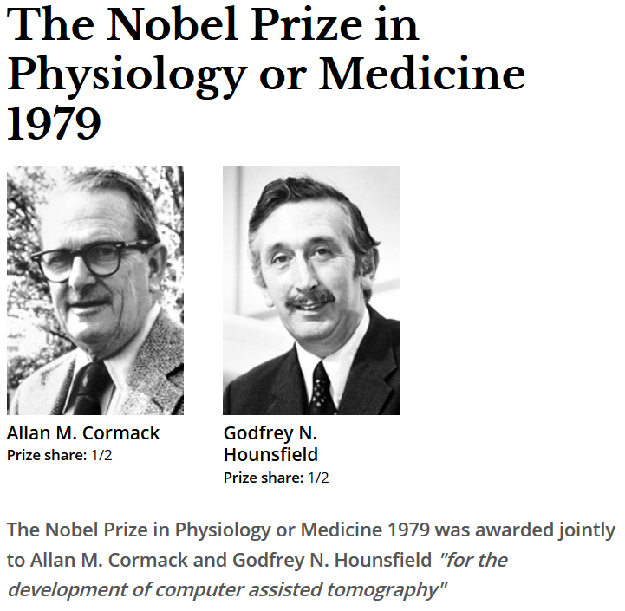
https://www.nobelprize.org/nobel_prizes/medicine/laureates/1979/

Slide 5
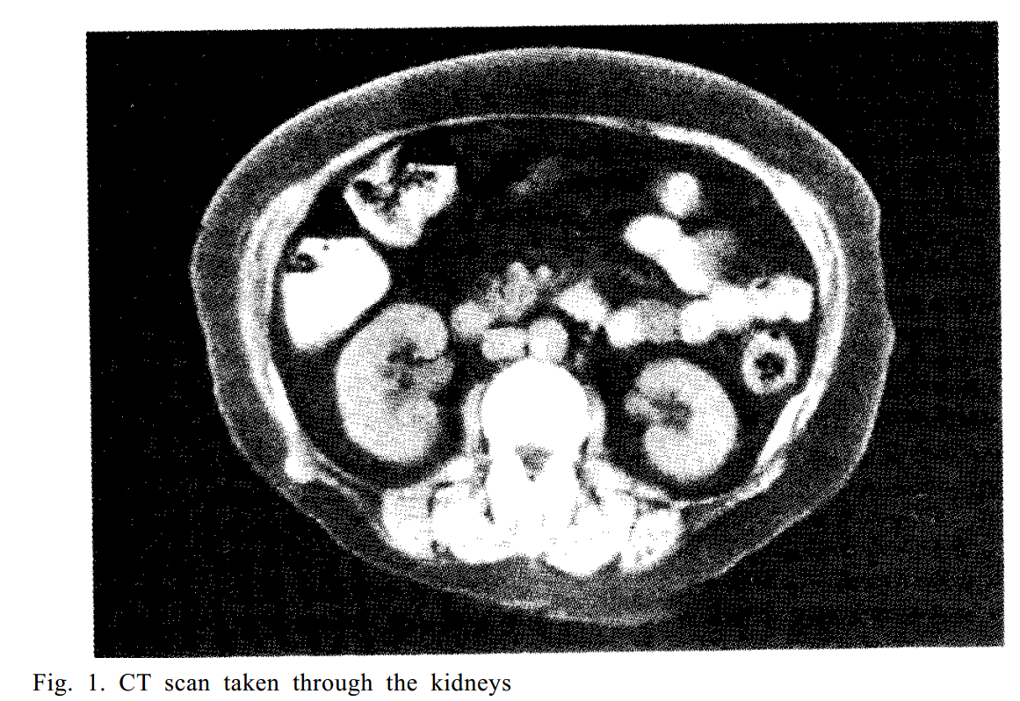
https://www.nobelprize.org/nobel_prizes/medicine/laureates/1979/hounsfield-lecture.pdf

Slide 6
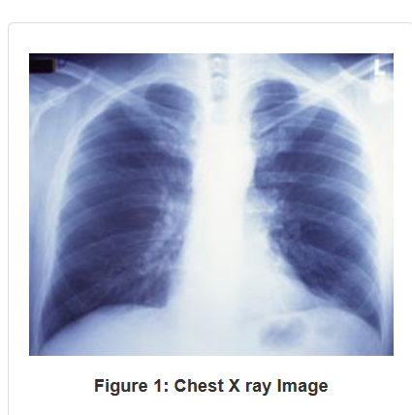
Conventional X ray image

Slide 7
The mathematical framework for computerized tomography is the Radon transform (J. Radon, Math. Phys. Klasse 69, 262 (1917)). In addition to medical imaging, it is also used in astrophysics, geophysics, and materials physics.
Beer’s law
I₀
P₀
P₁
l

Slide 8
https://www.fda.gov/Radiation-EmittingProducts/RadiationEmittingProductsandProcedures/MedicalImaging/MedicalX-Rays/ucm115318.htm

Slide 11
y
x₀
y₀
x

Slide 12
From scan

Slide 13
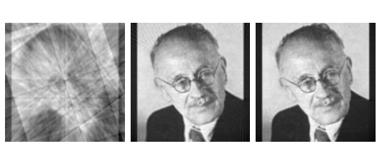
Example of reconstruction of photo from increasing number of projections

