Slide 1
PHY 712 Electrodynamics
9-9:50 AM MWF Olin 105
Plan for Lecture 39:
Special Topics in Electrodynamics:
Optical properties of materials
Brief introduction to non-linear optics
Ref. Robert W. Boyd, Nonlinear Optics
(material from that text used in lecture notes)
➔Evaluation form

Slide 2
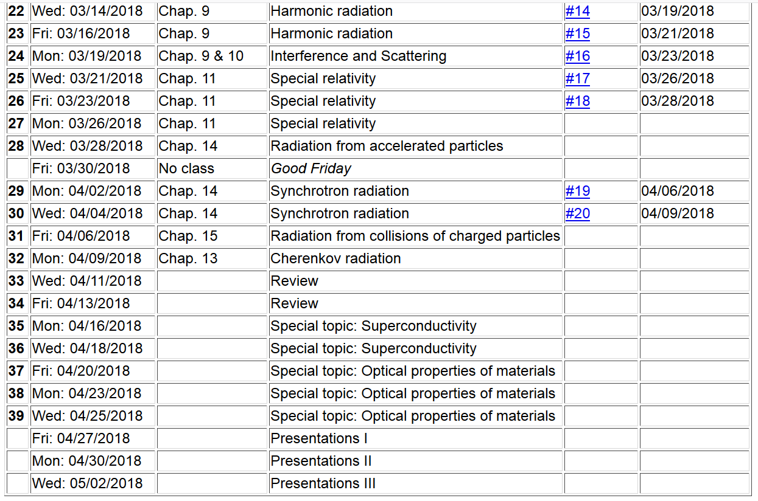

Slide 3
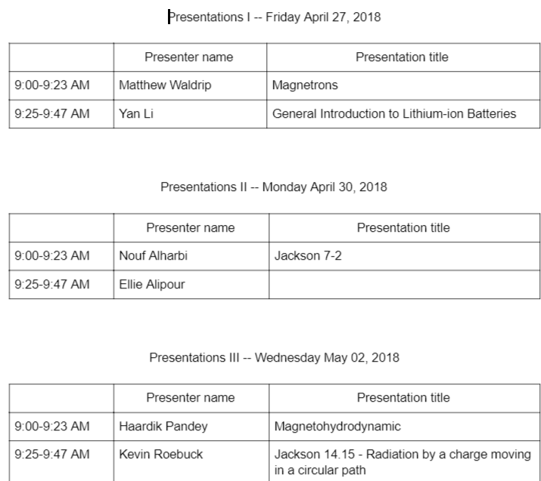

Slide 4
Take home exam
Exam due

Slide 5
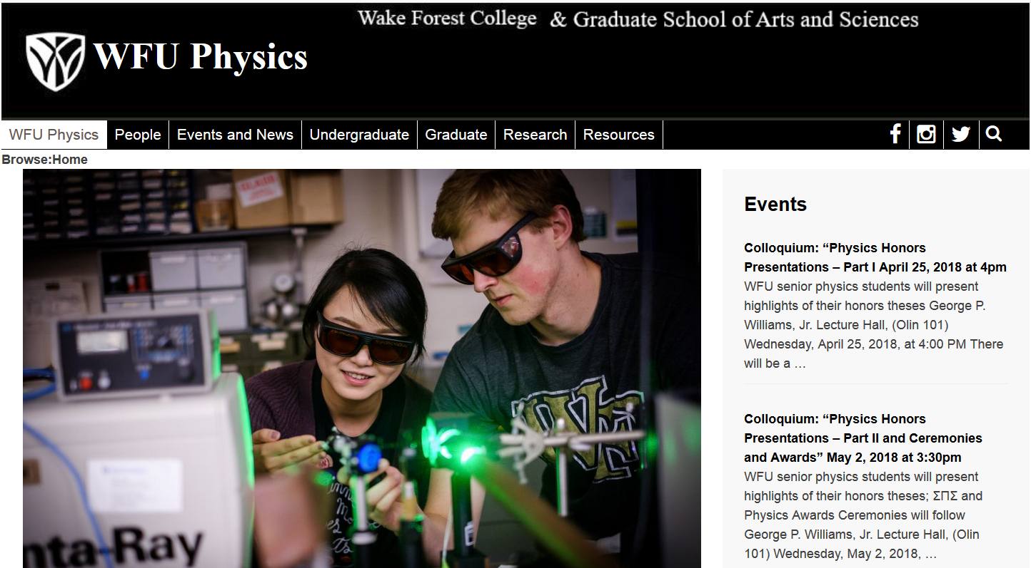

Slide 6
Up to now, we have considered electrodynamics as a linear phenomenon. Maxwell’s equations are linear equations. However, for some light-matter interactions, light alters the properties of the material and causes nonlinear effects.
Nonlinear response

Slide 7
Nonlinear response to time harmonic field:
optical rectification
second harmonic generation
Example Nd:YAG (Nd:Y₃Al₅O₁₂) laser has λ=1060 nm; a nonlinear crystal can output λ/2=530 nm.

Slide 8
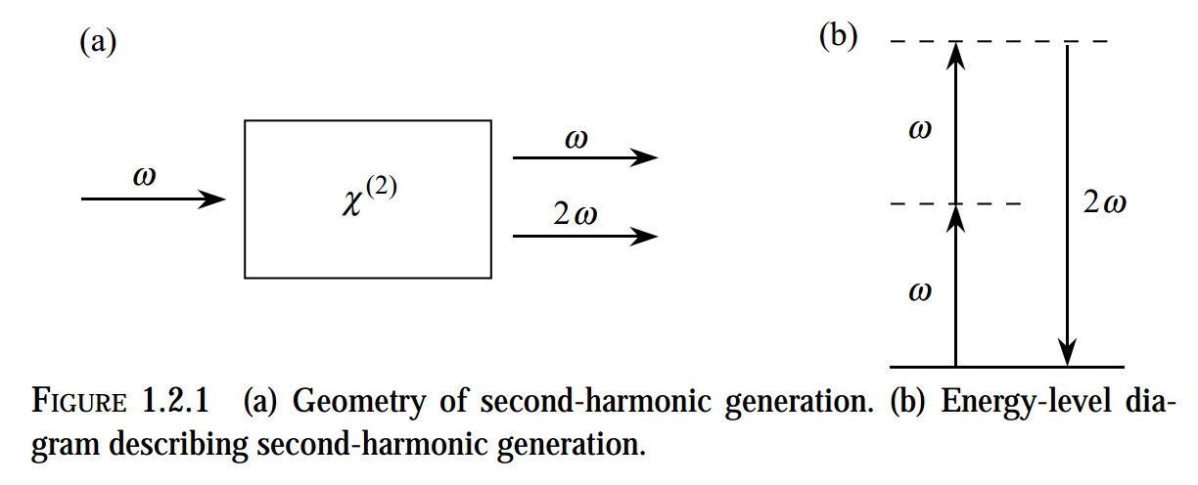

Slide 9
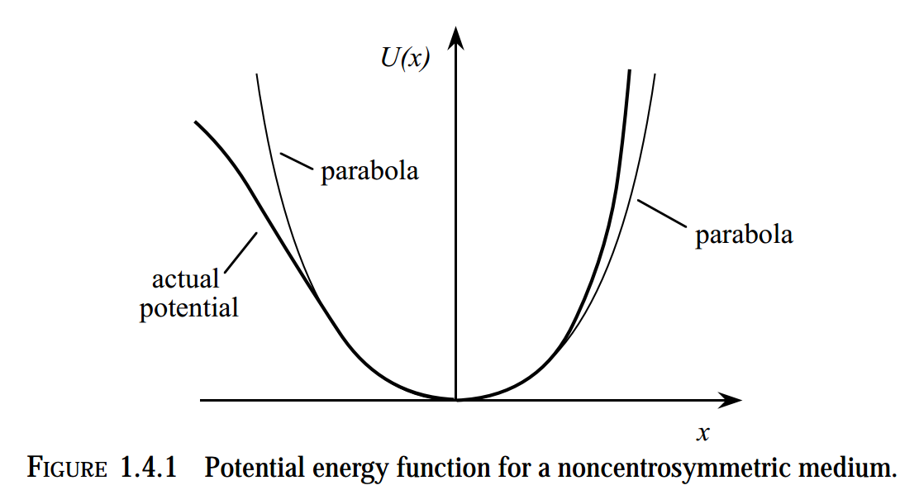
Drude-like model of nonlinear response of electron of mass m:

Slide 10
Drude-like model -- continued

Slide 11
Drude-like model -- continued
Note that this analysis assumes that the crystal is asymmetric.

Slide 12
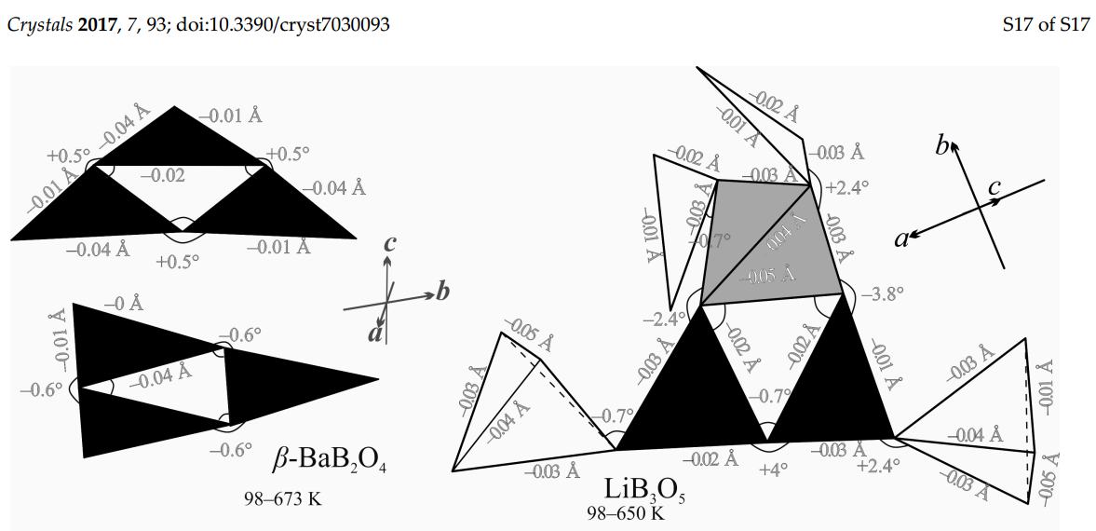
Examples of nonlinear crystals

