Slide 1
PHY 712 Electrodynamics
9-9:50 AM MWF Olin 105
Plan for Lecture 5:
Reading: Chapter 1 & 2 in JDJ
Introduction to numerical methods
Finite difference methods with 2-dimensional example (Section 1.13 of your textbook)
Finite element methods with 2-dimensional example (Section 2.12 of your textbook)

Slide 2
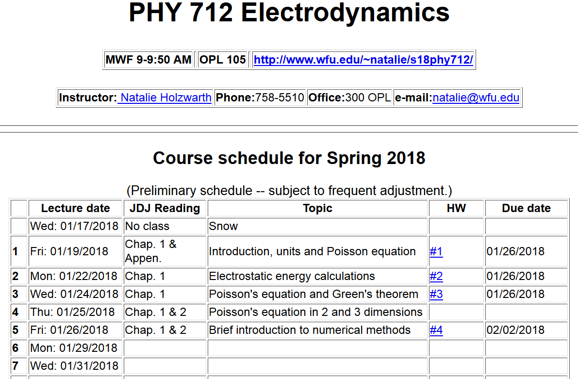

Slide 3
