Slide 1
PHY 712 Electrodynamics
9-9:50 AM MWF Olin 105
Plan for Lecture 1:
Reading: Appendix 1 and Chapters I&1
Course structure and expectations
Units – SI vs Gaussian
Electrostatics – Poisson equation

Slide 2
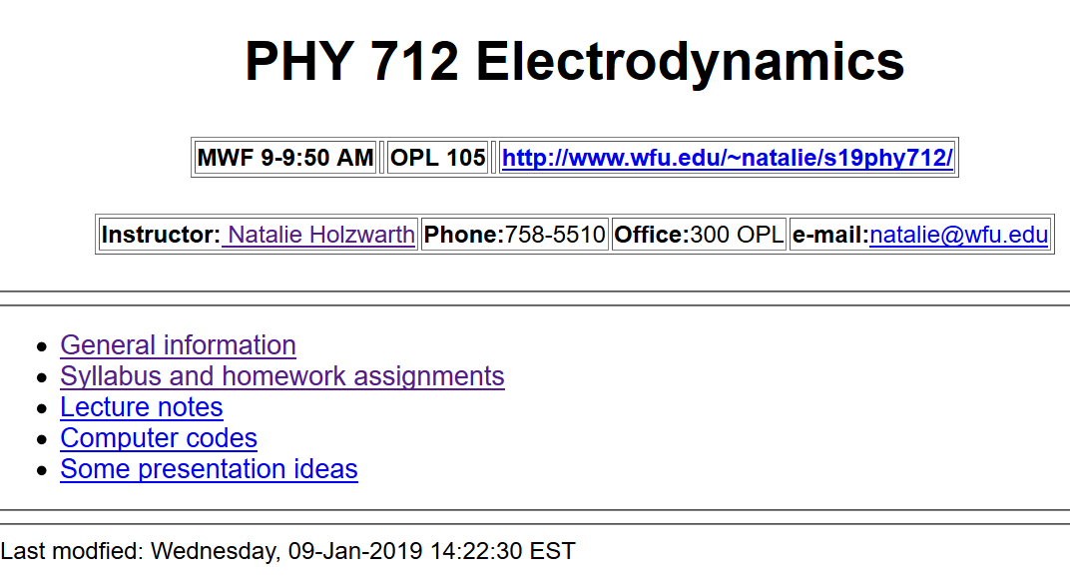
http://users.wfu.edu/natalie/s19phy712/

Slide 3
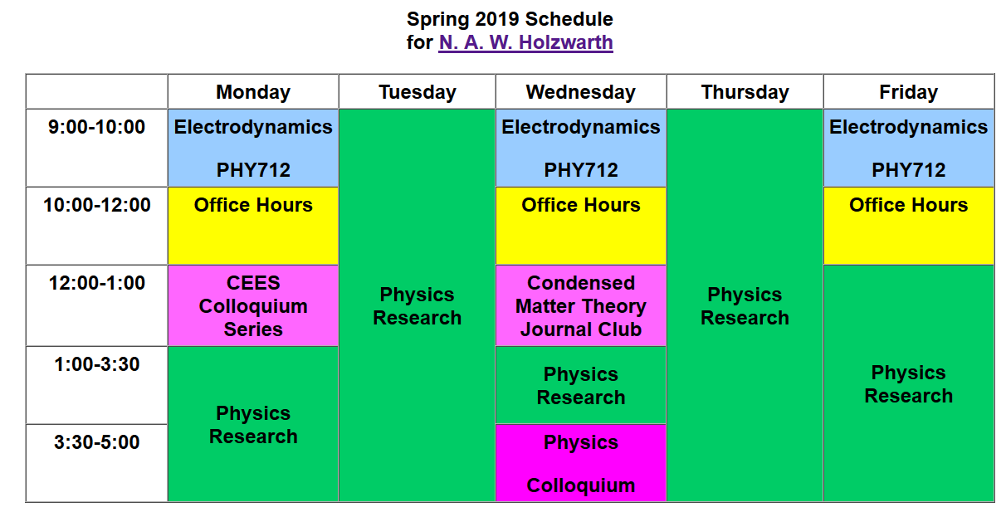
Please email natalie@wfu.edu if you would like to meet with me at any time.

Slide 5
Textbook
Optional supplement

Slide 6
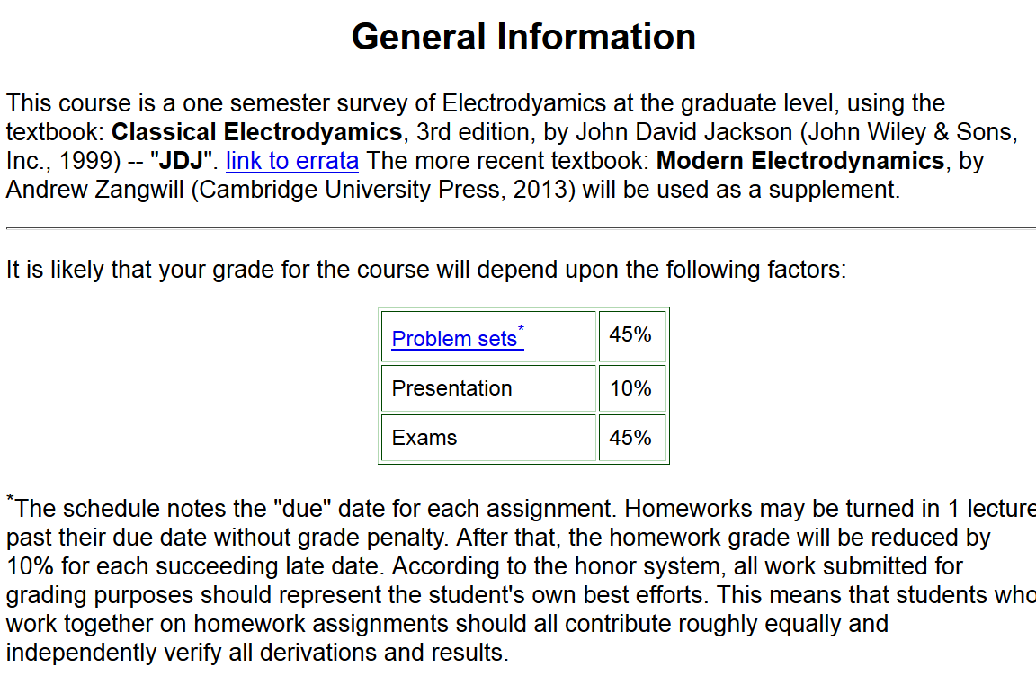

Slide 7
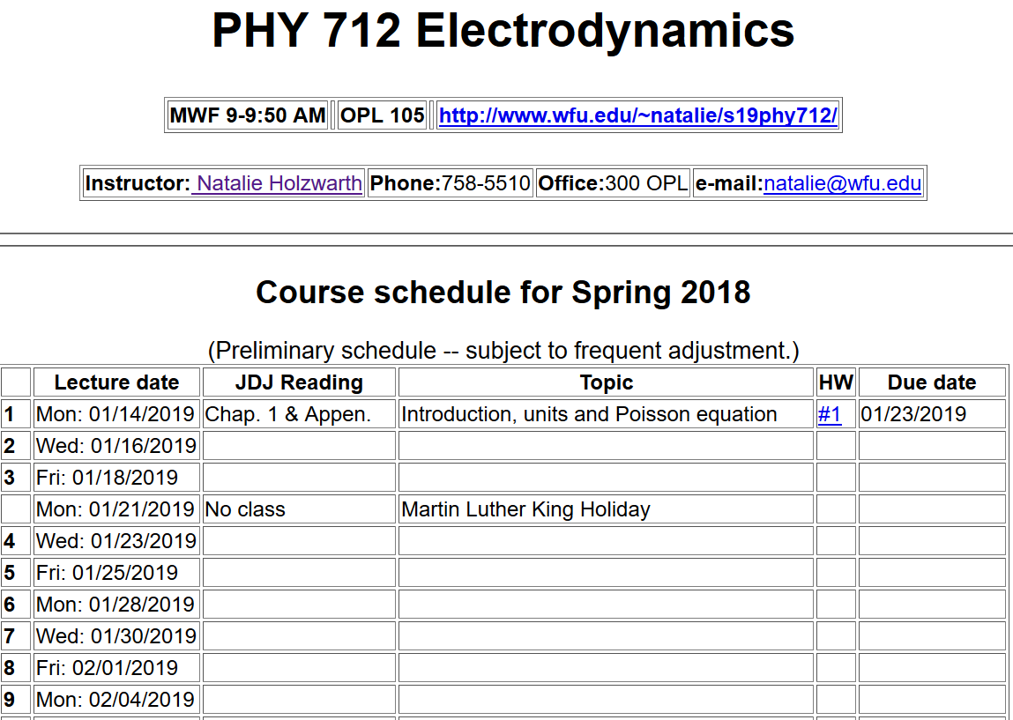

Slide 9
Comment about HW #1: (Jackson problem 1.5)
The time-averaged potential of a neutral hydrogen atom is given by:
where q denotes the magnitude of the elementary charge of an electron or proton and where a₀ denotes the Bohr radius. Find the distribution of charge (both continuous and discrete) that will give this potential and interpret your results physically.

Slide 11
Material discussed in Appendix of textbook --

Slide 15
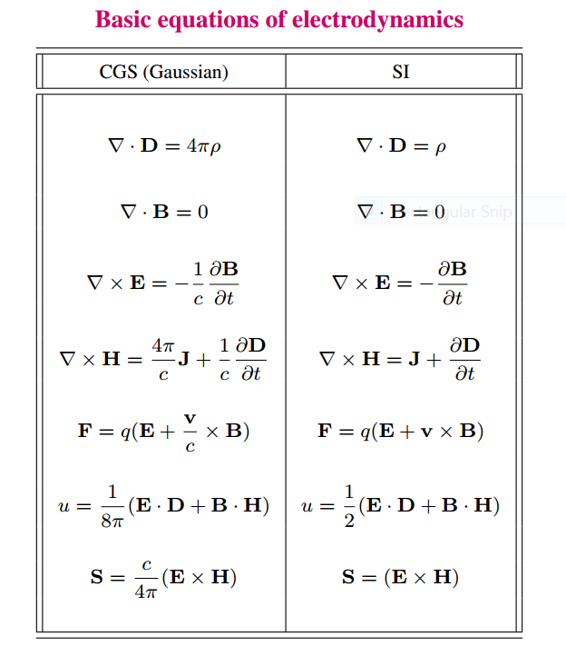

Slide 16
Units choice for this course:
SI units for Jackson in Chapters 1-10
Gaussian units for Jackson in Chapters 11-16
Electrostatics
q₂
q₁
q₃
q₄

Slide 17
Electrostatics
Discrete versus continuous charge distributions

Slide 18
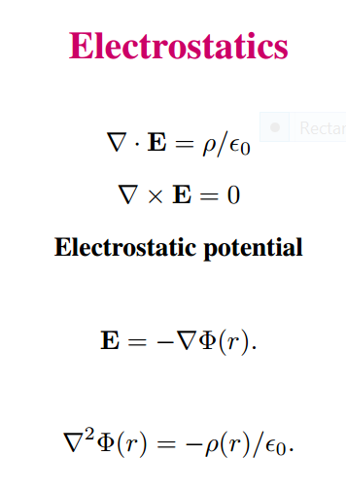
Differential equations --

Slide 19
Relationship between integral and differential forms of electrostatics --

Slide 20
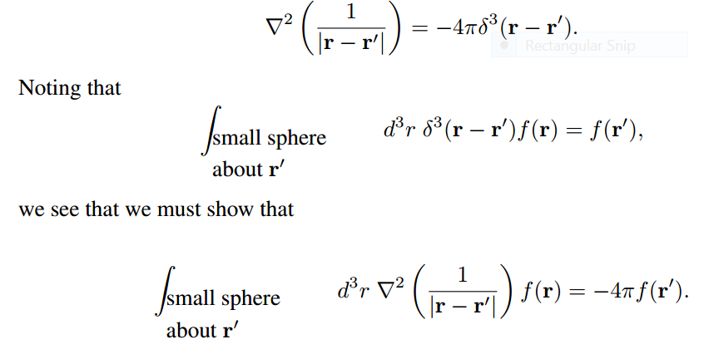
Relationship between integral and differential forms of electrostatics --
Need to show:

Slide 21
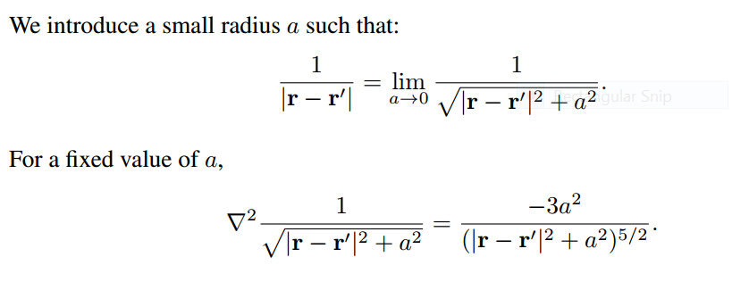

Slide 23
➔
➔

Slide 24
Example in HW1

