Slide 1
PHY 712 Electrodynamics
9-9:50 AM MWF Olin 105
Plan for Lecture 13:
Finish reading Chapter 5
Recap of hyperfine interaction
Macroscopic magnetization density M
H field and its relation to B
Magnetic boundary values

Slide 2
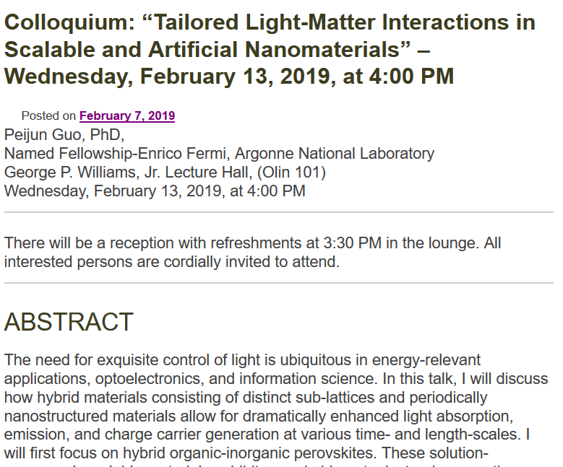

Slide 3
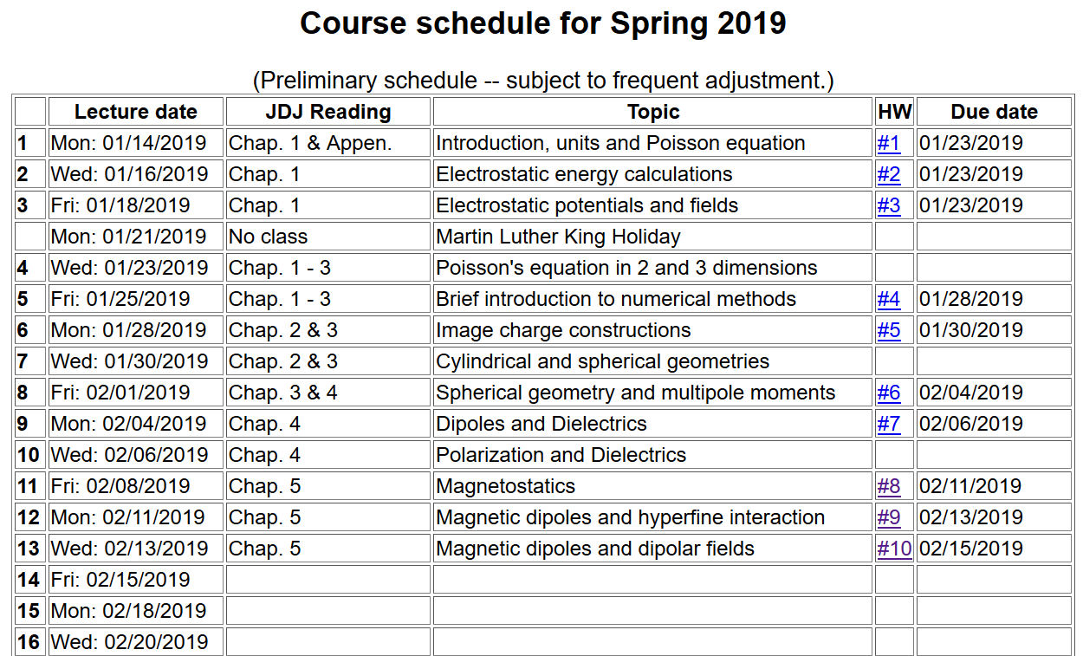

Slide 4
Summary of hyperfine interaction form:
Interactions between magnetic dipoles
Sources of magnetic dipoles and other sources of magnetism in an atom:
Intrinsic magnetic moment of a nucleus
Intrinsic magnetic moment of an electron
Magnetic field due to electron orbital current
Interaction energy between a magnetic dipole m and a magnetic field B:
r

Slide 5
Hyperfine interaction energy: -- continued
Evaluation of the magnetic field at the nucleus due to the electron current density:
The vector potential associated with an electron in a bound state of an atom as described by a quantum mechanical wavefunction can be written:
We want to evaluate the magnetic field
in the vicinity of the nucleus

Slide 6
Hyperfine interaction energy: -- continued

Slide 7
Hyperfine interaction energy: -- continued
Putting all of the terms together:
In this expression the brackets indicate evaluating the expectation value relative to the electronic state.

Slide 8
Macroscopic dipolar effects --
Magnetic dipole moment
Note that the intrinsic spin of elementary particles is associated with a magnetic dipole moment, but we often do not have a detailed knowledge of J(r).
Vector potential for magnetic dipole moment

Slide 9
Macroscopic magnetization
Vector potential due to “free” current J_{free}(r) and macroscopic magnetization M(r). Note: the designation J_{free}(r) implies that this current does not also contribute to the magnetization density.

Slide 10
Vector potential contributions from macroscopic magnetization -- continued

Slide 11
Vector potential contributions from macroscopic magnetization -- continued

Slide 12
Magnetic field contributions

Slide 13
Energy associated with magnetic fields

Slide 14
1
2

Slide 15
1
2

Slide 16
Example magnetostatic boundary value problem
M₀

Slide 17
Example magnetostatic boundary value problem -- continued
M₀

Slide 18
Example magnetostatic boundary value problem -- continued
M₀

Slide 19
Example magnetostatic boundary value problem -- continued
M₀

Slide 20
Check boundary values:

Slide 21
Variation; magnetic sphere plus external field B₀
M₀
B₀

Slide 22
1
2

Slide 23
Magnetism in materials

Slide 24
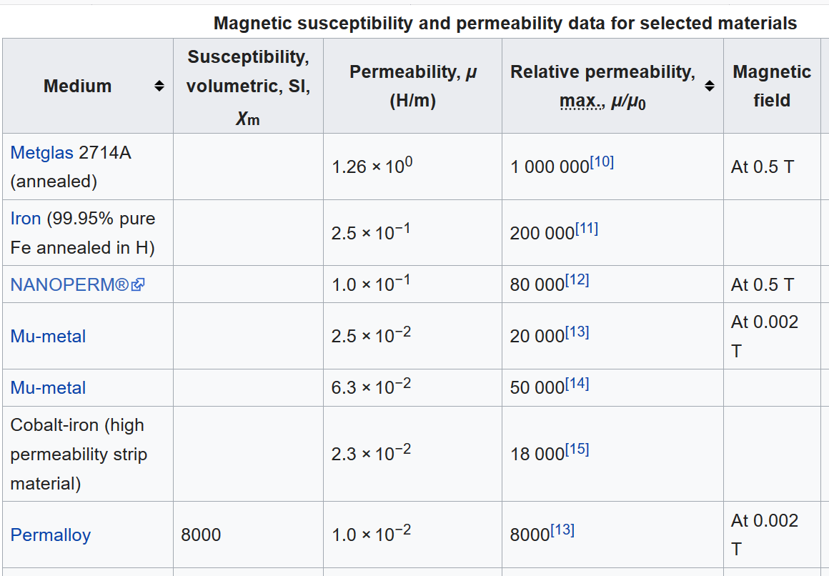
https://en.wikipedia.org/wiki/Permeability_(electromagnetism)

Slide 25
Composed of 80% Ni, 15% Fe, 5% Mo+other materials

Slide 26
Example: permalloy, mumetal μ/μ₀ ~ 10⁴
B₀
Spherical shell a < r < b :
μ
a
b
μ₀
μ₀

Slide 27
Example: permalloy, mumetal μ/μ₀ ~ 10⁴ -- continued
B₀
μ
a
b
μ₀
μ₀

Slide 28
Example: permalloy, mumetal μ/μ₀ ~ 10⁴ -- continued
B₀
μ
a
b
μ₀
μ₀

Slide 29
Example: permalloy, mumetal μ/μ₀ ~ 10⁴ -- continued
B₀
μ
a
b
μ₀
μ₀

Slide 30
Example: permalloy, mumetal μ/μ₀ ~ 10⁴ -- continued
B₀
μ
a
b
μ₀
μ₀

