Slide 1
PHY 712 Electrodynamics
9-9:50 AM MWF Olin 105
Plan for Lecture 23:
Complete reading of Chap. 9 & 10
Superposition of radiation
Scattered radiation

Slide 3
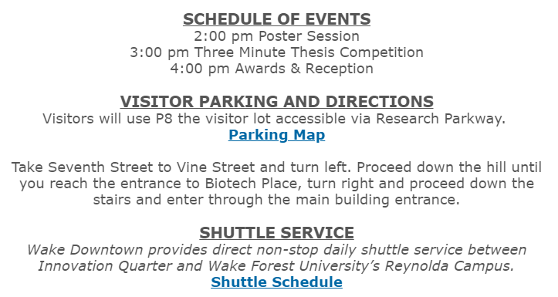

Slide 4
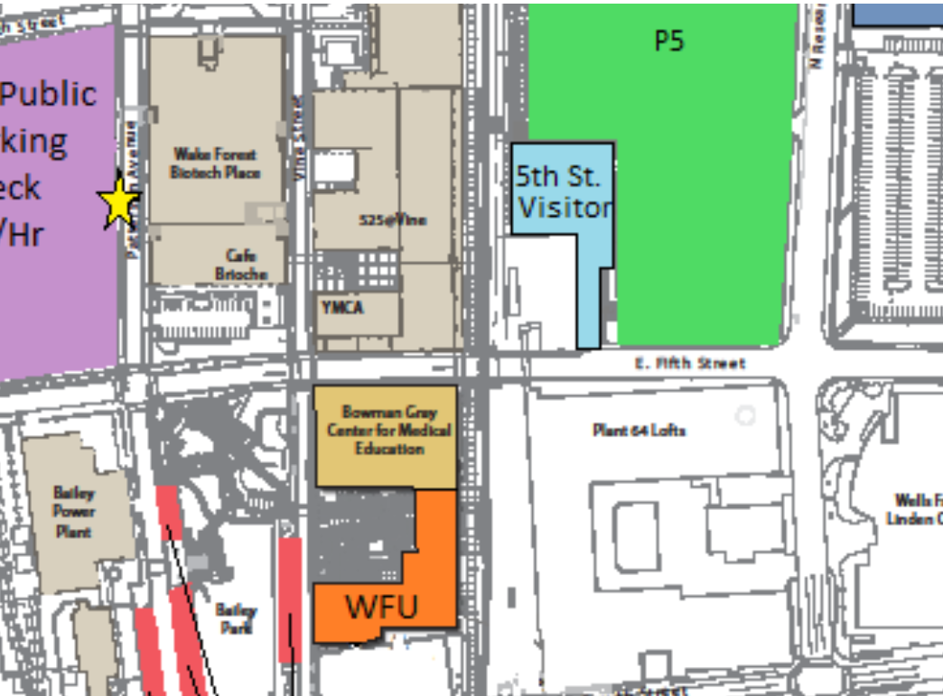

Slide 5
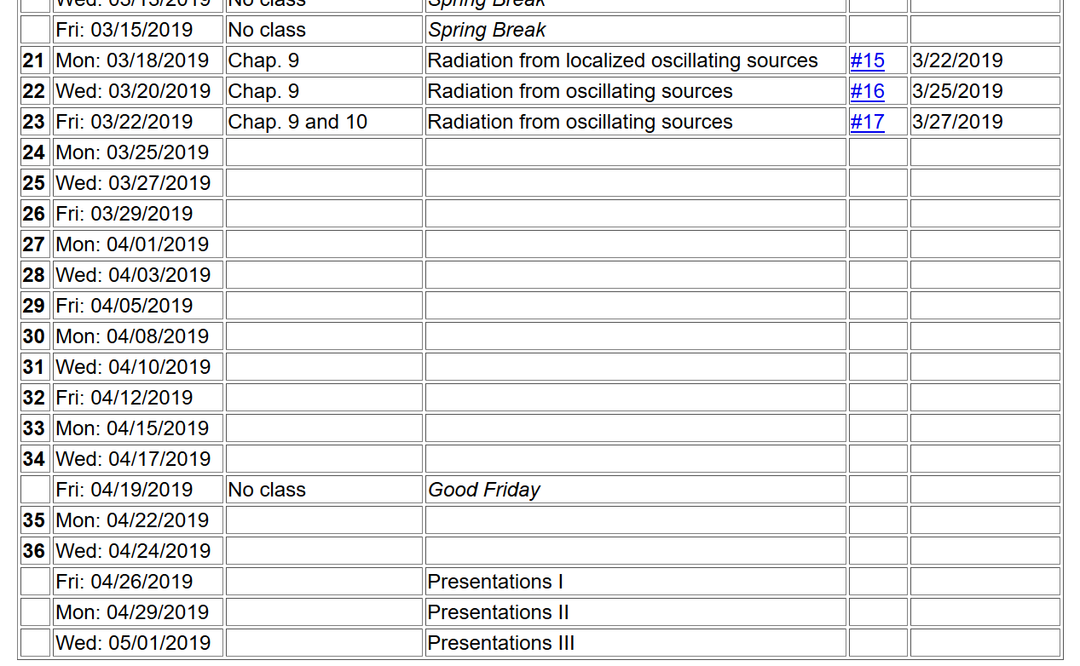

Slide 6
Electromagnetic waves from time harmonic sources – review:

Slide 7
Consider antenna source (center-fed)
Note – these notes differ from previous formulation d/2 ←→ d
r
z
d
θ
φ
y
d
x
7

Slide 8
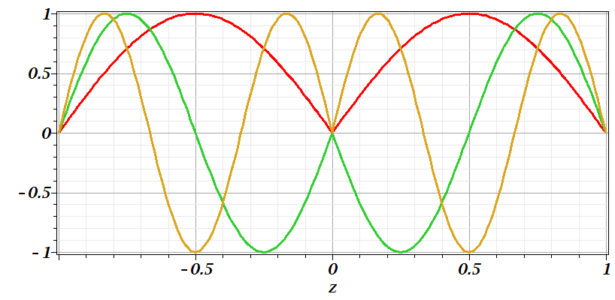
Consider antenna source -- continued
n=1
n=2
n=3

Slide 9
Consider antenna source -- continued

Slide 10
Consider antenna source -- continued

Slide 11
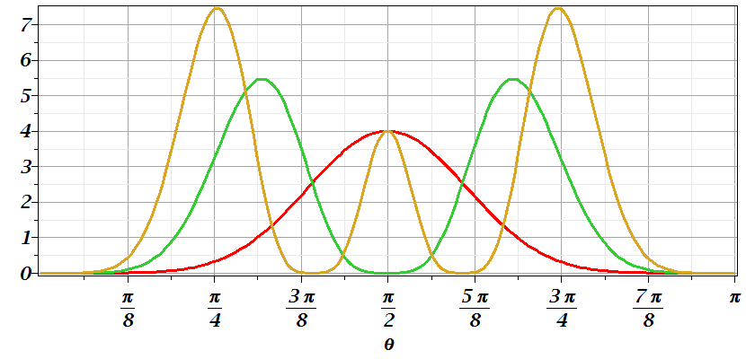
Consider antenna source -- continued
n=1
n=2
n=3

Slide 12
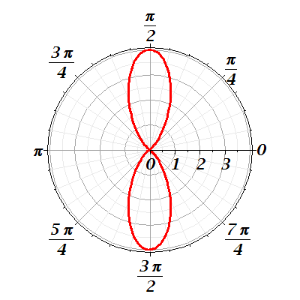
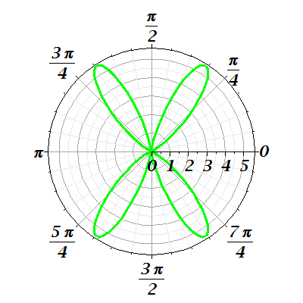
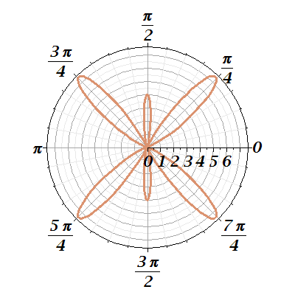
Consider antenna source -- continued
n=1
n=2
n=3

Slide 13
Radiation from antenna arrays
z
y
θ
φ
2d
x
a

Slide 14
Radiation from antenna arrays -- continued

Slide 15
Radiation from antenna arrays -- continued
N=2;a=d/2; φ=0
N=0
N=2;a=d; φ=0

Slide 16
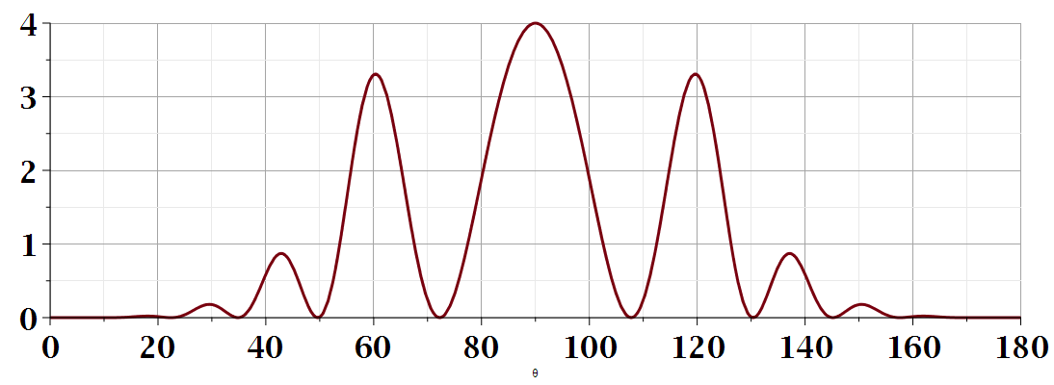
θ
Additional amplitude patterns can be obtained by controlling relative phases of antennas.

Slide 17
Dipole radiation in light scattering by small (dielectric) particles
E_{sc}
H_{sc}
E_{inc}
H_{inc}

Slide 18
Dipole radiation in light scattering by small (dielectric) particles
E_{sc}
H_{sc}
E_{inc}
H_{inc}

Slide 19
Recall previous analysis for electrostatic case:
Boundary value problems in the presence of dielectrics – example:
E₀
a
E
θ
z
ε
ε₀

Slide 20
Boundary value problems in the presence of dielectrics – example -- continued:

Slide 21
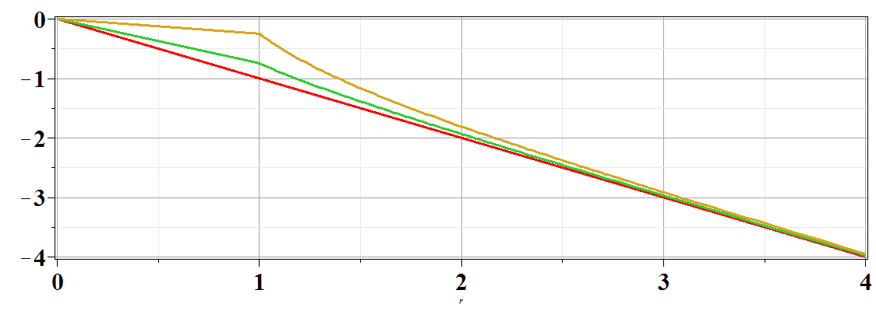
Boundary value problems in the presence of dielectrics – example -- continued:
Φ(r,θ=0)
ε/ε₀=
10
2
1
r/a

Slide 22
Estimation of scattering dipole moment:
Suppose the scattering particle is a dielectric sphere with permittivity ε and radius a:

Slide 23
Scattering by dielectric sphere with permittivity ε and radius a:
For E_{inc} polarized in scattering plane:
θ
θ

Slide 24
Scattering by dielectric sphere with permittivity ε and radius a:
For E_{inc} polarized perpendicular to scattering plane:
θ

Slide 25
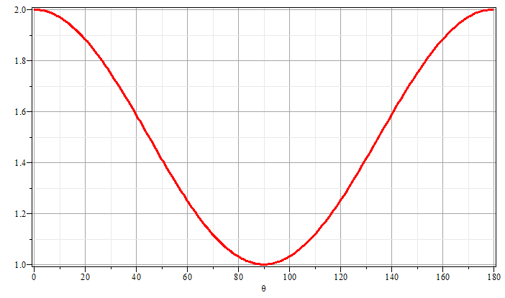
Scattering by dielectric sphere with permittivity ε and radius a:
θ
θ

Slide 27
Brief introduction to multipole expansion of electromagnetic fields (Chap. 9.7)

Slide 28
Multipole expansion of electromagnetic fields -- continued

Slide 29
Multipole expansion of electromagnetic fields -- continued
spherical Bessel function
spherical Bessel function

Slide 30
Multipole expansion of electromagnetic fields -- continued

Slide 31
Multipole expansion of electromagnetic fields -- continued

Slide 32
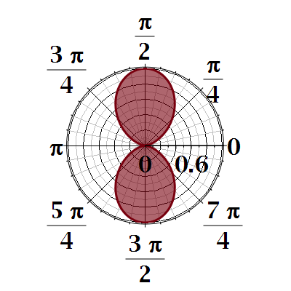
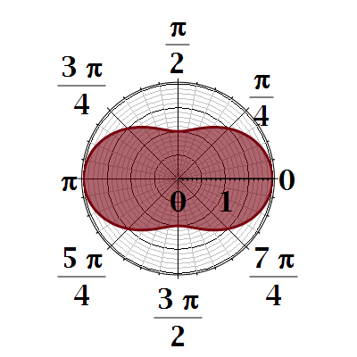

Slide 33
