Slide 1
PHY 712 Electrodynamics
9-9:50 AM MWF Olin 105
Plan for Lecture 32:
Special Topics in Electrodynamics:
Electromagnetic aspects of superconductivity

Slide 2
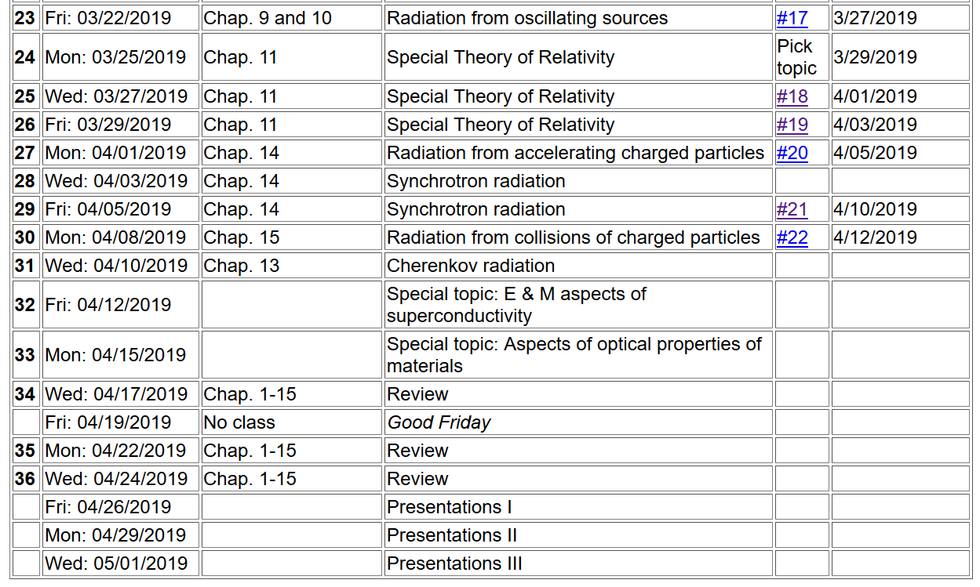

Slide 3
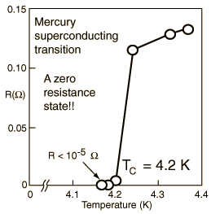
Special topic: Electromagnetic properties of superconductors
Ref:D. Teplitz, editor, Electromagnetism – paths to research,
Plenum Press (1982); Chapter 1 written by Brian Schwartz and Sonia Frota-Pessoa
History:
1908 H. Kamerlingh Onnes successfully liquified He
1911 H. Kamerlingh Onnes discovered that Hg at 4.2 K has vanishing resistance
1957 Theory of superconductivity by Bardeen, Cooper, and Schrieffer

Slide 4
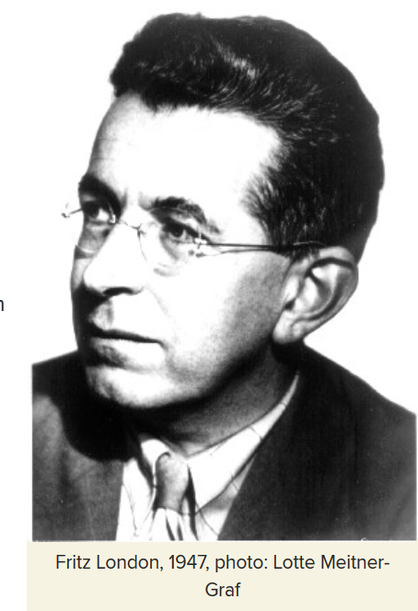
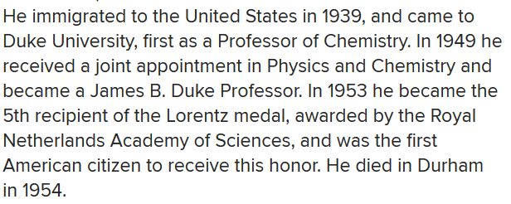
Fritz London 1900-1954
https://phy.duke.edu/about/history/historical-faculty/fritz-london

Slide 5
Some phenomenological theories < 1957 thanks to F. London
Note: Equations are in cgs Gaussian units.

Slide 6
Some phenomenological theories < 1957

Slide 7
London model – continued

Slide 8
London model – continued
λ_{L}
x

Slide 9
Behavior of superconducting material – exclusion of magnetic field according to the London model
λ_{L}
x

Slide 10
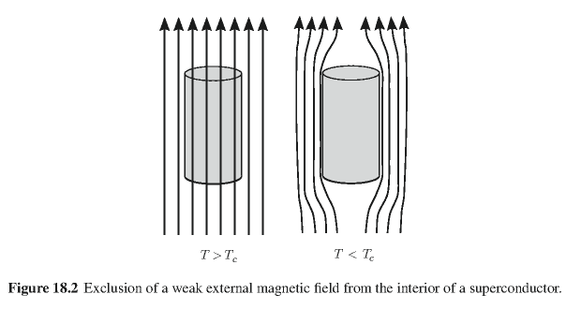
Behavior of magnetic field lines near superconductor
normal
state:
superconducting state:

Slide 11
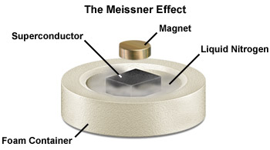

Slide 12
Need to consider phase equilibria between “normal” and superconducting state as a function of temperature and applied magnetic fields.

Slide 13
Magnetization field
At T=0K

Slide 14
Magnetization field (for “type I” superconductor)
B
H
H_{C}
-4πM
H
H_{C}
G_{S}-G_{N}
H_{C}
H

Slide 15
characteristic phonon energy
density of electron states at E_{F}
attraction potential between electron pairs

Slide 16
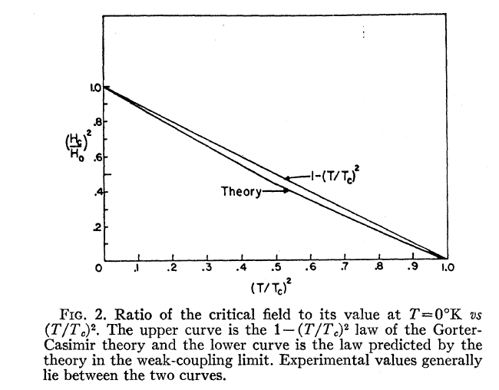
Temperature dependence of critical field
From PR 108, 1175 (1957)
Bardeen, Cooper, and Schrieffer, “Theory of Superconductivity”
characteristic phonon energy
density of electron states at E_{F}
attraction potential between electron pairs

Slide 17
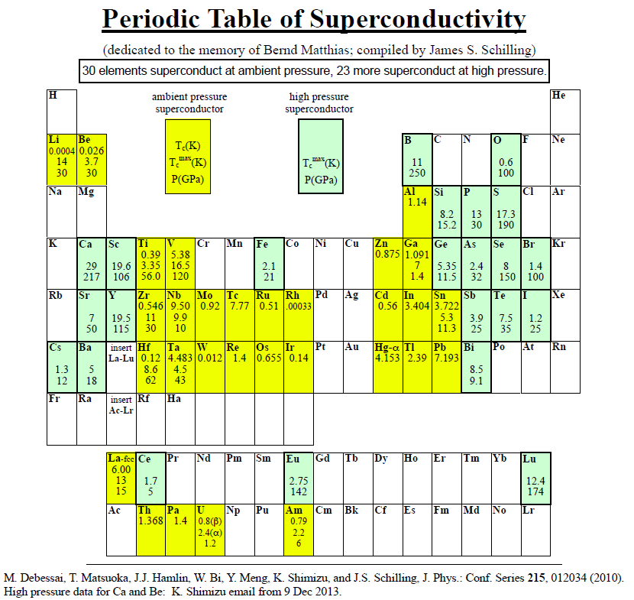
Type I elemental superconductors
http://wuphys.wustl.edu/~jss/NewPeriodicTable.pdf

Slide 18
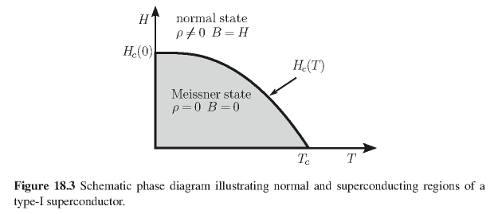
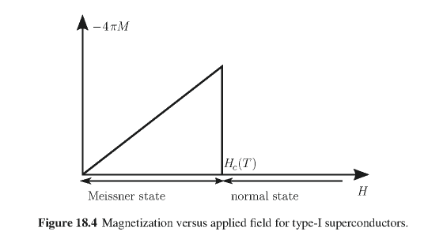
Type I superconductors:

Slide 19
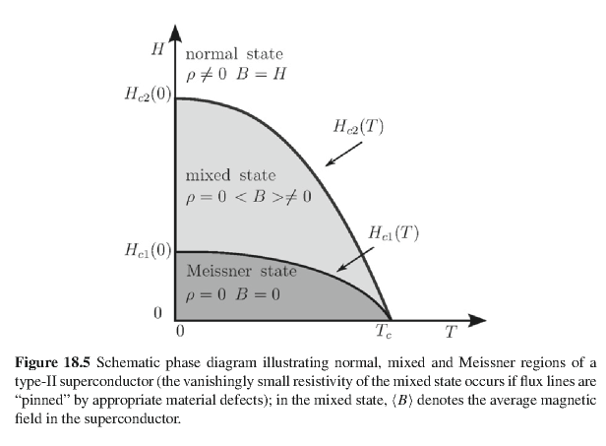
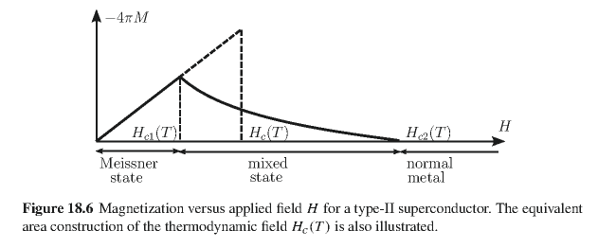
Type II superconductors

Slide 20
Quantization of current flux associated with the superconducting state (Ref: Ashcroft and Mermin, Solid State Physics)

Slide 21
Quantization of current flux associated with the superconducting state -- continued
Suppose a superconducting material has a cylindrical void. Evaluate the integral of the current in a closed path within the superconductor containing the void.
dl
Such “vortex” fields can exist within type II superconductors.

Slide 22
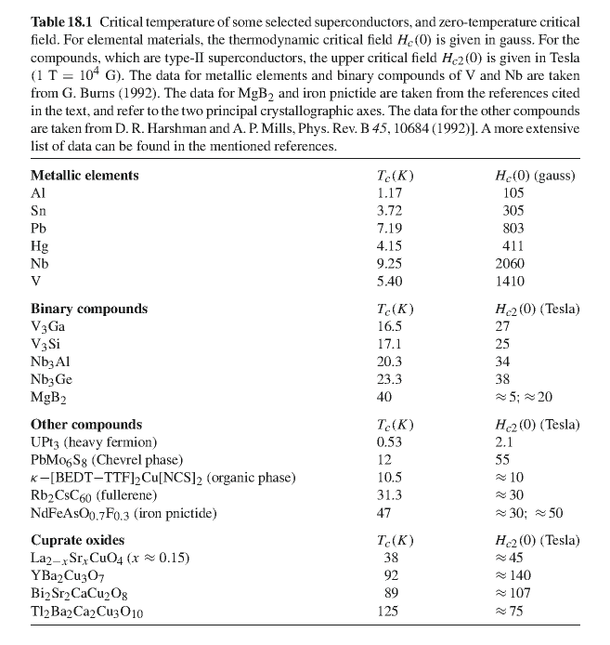

Slide 23
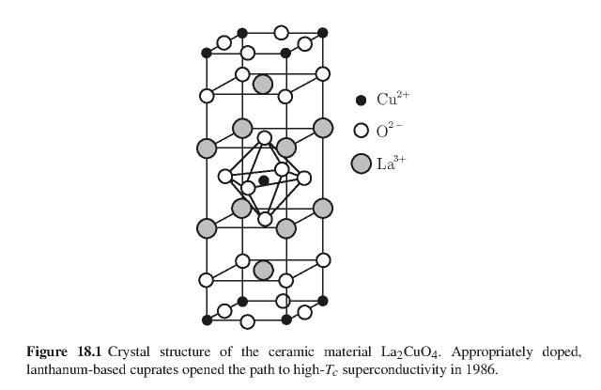
Crystal structure of one of the high temperature superconductors

Slide 24
Some details of single vortex in type II superconductor

Slide 25
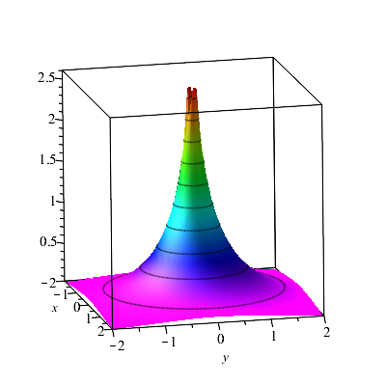
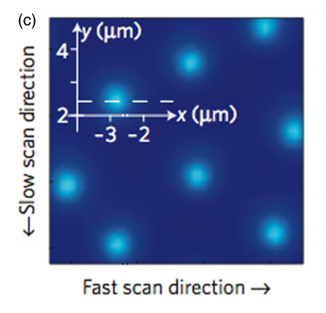
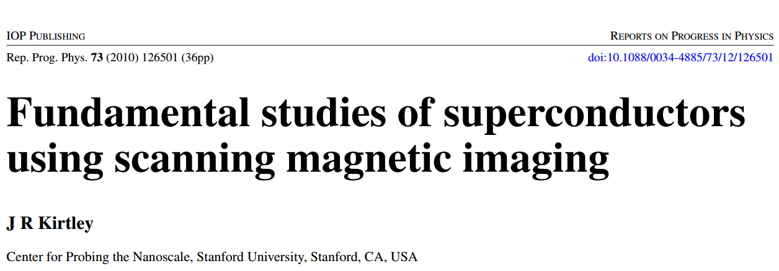
Scanning probe images of vortices in YBCO at 22 K

