Slide 1
PHY 712 Electrodynamics
9-9:50 AM MWF Olin 103
Plan for Lecture 1:
Reading: Appendix 1 and Chapters I&1
Course structure and expectations
Units – SI vs Gaussian
Electrostatics – Poisson equation

Slide 2
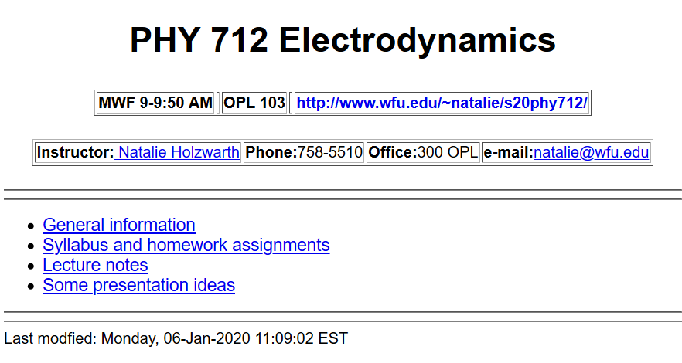
http://users.wfu.edu/natalie/s20phy712/

Slide 3
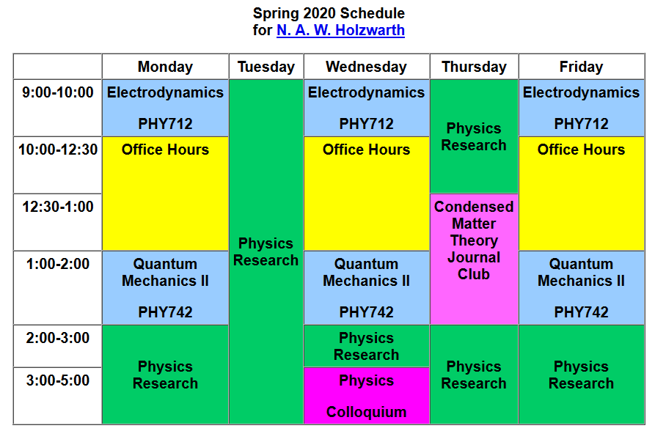
Please email natalie@wfu.edu if you would like to meet with me at any time.

Slide 4
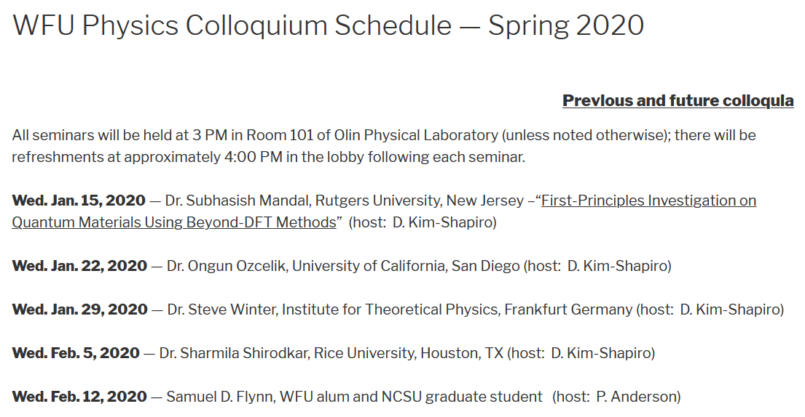
Physics Colloquium series – Wednesdays 3-4 PM
followed by refreshments

Slide 5
Physics Colloquium series – Wednesdays 3-4 PM
followed by refreshments

Slide 6
New notification of events on Physics web page –
https://www.physics.wfu.edu/

Slide 7
Textbook
Optional supplement

Slide 8
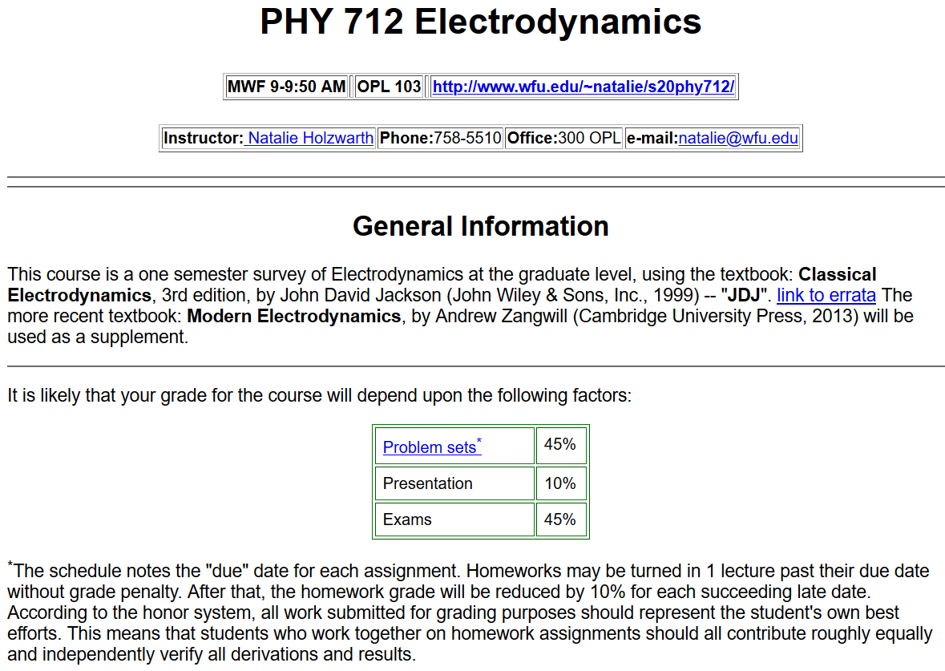

Slide 9
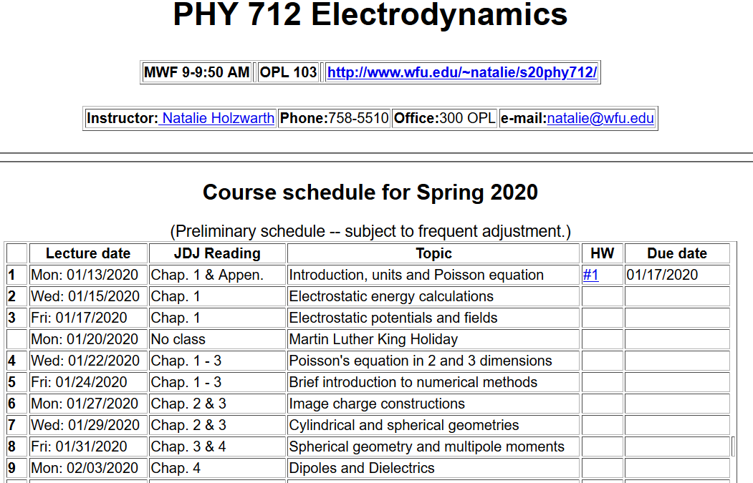

Slide 10
Comment about HW #1: (Jackson problem 1.5)
The time-averaged potential of a neutral hydrogen atom is given by:
where q denotes the magnitude of the elementary charge of an electron or proton and where a₀ denotes the Bohr radius. Find the distribution of charge (both continuous and discrete) that will give this potential and interpret your results physically.

Slide 11
Additional information –
Mid-term exam March 2-6, 2020 (same as QM II)
Presentations for both E&M and QM II – will be further discussed in QM II
Question – handouts or materials only on web?

Slide 12
Remember to check your algebraic manipulation software --
https://software.wfu.edu/audience/students/

Slide 14
Material discussed in Appendix of textbook --

Slide 18
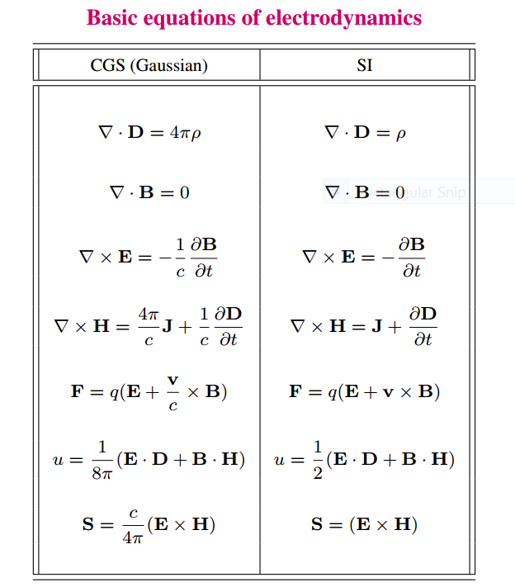

Slide 19
Units choice for this course:
SI units for Jackson in Chapters 1-10
Gaussian units for Jackson in Chapters 11-16
Electrostatics
q₂
q₁
q₃
q₄

Slide 20
Electrostatics
Discrete versus continuous charge distributions

Slide 21
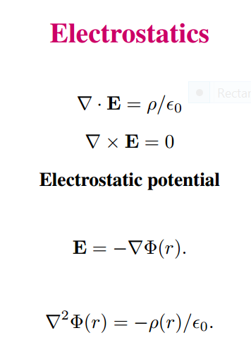
Differential equations --

Slide 22
Relationship between integral and differential forms of electrostatics --

Slide 23
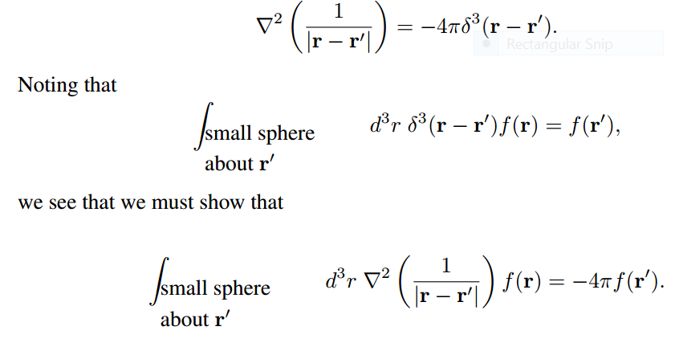
Relationship between integral and differential forms of electrostatics --
Need to show:

Slide 24
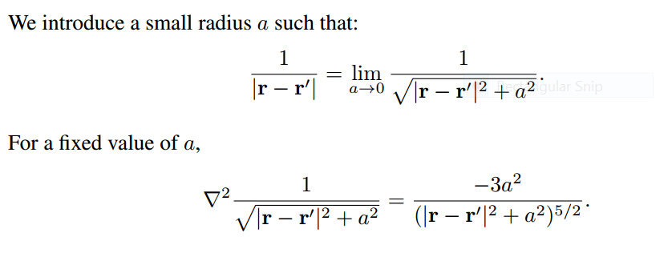

Slide 26
➔
➔

Slide 27
Example in HW1

