Slide 1
PHY 712 Electrodynamics
12-12:50 AM Olin 103
Plan for Lecture 20:
    Review of Chap. 1-8
      Plan for next week
      Comment on exam
      Review

Slide 2
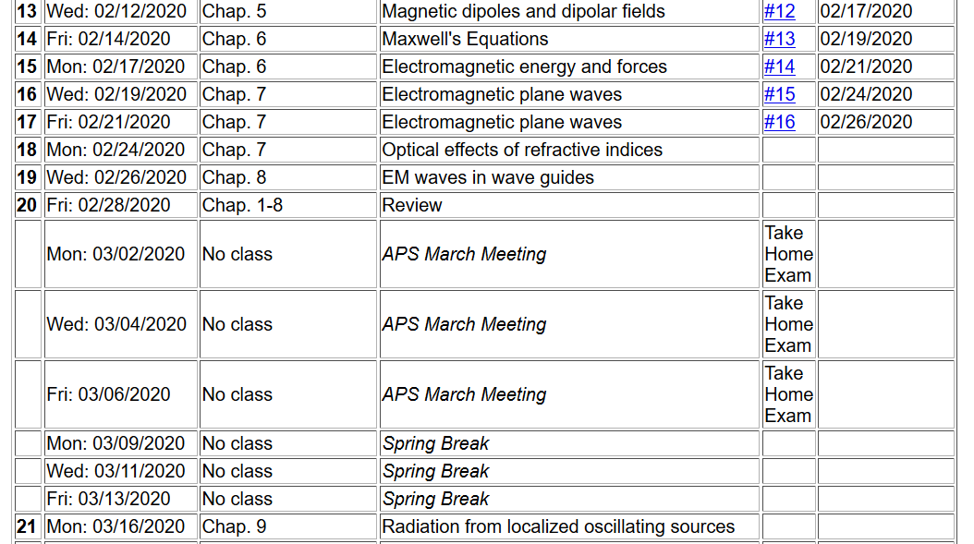

Slide 3
Next week --
Colloquium: “Changes in Blood Clot Structure and Mechanics in Cardiovascular and Thromboembolic Diseases”
Dr. Stephen Baker, Teacher Scholar Postdoctoral Fellow
WFU Physics
George P. Williams, Jr. Lecture Hall, (Olin 101)
Wednesday, March 4, 2020 at 3:00 PM
There will be a reception in the Olin Lounge at approximately 4 PM following the colloquium. All interested persons are cordially invited to attend.
ABSTRACT Studies in recent years have shown blood clot structure and mechanical properties to be a novel risk factor for cardiovascular diseases, the leading cause of morbidity and mortality worldwide. As a result, we need to better understand how the structural and mechanical properties of blood clots from patients with cardiovascular disease are different from those of healthy individuals. To study these properties, we need to determine how they change at different length scales. On the nano- and microscale, an atomic force microscope is an extremely versatile piece of equipment that can be used for nanometer to micrometer scale imaging, normal force unfolding of single molecules, or even novel lateral force techniques.

Slide 4
Comment on exam
Three multipart questions
Completed exam accepted until Monday, Mar. 9, 2020
Email your questions to natalie@wfu.edu
Will be present on Friday March 6, 2020
In your spare time, think about your presentation topic

Slide 5
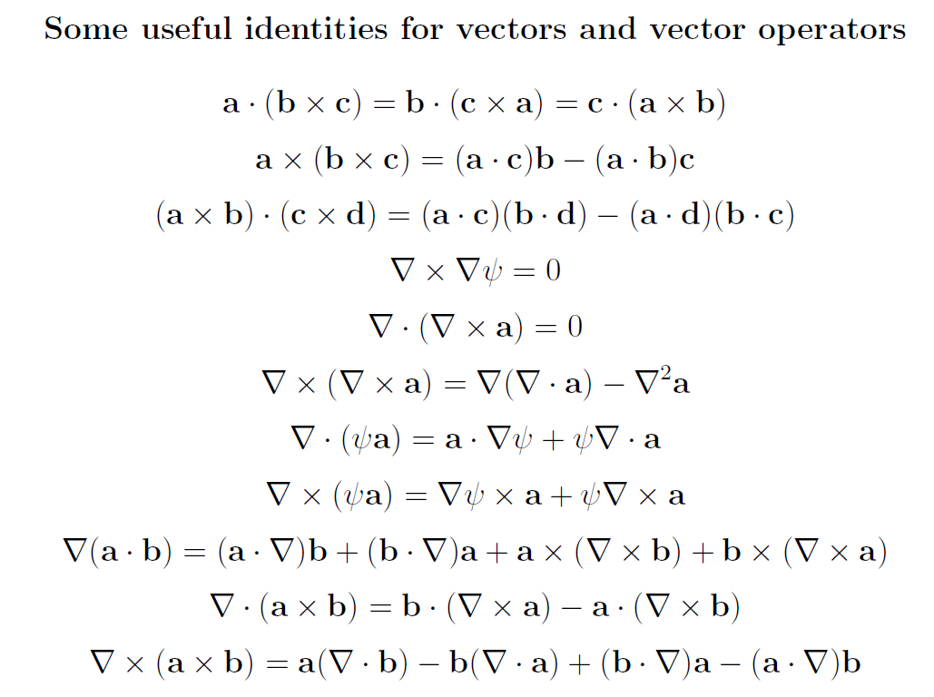
Review of mathematical relationships

Slide 6
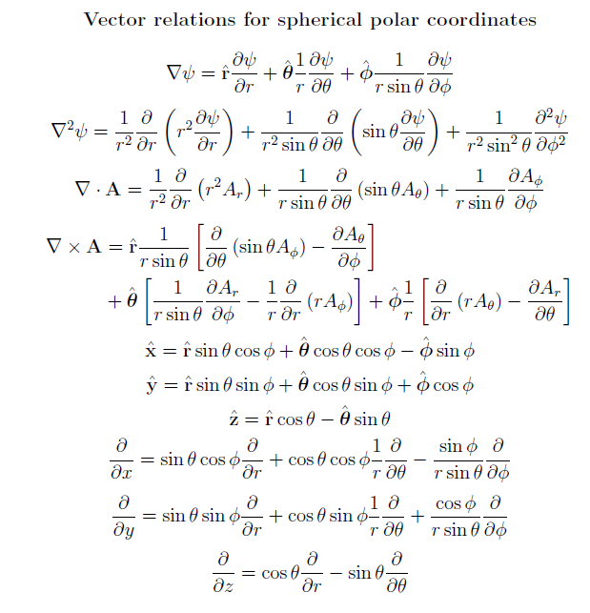

Slide 7
Some properties of a delta function
In one-dimension:
In three-dimensions:

Slide 8
Orthogonal functions useful for angular representations

Slide 9
Useful identities related to Coulomb kernel:

Slide 10
Green’s theorem for electrostatics
volume integral over source
surface integrals incorporating boundary values

Slide 11
Review
Maxwell’s equations

Slide 12
Review -- continued
Maxwell’s equations

Slide 13
Review -- continued

Slide 14
Review -- continued

Slide 15
Review – continued – focusing on statics --
When to solve equations using integral form
versus differential form?
Examples from electrostatic and magnetostatic cases:
Useful for spatially confined sources.

Slide 16
Review -- continued

Slide 17
Example of use of spherical harmonic expansion:
Problem #4.9 in Jackson. A point charge q is located in free space a distance d from the center of a dielectric sphere of radius a (a<d) and dielectric constant ε/ε₀. Find the electrostatic potential.
a
q
d

Slide 18
Review of HW -- continued

Slide 19
a
q
d

Slide 20
2 equations and 2 unknowns for each l

Slide 21
Review -- continued
Hyperfine interaction energy:
Putting all of the terms together:
In this expression the brackets indicate evaluating the expectation value relative to the electronic state.

Slide 22
Comment on HW problem
Consider an infinitely long wire with radius a, oriented along the z axis. There is a steady uniform current inside the wire. Specifically the current is along the z-axis with the magnitude of J₀ for ρ ≤ a and zero for ρ > a, where ρ denotes the radial parameter of the natural cylindrical coordinates of the system.
  Find the vector potential (A) for all ρ.
  Find the magnetic flux field (B) for all ρ.
Solution to problem using PHY 114 ideas
In this case, it is convenient to solve part b first.
Top view for ρ < a
Top view for ρ > a
J₀
B
B

Slide 23
Comment on HW -- continued
Top view for ρ < a
Top view for ρ > a
B
B

Slide 24
Comment on HW -- continued
J₀

Slide 25
Comment on magnetic problem
A sphere of radius a carries a uniform surface charge distribution σ. The sphere is rotated about a diameter with constant angular velocity ω. Find the vector potential A and magnetic field B both inside and outside the sphere.
ω
r

Slide 26
Comment on magnetic problem -- continued

