Slide 1
PHY 712 Electrodynamics
12-12:50 AM MWF via video link:
https://wakeforest-university.zoom.us/my/natalie.holzwarth
Plan for Lecture 21:
Sources of radiation
Start reading Chap. 9
Electromagnetic waves due to specific sources
Dipole radiation patterns
Notes:
Welcome to the new version of PHY 712. As stated in the email, this new format offers us a wonderful opportunity to focus attention on our studies and advance our physics knowledge and skills quickly. We just have to figure out the best way to keep focused and motivated, filtering out the distractions at least for several hours each day.…. In this new format, you are asked to carefully review the lecture and notes with time enough to pose questions before 10 AM each MWF. The online class time 12-12:50 will be devoted to discussion, initially starting with your questions.
Please start reading Chapter 9 in Jackson. We will cover most of the chapter, not quite in the order presented in Jackson. It turns out that radiation from the time harmonic sources considered in this chapter can evaluated exactly. From the exact expressions, we can see how the various approximations can be derived. Jackson’s treatment is more focused on the approximations first.

Slide 2
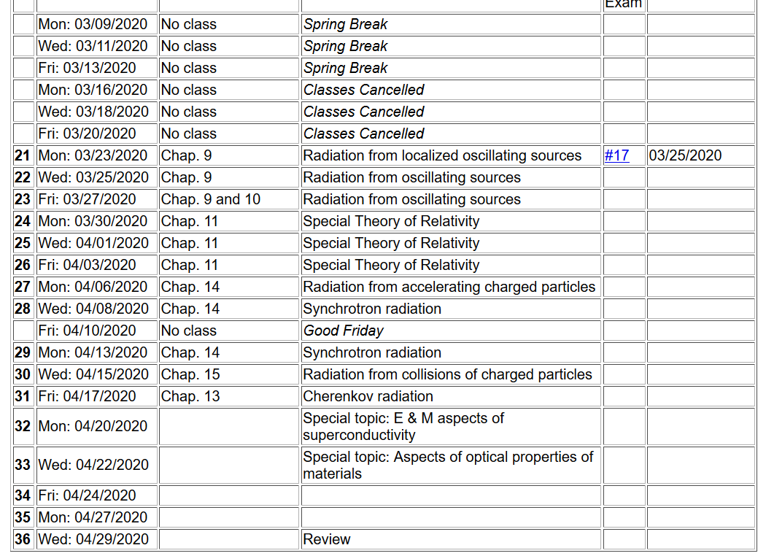
Notes:
Here is the tentative new schedule. It differs from the original plan mainly in that the week we missed has pushed out the “presentations”. As mentioned in the email, the projects will now presented in written form. At this time, you should have a reasonable idea of your project topics. Of course I am happy to discuss/advise/help in any way. Also note that the homework is now due by the next lecture. Hopefully with your cleared schedules this will be possible. Of course, I am always happy to consult via email or video conferencing.

Slide 3
Online colloquium on Wednesday –
https://www.physics.wfu.edu/events/rick-matthews-41-years/
Notes:
This is a reminder that on Wednesday we will have the first of two online colloquia. Professor Matthews has been a leader in technology at WFU throughout his career. It will be very interesting to hear his perspective on how this has been put to good use in physics and physics education.

Slide 4
Maxwell’s equations
Notes:
Since Maxwell’s equations were introduced and used in Chapters 6-8, we have focused on the properties of the fields themselves. Now we will begin to study how these fields are produced by particular sources. The sources that we will consider are harmonic in time and their spatial form (considered to be localized in space) is represented by a multiplicative factor. More generally, we are considering one component in the Fourier transform for the source function. The results are quite different from the Liénard-Wiechert potentials discussed a few weeks ago. In this slide, Maxwell’s equations are presented for the case that the sources are completely represented by the charge and current densities.

Slide 5
Formulation of Maxwell’s equations in terms of vector and scalar potentials
Notes:
It is convenient to express the coupled vector fields in terms of the scalar and vector potentials as we have discussed previously.

Slide 6
Formulation of Maxwell’s equations in terms of vector and scalar potentials -- continued
Notes:
We will focus our attention on the Lorentz Gauge representations. In this case, the scalar potential and each of the three Cartesian components of the vector potential each have to solve an inhomogeneous differential equation of the same form.

Slide 7
Solution of Maxwell’s equations in the Lorentz gauge -- continued
Notes:
For a spatially localized source, the physically meaningful solution can be written as an integral over the source time t’ and space r’ as discussed previously before.

Slide 8
Electromagnetic waves from time harmonic sources
Notes:
Now we specialize to the pure harmonic time dependence. Mathematically, we will evaluate the sources with the complex function exp(-iωt), taking the real part at the end of the analysis. Note that because we need to conserve charge, the continuity equation must satisfied which consequently means that the current and charge densities are functionally related.

Slide 9
Electromagnetic waves from time harmonic sources – continued:
Notes:
Putting the form of the source term in the integral, we can first perform the integral over the source time t’, resulting in the last equation of the slide. Notice that the full solution of the differential equation also may have a solution to the inhomogeneous equation as represented by the last term.

Slide 10
Electromagnetic waves from time harmonic sources – continued:
Notes:
From the results on the previous slide, we can explicitly write out the solutions for the scalar and vector potentials in terms of the charge and current densities.

Slide 11
Electromagnetic waves from time harmonic sources – continued:
Notes:
In order to evaluate the equations on the previous slide, we can make use an exact expansion in terms of spherical harmonic functions and spherical Bessel and Hankel functions. The proof of this expansion is not trivial, but some details are available in Jackson (near Eq. 9.98) and from the NIST website https://dlmf.nist.gov/10.60. It naturally follows that the scalar potential can be expressed as a sum of spherical harmonic functions time corresponding radial forms.

Slide 12
Electromagnetic waves from time harmonic sources – continued:
Notes:
It naturally follows that the vector potential can be expressed as a sum of spherical harmonic functions time corresponding radial forms.

Slide 13
Forms of spherical Bessel and Hankel functions:
Notes:
These relationships of spherical Bessel functions are given on page 426 of Jackson.

Slide 14
Notes:
This material summarizes some of the results from Seciont 9.6 of Jackson

Slide 15
Electromagnetic waves from time harmonic sources – continued:
Notes:
What is the rational/significance of the last two equations?

Slide 16
Some details:
Notes:
Do you agree with these results?

Slide 17
Electromagnetic waves from time harmonic sources – continued -- some details:
Notes:
From this analysis, for a source confined within a sphere of radius R, the radiation field for the lm component of the field has a radial form proportional to a spherical Hankel function.

Slide 18
Electromagnetic waves from time harmonic sources – continued:
Notes:
Some further relations can be derived due to the continuity equation for the current density and the charge density.

Slide 19
Electromagnetic waves from time harmonic sources – continued:
Notes:
The previous slides gave rigorous results far from the source. In this slide we consider further approximations. The kr’<<1 case is also referenced as the long wavelength approximation.

Slide 20
Some details:
Notes:
Long wavelength approximation; relationship to dipole approximation.

Slide 21
Some details -- continued:
(assuming confined source)
Notes:
Dipole approximation continued.

Slide 22
Electromagnetic waves from time harmonic sources – continued:
Note: in this case we have assumed a restricted extent of the source such that kr’<<1.
Notes:
Dipole approximation continued.

Slide 23
Electromagnetic waves from time harmonic sources – continued:
Notes:
Dipole approximation continued.

Slide 24
Example of dipole radiation source
Notes:
Comparison of exact asymptotic results with dipole approximation.

Slide 25
Example of dipole radiation source -- continued
Relationship to pure dipole approximation (exact when kR➔0)
Notes:
Comparison of exact asymptotic results with dipole approximation – continued.

