Slide 1
PHY 742 Quantum Mechanics II
1-1:50 AM MWF Olin 103
Plan for Lecture 1
Structure of the course
Review of main concepts from Quantum Mechanics I
Preview of topics for Quantum Mechanics II
Quantum particle interacting with classical electromagnetic fields
Reading: Chapter 9 in Carlson’s textbook

Slide 2
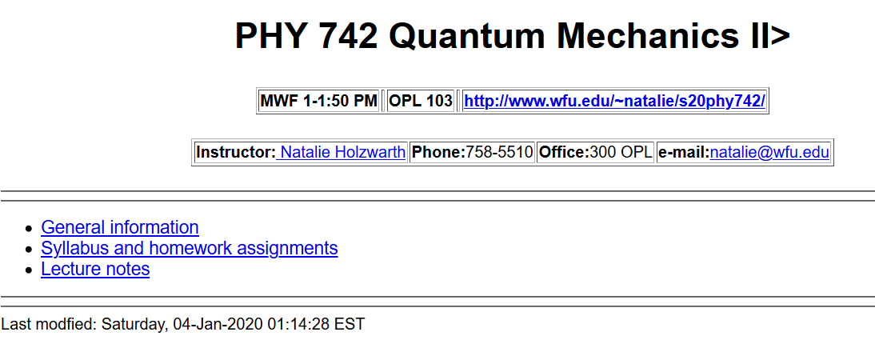

Slide 4
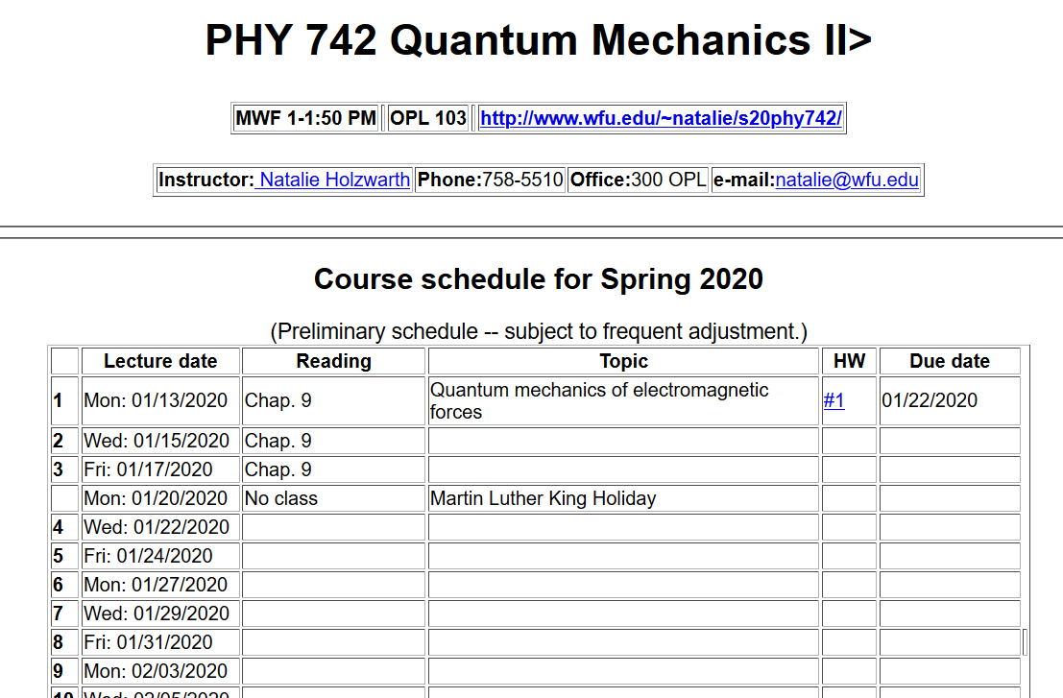

Slide 5
Discussion points on course structure –
Where/how to keep supplemental texts?
Take home exams
Mid-term during the week of Mar. 2-6
Final during the week of May 1-8
Presentations?
How to interface with PHY 712 presentations?

Slide 6
Summary of topics covered in Quantum Mechanics I
Topic | Chapters in EC Text
Fundamentals and formalism of QM | 1,3,4,11
Solution of S. E. for simple 1-dim potentials | 2
Quantum mechanics of harmonic oscillator | 5
Angular momentum | 7
Addition and rotation of angular momentum including spin | 8
Hydrogen atom | 7
Time-independent perturbation theory methods | 12

Slide 7
Topics for Quantum Mechanics II
Single particle analysis
Single particle interacting with electromagnetic fields – EC Chap. 9
Scattering of a particle from a spherical potential – EC Chap. 14
More time independent perturbation methods – EC Chap. 12, 13
Single electron states of a multi-well potential ➔ molecules and solids – EC Chap. 2,6
Time dependent perturbation methods – EC Chap. 15
Relativistic effects and the Dirac Equation – EC Chap. 16
Multiple particle analysis
Quantization of the electromagnetic fields – EC Chap. 17
Photons and atoms – EC Chap. 18
Multi particle systems; Bose and Fermi particles – EC Chap. 10
Multi electron atoms and materials
Hartree-Fock approximation
Density functional approximation

Slide 8
Interaction of a particle with an electromagnetic field
Ref: Chapter 9 of Professor Carlson’s text
Additional references: L&L #22, XVI
Results from Classical Mechanics: (cgs Gaussian units)

Slide 9
Results from Classical Mechanics, (cgs Gaussian units) continued
Canonical form

Slide 10
Interaction of a particle of mass m and charge q with an electromagnetic field:
Classical Hamiltonian in SI units:
Quantum Hamiltonian in SI units and in coordinate representation:
Relationship of scalar and vector potentials to electric and magnetic fields:

Slide 11
Quantum mechanical treatment of interaction of particle of mass m and charge q with
classical electromagnetic fields in terms of scalar and vector potentials U(r,t) and A(r,t)
Note that, as shown in EC’s text and as we will also see in classical electrodynamics, the
scalar and vector coordinates are ambiguous wrt a “gauge” transformation

Slide 12
⬅differs only by phase factor

Slide 13
Properties of the “kinetic momentum operator”
This means that for a charged particle moving in a magnetic field, the there is uncertainty in the simultaneous measurement of the three components of the kinetic momentum.

Slide 14
Effects of the electromagnetic field on the particle current operator.

Slide 15
Effects of the electromagnetic field on the particle current operator -- continued

Slide 16
Summary of results --

