Slide 1
PHY 742 Quantum Mechanics II
1-1:50 AM MWF Olin 103
Plan for Lecture 9
Single particle states of molecules and solids
Part of this material is mentioned in Chapters 2 and 6 of Professor Carlson’s textbook
Comparison of the eigenstate analysis of a H atom and an H₂⁺ molecular ion
Born-Oppenheimer approximation
Additional references: Ref: Linus Pauling and E. Bright Wilson, “Introduction to Quantum Mechanics”, McGraw Hill, 1935, Max Born and Kun Huang, “Dynamical Theory of Crystal Lattices”, Oxford, 1954

Slide 2
Topics for Quantum Mechanics II
Single particle analysis
Single particle interacting with electromagnetic fields – EC Chap. 9
Scattering of a particle from a spherical potential – EC Chap. 14
More time independent perturbation methods – EC Chap. 12, 13
Single electron states of a multi-well potential ➔ molecules and solids – EC Chap. 2,6
Time dependent perturbation methods – EC Chap. 15
Path integral formalism (Feynman) – EC Chap. 11.C
Relativistic effects and the Dirac Equation – EC Chap. 16
Multiple particle analysis
Quantization of the electromagnetic fields – EC Chap. 17
Photons and atoms – EC Chap. 18
Multi particle systems; Bose and Fermi particles – EC Chap. 10
Multi electron atoms and materials
Hartree-Fock approximation
Density functional approximation

Slide 3
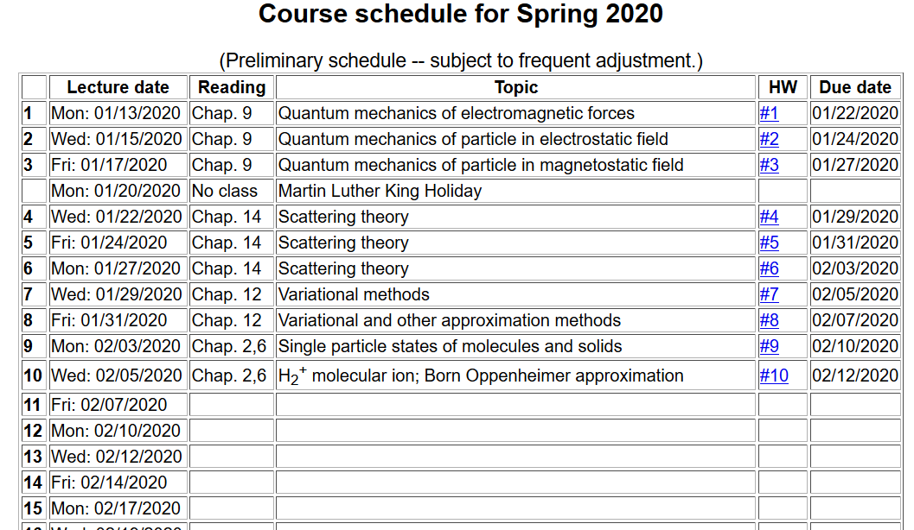

Slide 4
Quantum states of H₂⁺
e
r_{B}
r_{A}
R_{AB}

Slide 5
Recall the eigenstates of a H atom --
n=5, n=4
n=3
n=2
n=1
Useful basis for representing states of H₂⁺ ion

Slide 6
e
r_{B}
r_{A}
R_{AB}

Slide 7
r_{B}
r_{A}
R_{AB}

Slide 9
Evaluation of matrix elements:

Slide 10
Evaluation of matrix elements – summary --

Slide 11
D

Slide 12
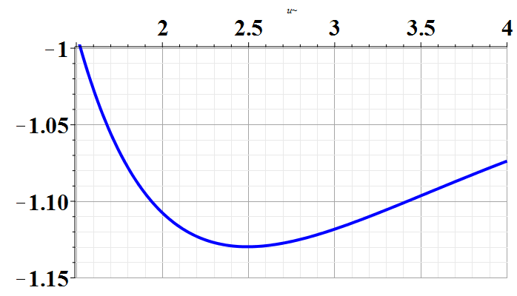
D
U₊(Ry)
Experimental bond length according to NIST:
~ 2 Bohr

Slide 13
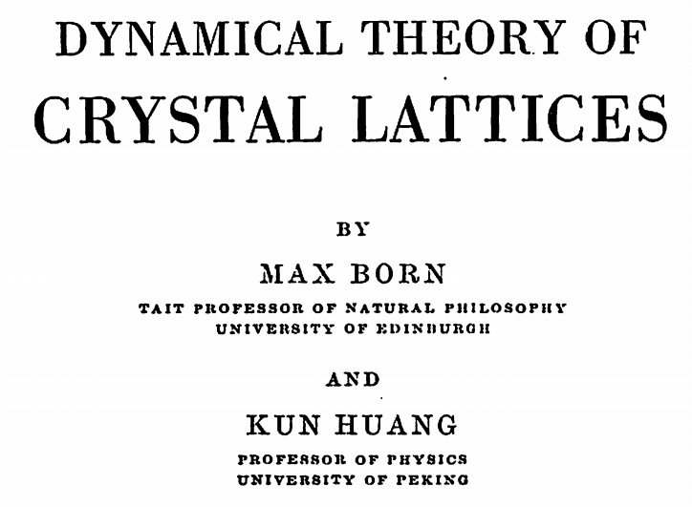
A more complete treatment, takes into account the effects of nuclear motions --

Slide 14
Born-Oppenheimer approximation
M. Born and R. Oppenheimer, Ann. d. Phys. 84, 457 (1927)
Total Hamiltonian
Electron kinetic energy
Nuclear kinetic energy
Electron-nuclear coupling
Fixed nuclear positions

Slide 15
Eigenstates of electronic Hamiltonian at fixed X:
Full eigenstates:
Solving for the nuclear functions:
Often neglected

Slide 16
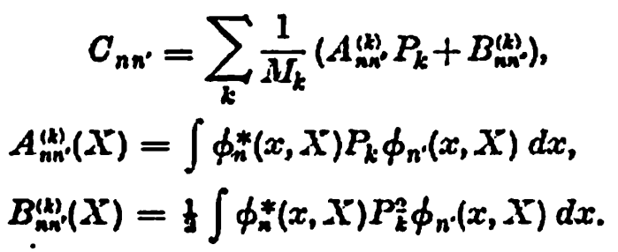
Nuclear kinetic energy

Slide 17
Treatment of nuclear motion
e
r_{B}
r_{A}
R_{AB}

Slide 19
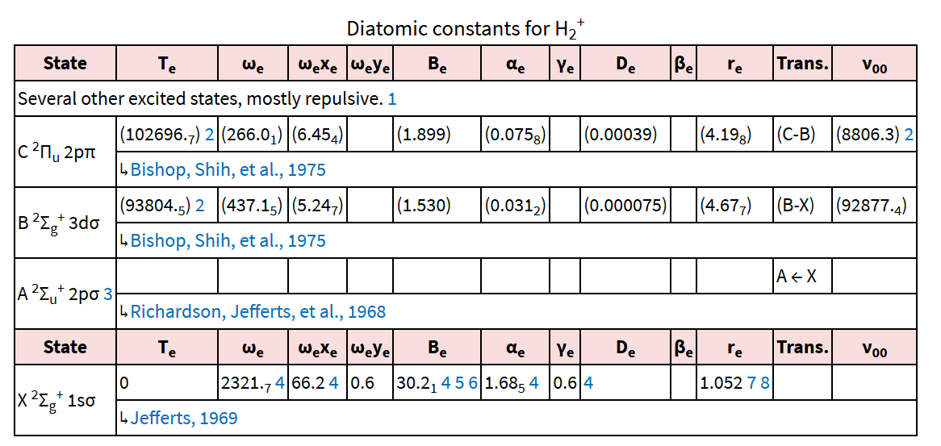
NIST data for H₂⁺

Slide 21
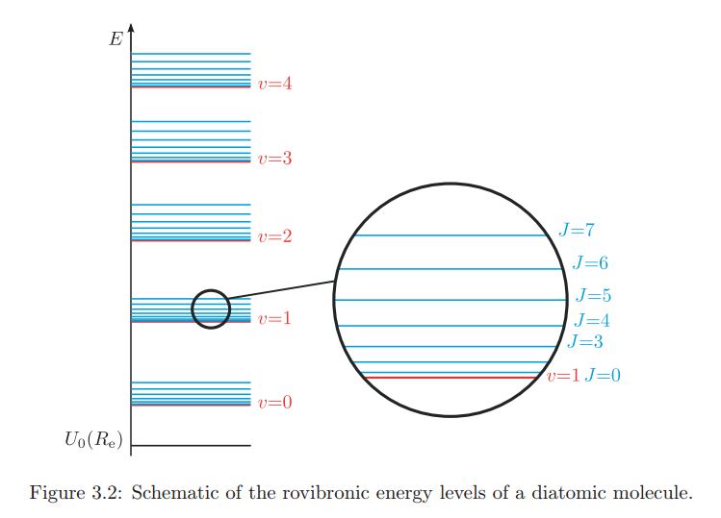
From: https://www.google.com/url?sa=t&rct=j&q=&esrc=s&source=web&cd=6&ved=0ahUKEwjc7cmpipHXAhVH6SYKHTKqCbkQFghEMAU&url=https%3A%2F%2Fwww.ethz.ch%2Fcontent%2Fdam%2Fethz%2Fspecial-interest%2Fchab%2Fphysical-chemistry%2Fultrafast-spectroscopy-dam%2Fdocuments%2Flectures%2FspectroscopyFS13%2FscriptFS13%2FPCV_Ch3.pdf&usg=AOvVaw3UBFJLJvEzpZNAyr-NHGxI

Slide 22
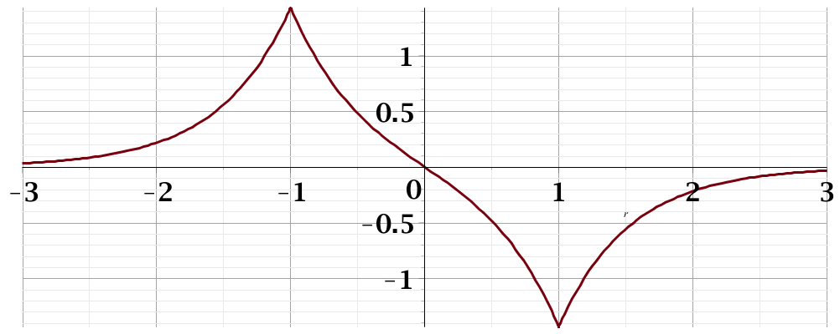
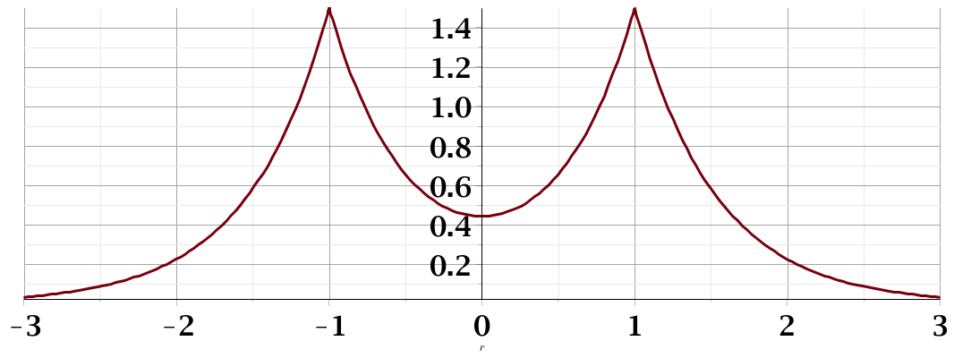
Electronic structure of H₂⁺ -like molecular ion – continued
Summary --
antibonding
Ψ₋
E₋
H_{AA}
H_{BB}
E₊
bonding
Ψ₊

Slide 23
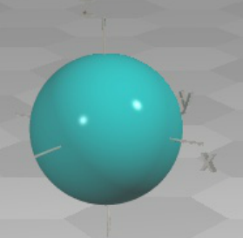
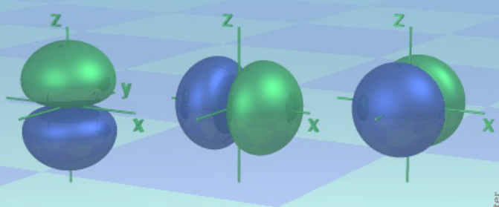
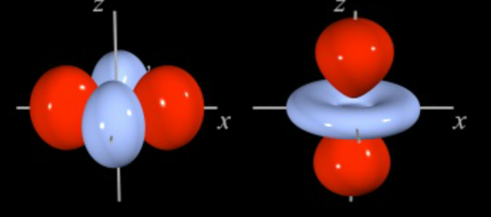
LCAO→Linear Combination of Atomic Orbitals
LCAO methods -- continued – angular varity
http://winter.group.shef.ac.uk/orbitron/
l=0
l=1
l=2

Slide 24
LCAO methods -- continued – angular varity
While, for atoms the “z” axis is an arbitrary direction, for diatomic molecules and for describing bonds, it is convenient to take the “z” axis as the bond direction.
Atom
symbol
l=0 m=0 s
l=1 m=0 p
m= ±1 p
l=2 m=0 d
m= ± 1 d
m= ± 2 d
Bond
symbol
l=0 λ=0 σ
l=1 λ=0 σ
λ=1 π
l=2 λ=0 σ
λ=1 π
λ= 2 δ

Slide 25
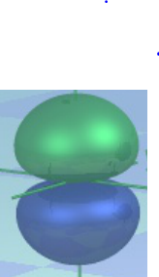
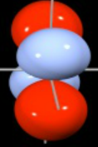
LCAO methods -- continued – bond types
ssσ
ppσ
ppπ
ddπ

